Slide 1
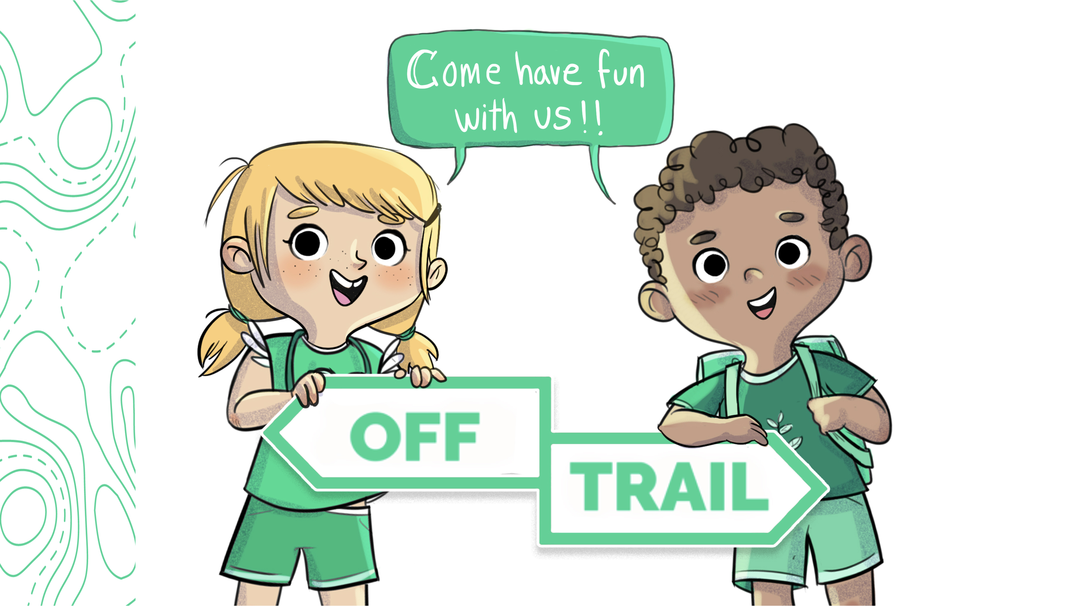
Grade 1
Workshop 1.1

Slide 2
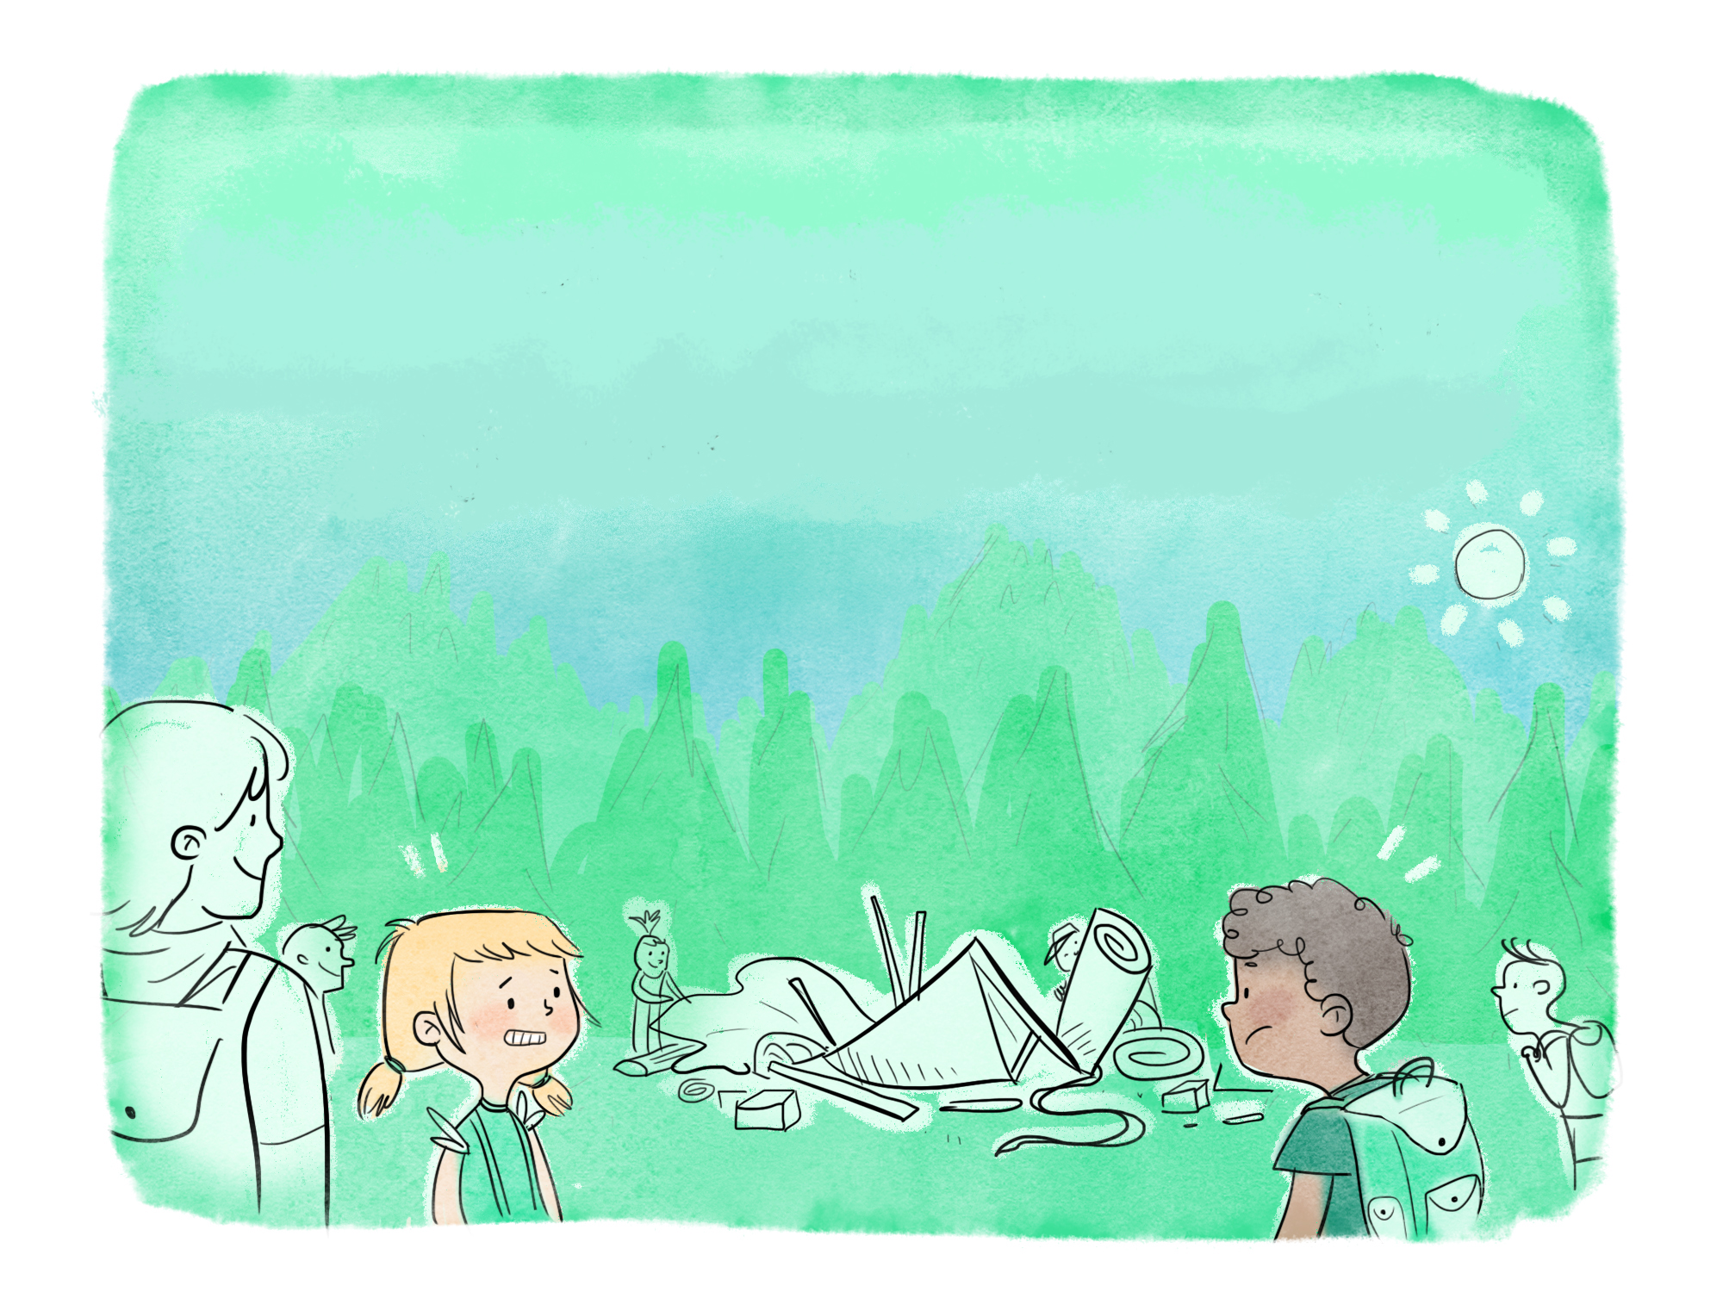
The Adventures of Leo and Charlie
OFF-TRAIL CAMPING
“Getting to know yourself”
Notes:
1.1

Slide 3
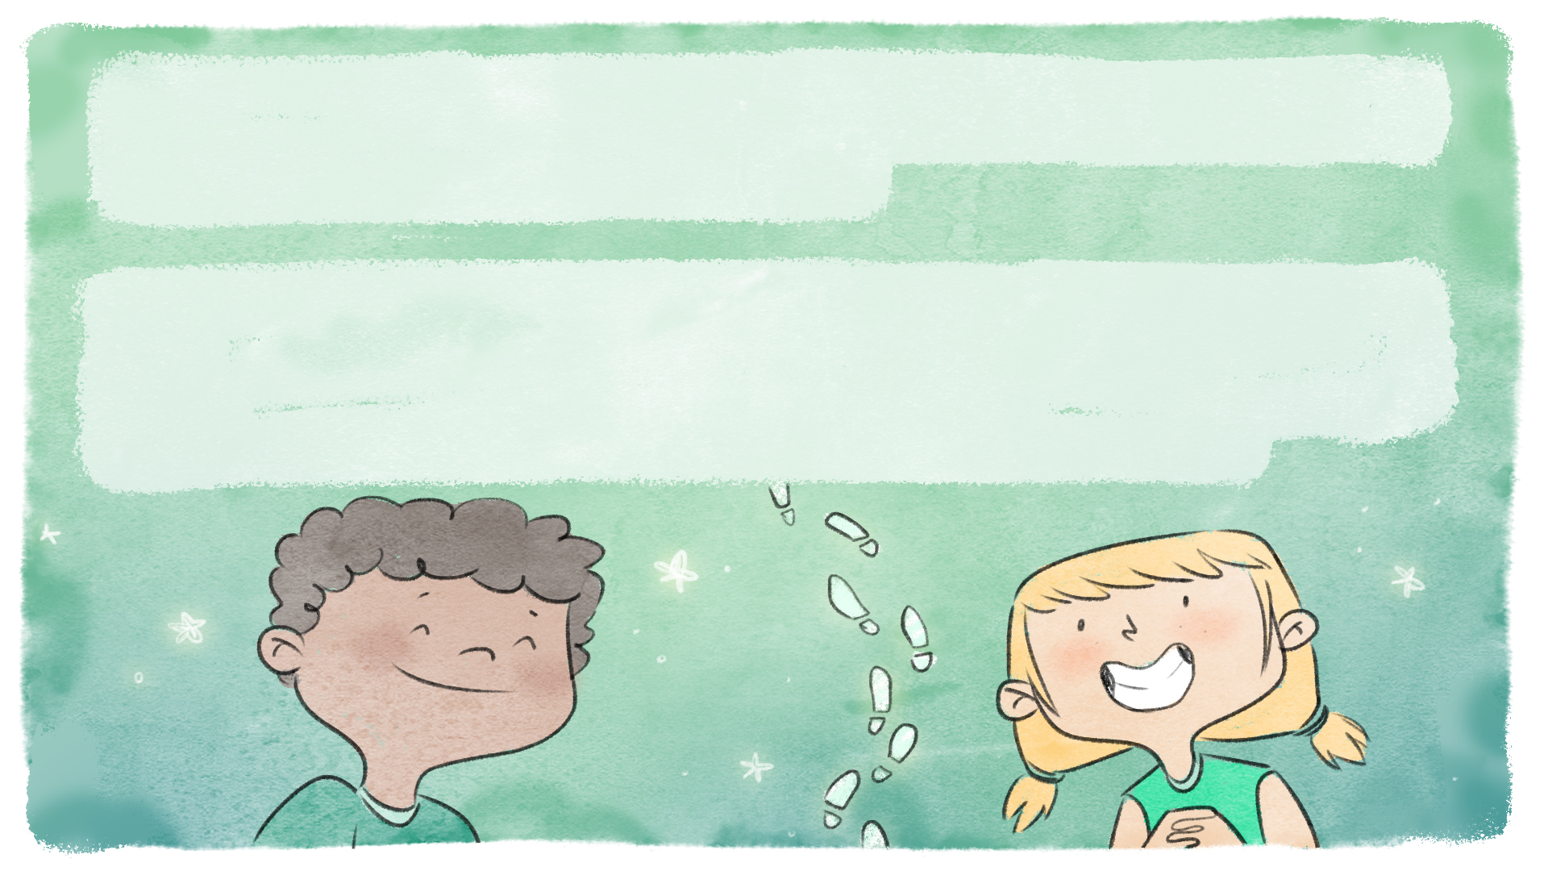
This year's OFF-TRAIL camp promises to be full of great adventures! On the bus ride to the camp, Leo and Charlie are already trying to guess what activity they'll be doing.
Last year, they loved the hike. Leo discovered that he is curious and determined, and Charlie learned that she is very resourceful and energetic. All year long, they put these qualities to good use and really enjoyed their outdoor activities.

Slide 4
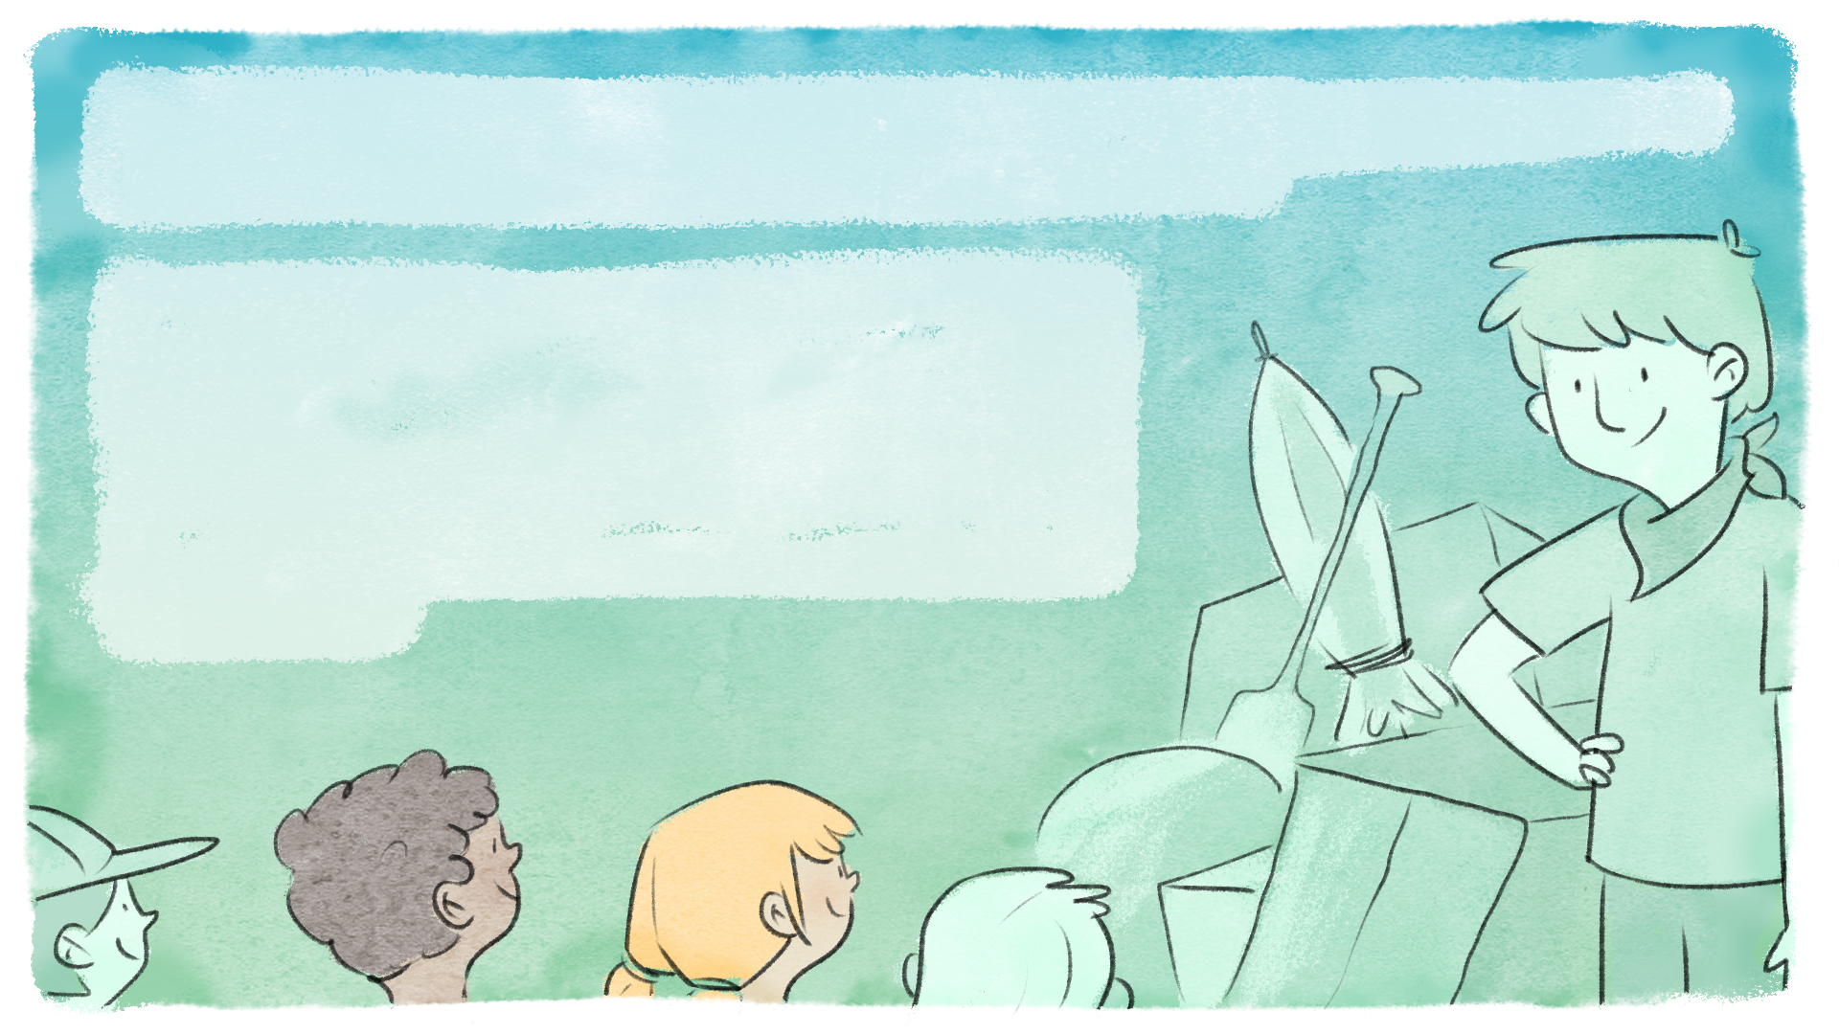
By the time the bus arrives at the camp, it's almost the end of the day, and the sun is getting low in the sky.
The group is greeted by Mr. Julian, an adventurer and nature lover, who is waiting for them next to a big pile of objects. Everyone knows that Mr. Julian is sociable, hard-working and always in a good mood.

Slide 5
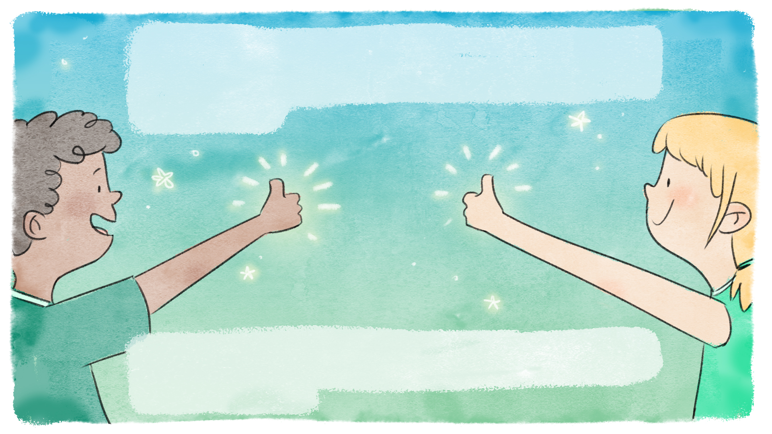
Once everyone is standing around the pile of objects,
Mr. Julian announces that they'll have to help each other
set up the camp for their first night of camping.
Night is coming, so they'll have to move fast. Everyone must use their strengths and qualities to get the job done, and they must work as a team.

Slide 6
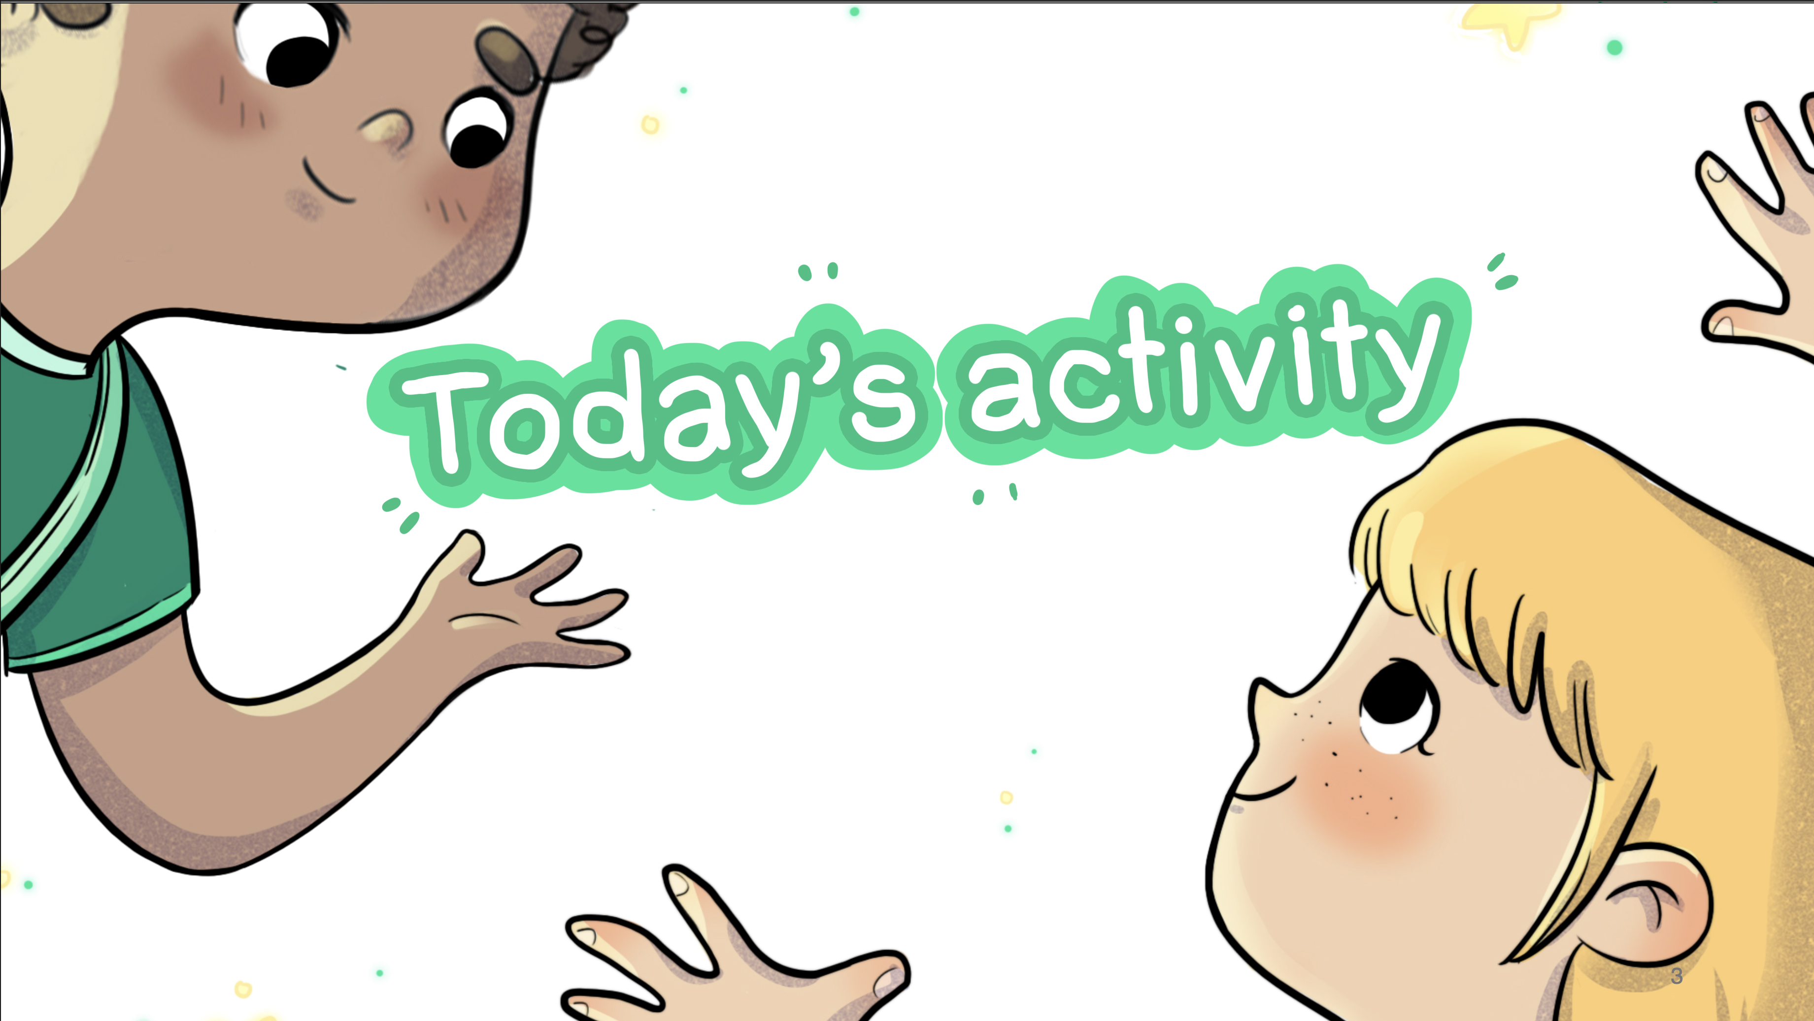

Slide 7


OFF-TRAIL Camping
  Do you know what a quality is?
  It's what describes a person,
  what we find special about them,
  what we like about them.

Slide 8
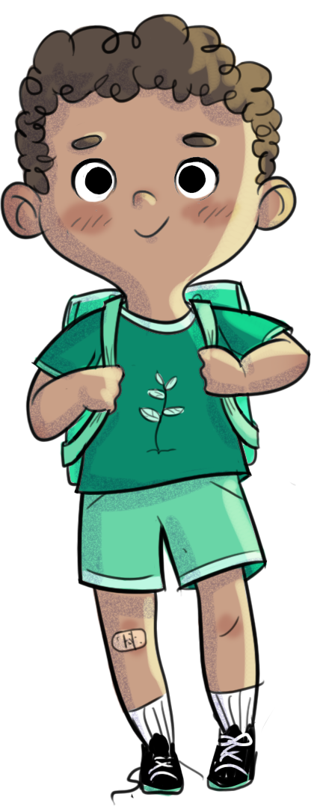
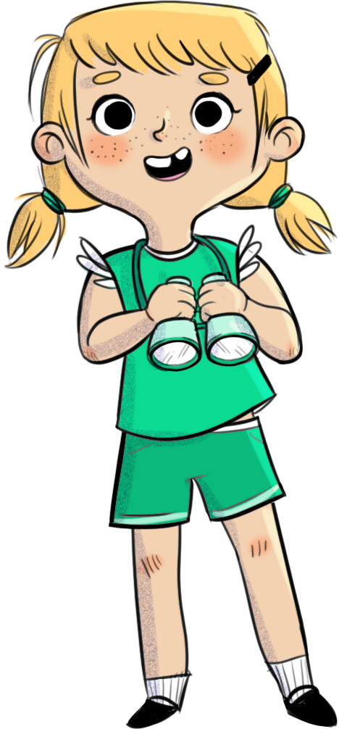
OFF-TRAIL Camping
  What are the qualities of Leo and Charlie in the story I read earlier?

Slide 9

OFF-TRAIL Camping
  With your team, build a cabin with the materials
  I gave you.

Slide 10
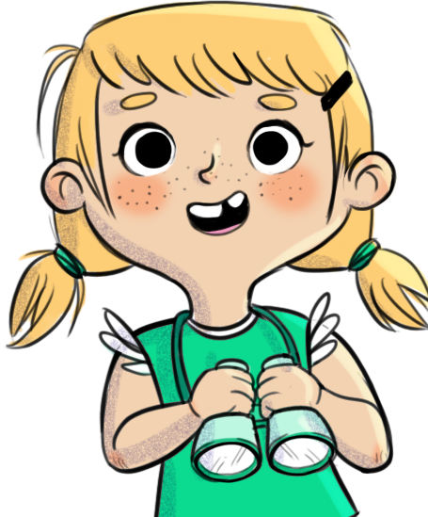
OFF-TRAIL Camping
  Now that the cabin is finished... Let's talk about your qualities.
  Name one quality you have, that you used to build the cabin.
  Name one quality you saw in your teammates.

Slide 11
















List of qualities
Creative
Smiling
Smart
Brave
Friendly
Calm
Patient
Resourceful
Funny
Energetic
Determined
Kind
Handy
Imaginative
Encouraging
Curious

Slide 12
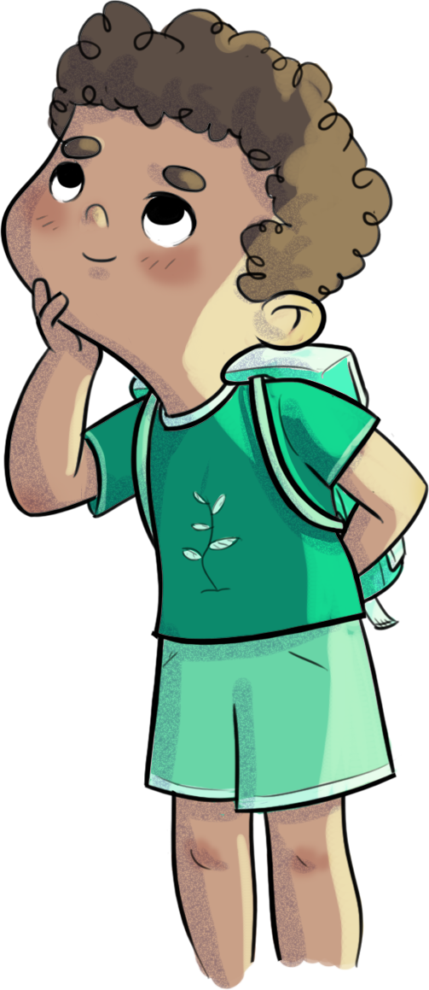
OFF-TRAIL Camping
Does everyone have qualities? Are they the same for everyone?
Why should we know what our qualities are? Why are they important?

Slide 13

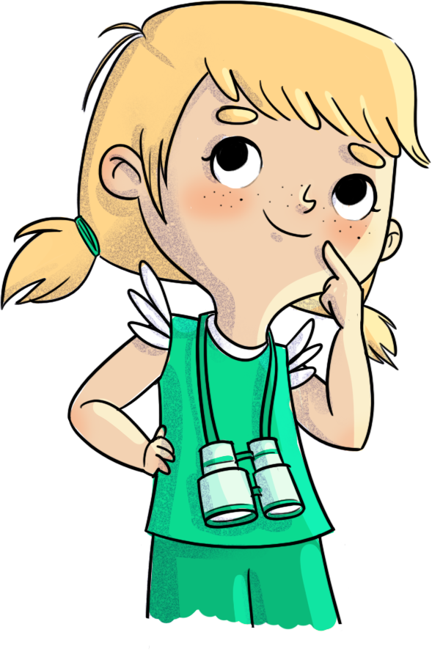
Challenge
Before the next OFF-TRAIL workshop, name a quality you notice in a friend.

Slide 14
