Slide 1







Introductory workshop for the school team
Text is under a CC BY-NC 4.0 licence. Graphics designed with Canva are under Canva's content licence.
© OFF-TRAIL program by Centre RBC d'expertise universitaire en santé mentale (2025), Université de Sherbrooke.

Slide 2
2
By the end of the workshop, you will…
Understand the purpose of the OFF-TRAIL program;
Be familiar with how the program works and the philosophy behind it;
Make links between the program and the needs of the school.

Slide 3
Where does the OFF-TRAIL program come from?
3
5
4
3
Developed by the Centre RBC d’expertise universitaire en santé mentale
at Université de Sherbrooke:
Consultation with stakeholders and assessment of young people’s needs;
Review of evidence-based programs and explanatory models for anxiety disorders;
Co-construction with stakeholders in the field and young people;
Evaluations to refine the program and measure its concrete impacts;
Process based on best practices derived from implementation science and knowledge transfer.
An innovative, non-directive approach that adapts to diverse contexts and realities.
In January 2020, the CISSS Montérégie-Centre received a mandate from the MSSS to introduce OFF-TRAIL to secondary schools across Quebec.
Notes:
The OFF-TRAIL program is an initiative of the Centre RBC, launched in response to numerous requests from stakeholders to develop a program aimed at preventing anxiety in adolescents.
This evidence-based program was developed collaboratively by hundreds of stakeholders from the education sector, the health and social services network, the community, parents, and young people.
Through ongoing evaluation, the Centre RBC team has been able to adjust the program over several years to ensure it aligns with the realities on the ground.

Slide 4
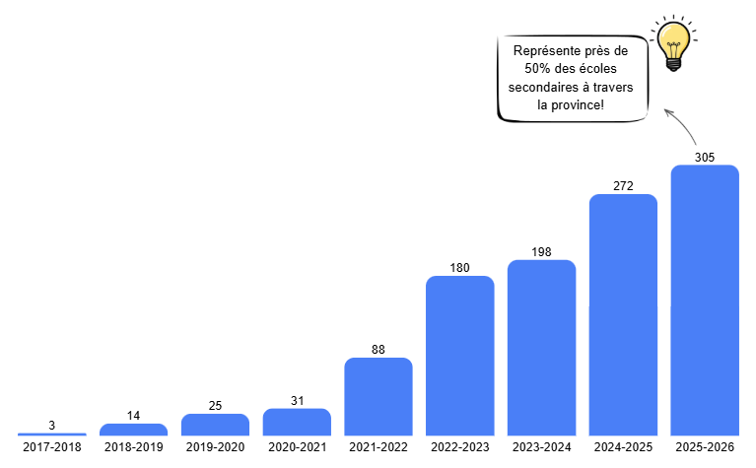

A program that’s
4
blossoming in secondary school
Represents nearly 50% of secondary schools in the province!
Did you know?
​OFF-TRAIL is now available internationally
in 5 countries!​
Notes:
United States, Switzerland, Belgium, France, Lebanon

Slide 5
5
What is your experience with anxiety?

Slide 6

6
Why address anxiety disorders?
On the rise since 2010-2011.¹
  Appear before the age of 6 in 50% of cases.²
  They often go unnoticed. Most anxious young people suffer in silence,³ self-isolate
  and become socially invisible.⁴
They are among the most common mental health conditions in childhood and adolescence. Approximately 20% of high school students report that a doctor or health care professional has diagnosed them with an anxiety disorder (2022-2023).¹
  1- (Institut de la statistique du Québec, 2024); 2- (Dougherty et al., 2013; Whalen et al. 2017); 3- (Dumas, 2013); 4- (Lambert-Samson, 2016).
Notes:
Briefly present a few statistics and make links with elements that emerged from the discussion.

Slide 7



7
Why address anxiety disorders?
On a psychosocial level, anxiety can lead to
low self-esteem¹
difficulties with social relationships¹
depressive symptoms and suicidal
thoughts²⁻³
depression⁵
eating disorders⁴
In school, anxiety affects
and can lead to
learning difficulties² that can ultimately lead to dropout⁸
the student’s
judgment⁶
their working memory⁷
  1- (Charrette, 2012); 2- (APA, 2013); 3- (Dubé, 2009); 4- (Trudeau, 2006); 5- (Marcotte, 2013); 6- (Tardif, 2008); 7- (Cassady, 2010); 8-(Lapointe & Freiberg, 2007).
Notes:
The psychosocial consequences of anxiety (1st paragraph) are generally well known. However, the impacts on student learning (2nd paragraph) are sometimes overlooked.
These impacts will affect your daily lives as teachers and school staff. A young person overwhelmed by anxiety will not always be emotionally and cognitively available to listen in class, concentrate during exams, organize their schoolwork, or build relationships with their peers. So, even if you have a rock-solid lesson plan, incredible educational activities, and 12 make-up periods, it’s possible that the student won’t be receptive to listening to you. By addressing students’ anxiety, you help support not only their well-being but also their academic success.

Slide 8
8
Why address anxiety disorders?
Anxiety disorders can precede the onset of several issues,
sometimes by several years¹…
  panic disorder;
  depressive disorder;
  alcohol, drug or tobacco use;
  higher risk of considering or committing suicide.
Hence the importance of taking preventive action from the beginning of elementary school!
  1- (Dumas, 2013).
Notes:
There are also potential long-term consequences, which is why it is important to take preventive action

Slide 9


9
Psychosocial skills to the rescue
  For more than 30 years, the World Health Organization has emphasized the importance of developing young people’s psychosocial or socio-emotional skills!
  In recent years, the Conseil supérieur de l’éducation
  has brought this issue back to the forefront.
Notes:
These issues are likely related to the fact that the development of psychosocial skills is not a priority in our education programs. Yet growing concern about the development of social-emotional skills has been highlighted by the Conseil supérieur de l’éducation, with the continued goal of encouraging schools to incorporate this aspect as a fundamental component of education programs.

Slide 10
10
Psychosocial skills to the rescue
Emotional distress
Behavioural problems
Substance abuse²
Socio-emotional skills are a protective factor against anxiety in children.¹
Psychosocial skills
Well-being
Resilience
School climate
Academic performance³
  1- (Daniel et al., 2020; Donovan et Spence, 2000; National Research Council and Institute of Medicine, 2009); 2- (Durlak et al., 2011; Mahoney et al., 2018; Sklad et al., 2012; Taylor et al., 2017); 3- (Carroll et al., 2020; Coelho et al., 2021; Low et al., 2019; Valido et al., 2023).
Notes:
Developing students’ psychosocial skills helps address anxiety, but also other factors, as this slide shows.

Slide 11
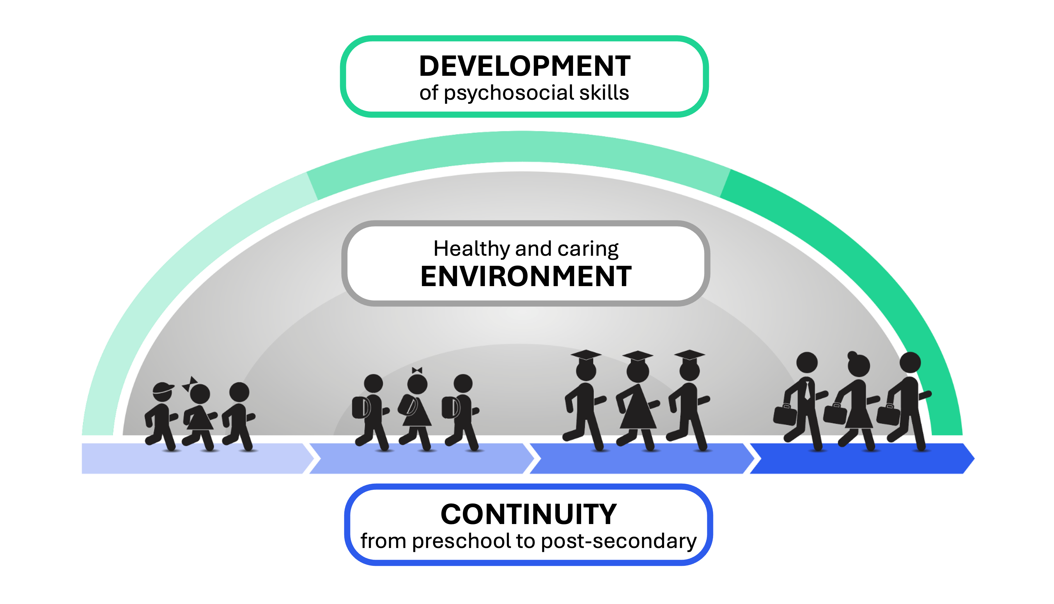
11
OFF-TRAIL
a comprehensive approach to promoting well-being and preventing anxiety disorders
Notes:
OFF-TRAIL helps foster the development of psychosocial skills and create a healthy, caring environment, from preschool through university. Addressing these determinants of well-being helps prevent anxiety and other adjustment disorders by helping young people develop the tools they need to face life’s challenges.

Slide 12
12
OFF-TRAIL
Cross-cutting competencies
an asset, not an add-on
​OFF-TRAIL is partly based on:
The competencies to develop under the ÉKIP framework​.¹
OFF-TRAIL is in alignment with:
Content for the development of personal and social competencies under the MEQ
Several dimensions of the Quebec Education Program (QEP) including:
Several well-being indicators or certain objectives of the PEVR
Competencies targeted in secondary education
The following broad areas of learning: Health and Well-Being, and Citizenship and Community Life
The following areas of personal development: Physical and Health Education, and Québec Culture and Citizenship
  1- (Gouvernement du Québec, 2021)
Connecting CCQ-OT
*Currently available in French only
Notes:
Teachers can make links between the skills developed in OFF-TRAIL, certain objectives of the QEP, and content for the development of personal and social competencies under the MEQ. In this way, the OFF-TRAIL workshops can support the achievement of certain objectives, particularly those related to cross-curricular competencies, certain broad areas of learning, and certain areas of personal development.
Furthermore, the OFF-TRAIL program is based in part on the competencies outlined in the ÉKIP framework and thus serves as a means to achieve certain objectives of that framework.

Slide 13
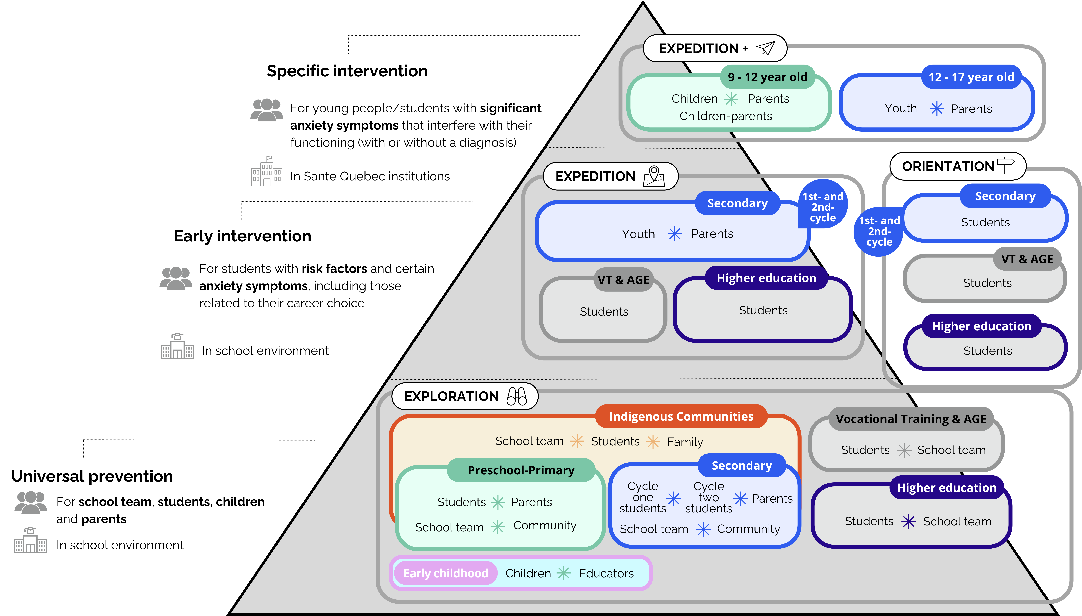
OFF-TRAIL
13
at a glance
SCHOOL SETTINGS
Postsecondary
Notes:
The OFF-TRAIL program consists of several components based on the RTI model. If your school begins by implementing the universal prevention component, you can place greater emphasis on that component.

Slide 14
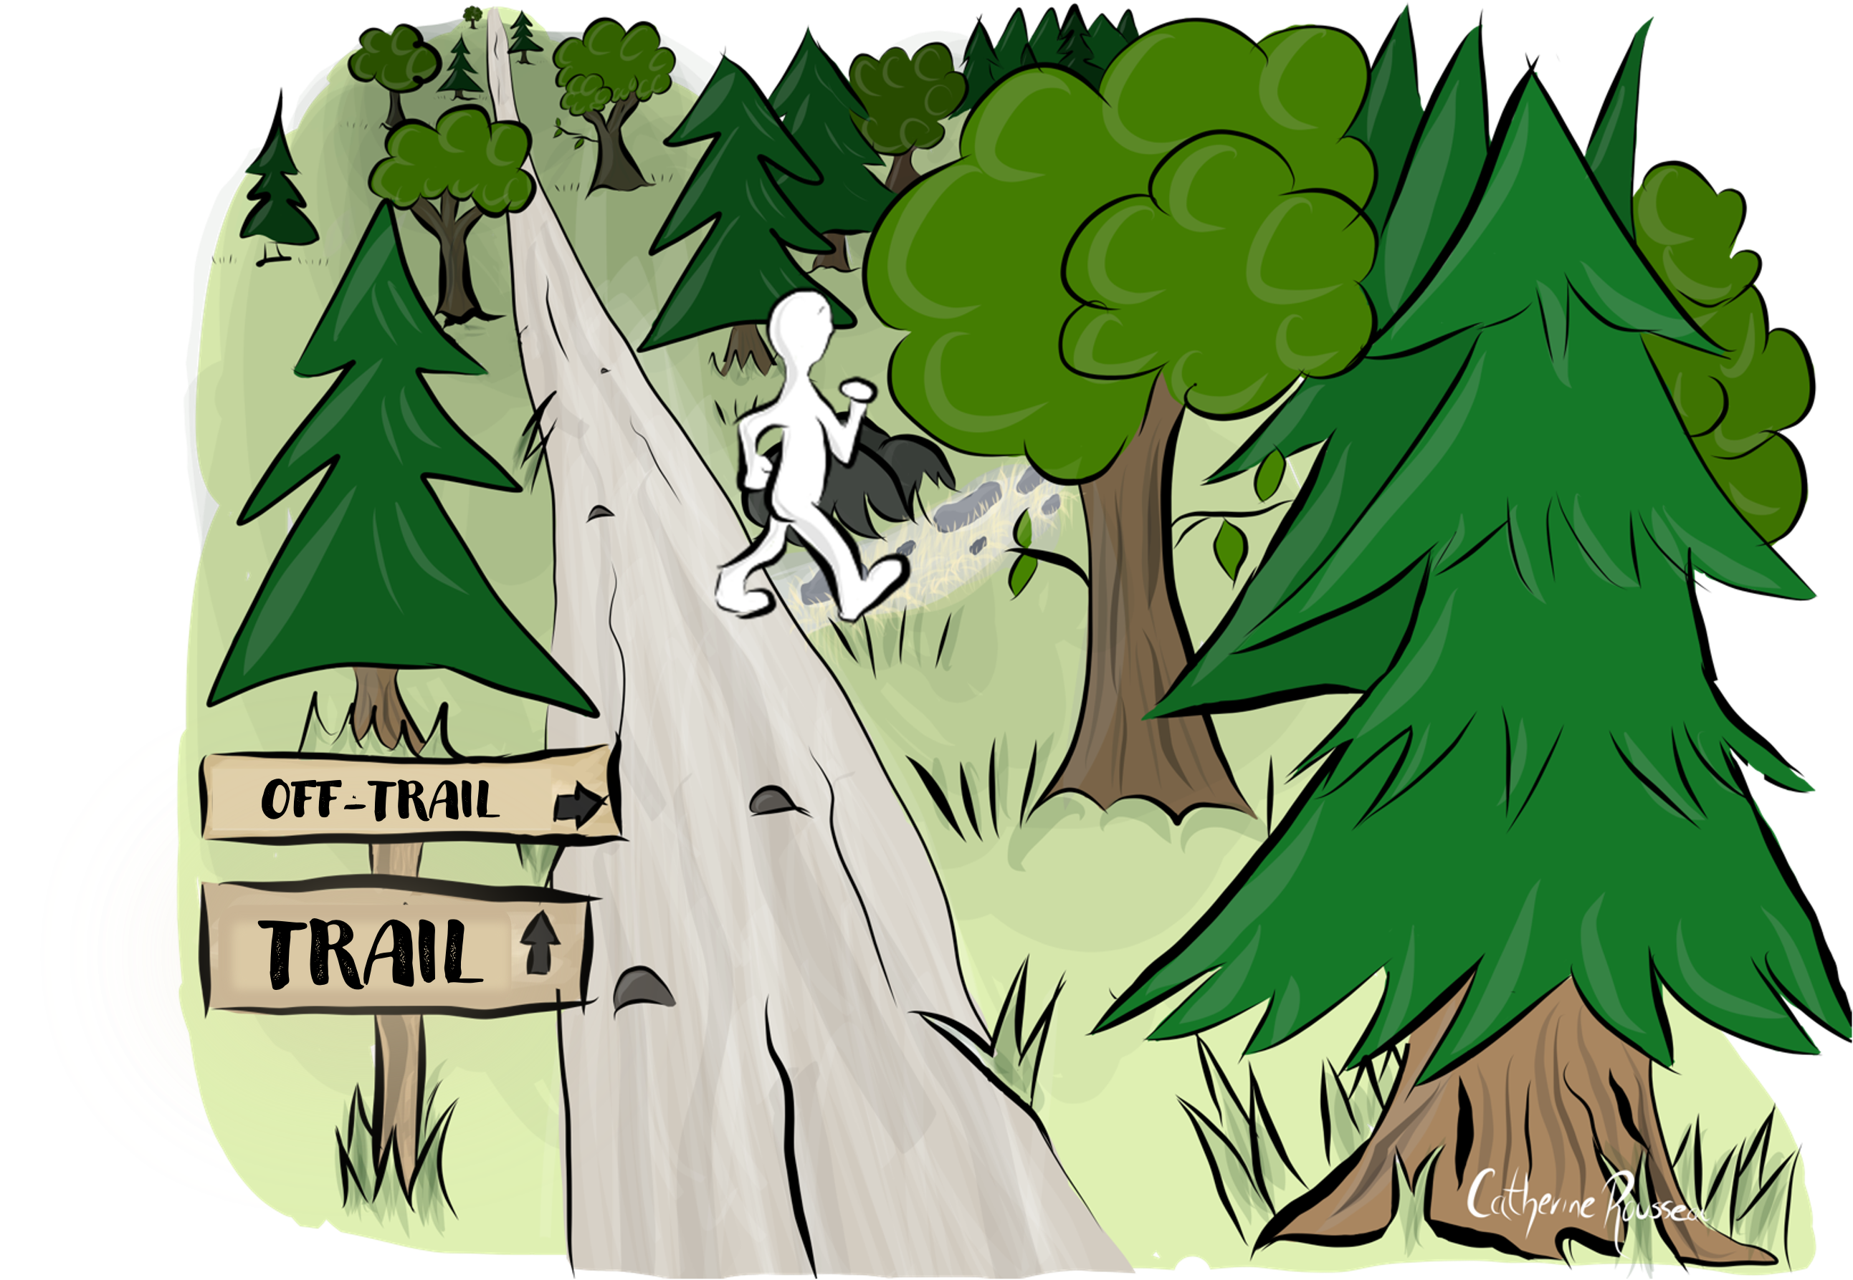
14
What is OFF-TRAIL?
Experience and observe
Try out new strategies
Challenge yourself
Expand your comfort zone
Develop skills
Notes:
“OFF-TRAIL” is the unconventional path—the one that few people dare to take.
Whether you’re skiing, snowboarding or hiking, venturing OFF-TRAIL involves taking risks (unknown terrain, higher difficulty), but these trails also offer us opportunities to make new discoveries, surpass ourselves, and learn about our strengths and limits.
The OFF-TRAIL program aims to reflect this spirit. Throughout the workshops, the OFF-TRAIL program will encourage students to take risks, face their challenges, explore new paths, try new solutions, and discover new ways to handle stressful situations. Through all of this, the OFF-TRAIL program will help students get to know themselves better and recognize their strengths and limitations. Above all, it will guide them in discovering new ways to approach life with confidence, compassion and perseverance.

Slide 15
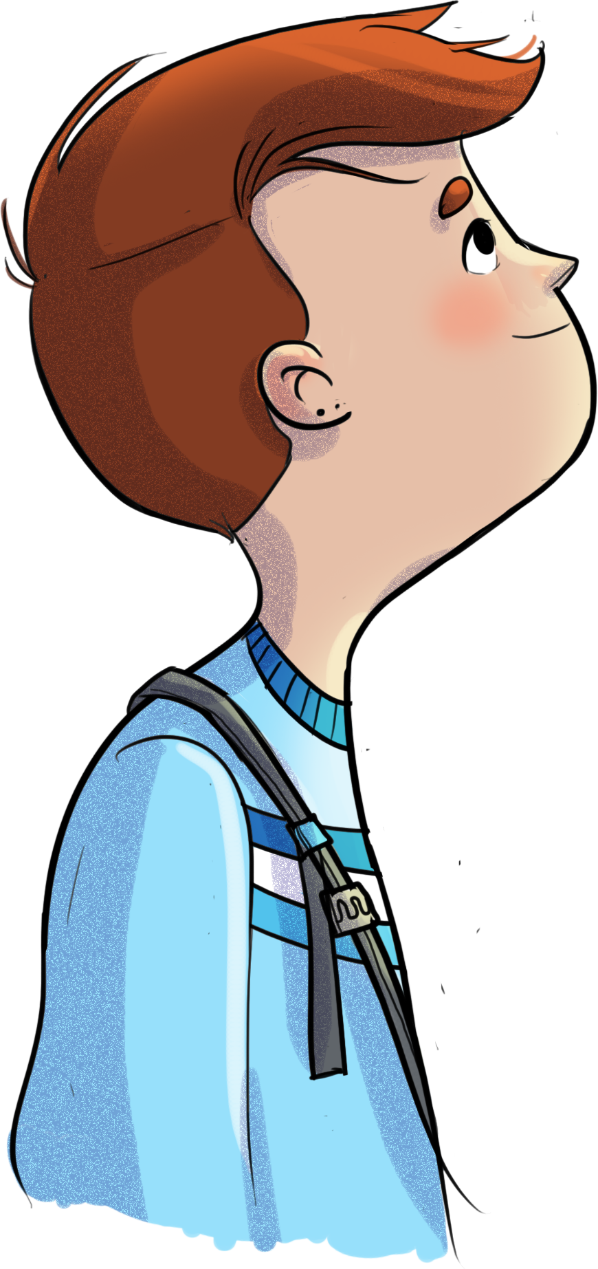
15
Participatory workshops
for cycle 1 students
Secondary 1 and 2
5 workshops per
grade level
Facilitated in class by teacher(s) or staff
Roughly 60-minute duration per workshop (40-minute option available)
Complementary mindfulness activities
Notes:
The OFF-TRAIL program offers a series of ten participatory workshops: five in secondary 1 and five in secondary 2.
The workshops take place during class periods (or study periods).

Slide 16
16
Workshop themes
  Stress
  Anxiety
  Emotions and asking for help
  Social comparison and self-knowledge
  Social pressure and assertiveness
  Self-esteem
  Judgments and compassion
  Conflicts and communication
  Friendships and prosocial behaviour
  Social media and critical thinking
Notes:
The workshops in the OFF-TRAIL program address topics that concern and speak to young people. These themes were selected following an extensive consultation with school stakeholders regarding the issues and challenges young people face.
All the workshops promote the development of psychosocial competencies based on the ÉKIP and WHO guidelines, in addition to covering the cross-curricular competencies outlined in the QEP and some of the content for the development of personal and social competencies set out by the MEQ for secondary 1 and 2.

Slide 17
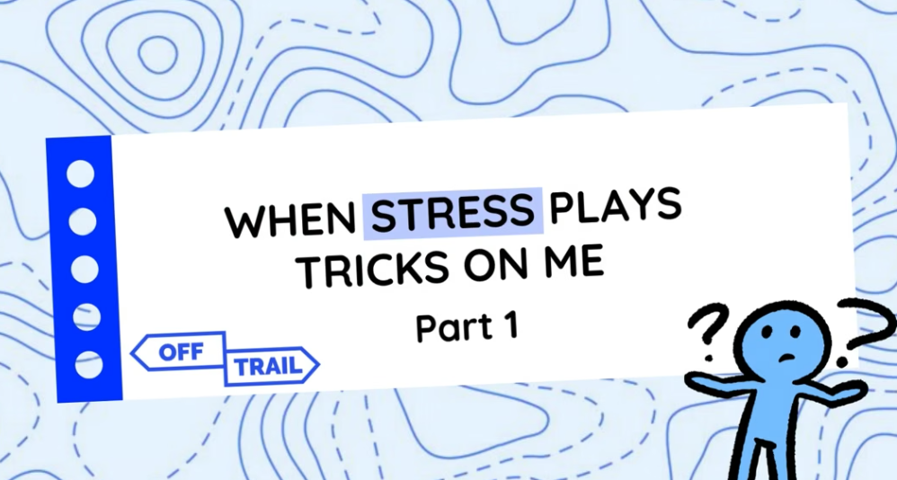
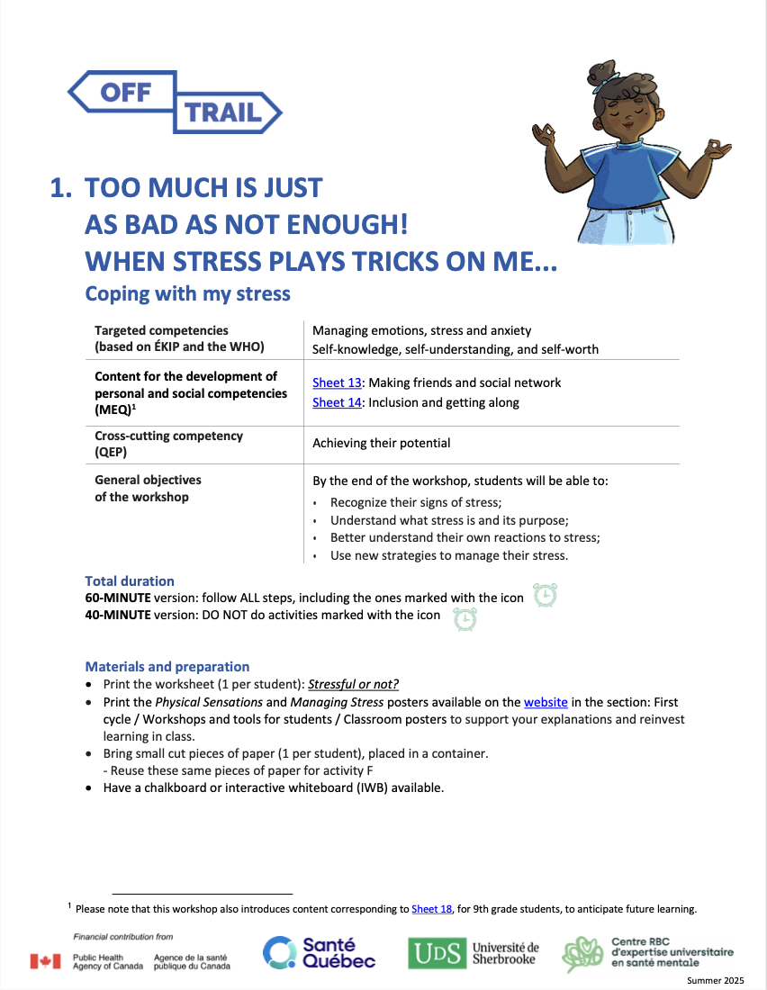
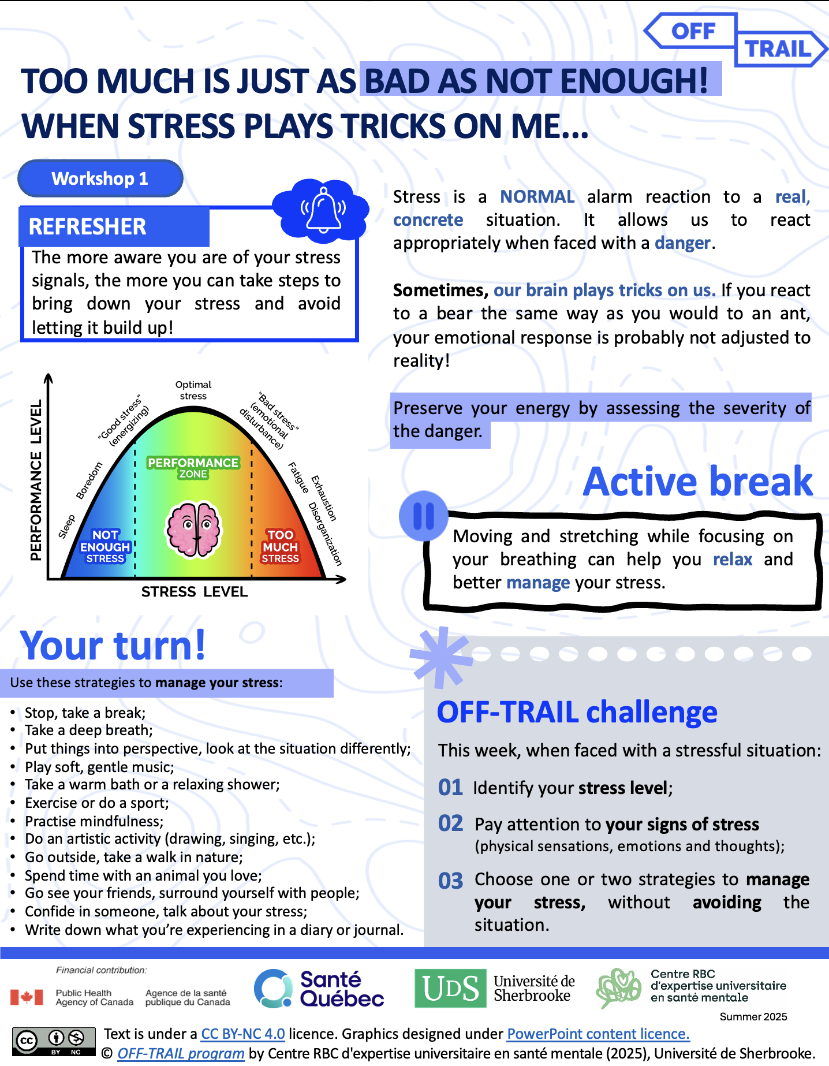
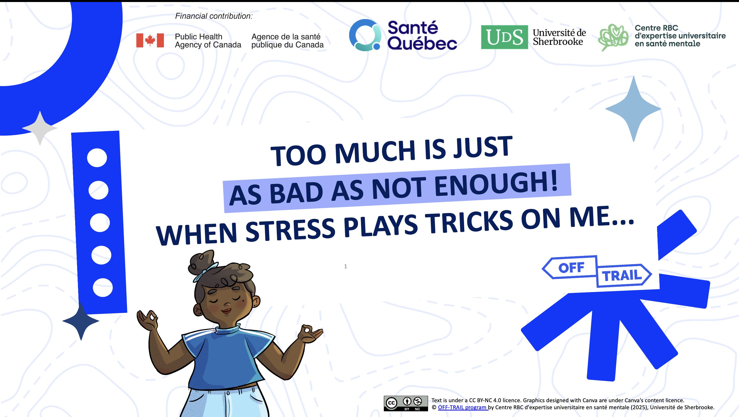
17
Turnkey materials
Educational clip
Facilitation sheet
Summary sheet
Presentation slideshow
Notes:
Here are some visual examples of the materials provided to help you facilitate the workshops:
-Facilitation sheet (introduction page)
-Worksheet to print for students
-Slideshow
-Video clip

Slide 18
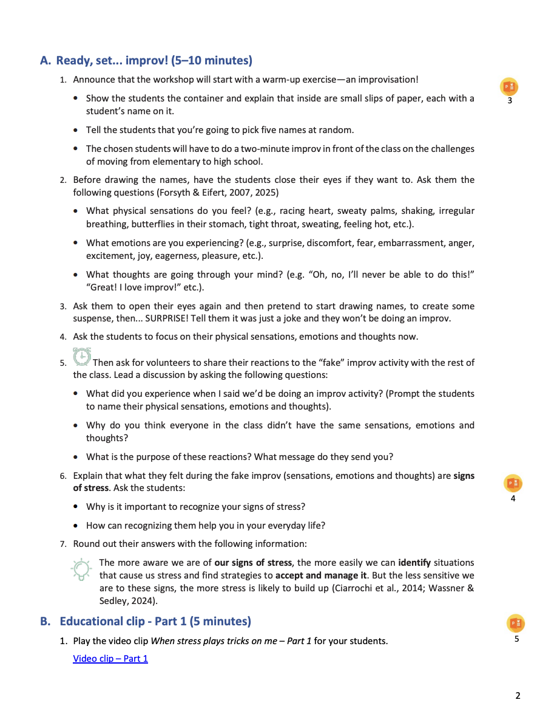
18
Example facilitation sheet
Notes:
Example facilitation sheet:
The title page lists the targeted competencies, the specific workshop objectives, the workshop length, and the materials needed to prepare the workshop. The instructions are linked to symbols to help you align your facilitation with the slideshow.

Slide 19
19
Tools for parents
Summary sheet on stress and anxiety
Welcome and closing email
Workshop on stress and anxiety
Reinvestment sheets
Notes:
The OFF-TRAIL program is also designed to inform parents about what their children are exposed to as part of the program (welcome and closing emails, reinvestment sheets), so that parents can support their children in their learning.
The program also offers tools designed specifically for parents to provide them with more practical support in addressing stress and anxiety in young people (summary sheet and workshop on stress and anxiety).

Slide 20
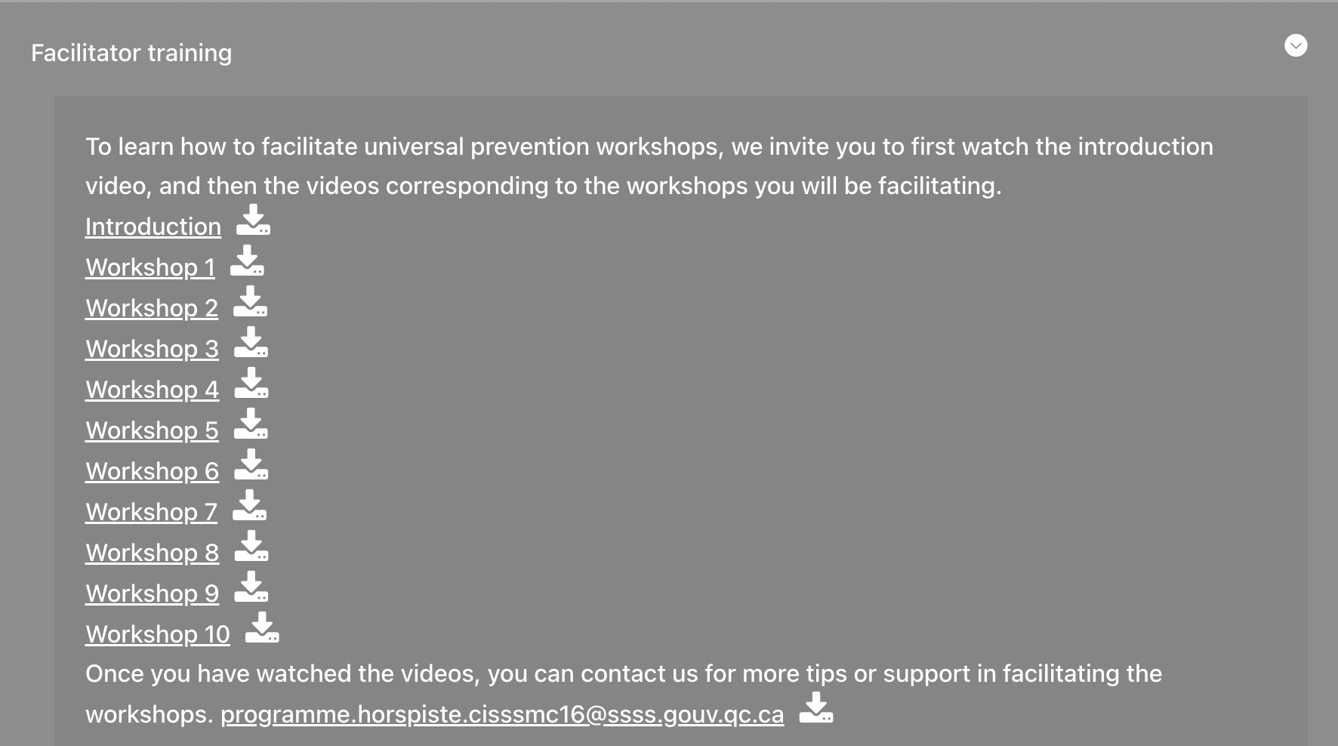
20
Workshop tools for you
A workshop on student stress and anxiety
A wellness workshop to support staff members
Online videos on mindfulness (available in French only)
11 short online videos to support workshop facilitation
A summary sheet on stress and anxiety
Notes:
The OFF-TRAIL program also offers various tools for school teams to help you adapt the workshops for use in the classroom, update your knowledge of certain concepts (e.g., stress, anxiety, mindfulness), and support your school community in implementing practices that promote well-being for everyone at school.

Slide 21
21
A program that makes a real difference
Evaluation of the Exploration component
Significant decrease in several anxiety symptoms, including:
2018-2023
separation anxiety;
Effects measured in secondary 1 and secondary 2 students:
  8 schools in 2018-2019
  (n = 1,466)
  16 schools in 2019-2020
  (n = 2,276)
  10 schools in 2020-2021
  (n = 1,202)
  8 schools in 2021-2022 (n = 543)
  7 schools in 2022-2023 (n = 506)
social phobia;
obsessive compulsive disorder;
post-traumatic stress disorder;
test anxiety;
cognitive avoidance.
And an increase in personal self-efficacy!
5,993
participating students
Notes:
For all initiatives carried out as part of the OFF-TRAIL program, evaluation processes are in place to make sure that efforts are producing results. Here is an overview of the outcomes of the Exploration component.

Slide 22
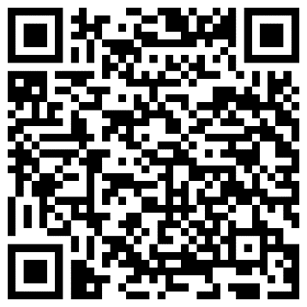
22
A program that makes a real difference
Evaluation of the Exploration component
Control group
Want to find out more? Complete reports are available on the Centre RBC website
In 2018-2019, 108 students not exposed to the program also participated in an evaluation of changes in their characteristics in order to compare their results with those of the students who participated in the program.
The results show that the non-program students experienced:
Few positive changes;
A significant increase in certain symptoms and risk factors.
Currently available in French only
Notes:
For all initiatives carried out as part of the OFF-TRAIL program, evaluation processes are in place to make sure that efforts are producing results. Here is an overview of the outcomes of the Exploration component.

Slide 23
23
A program that makes a real difference
  What do you think about the program as presented?
  Do you think this program could meet the needs of our students and our school?
  Who among you would like to be part of a small committee to help implement this program at the school?
Notes:
Here are a few examples of questions you can explore with your school team if you’d like:
What do you think of the program that was presented? What are its advantages? What are its limitations?
Do you believe this program could meet the needs of our students and our school? How?
Do you think implementing the program is realistic and consistent with the initiatives already in place at the school?
Would you like to have these workshops in your classroom?
Which members of the school team should lead the workshops in the classrooms (teachers, support staff, shared responsibility, co-facilitation)?
In which classes should the workshops be offered (school-wide? only certain grade levels)?
What training workshops for the school team might interest you:
A workshop to prioritize self-care and support your well-being?
A workshop to equip you to prevent or reduce anxiety in your students?
A workshop to equip you to use mindfulness in your own life and with your students?
A workshop on creating a positive school environment
Who among you would like to be part of a small committee tasked with defining the implementation model and monitoring the program’s progress at the school (approximately two meetings per year)?

Slide 24
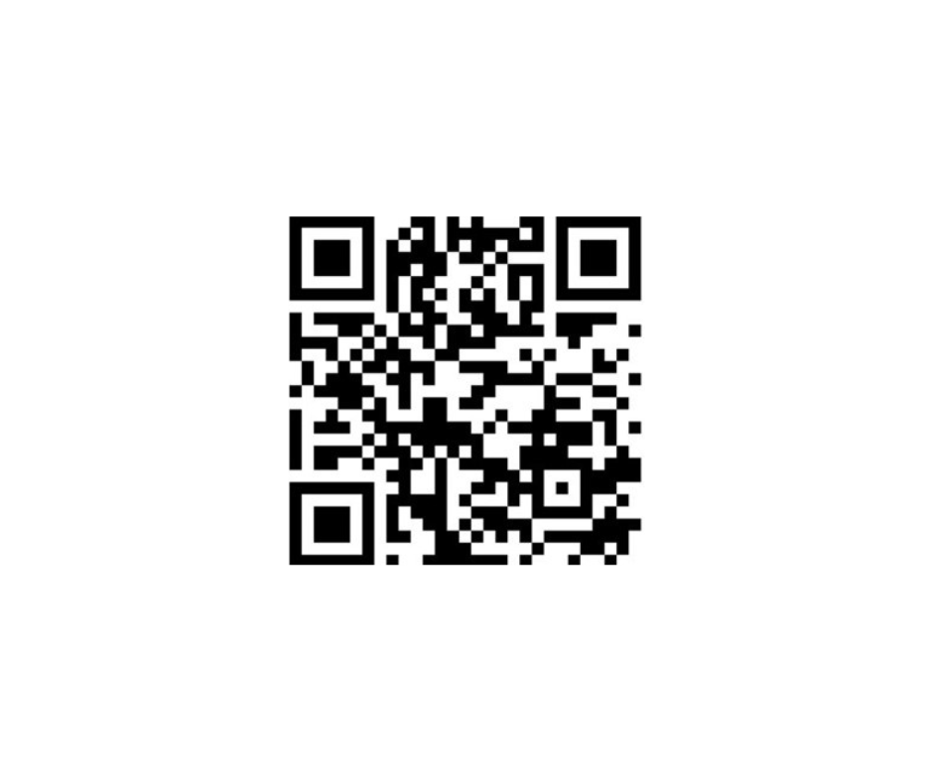
24
THANK YOU
Find out more:
Currently available in French only

