Slide 1


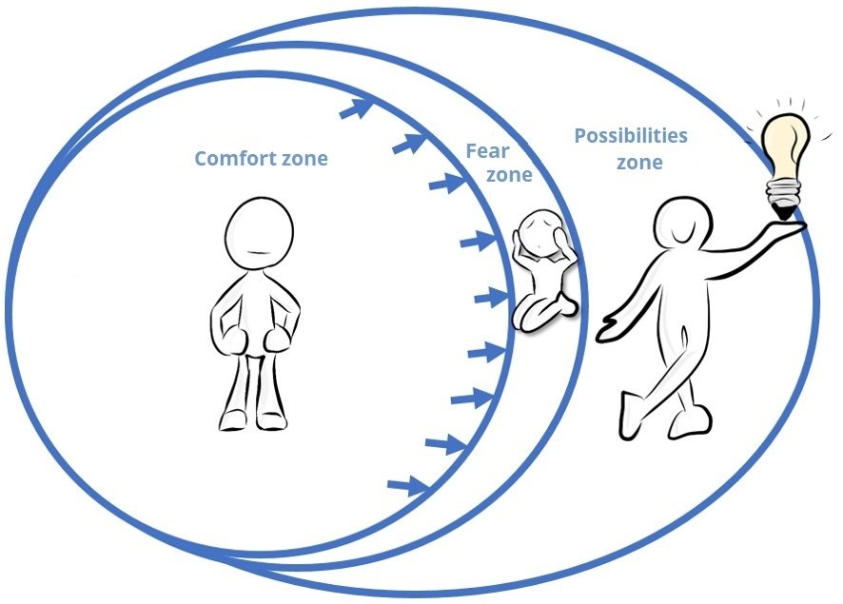





THE FEAR OF BEING AFRAID...
WHEN ANXIETY TAKES OVER!
Workshop 2
Exposing yourself to situations to expand
your comfort zone
REFRESHER
Anxiety is not dangerous.
It is normal and temporary. It always eventually goes away!
Anxiety is the emotion that comes with the tendency to imagine worst-case scenarios and worry about things that haven’t happened yet.
Your intolerances, those situations you’re more sensitive to, are like lenses that distort reality. Be aware of your intolerances and try taking off your “glasses” to see the situation differently!
REMINDER
The more you face your fears, the more you develop your tolerance to uncomfortable situations, and the more your comfort zone can expand!
Your turn!
Use these strategies to
help expose yourself to the situation:
OFF-TRAIL challenge
Put the actual risks of a situation into perspective;
Question your thoughts and perceptions;
Accept that you can’t control everything;
Let go of what is not in your control;
Refocus on yourself and your needs;
Express your boundaries to others, learn to say “no”;
Maintain positive self-talk about your personal worth;
See challenges and mistakes as opportunities to learn;
Remember that emotions and sensations in your body are normal and not dangerous.
This week, when faced with an anxiety-provoking situation:
01
Notice your reactions to certain situations that cause you to react strongly (intolerances);
02
Choose two strategies to calm yourself and to expose yourself to these situations, at your own pace.
Summer 2025
Text is under a CC BY-NC 4.0 licence. Graphics designed under PowerPoint content licence.
© OFF-TRAIL program by Centre RBC d'expertise universitaire en santé mentale (2025), Université de Sherbrooke.

