Slide 1





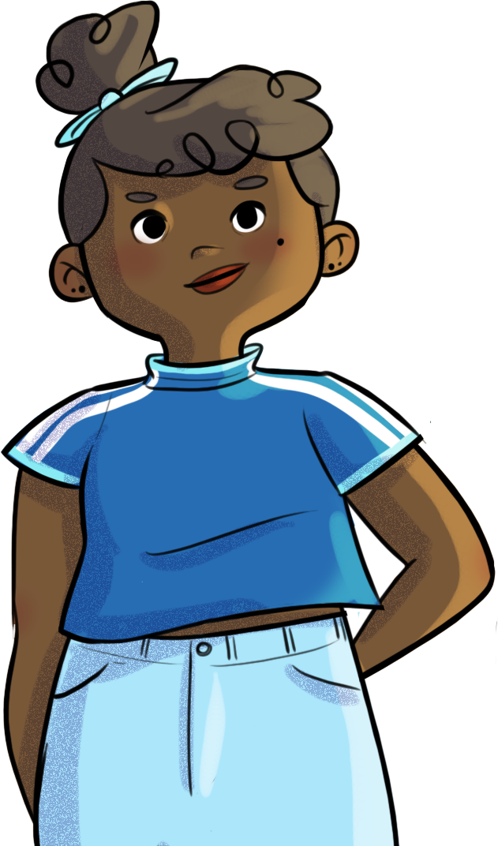
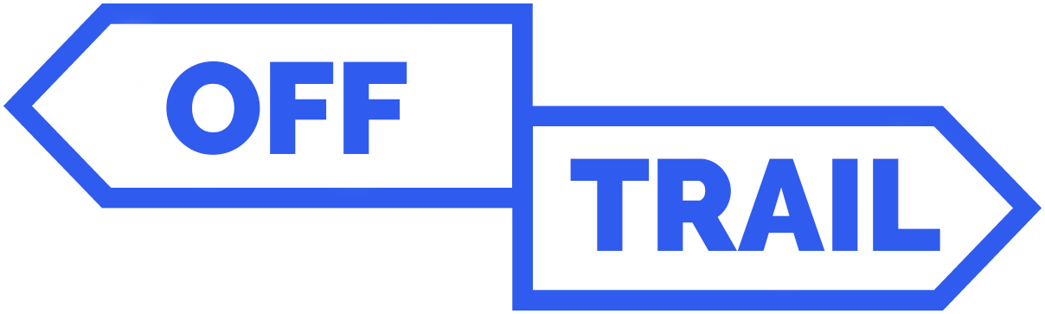

TAPPING INTO YOUR CRITICAL MIND!
Text is under a CC BY-NC 4.0 licence. Graphics designed with Canva are under Canva's content licence.
© OFF-TRAIL program by Centre RBC d'expertise universitaire en santé mentale (2025), Université de Sherbrooke.

Slide 2
2
By the end of the workshop,
you’ll be able to:
understand issues surrounding social media use;
understand your responsibility to follow internet codes of conduct and how failing to do so can have consequences for yourself and others;
understand attitudes and practices to help develop your critical thinking skills;
use strategies for responsible social media use.

Slide 3
3
Think about it… wireless or filter-less?
What social media platforms do you use?
Do you ever go on social media because you’re on “autopilot”, without realizing how much time you’re spending online?
What do you do on these social media platforms?
What are the pros and cons of social media?
How many hours a day do you spend on social media? How many hours do you spend on screen time in general?

Slide 4
4
Think about it… wireless or filter-less?
01
True or false?
Screen time and social media use can have an impact on our health…
TRUE! These impacts can be…
Harmful
Decline in healthy lifestyle habits;
Increased risks of chronic diseases and mental health disorders (e.g., depression in adolescence);
Lower self-esteem,
Loss of sleep;
Trouble concentrating;
Decrease in physical activity;
Increased feelings of anxiety, depression, frustration, and envy toward others;
Trouble functioning throughout the day (drowsy or lethargic in class, trouble getting up in the morning).
Helpful
Apps for unwinding, meditating, and relaxing;
Tools for better organization;
Promoting creativity and personal expression;
Support services (education, mental health);
Video games: learning, creativity, problem-solving, dealing with failure, awareness of social issues, sportsmanship, learning other languages, mastering technology, opportunities for social interaction.

Slide 5
5
Think about it… wireless or filter-less?
02
True or false?
Using social media can affect your mood…
TRUE! The more active someone is on social media, the more negative they feel after using it.
Social media has become a place where people compare themselves to others. People who use social media platforms a lot are more likely to compare themselves negatively.
For example: thinking that other people are happier and have easier, more pleasant lives than your own.
This can make you:
feel like life is unfair;
fixate on ideas;
dwell on negative thoughts;
have feelings or symptoms of depression.

Slide 6
6
Think about it… wireless or filter-less?
03
True or false?
Cyberbullying has fewer consequences than traditional bullying…
FALSE! Cyberbullying has the same consequences as traditional bullying. These consequences can be harmful, even devastating.
Cyberbullying also comes with
its own specific consequences:
breach of trust;
invasion of privacy;
feeling powerless against a bully who may be anonymous.
it’s often impossible to erase all traces of cyberbullying.
Did you know? According to one study…
1 in 3 young people has been a victim of online mistreatment.
1 in 2 young people has witnessed bullying or cruelty online.
In both cases, young people tend to do nothing or ignore the behaviour.

Slide 7
7
Think about it… wireless or filter-less?
04
True or false?
Social media can help us get through hard times in our lives.
TRUE! Despite its drawbacks…
Social connections are central to young people’s internet use!
Social media gives young people a feeling of “connection with others” that is beneficial for them, especially during difficult or challenging times.
Communicating with loved ones, (friends, family, etc.) accounts for a significant portion of time spent online.
For young people from diverse backgrounds (e.g., immigrants, the LGBTQ+ community, individuals with disabilities, etc.), social media offers access to support, resources and online communities.
→ Reducing isolation during the pandemic!
This shows just how important these spaces are for inclusion and well-being!

Slide 8
8
Think about it… wireless or filter-less?
05
True or false?
Our personal information is safe on social media.
FALSE! There are many risks to our personal information on social media:
It’s important to be on guard to protect your digital identity and to limit the information you share online.
losing control over your privacy;
your account getting hacked;
identity theft;
etc.
What’s a digital identity?
All the traces you leave on the internet, often without even realizing you’re doing so.
Every connection, every click leaves traces—sometimes permanent—in the public sphere. This data can be accessed at any time and used for malicious purposes.
WARNING! Just because there’s a privacy policy, that does not mean your personal information is safe from being shared with others.
Creates a false sense of security;
Many platforms share or even sell your personal information!

Slide 9
9
Think about it… wireless or filter-less?
06
True or false?
Everything we see on social media is true.
FALSE! The information we see on social media is not always accurate.
These days, information is plentiful and readily available. It’s getting harder to distinguish accurate and reliable information from misinformation or lies.
Sometimes we might even spread false or misleading information ourselves, without realizing that’s what we’re doing!

Slide 10
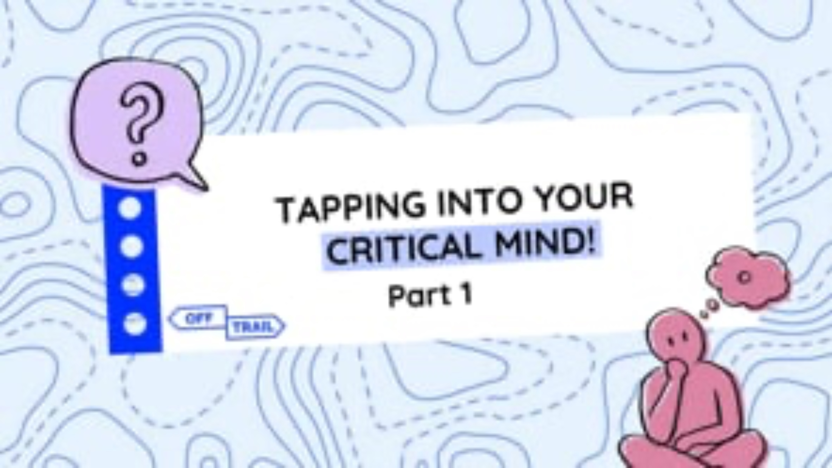
10
Educational clip – Part 1
Video clip

Slide 11
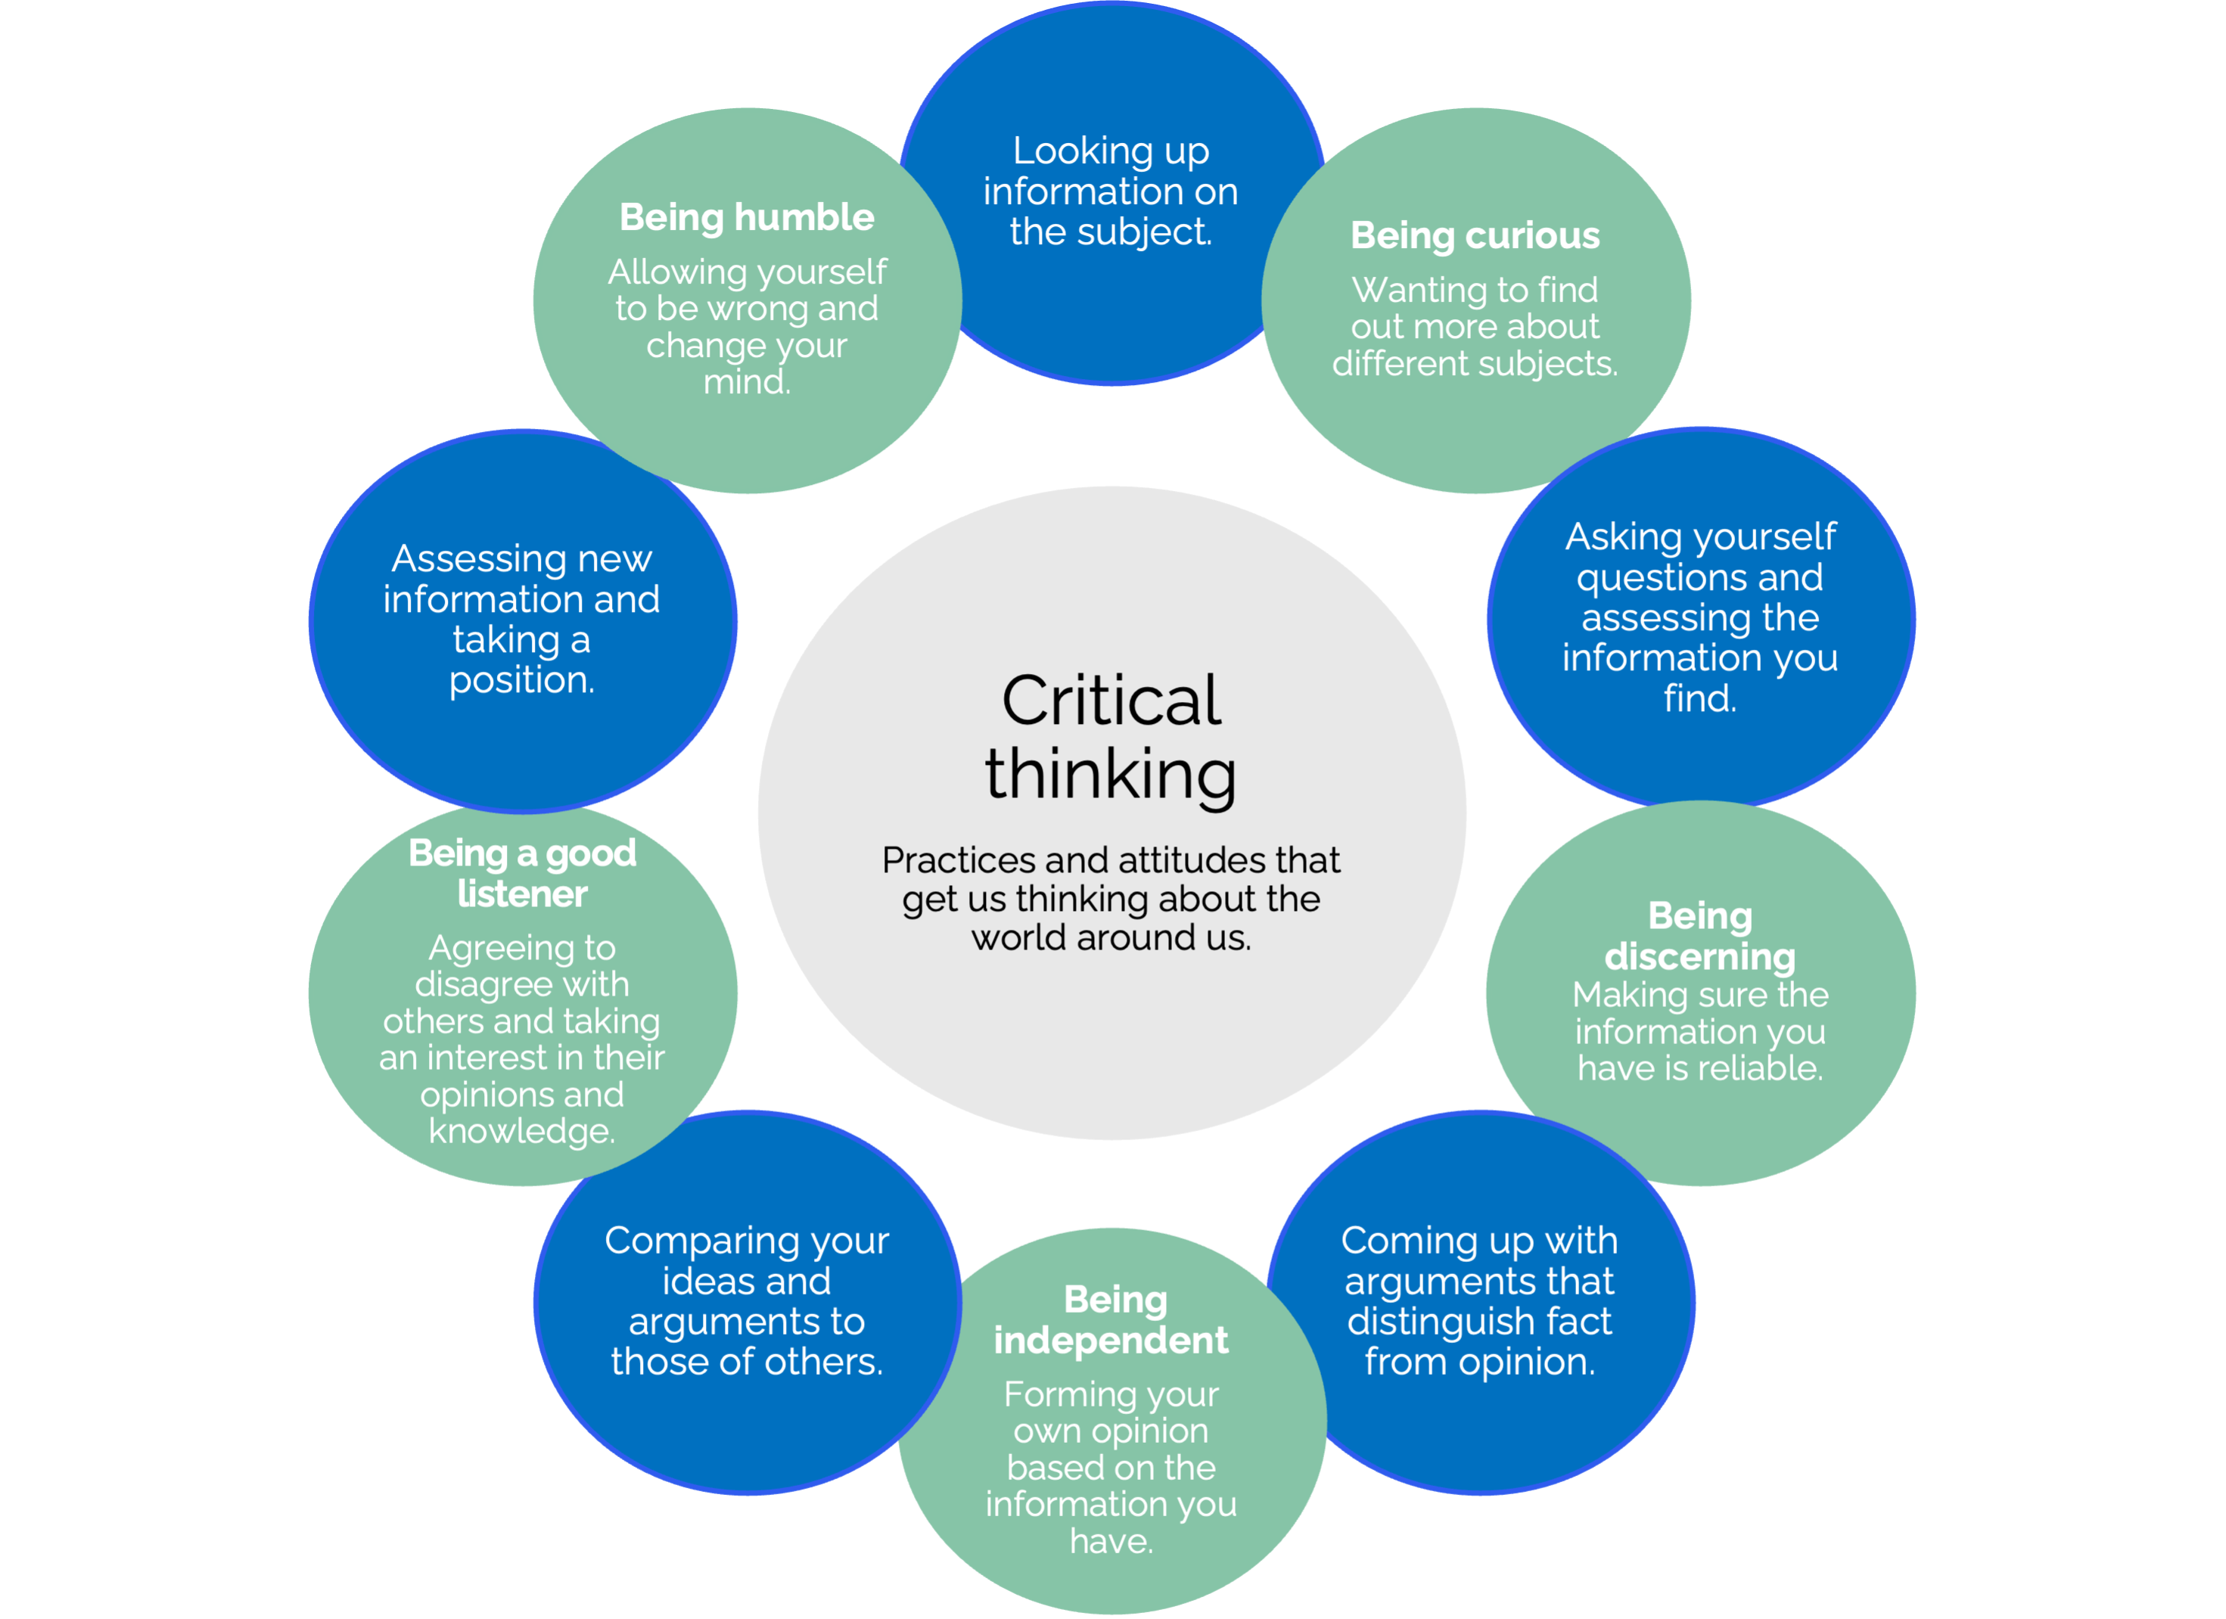
11
Don’t believe everything you read!
What is critical thinking?
Attitudes: ways of being, personality traits, personal characteristics
Practices: concrete actions to take and important things to do.

Slide 12
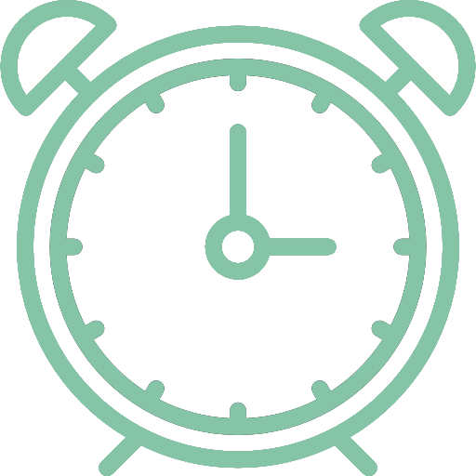
12
Devil’s advocate
A debate about social media
Goals:
Think about the issue;
Debate your ideas with each other;
Take a position for or against the question.
Take this opportunity to explore attitudes and practices for critical thinking!

Slide 13
13
Devil’s advocate
A debate about social media
  Is social media helpful or harmful when it comes to personal relationships?
5-minute debate, MAX!
FOR: Helpful
AGAINST: Harmful

Slide 14
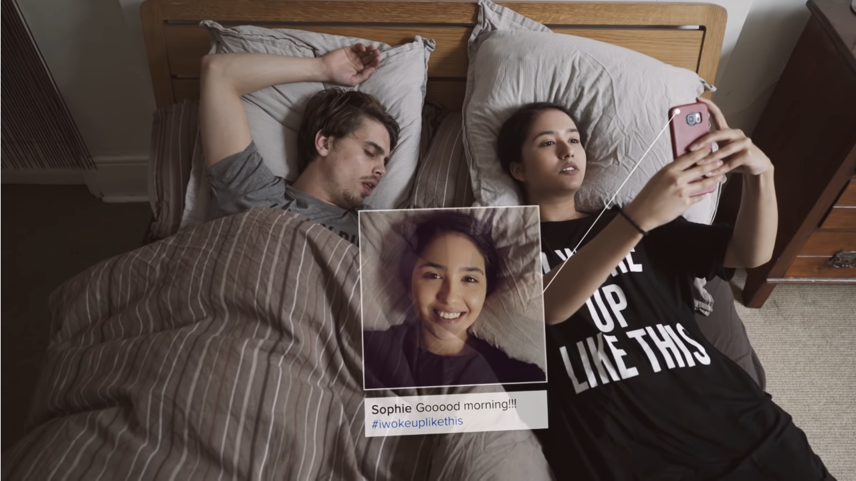
14
Devil’s advocate
A debate about social media
Are you living an insta lie? Social Media Vs. Reality
URL: https://www.youtube.com/watch?v=0EFHbruKEmw

Slide 15
15
Devil’s advocate
A debate about social media
  Is social media helpful or harmful when it comes to personal relationships?
5-minute debate, MAX!
FOR: Helpful
AGAINST: Harmful
UNDECIDED?

Slide 16
16
Devil’s advocate
A debate about social media
  What did you learn from this debate experience?
Share your thoughts!

Slide 17
17
Social can be a valuable resource and a source of opportunities.! As long as you use it thoughtfully and responsibly…
Your turn!
Strategies for responsible social media use!
Use your critical thinking;
When using social media, stop and take breaks;
Choose the pages you like and the people you follow very carefully;
Become aware of how social media affects you (positively or negatively) while you’re using it and afterwards;
Try to nurture authentic relationships and put yourself in positive situations;
Take a moment to think before posting or sharing;
Limit how much personal information you disclose and share online;
Try going offline for a few hours (for example, while you’re out with friends) or for a few days;
Think about the time you usually spend on social media, and what you could be doing instead;
Follow the “3 zeros” rule: zero screens while getting ready in the morning, zero screens during meals, and zero screens in your bedroom;
Turn on the “Screen Time” feature on your cell phone to see how many minutes you use it each day;
Turn all your screens off an hour before you go to bed, in order to sleep better;
Turn off non-essential notifications.

Slide 18

18
Educational clip – Part 2
Video clip

Slide 19
19
OFF-TRAIL Challenge
This week…
01
03
02
Think about how you could improve or change your social media habits to be more effective.
Talk to your friends about it!
Try at least two strategies to accomplish this goal.

