Slide 1







Introductory workshop for students
Text is under a CC BY-NC 4.0 licence. Graphics designed with Canva are under Canva's content licence.
© OFF-TRAIL program by Centre RBC d'expertise universitaire en santé mentale (2025), Université de Sherbrooke.
Notes:
1

Slide 2
2
By the end of the workshop, you will…
Understand the purpose of the OFF-TRAIL program;
Be familiar with how the program works
and the philosophy behind it;
Understand the nature and benefits of mindfulness.

Slide 3
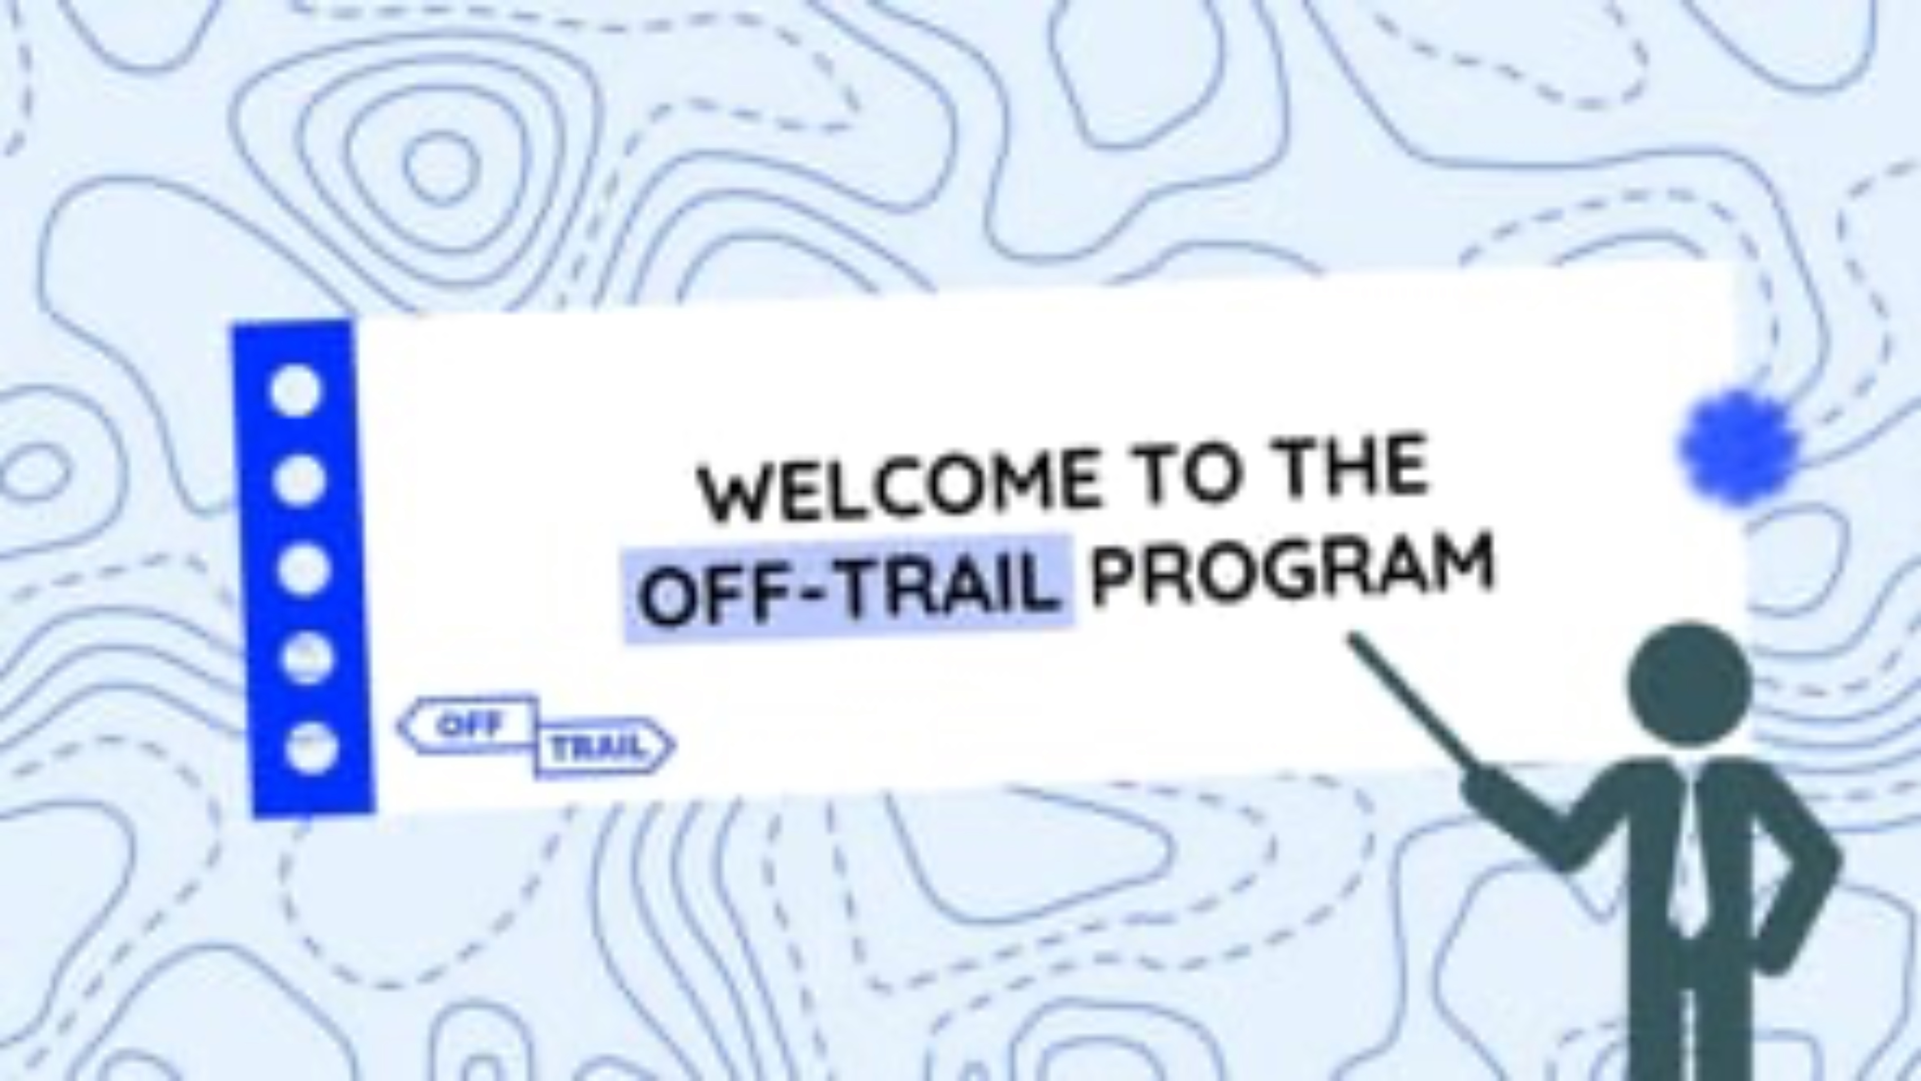
3
Introductory video
Video clip
Notes:
IMPORTANT!
Have your students listen to the introductory clip.
To do so, choose from the following two formats the one you consider most appropriate based on your students’ needs and characteristics.
Note that the two formats contain essentially the same information.
3

Slide 4

4
Adolescence is a time of:
Significant physical and psychological changes;
Beautiful discoveries;
Major personal challenges.
It’s a bit like climbing a mountain…
Capsule audio bientôt disponible.
  Why, in your opinion?
  What challenges do you face
  along the way?
  Do you ever feel stressed or anxious about your journey?
Notes:
Making your way through high school is like climbing a mountain… You start at the very bottom and take the trail that lies in front of you. During the climb, you share pleasant moments with your friends, make exciting discoveries, and experience wins, but you also face many obstacles, such as steeper places, streams that need to be crossed, fatigue, hunger and mosquitoes. Sometimes you need to take breaks, use the supplies in your backpack to repair your shoes, put on warmer clothes, eat, drink some water, apply mosquito repellent, check a map and a compass to find your way, and so on.
It’s perfectly normal during high school—just as in life in general—to encounter certain more stressful situations: dealing with pressure from parents, teachers and friends; finding your place within your friend group; resolving conflicts; coping with comparisons; feeling afraid of being excluded or judged; and experiencing failure.
The OFF-TRAIL program is designed to help you use the tools you already have in your backpack and develop new ones that will serve you well not only throughout high school but also throughout your life. Even if everything is going well right now and you’re not stressed out, the workshops will still give you plenty of tips, ideas and experiences that are sure to come in handy at one time or another.
4

Slide 5
5
What is the OFF-TRAIL program?
10 workshops (5 per year)
During class hours
Facilitated by members of the school team
Notes:
The OFF-TRAIL program is a series of ten workshops (five in secondary 1 and five in secondary 2). The workshops take place during class periods (or study periods).
They will be led by school staff members (facilitator names).
5

Slide 6
6
Thinking outside the box…
but how?
Through workshops designed to encourage your active participation
The workshops in the OFF-TRAIL program are designed to help you…
  apply what you learn;
  develop your competencies.
feel
discover
share
take action
try out
experience
There’s no room for laziness during the workshops in the OFF-TRAIL program!
Notes:
The goal isn’t to simply teach you some material, but to help you experience things, share your knowledge, and try out new strategies. You’ll have the chance to share your questions, stories and what's working for you.
It’s been proven that we learn better and remember more when we have the chance to experience things. So, if you want to fill your backpack with useful tools, you’ll need to take action and actively participate in the workshop activities. And if you want these tools to be genuinely useful to you, you’ll need to put them into practice in your everyday life by taking on a challenge after each workshop.
6

Slide 7
7
The workshops let you…
express yourself;
get to know yourself;
share your opinions;
find your place;
learn to love yourself;
take a stand;
connect with others;
ground yourself and refocus;
articulate your thoughts;
reflect;
open up and broaden your perspective;
etc.
Notes:
The goal isn’t to simply teach you some material, but to help you experience things, share your knowledge, and try out new strategies. You’ll have the chance to share your questions, stories and what's working for you.
It’s been proven that we learn better and remember more when we have the chance to experience things. So, if you want to fill your backpack with useful tools, you’ll need to take action and actively participate in the workshop activities. And if you want these tools to be genuinely useful to you, you’ll need to put them into practice in your everyday life by taking on a challenge after each workshop.
7

Slide 8
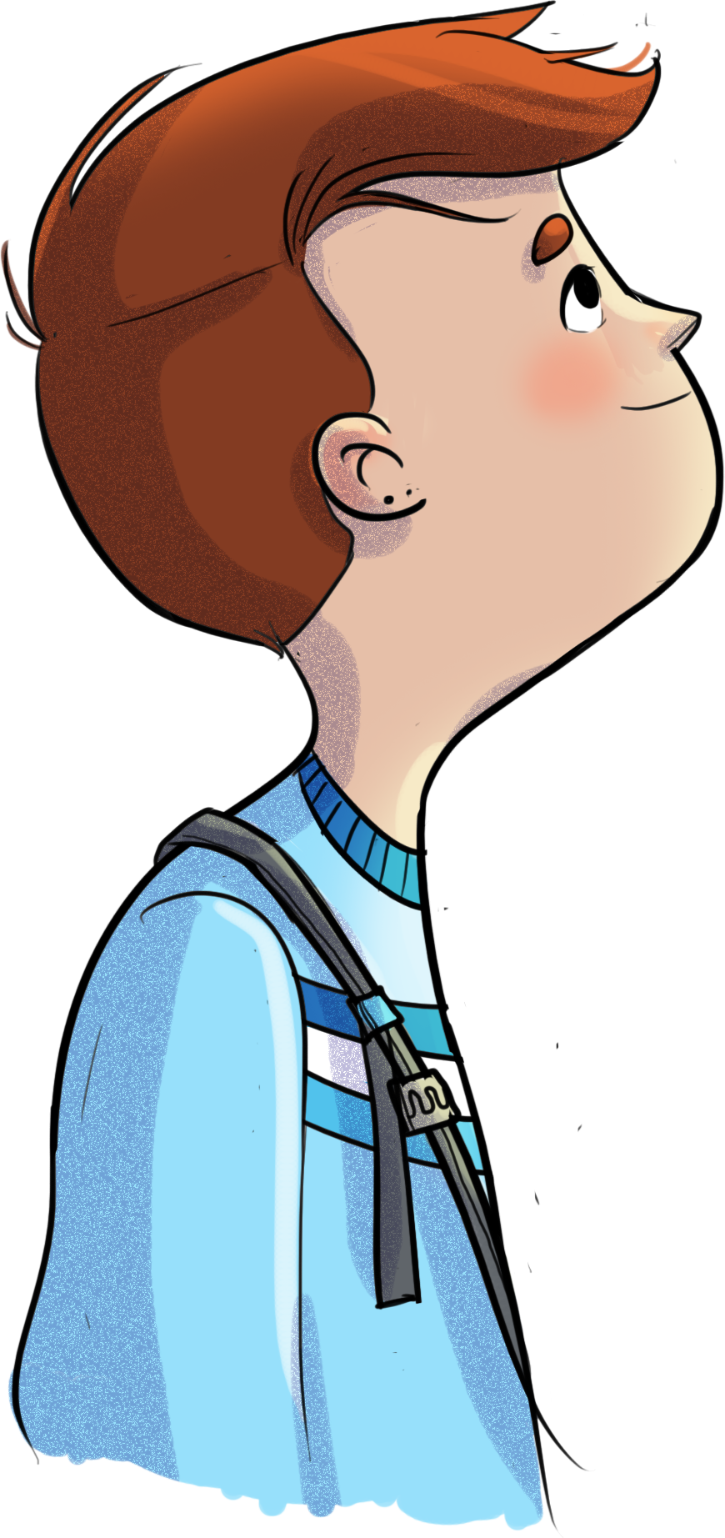
8
Methods
Theoretical lessons
Video clips
High-impact techniques
Quiz games
Scenarios and role-playing
Interactive theater
Debates
Individual and group reflections
Group discussions
Mindfulness
OFF-TRAIL challenges
Notes:
The goal isn’t to simply teach you some material, but to help you experience things, share your knowledge, and try out new strategies. You’ll have the chance to share your questions, stories and what's working for you.
It’s been proven that we learn better and remember more when we have the chance to experience things. So, if you want to fill your backpack with useful tools, you’ll need to take action and actively participate in the workshop activities. And if you want these tools to be genuinely useful to you, you’ll need to put them into practice in your everyday life by taking on a challenge after each workshop.
8

Slide 9
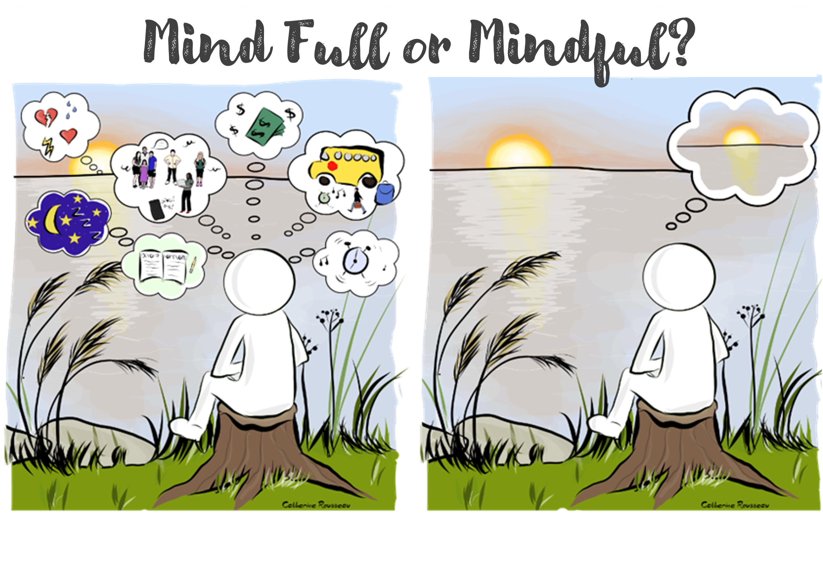
9
Mindfulness
Mindfulness is…
A state of mind, an attitude, a stance, a way of being and acting
A method, a practice
It helps…
Observe and be open to what is happening within and around you…
…in the present moment
  …without judgment
Make healthier and more mindful choices
Notes:
Here, we lay down the foundations of mindfulness in order to introduce the approach to students.
Note that mindfulness is incorporated across all the workshops—both in the facilitators’ stance and attitudes and in the way theoretical concepts are conveyed to students and the strategies are presented.
Some workshops specifically include mindfulness exercises for students to try out (see next slide).
9

Slide 10
10
Mindfulness
In OFF-TRAIL workshops…
Attitude and stance in the workshops
Breathing exercises
Movement through the body and space
Guided meditations
Above all, the idea is to try out a variety of strategies—at your own pace—so you can find the ones that work for you!
Notes:
Here, students are introduced to the different types of mindfulness exercises they will experience in the workshops. They are made aware that when we connect with what is going on inside ourselves, what we find there may not always be comfortable!
Practising mindfulness allows students to be open to and ease this discomfort in a safe, caring environment, where each student is free to go at their own pace, in a way that works for them.
10

Slide 11
11
Student contract
I will respect others. Period. That’s non-negotiable.
I will keep everything I hear confidential. In other words, what’s said in the workshops stays in the workshops.
I will use “I” statements. (“I” is referring to you. Not the others. Talk about your experiences, your feelings.)
I will only talk about the things I feel comfortable sharing. (Basically, no one is forcing you to say anything. But, trust us, it feels good to talk.)
I will listen to others, without judgment. That’s expert-level respect.
I will wait my turn before speaking. Once again, that’s just a given.
I will help others express and share their opinions.
I will participate in the workshops. Otherwise, what’s the point? No, but really ?
Between meetings, I will practise the tips I’ve learned. I will continue to think about the topics discussed and do my weekly challenge.
I will remember that I am surrounded by friends, family, counsellors, and teachers I can confide in and ask for help.
j
I commit to following these 10 basic rules to the best of my ability.
Notes:
11

Slide 12
Thank you for your attention and see you soon!
Notes:
12

