Slide 1





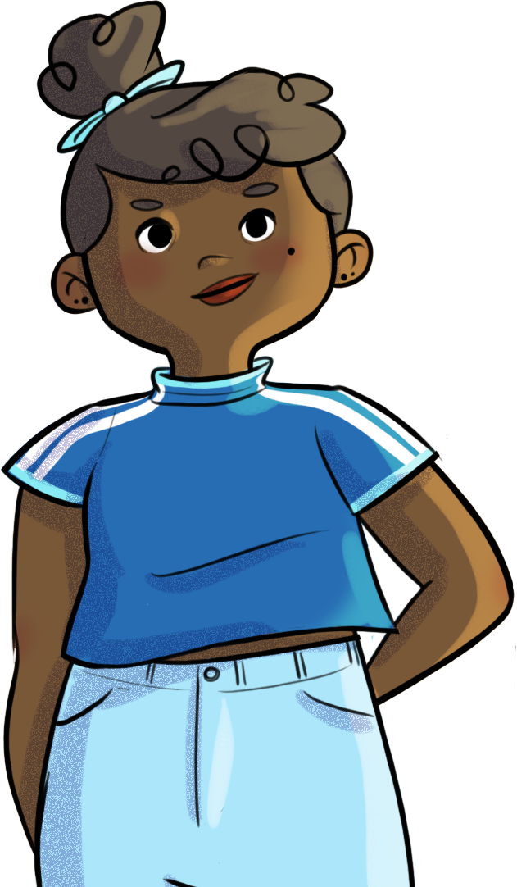


CARVING OUT
YOUR PLACE!
Text is under a CC BY-NC 4.0 licence. Graphics designed with Canva are under Canva's content licence.
© OFF-TRAIL program by Centre RBC d'expertise universitaire en santé mentale (2025), Université de Sherbrooke.

Slide 2
2
By the end of the workshop,
you’ll be able to:
understand the importance of prosocial behaviour for getting along and finding your rightful place in a group;
recognize the importance of healthy friendships as a protective factor for tackling life’s challenges;
adopt new strategies for creating and maintaining healthy friendships and for leaving uncomfortable relationships.

Slide 3
3
Twelve skilled hands...
Form 6-person teams
Your challenge:
Make a group drawing on the theme of your choice (e.g., friendship, justice, music, arts, sports, environment, travel, etc.).
Don't forget to do your secret mission!

Slide 4
4
Twelve skilled hands...
What did you think of this experience?
TIME’S UP!
How did your secret mission go?
Were you able to find your place in the group and participate in the exercise, despite the obstacles you encountered? Why or why not?
Did you figure out what your team members’ secret missions were?

Slide 5

5
Twelve skilled hands...
Continuing the conversation...
What were your reactions (physical feelings, emotions, thoughts, behaviours) to the attitudes of some of your teammates?
How did you determine roles (who does what and how)?
Did everyone on your team participate equally or fairly in the group drawing?
How did the strengths and skills of those on your team help complete the task?
How did you work as a team to resolve the challenges you faced?

Slide 6
6
Don’t forget!
It’s important to find a comfortable place among your peers.
In a group, each person has their own unique and important place to carve out.
No more, no less!

Slide 7
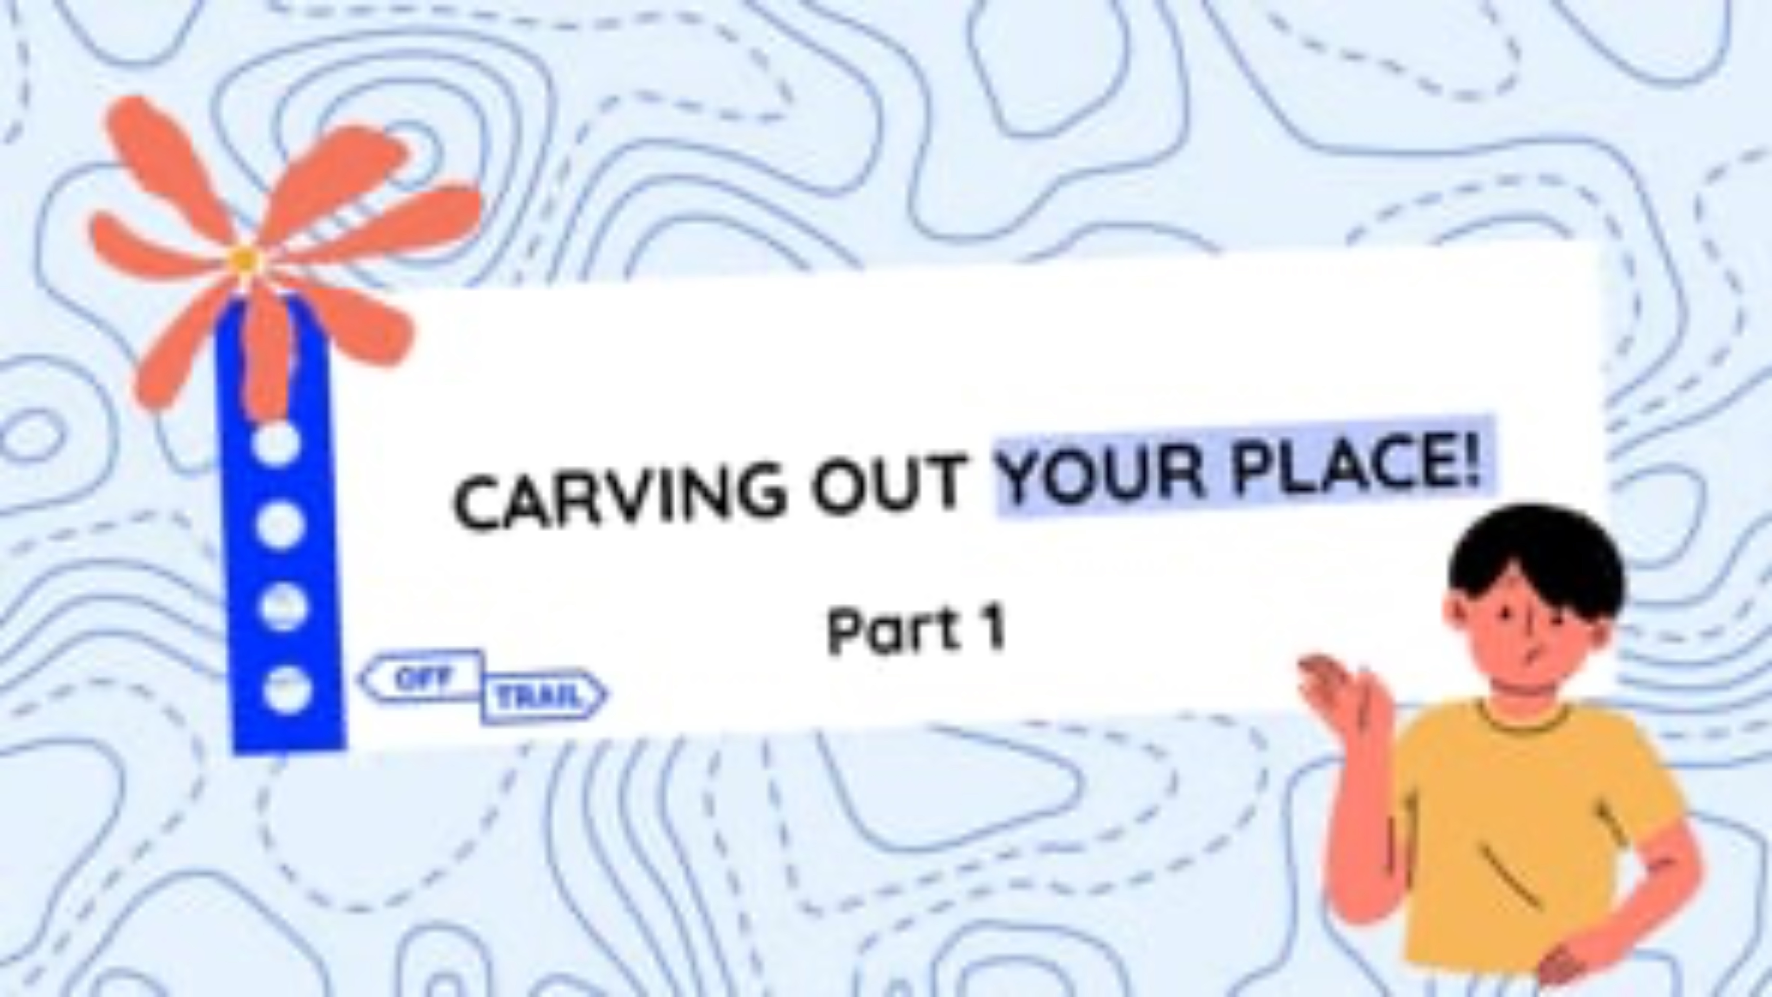
7
Educational clip — Part 1
Video clip
Notes:
NOTE!
Play the video clip Carving out your place – Part 1 for your students.
To do so, look at the following two formats, and choose the one that you think will work best based on the needs and characteristics of your students.
Note that both formats contain essentially the same information.

Slide 8
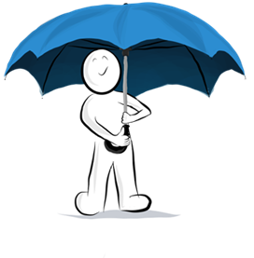
8
Real connections vs. virtual connections
Friendships play an important role in your ability to adapt to all the changes that occur during adolescence.
They act as protective factors against life's challenges, much like an umbrella!
Friendships are crucial to your emotional needs during adolescence.

Slide 9
9
Real connections vs. virtual connections
Conversely...
Lacking friendships
Feeling left out in your group
Feeling like you don’t belong
…
Can affect your self-esteem and lead to feelings of sadness, isolation, helplessness, and stress when it comes to dealing with life's challenges.
Having friends helps you feel like you have importance and value as a person.
Helps your
self-esteem,
confidence,
and courage!

Slide 10
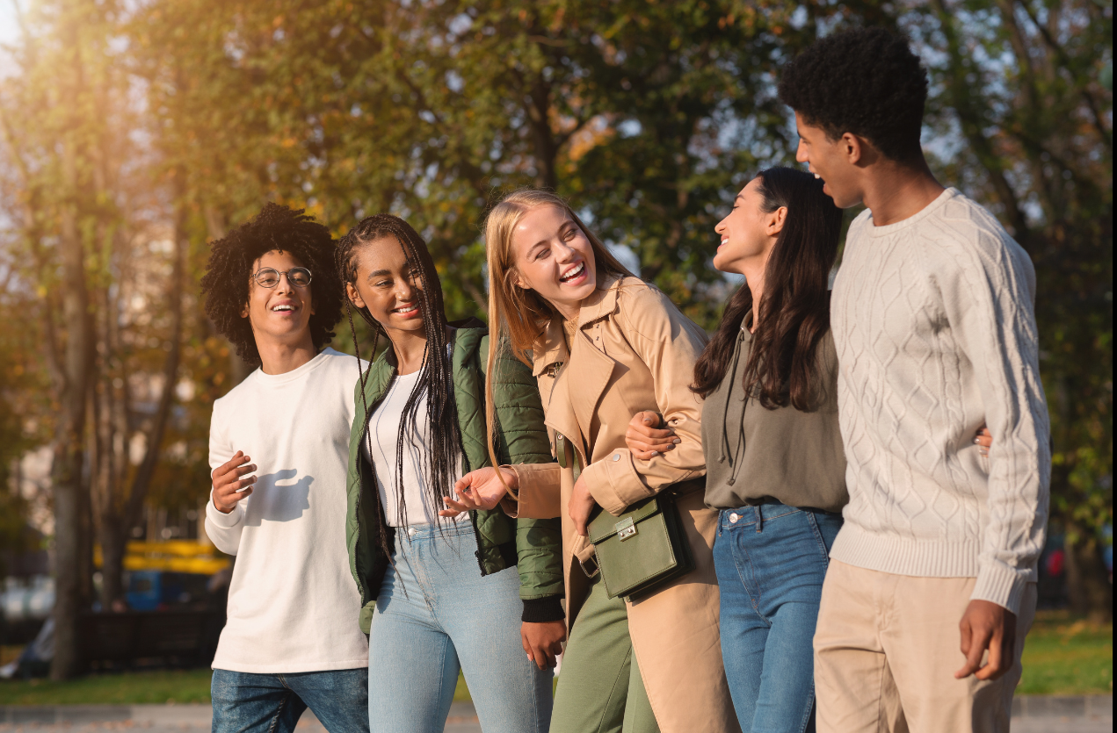

10
Real connections vs. virtual connections

Slide 11
11
Real connections vs. virtual connections
Whether you’re connecting with others on social media or in person...
it’s the quality of these relationship that matters most,
not the quantity.
Don’t forget!
It’s important to develop and nurture authentic and meaningful relationships with other people by sharing experiences in the real world,
in person!
It’s better to have a few friends you can count on and have a sincere, fulfilling and mutual relationship with...
than to have a bunch of superficial relationships with people who don’t care very much about you, where you don’t feel that you’ve found your place or don’t feel like you can be yourself.

Slide 12

12
Navigating troubled waters...
Friendships are bound
to grow or even change
over time!
Take a step forward if you’ve ever experienced a similar situation.

Slide 13
13
Navigating troubled waters...
What did this exercise teach you about yourself or about others?
Why do you think someone might stay in a group of friends even when they start to feel uncomfortable or out of place there?
What emotions did you feel?
What advice would you give to a young person in this kind of situation to help them get out of it?
Have you ever been in a situation where you put aside some of your personal values in order to stay part of a group? How did that make you feel inside?

Slide 14
14
Navigating troubled waters...
Don’t forget!
Fear of rejection, exclusion, loneliness, or judgment can lead you to use strategies that might trap you in relationships that are harmful or that affect you negatively.
Try to listen to yourself—to your values and your needs—so you can act in a way that’s consistent with them and improve your relationships!

Slide 15
15
Your turn!
Strategies for building friendships!
Take the first steps to talk to someone.
Participate in the discussion.
Show interest and ask questions.
Use humour.
Use non-verbal cues to show openness (smiling, making eye contact, nodding, speaking with a calm and composed tone of voice, etc.)
Recognize the other person’s value and highlight their achievements and skills.
Identify your shared interests.
Take the time to listen attentively to the other person before resuming the discussion.
Make eye contact with the person you’re talking with.

Slide 16
16
Your turn!
Strategies for maintaining positive relationships!
Be involved in the relationship and check in on the other person.
Express yourself clearly and honestly.
Take initiative and talk about your ideas and projects.
Listen attentively to the other person.
Be sensitive to the other person (including their emotions and needs).
Be critical of the other person’s behaviour and ideas, but without judging them as a person.
Respect the other person’s values and point of view.
Accept and welcome criticism directed at you.
Be tolerant of differences, including differences of opinion.
Be able to apologize.
Open up and learn to talk about yourself.
Encourage, help, and compliment others.
Have a sense of humour.

Slide 17
17
Your turn!
Strategies for getting out of uncomfortable relationships!
Discuss the discomfort you feel in a
respectful manner.
Gradually distance yourself from harmful relationships.
Identify and express your own emotions and needs.
Leave the group if behaviour goes over the line or no longer aligns with your values.
Actively look for solutions.
Find an ally.
Choose activities where you feel more
comfortable.
Choose yourself,
despite your fears and doubts.
Develop other friendships at the same time.
Ask for help.

Slide 18
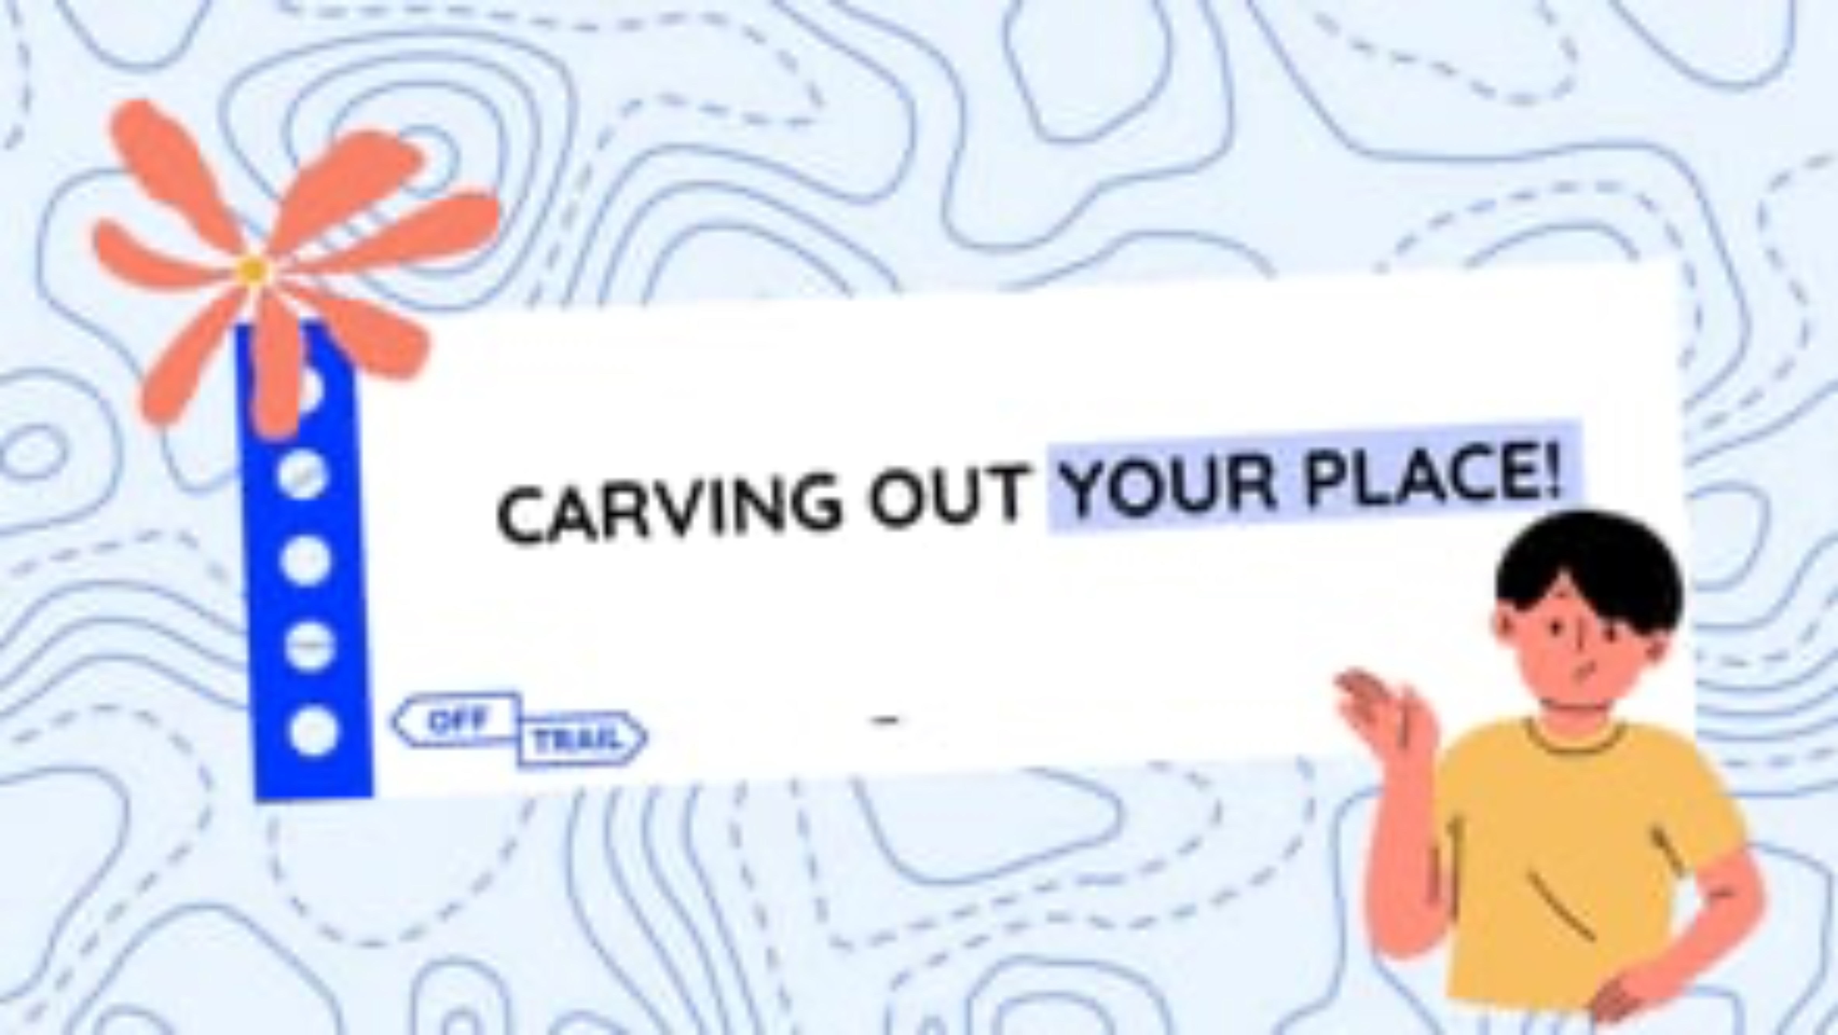
18
Educational clip — Part 2
Video clip
Notes:
NOTE!
Play the video clip Carving out your place – Part 2 for your students.
Make sure you use the same format that you used for Part 1.

Slide 19
19
OFF-TRAIL Challenge
This week...
02
01
Choose two strategies you could use to improve the quality of your friendships.
Reflect on your friendships...
(How do you feel about your friendships or friend group?)

