Slide 1





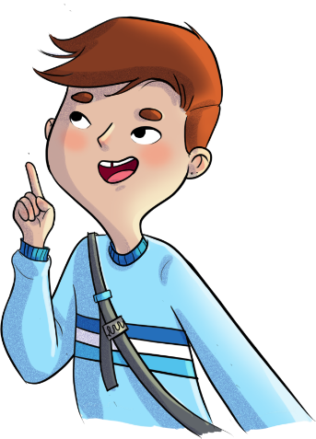


NOT RIGHT OR WRONG: IT’S A MATTER OF PERCEPTION! ​
Text is under a CC BY-NC 4.0 licence. Graphics designed with Canva are under Canva's content licence.
© OFF-TRAIL program by Centre RBC d'expertise universitaire en santé mentale (2025), Université de Sherbrooke.

Slide 2
2
By the end of the workshop,
you’ll be able to:
understand the role that perceptions play during conflicts;​
become aware of your own attitudes and behaviours that worsen conflicts;
use an approach to conflict resolution based on compassionate communication;
use positive strategies for listening to others and expressing yourself.

Slide 3
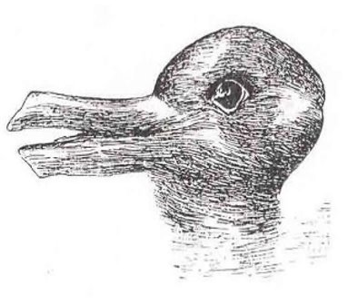
3
Perceptions
What do you see?

Slide 4
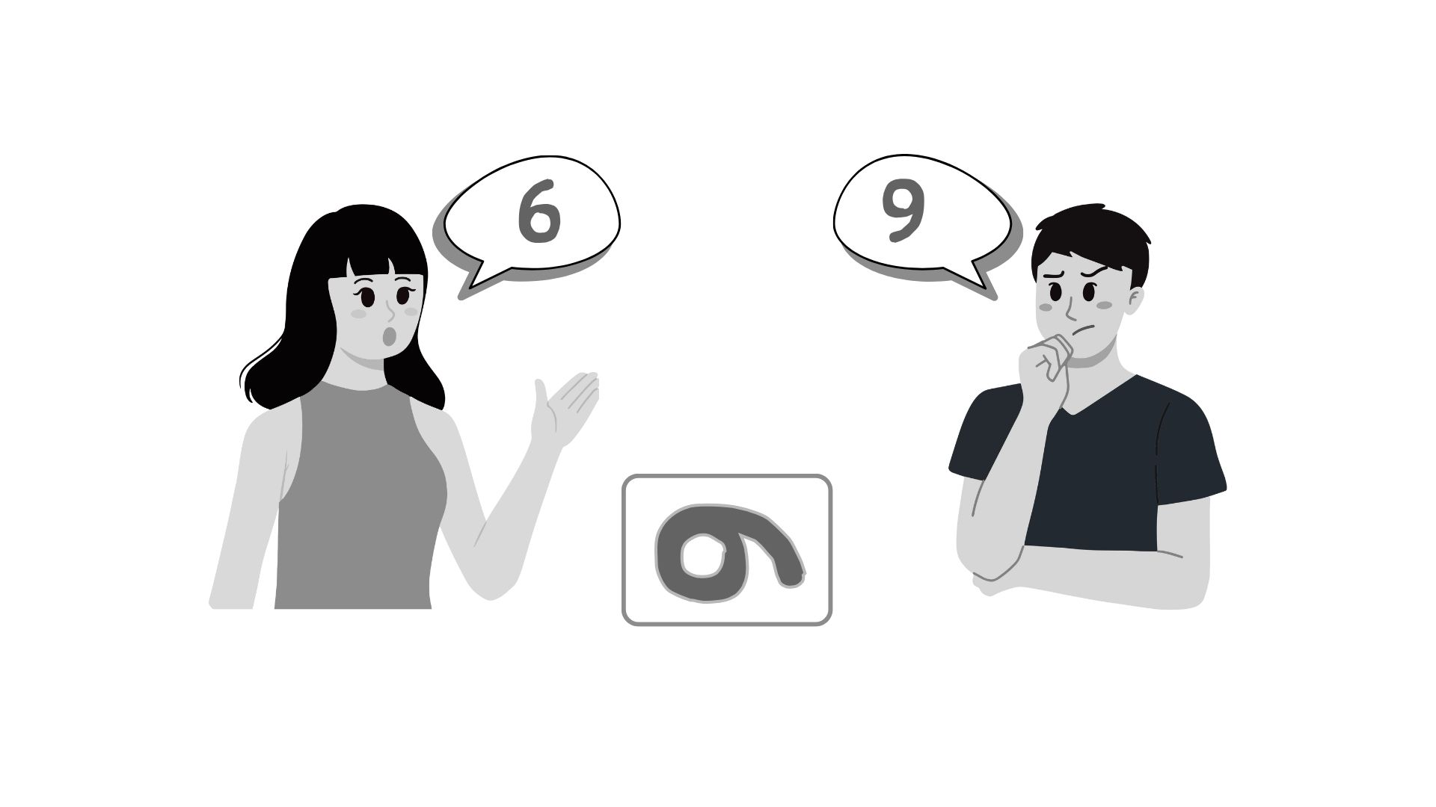
4
Perceptions
What do you see?

Slide 5

5
Perceptions
What do you see?

Slide 6
6
Perceptions
Can you change your perspective to see how others interpreted the images differently?​
When looking at the images, did everyone see the same thing at first glance? Why or why not?​
Has there ever been a time where you and another person had different perceptions of the same situation?​
What might this exercise teach us about our perceptions?​

Slide 7
7
Perceptions
There might be multiple perceptions, perspectives or points of view about a single situation.​
So, there’s no point trying to figure out who’s right and who’s wrong!
But these differences in perception are often at the root of interpersonal conflicts…

Slide 8
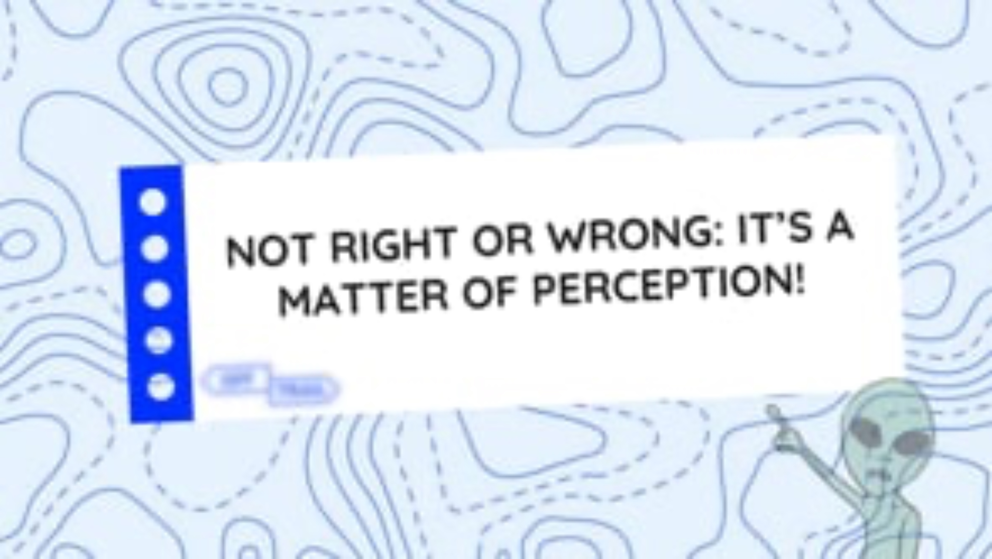
8
Educational clip—Part 1
Video clip
Notes:
ATTENTION!
Play the educational clip Not right or wrong: it’s a matter of perception! – Part 1 for your students.
To do so, look at the following two formats, and choose the one that you think will work best based on the needs and characteristics of your students.
Note that both formats contain essentially the same information.

Slide 9
9
Communication is the key!
Examples of conflicts that were resolved positively or were helpful?​
Examples of conflicts that got out of hand or were harmful?​
Why were the outcomes of these conflicts different? ​

Slide 10
10
Communication is the key!
The way you react to a conflict can influence its outcome!​
Your spontaneous reactions (attitudes and behaviours adopted without thinking) can make conflicts worse… ​
Positive strategies help you resolve your conflicts in an effective and helpful way!
“Communication is the key!”

Slide 11
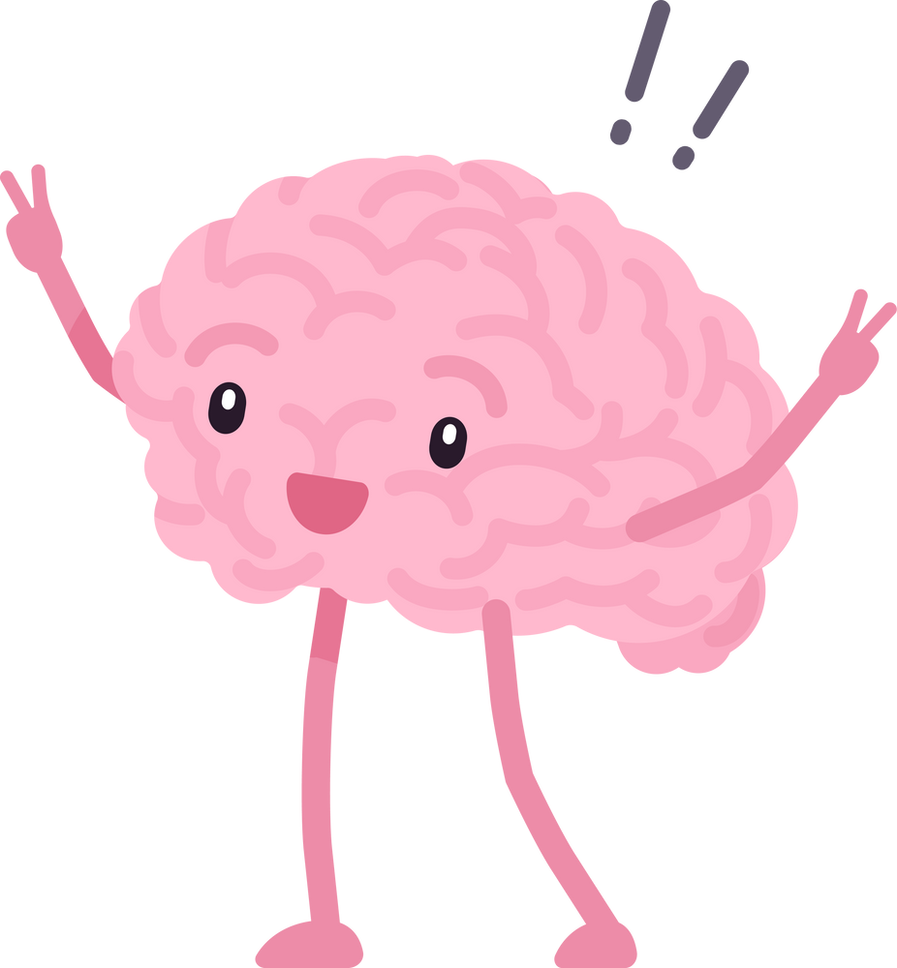
Communication is the key!
11
Approach to conflict resolution based on compassionate communication
01
03
Calm yourself and refocus​
Communicate with compassion
Choose and implement a solution
Look for solutions​
04
02

Slide 12
12
Communication is the key!
Quick reminder
01
Calm yourself and refocus​
Your emotions speak to you! They send you an important message: “There’s a need that requires your attention!”
Stop and take a break;​
Remove yourself from the conflict and go somewhere quiet;​
Take a deep breath;​
Take a look at what’s happening inside yourself;​
Identify your own emotions and needs regarding the conflict;​
Release your emotions in a healthy way (exercising, drawing, writing, listening to soothing music, etc.);​
Refocus your attention on what is important to you and on your values.

Slide 13
13
Communication is the key!
02
Communicate with compassion
Listening to the other person:​
Use nonverbal communication (e.g., eye contact, facial expressions, tone of voice) that shows your interest;​
Be open and receptive to what the other person has to say; ​
Give the other person time to speak without interrupting them; ​
Try to understand the other person’s point of view without judging them;​
Put yourself in the other person’s shoes and be sensitive to their emotions and needs; ​
In short, listen to the other person just like you want them to listen to you!
Expressing yourself:​
Describe the facts of the situation without making judgments or interpretations;​
Avoid making assumptions about the other person’s intentions; ​
Use “I” statements about yourself, rather than “You” statements about the other person;​
Clearly express your emotions and needs regarding the conflict;​
Don’t blame the other person for your emotions and feelings; ​
Admit your own faults in the situation and be able to apologize.

Slide 14
14
Communication is the key!
03
04
Look for solutions
Choose and implement a solution
Propose realistic ideas, solutions or actions that would meet the needs of everyone involved in the conflict;​
Come up with a range of solutions.
Consider the pros and cons of each proposed idea, solution or action. ​
Work together to choose the solution(s) that best meet(s) the needs of everyone involved in the conflict;​
Implement the solution.

Slide 15
15
Communication is the key!
Don’t forget!
Use the strategies for compassionate communication (expressing yourself and listening to the other person) throughout the conflict resolution process.​
If your emotions start to get the better of you at any point, go back to step 1 and give yourself time to calm down again.​
Ask for help whenever you need it.

Slide 16
16
Communication is the key!
A poorly managed conflict… ​
​
affects and weakens the relationship between those involved.
​
Examples of attitudes and behaviours to avoid:​
​
Ignoring the other person​
Running away from the conflict​
Trying to control the other person
A properly managed conflict… ​
strengthens the relationship between those involved.​
It helps you know and understand each other better.
It helps find new solutions!

Slide 17
17
Communication is the key!
Conflicts vs. situations of violence and bullying ​
A conflict can be resolved between two people acting honestly and in good faith who are willing to meet each other halfway! ​
​
If there’s a power imbalance or some form of violence from one person toward another (like bullying), it is not a conflict. ​
​
If you’re a witness to or a victim of such violence or bullying, it’s best to distance yourself from that situation or person in order to protect yourself, then go ask for help.

Slide 18
18
Your turn!
“You get home from school and notice that the books on your desk have been moved. Right away, you assume your sister went into your room yet again without asking for permission. You run to her room, barge in without knocking, and loudly accuse her of snooping around your room. Your sister asks you what your problem is and tells you that you always get worked up over nothing. She says she didn’t go in your room, but you don’t believe her. A conflict breaks out between you and your sister…”​
Use the strategies you’ve learned in order
to resolve the conflict step by step, with compassionate communication!​

Slide 19

19
A dramatic turn of events!
Interactive theatre to help learn how to use conflict resolution strategies
Intervene in the scene to help resolve the conflict!​
Multiple directors ​
“CUT”
One scene​
Two characters​

Slide 20

20
A dramatic turn of events!
Action!
Emil invites his friend Ophelia to the movies to see a new film that just came out. Ophelia tells him she can’t go with him this evening because she’s going to visit her grandparents. That night, before going to bed, Emil sees on social media that Ophelia has posted photos of herself hanging out with other friends at a party. Emil feels his anger rising quickly. He feels ashamed that his friend lied to him. The next day at school, he ignores Ophelia when they cross paths in the hall. Ophelia snaps at him and yells, “Hey, you could try saying, ‘hi’!” Emil tells her that he doesn’t know why he would say “hi” to her when clearly she has better things to do than spend time with him. Seeing the puzzled look on Ophelia’s face, Emil tells her that he saw her photos on Facebook and knows that she lied to get out of going to the movies with him. Ophelia tells him that those photos are from last week. Emil doesn’t believe her—why would she post old photos? He accuses her of lying again. The tension is building…
Character 1: Emil
Character 2: Ophelia

Slide 21
21
A dramatic turn of events!
Leo is going out with his friends this Friday for a special occasion. He wants to be able to come home around midnight instead of 10 p.m., his usual curfew. Everyone else has permission from their parents to come home late, but Leo talked with his parents at breakfast this morning and their answer was a big, fat “no.” At dinner, he tries to bring up the topic again. The response is still “no.” Leo feels a growing sense that this is really unfair. He raises his voice, saying that it’s totally unfair and humiliating that he’s the only one not to have this freedom. His parents remain firm: it’s a no. They tell him that they’re still the ones in charge and that he doesn’t get to negotiate these kinds of decisions at his age. They go on to say that he needs to learn to take no for an answer and that he can do what he wants when he turns 18. Leo is seething with rage inside. The tension is building…
Action!
Character 1: Leo
Character 2: Parents

Slide 22
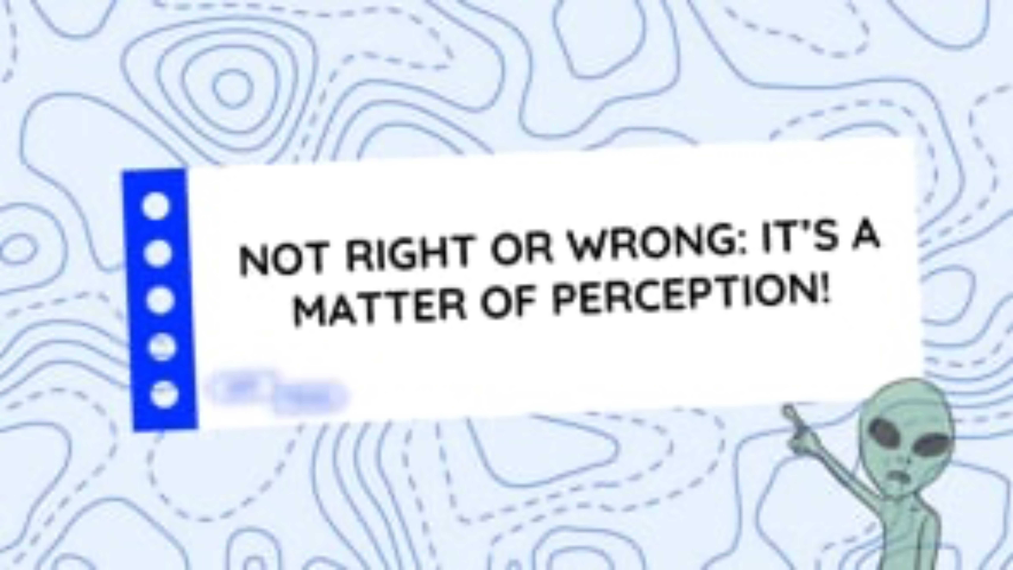
22
Educational clip—Part 2
Video clip
Notes:
ATTENTION!
Play the educational clip Not right or wrong: it’s a matter of perception! – Part 2 for your students.
Make sure you use the same format that you used for Part 1.

Slide 23
23
OFF-TRAIL Challenge
This week…
01
02
03
Identify a spontaneous reaction that you often adopt without really thinking but which may make your conflicts worse.
Identify a conflict resolution strategy you already use and that comes naturally to you.
Identify a new strategy of compassionate communication (to listen better to others and express yourself better) that you can apply.​

