Slide 1





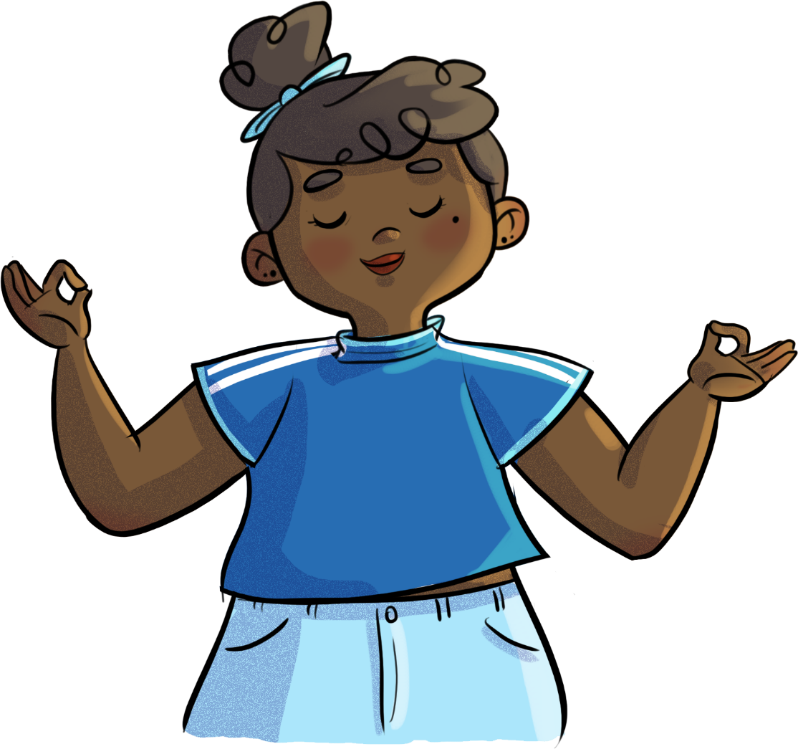


BEING OPEN-MINDED
DOESN’T MEAN YOU HAVE A HOLE IN YOUR HEAD!
Text is under a CC BY-NC 4.0 licence. Graphics designed with Canva are under Canva's content licence.
© OFF-TRAIL program by Centre RBC d'expertise universitaire en santé mentale (2025), Université de Sherbrooke.

Slide 2
2
By the end of the workshop,
you’ll be able to:
understand how prejudice and judgments impact others,
yourself and your relationships;
adopt an attitude of openness, attentiveness, understanding and respect toward others;
use more strategies to develop empathy and compassion toward yourself and others.

Slide 3
3
Get labelling!
“Lou often looks unhappy. At school, he doesn’t talk to anyone. You’d almost think Lou doesn’t like people all that much.”
Why do you think Lou acts this way?

Slide 4
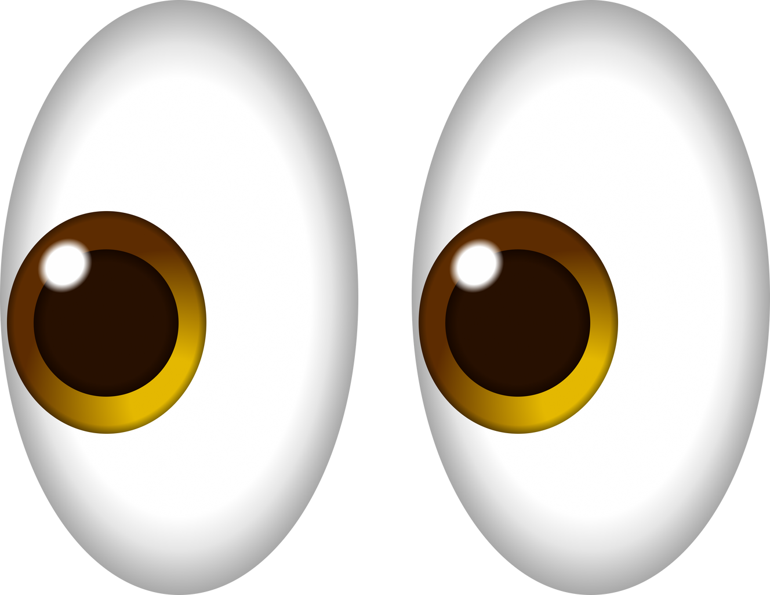
4
Get labelling!
Prejudices:
Remember!
Things are rarely what they seem at first glance!
Making assumptions, judging others too quickly without really knowing them.
Based on your own perceptions or on incomplete or unfounded information.
“Judging is sometimes a pleasure,
understanding is always one!”
– HENRI DE RÉGNIER
Prevent you from seeing what the other person is truly like.

Slide 5
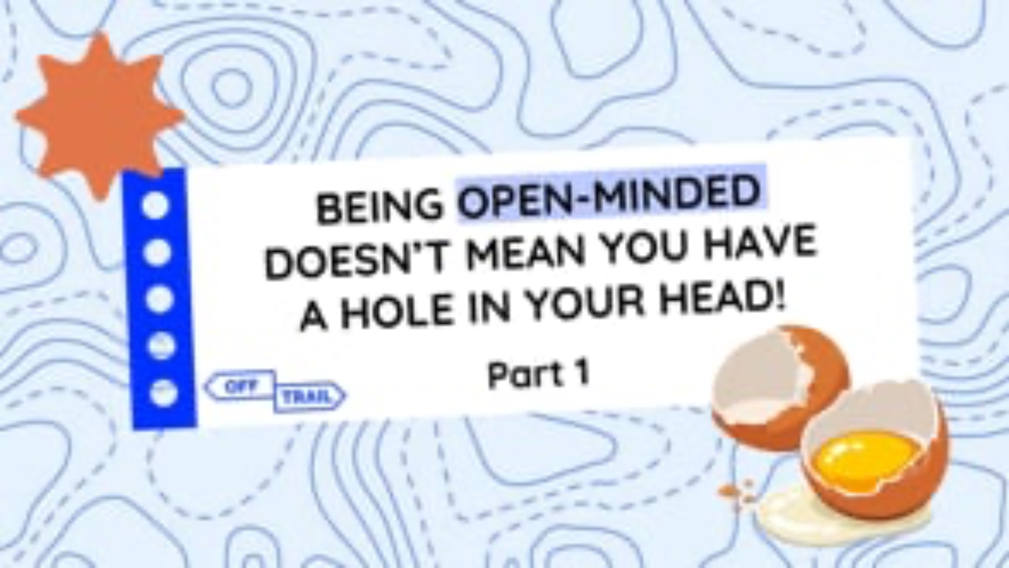
5
Educational clip—Part 1
Video clip
Notes:
ATTENTION!
Play the educational clip Being open-minded doesn’t mean you have a hole in your head! - Part 1 for your students.
To do so, look at the following two formats, and choose the one that you think will work best based on the needs and characteristics of your students.
Note that both formats contain essentially the same information.

Slide 6
6
Be kind to yourself
What does empathy mean to you?
Empathy is…
Putting yourself in someone else’s shoes;
Understanding someone’s experience;
Developing empathy helps cultivate compassion!
Understanding and being sensitive to someone’s feelings and needs.

Slide 7
7
Be kind to yourself
What does compassion mean to you?
Compassion is…
Caring about the well-being of others;
Having a positive and respectful attitude toward others, without expecting anything in return;
Being open to differences;
Empathy and compassion are important for developing and maintaining healthy, harmonious relationships!
Asserting yourself respectfully, sincerely and with positive intentions.

Slide 8
8
Labels that leave a mark…
Now that you know that Lou is being bullied at school, what might you say to him?
What could you do to help lessen the judgments weighing Lou down?

Slide 9
9
Labels that leave a mark…
They can weaken the other person’s self-esteem, and damage our relationships.
Our prejudices and judgments about people and the labels we place on them can leave a mark.
So, it’s better to take a genuine and sincere interest in the other person.
At the least, lead by example and refrain from judging others yourself!
That’s how you start developing your empathy and compassion!

Slide 10

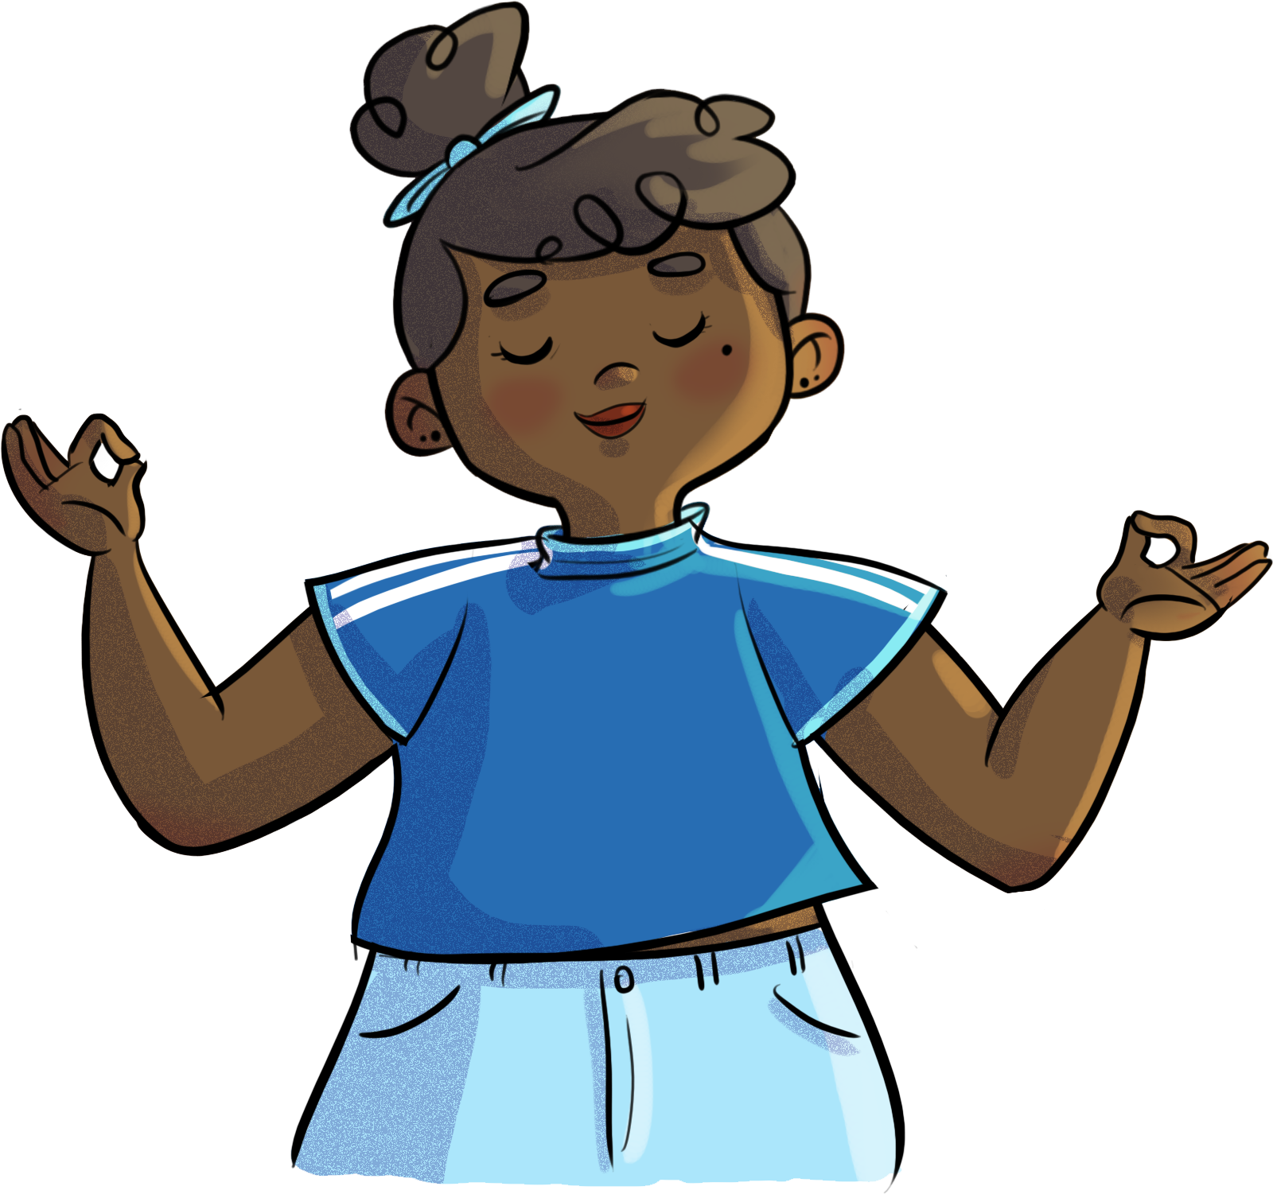

10
Kindness meditation
Close your eyes and
centre yourself.

Slide 11

11
Because we’re a lot alike!
Please be honest, respectful and mature so that everyone can have an enjoyable, positive and meaningful experience!

Slide 12
12
Because we’re a lot alike!
01
02
Find a comfortable place to sit, then sit quietly with your eyes closed.
For each statement that applies to you, raise your hand
(but keep your eyes closed).
03
04
When I say so, open your eyes and look at the others around you with compassion.
If the statement doesn’t apply to you, keep your eyes closed.

Slide 13
13
Because we’re a lot alike!
  Did you find this exercise easy or difficult? Why?
  How did you feel when you saw other students who are in the same boat as you?
  What did you find out about your classmates? And about yourself?

Slide 14
14
Because we’re a lot alike…
Let’s focus our attention on the bridges that connect us, rather than on the differences that divide us… Doing so will help us better deal with judgments!
Because deep down, we’re more alike than we think!

Slide 15
15
Your turn!
Strategies to develop empathy and compassion toward others
Avoid making assumptions or holding prejudices.
Recognize the other person’s strengths and positive qualities.
Describe behaviours and facts, without judgment.
Focus on what you have in common with the other person, rather than on the differences.
Put yourself in the other person’s shoes—be sensitive to their needs and emotions.
Appreciate the similarities that bring you together.
Have an attitude of openness, attentiveness, understanding and respect toward others.
Think of difference as a positive asset.
Take an interest in truly getting to know the other person.
Be grateful toward others and recognize that good that they can bring.
Be generous, do good deeds and help others.
Accept others without trying to change them.

Slide 16
16
Your turn!
Strategies to develop empathy and compassion toward yourself
Talk to yourself as if you were talking to someone you love.
When you’re overwhelmed by emotions, take a minute to breathe.
Listen to yourself and be attentive to what you’re feeling (emotions and needs).
Be aware of and respect your own limitations.
When facing judgment from others, assert yourself in a way that encourages respect.
Write down your feelings in a journal.
Practise self-care by doing the things that are good for you.
Ask for help if needed.

Slide 17
What level of stress does each situation on your sheet correspond to?
17
Your turn!
Remember…
Building and developing your self-esteem can help you better handle judgments.
The more you feel that you’re valuable and worthy of love, the less you’ll fear others’ judgment and the less likely you are to judge others for trivial reasons!

Slide 18
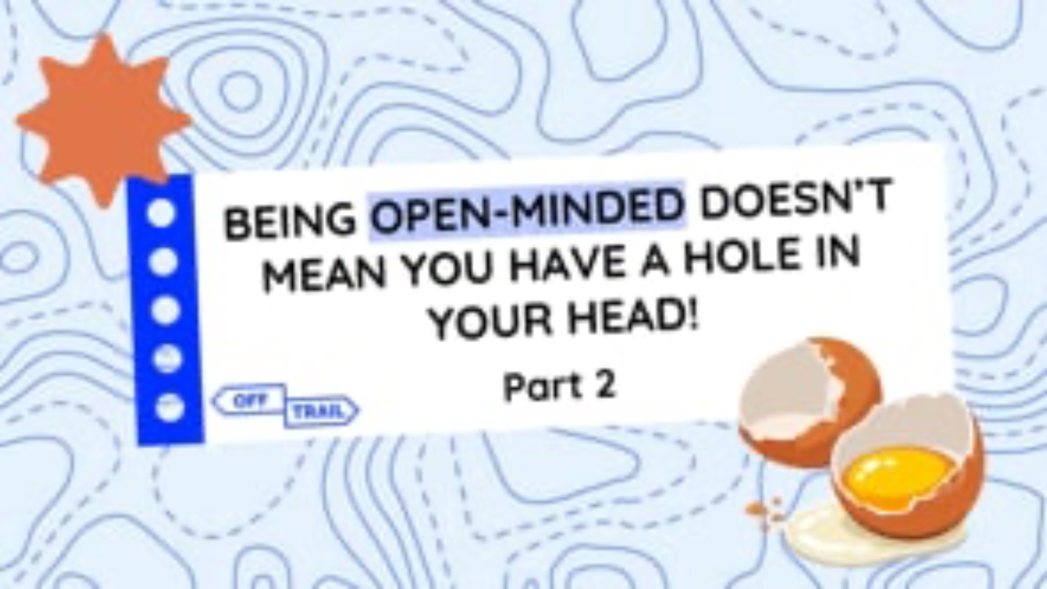
18
Educational clip—Part 2
Video clip
Notes:
ATTENTION!
Play the Being open-minded doesn’t mean you have a hole in your head! - Part 2 educational clip for your students.
Make sure you use the same format that you used for Part 1.

Slide 19
19
OFF-TRAIL Challenge
This week…
03
01
02
Identify a person/group of people that you tend to judge without really knowing them.
Observe how this influences the way you feel or act toward that person or group.
Find two strengths or positive qualities in this person (or group) or two things you have in common.

