Slide 1





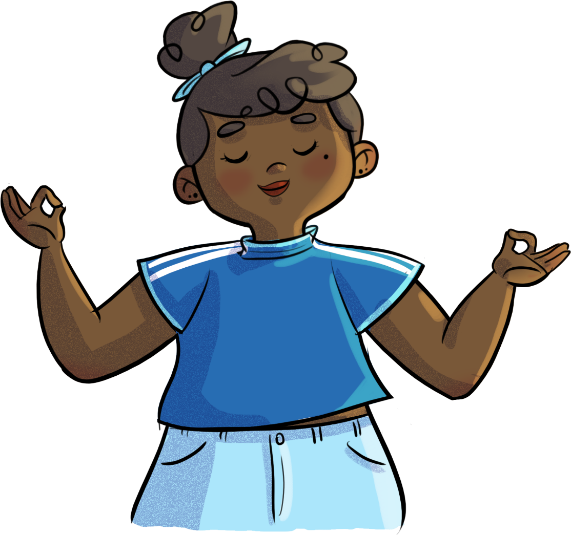


IMPERFECT? PERFECT!
Text is under a CC BY-NC 4.0 licence. Graphics designed with Canva are under Canva's content licence.
© OFF-TRAIL program by Centre RBC d'expertise universitaire en santé mentale (2025), Université de Sherbrooke.

Slide 2
2
By the end of the workshop,
you’ll be able to:
understand what self-esteem is and the factors that strengthen or weaken it;
define the real me, the ideal me, and the gap between the two;
use strategies to help build and bolster your self-esteem.

Slide 3


3
CHALLENGE TIME!
You have 2 minutes max to complete the challenge!​
5 minutes max to complete the challenges!

Slide 4
4
CHALLENGE TIME!
Honest
Calm
Enthusiastic
Motivated
Attentive
Cheerful
Responsible
Sincere
Caring
Thoughtful
Tolerant
Funny
Persevering
Creative
Respectful
Generous
Patient
Brave
Organized
Positive
Observant

Slide 5
5
CHALLENGE TIME!
What did you think of the challenges you had to do? Were they easy or hard?
How did you feel while you were doing the challenges?
How did you feel when you received compliments?
Did you notice any change in how your classmates looked or acted after getting complimented?
How do you usually feel when someone compliments you?
Is it easy for you to compliment others? Is it easier to give compliments or receive them?

Slide 6

6
CHALLENGE TIME!
Every person has their own unique strengths and qualities that contribute to their beauty, both inside and out.
It’s not pretentious to recognize your own beauty.
In fact, it’s important for learning how to love and value yourself!

Slide 7

7
Educational clip—Part 1
Video clip
Notes:
ATTENTION!
Play the educational capsule Imperfect? Perfect! – Part 1 for your students.
To do so, look at the following two formats, and choose the one that you think will work best based on the needs and characteristics of your students.
Note that both formats contain essentially the same information.

Slide 8
8
What is self-esteem?
Tell me in your own words
what self-esteem means to you
Feeling like you have importance and VALUE as a person and are worthy of love;
The overall assessment (positive or negative) of your value as a person;
Can be strong or weak;
The emotions or thoughts you have when thinking about yourself are good indicators.

Slide 9
What is self-esteem?
Strong self-esteem
Weak self-esteem
“I may have flaws and I may fail sometimes, but I still consider myself to have inherent worth as a person.”
“I’m constantly worried about or even obsessed
with my image.”
“I have a good understanding of myself (my strengths and weaknesses) and act accordingly.”
“I feel insecure in social situations and tend to be self-conscious of how others look at me.”
“I accept and welcome compliments
that people give me.”
“I tend to make choices that go against my own wants and needs, so I don’t upset others.”
“I assert myself and make sure I’m treated with respect.”
“I tend to feel excluded or different from others: more vulnerable, weaker or less competent.”
“I accept that I can’t be talented and successful at everything, and that fact doesn’t make me a failure.”
“I have a hard time accepting criticism
or dealing with failure.”
“I recognize my qualities, strengths,
abilities and achievements.”
“It’s hard for me to recognize my qualities, strengths or abilities. I have trouble taking credit for my own achievements.”

Slide 10
10
What is self-esteem?
Don’t forget!
Self-esteem is…​
Still under construction when you’re a teenager;​
Influenced by changes in your identity and by your interpersonal events and experiences;
What’s important is that you understand your self-esteem in the present moment, so that you can build it up and strengthen it with kindness, one step at a time! ​
Bound to evolve over time.

Slide 11
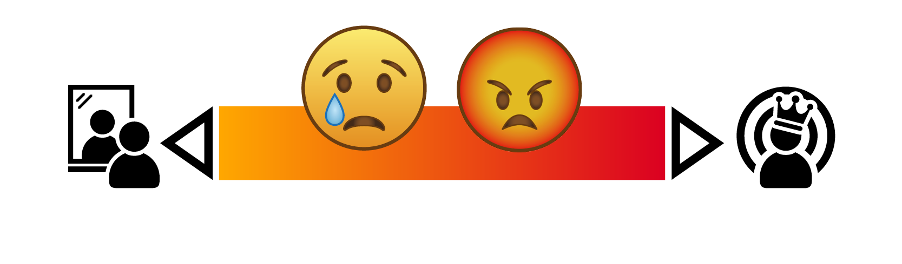

11
Real Me or Ideal Me?
Are they
Or close
far apart?
together?

Slide 12
12
Real Me or Ideal Me?
Use the Exploring your self-esteem​
worksheet to describe
your Real Me & your Ideal Me
Are they far apart or close together? ​
What does that tell you about yourself and your self-esteem?​
How big is the gap, difference or distance between your two “me”s?

Slide 13
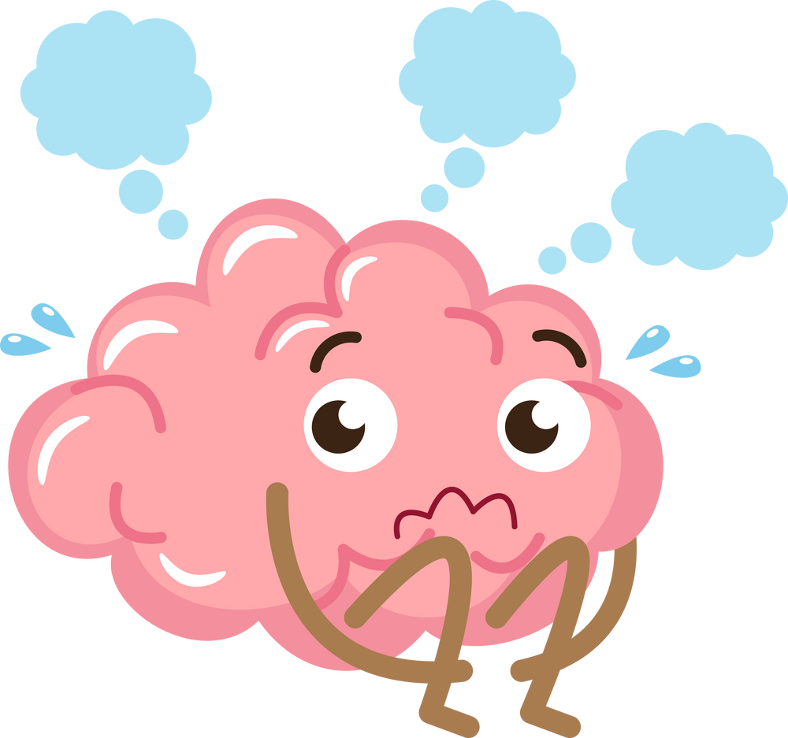
13
Real Me or Ideal Me?
A positive, balanced, healthy and strong self-esteem…
Is NOT self-glorification: overvaluing yourself, trying to appear unshakeable, never doubting yourself, always putting yourself first over other people
Is NOT self-trivialization:
judging yourself harshly, devaluing yourself, minimizing your own successes, making yourself invisible
Is being able to make a kind and realistic assessment of yourself!

Slide 14
14
Your turn!
Strategies to help build and develop your self-esteem
Be mindful of the vocabulary you use when talking about yourself
Write down your qualities, accomplishments and successes
in a journal
Leave your comfort zone and dare to take risks
Be aware of your inner dialogue
Avoid disparaging or overly demanding thoughts about yourself
Criticize yourself less and don’t judge yourself too harshly
Don’t define yourself solely by your difficult or past experiences
Take a fresh look at yourself, and see what is beautiful within you
Develop a kinder and more forgiving inner dialogue
Assert yourself calmly and respectfully
Accept the possibility of failure
Avoid comparing yourself to others… Instead, compare yourself to yourself!
Get a better understanding of your strengths and weaknesses
Accept yourself as you are
Welcome criticism and treat it as an opportunity to learn
Be open to compliments from others
Allow yourself to say no, even if it may disappoint others

Slide 15
15
Your turn!
Don’t forget!
“It’s impossible to achieve perfect self-esteem!”
Love accept yourself for who you are:
no more, no less!

Slide 16

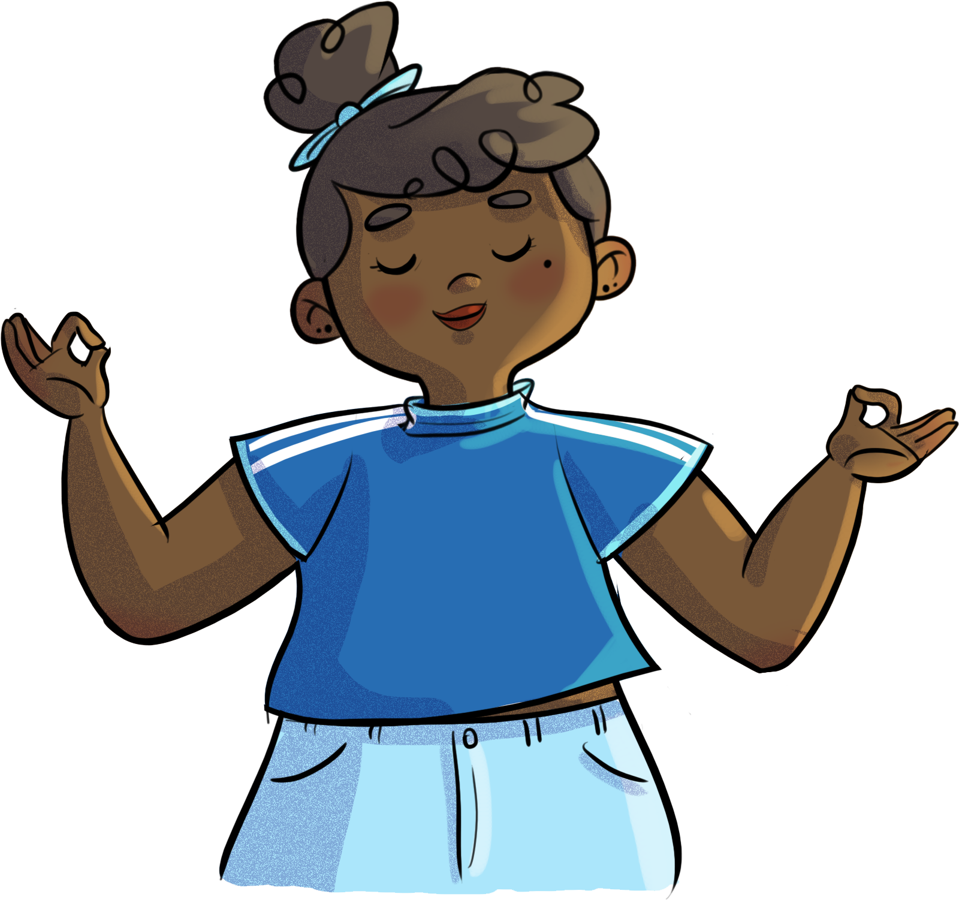
16
Meditation on your strengths
Close your eyes and centre yourself.

Slide 17

17
Educational clip—Part 2
Video clip
Notes:
ATTENTION!
Play the educational capsule Imperfect? Perfect! – Part 2 for your students.
Make sure you use the same format that you used for Part 1.

Slide 18
18
OFF-TRAIL Challenge
This week…
03
02
01
Turn your self-criticism into kinder, more positive and more realistic statements.​
Try using some of the strategies covered in this workshop to improve your self-esteem.
Pay attention to your inner dialogue and how it affects your self-esteem.​

