Slide 1







DON’T SQUEEZE ME! I’M NOT A LEMON...
Text is under a CC BY-NC 4.0 licence. Graphics designed with Canva are under Canva's content licence.
© OFF-TRAIL program by Centre RBC d'expertise universitaire en santé mentale (2025), Université de Sherbrooke.

Slide 2
2
By the end of the workshop,
you will be able...
to understand what social pressure is;
to recognize how social pressure influences you, your health and your well-being;
to use various strategies to better cope with social pressure;
to assert yourself calmly, respectfully, confidently and courageously.

Slide 3

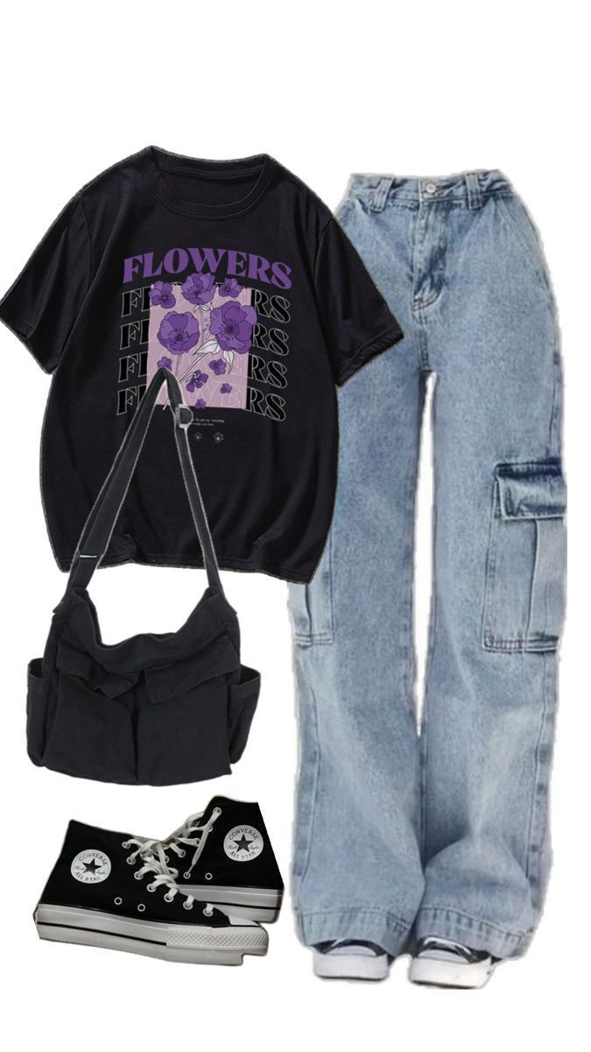
3
A round of opinions!
“Your friend receives a gift card to buy new clothes. She asks what you think she should buy.
You show her this picture of an outfit that you like...”
Image source: Pinterest according to the license in effect.

Slide 4
4
A round of opinions!
What parents and grandparents think
Comfortable!
Not too pricey!
Not too
sexy!

Slide 5
5
A round of opinions!
What friends think
Original clothing
that stands out!
Plain
clothes

Slide 6
6
A round of opinions!
What teachers think...
Does it follow the school’s dress code?

Slide 7
7
A round of opinions!
What society thinks
Trendy, fashionable!
Used or recycled!

Slide 8
8
A round of opinions!
Is it possible to please everyone? If so, how? If not, why?
Do your suggested clothes meet all the criteria of all the different characters?
Can displeasing others affect our relationships?

Slide 9
A round of opinions!
Remember...
You can’t please everyone—just like not everyone pleases you!
What matters is that you make your own choices, based on your needs, feelings, tastes, interests, values and rights.
Strong relationships don’t usually break down over a simple disagreement
or a difference in taste!

Slide 10
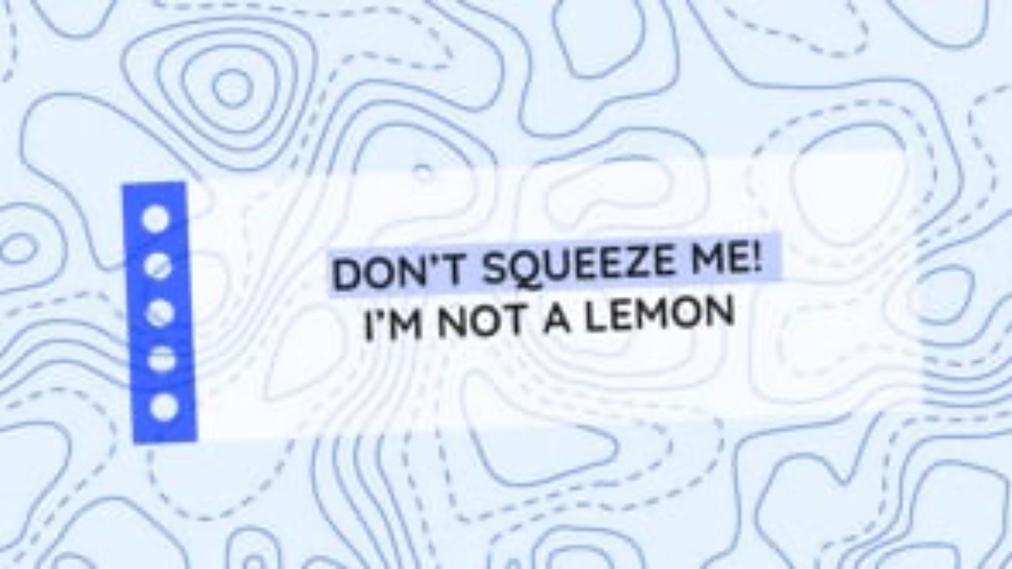
10
Educational clip – Part 1
Video clip
Notes:
NOTE!
You play the educational clip Don't squeeze me! I'm not a lemon... – Part 1 to your students.
To do so, choose the format that you consider most appropriate based on the needs and characteristics of your students, from the following two options.
Note that the two formats contain essentially the same information

Slide 11
11
Lemon squeezer
Examples of social pressure:
Beauty standards;
Bodily norms;
Gendered social roles;
Performance culture (academic, athletic);
Romantic and sexual experiences;
Risky behaviours;
Substance use (alcohol, drugs, etc.).
What is social pressure?
Social pressure can be found everywhere in your environment, including your family, friends, school, sports, the media, society, etc.
It shapes how you show up and behave: your opinions, perceptions, behaviours, attitudes and choices.

Slide 12
12
Lemon squeezer
What happens inside you when you keep being subjected to this external pressure?
Without really realizing it, we internalize pressure and impose it on ourselves... We end up feeling squeezed like a lemon!
Under pressure, we change how we show up and how we behave,
to “conform” to norms.

Slide 13
13
Lemon squeezer
“During recess, your friends make insulting remarks about another student’s physical appearance. You feel uncomfortable and disagree with the way they’re acting, but you don’t dare say so. You even end up playing along and laughing at their comments, just like everyone else. Otherwise, you might come across as being boring or too sensitive... People might laugh at you or, worse, exclude you...”

Slide 14
14
Lemon squeezer
“Your friends shared a video on social media where they put themselves in all kinds of risky situations, to get as many likes as possible on their post. You didn’t participate, and you don’t agree with any of it. Even though they insist that you share the video too, you decide to stand your ground, and you refuse to do it. You prefer to stay true to your values and integrity rather than go with the crowd and encourage risky behaviour.”

Slide 15
15
Lemon squeezer
Which situation illustrates someone resisting pressure?
Which situation illustrates someone giving in to pressure?
In your opinion, what things made them react differently to the pressure?

Slide 16
16
Lemon squeezer
How we react depends in part on our self-confidence.
Lower self-confidence leads to greater conformity or submitting to pressure, rather than resisting and being assertive!

Slide 17
17
Lemon squeezer
Assert yourself... but not just any old way!
This includes two types of RESPECT:
Assertiveness refers to your ability to calmly and honestly communicate your thoughts and feelings to others.
toward yourself (your needs, rights, thoughts and feelings);
toward others (other people’s needs, rights, thoughts and feelings);

Slide 18

18
Resist the squeeze—be assertive!
RESIST THE SQUEEZE! pause
Challenge
Stop, close your eyes and breathe.
Make decisions and assert yourself calmly, respectfully, confidently and courageously in the face of social pressure.
Look within: “How does this make me feel inside (sensations, emotions and thoughts)?”
Make up your mind and be assertive: “What do I decide to do about this situation and how can I be assertive?”

Slide 19
19
Your turn!
Strategies to better cope with social pressure and be assertive!
Stop, breathe, refocus
(use the RESIST THE SQUEEZE! pause)
Challenge preconceived notions, don’t buy into everything
Listen to yourself first
When you’re not sure, give yourself some time before making choices
Respect yourself: needs, feelings, tastes, values and rights
Demonstrate confidence and courage
Respect others: needs, feelings, tastes,
values and rights
Confront your fear of displeasing others,
say no
Ask questions, gather information, try to understand
Communicate calmly and honestly
Use humour to defuse tension without trivializing the situation

Slide 20

20
Educational clip – Part 2
Video clip
Notes:
NOTE!
You play the educational clip Don't squeeze me! I'm not a lemon... – Part 2 to your students.
Make sure you use the same format as before.

Slide 21
21
OFF-TRAIL challenge
This week...
01
02
03
04
Use the “RESIST THE SQUEEZE!” pause and notice how this pressure makes you feel inside.
Practise another one of the strategies you learned.
Identify a situation where you experience some form of pressure
(with your friends, in class, at lunchtime, during an activity or sport, with your family, etc.)
Make a decision and try to be assertive.

