Slide 1





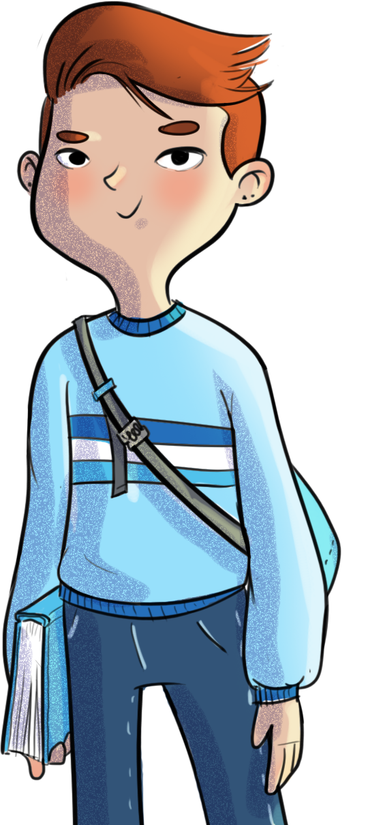


Don’t put your self-worth in other people’s hands!
Text is under a CC BY-NC 4.0 licence. Graphics designed with Canva are under Canva's content licence.
© OFF-TRAIL program by Centre RBC d'expertise universitaire en santé mentale (2025), Université de Sherbrooke.

Slide 2
2
By the end of the workshop,
you will be able...
to identify some of your own values and characteristics;
to understand how social comparison
impacts self-confidence;
to use new strategies to get to know yourself better, strengthen your self-worth, and deal with social comparison.

Slide 3
3
Three wishes!
Imagine if you had the power to make three of your biggest wishes come true.
What would you wish for?
Write down your three wishes on the worksheet you received.

Slide 4
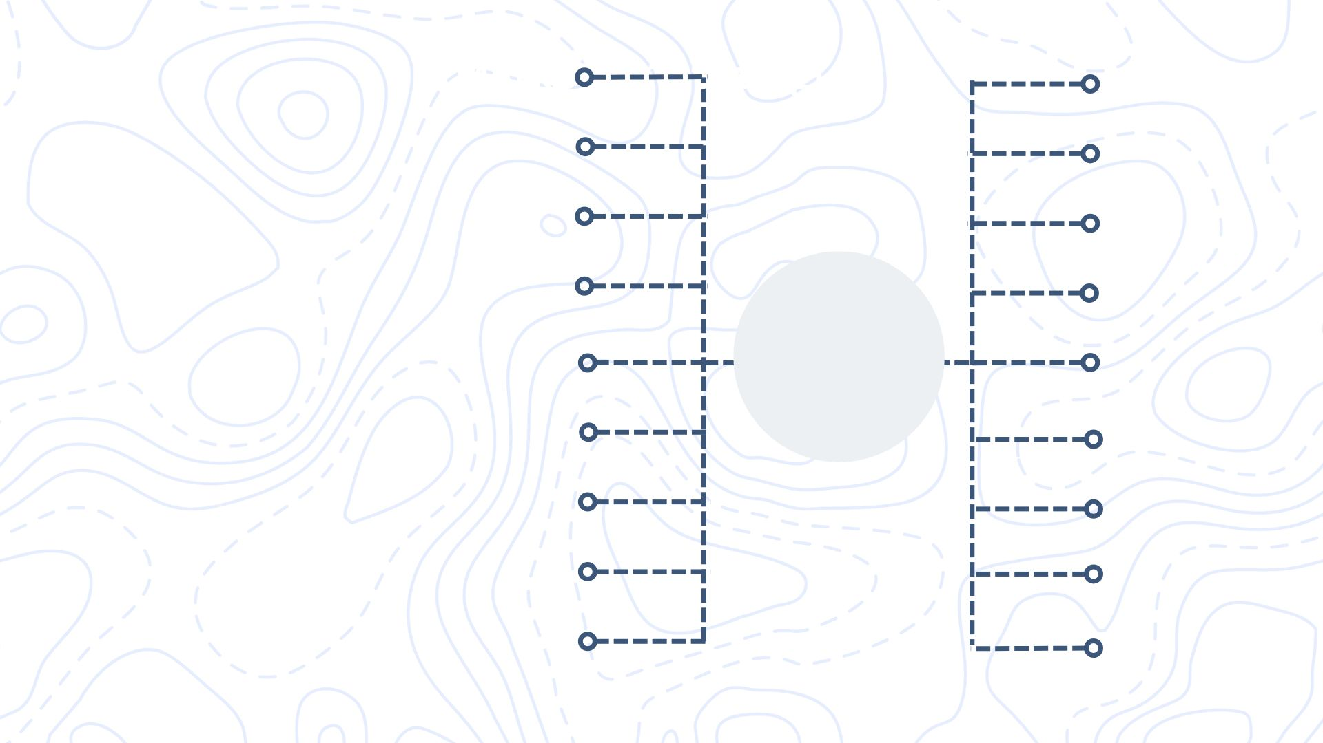
4
Freedom
Listening
Loyalty
Discipline
Friendship
Honesty
Environment
Fairness
Solidarity
Honour
Tolerance
Courage
Three wishes!
Education
Work
Faithfulness
Justice
Sharing
Perseverance
Fun
Health
Respect
Security
Love
Patience
Power
Success
Family

Slide 5
Three wishes!
5
What we hold most dear;
What is a value?
What we want to defend;
How we want to interact with the world around us;
Our compass: the principles that guide our choices and motivate us throughout our lives!

Slide 6
6
Three wishes!
Why is it important to identify your values?
Choose one of your wishes and write down the value associated with it on your worksheet.
Should your personal values be the same as other people’s?

Slide 7

7
Educational clip – Part 1
Video clip
Notes:
NOTE!
Have your students listen to the educational clip Don't put your self-worth in other people's hands – Part 1.

Slide 8
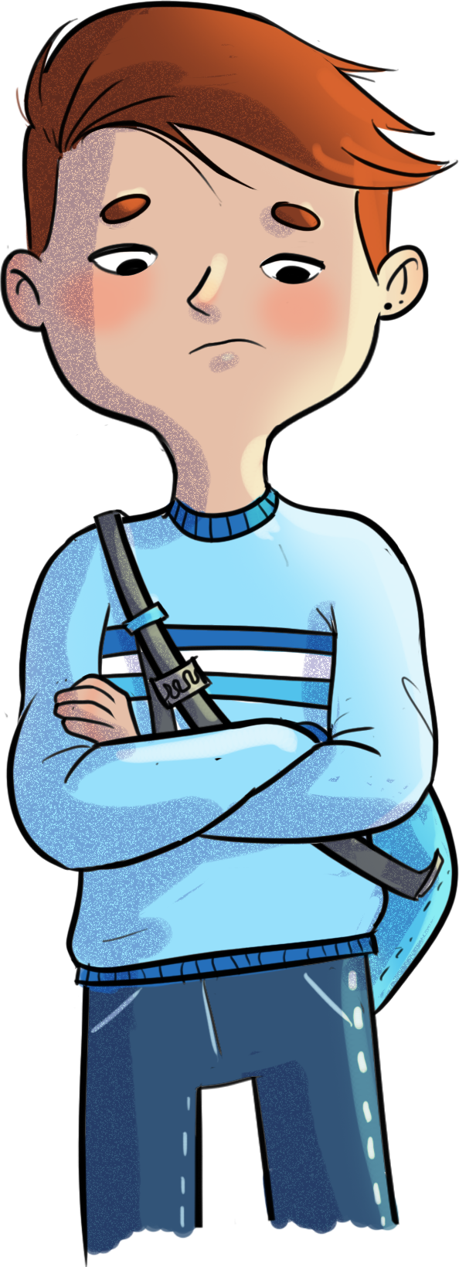
8
The same, not the same!
In what ways do you think social comparison can undermine self-confidence?

Slide 9
9
The same, not the same!
The more we compare ourselves to others...
The more we risk viewing ourselves (and others) in a negative or distorted light...
The more this negatively affects our self-confidence (and confidence in others).

Slide 10
10
The same, not the same!
  Imagine that the balloon represents
  self-confidence.
  If it’s inflated, what
  does that mean?
  If it’s deflated, what does that mean?
Self-confidence varies depending on the context and the people you’re with.

Slide 11
11
The same, not the same!
  What should the balloon’s ‘normal’
  size be?
The “normal” size of the balloon should depend on how you feel inwardly about your self-confidence. So, it can vary significantly from person to person!

Slide 12
12
The same, not the same!
Silently, with your eyes open or closed...
Inflate your balloon so it represents your level of self-confidence.
  Did you look at the balloons around you before inflating yours? Or did you inflate your balloon quickly before everyone else?
  Look around... What do you notice? How do you feel? Observe the sensations, emotions and thoughts within you.

Slide 13

13
The same, not the same!
Scenario 1
KEEP YOUR EYES OPEN
You spent a quiet weekend at home relaxing. When you check your social media on Sunday, you see that your friends went out last night and are posting photos where they look like they’re having a great time. You weren’t invited.
How do you feel? How is your self-confidence?
Adjust your balloon.

Slide 14
14
The same, not the same!
Scenario 2
CLOSE YOUR EYES AND FOCUS ON WHAT YOU FEEL
Your teacher announces that you need to work in teams of 4 students. Your 4 friends get together and you find yourself alone. By the time you start looking for teammates, the other students have already all gotten into teams. How do you feel? How is your self-confidence?
Adjust your balloon.

Slide 15
15
The same, not the same!
Scenario 3
CLOSE YOUR EYES AND FOCUS ON WHAT YOU FEEL
You’re playing in a sports tournament, representing your school. The game is tied, and the next point will determine the winning team. You’re feeling the pressure. You’re in a good position and a player on your team passes you the ball. Unfortunately, you miss the pass and the opponent scores a goal. How do you feel? How is your self-confidence?
Adjust your balloon.

Slide 16
16
The same, not the same!
Scenario 4
KEEP YOUR EYES OPEN
Today in class, you’re going to receive your grade for your math exam. You studied hard for this exam and got a 73%. The class average is 85%. How do you feel? How is your self-confidence?
Adjust your balloon.

Slide 17
17
The same, not the same!
Did having your eyes open or closed influence how you adjusted your balloon? Why?
How do you feel when you notice that your balloon isn’t as inflated as the other students’?
How important is other people’s opinion to you? (Very important, somewhat, etc.)
What’s the purpose of comparing yourself to others?

Slide 18
18
The same, not the same!
Comparison has negative effects on self-esteem and self-confidence. It’s better to compare yourself with your past self so you can appreciate your progress, take the time to recognize your strengths and abilities, and try new experiences to develop your self-confidence.

Slide 19

19
Between me and myself!
Self-knowledge means:
Understanding your own nature;
Knowing your values, strengths and aspirations;
Being aware of your challenges, limitations and weaknesses;
Includes intuition and discovering and developing your talents.

Slide 20
20
Between me and myself!
What are your strengths, qualities and talents?
Identify 4.
What makes you feel good or brings you satisfaction?
What are your imperfections? Identify 2.
What is challenging for you?
Write down your three wishes on the worksheet you received.

Slide 21
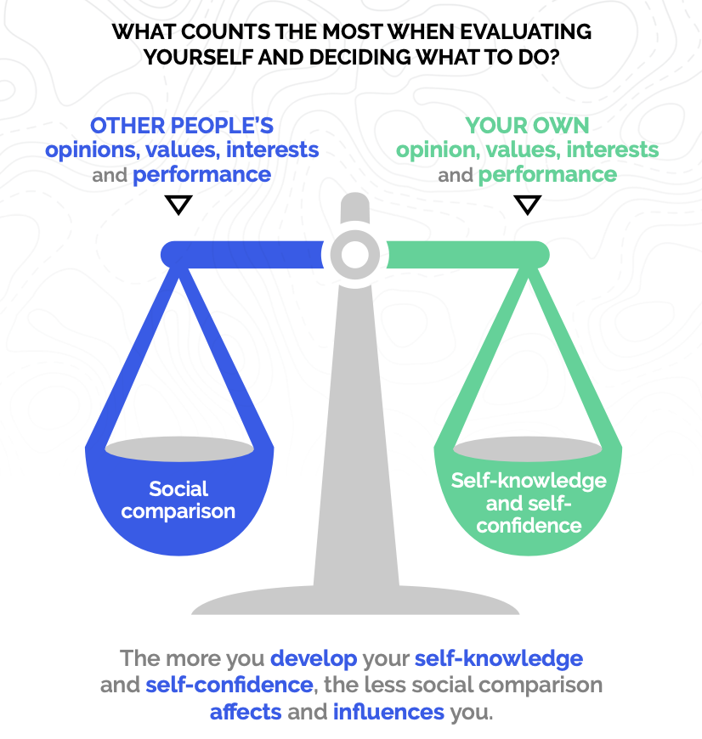
21
Between me and myself!
What is the purpose of getting to know yourself better?
Can you think of examples of situations where this was important or beneficial to you?

Slide 22
22
Your turn!
Strategies to get to know and appreciate yourself better
How do you get to know yourself? Do you have any ideas or strategies?
Give yourself the right to make mistakes, without judging yourself... Accept that it won’t be perfect.
Dare to jump in and try new experiences!
Try to look within and notice what you are experiencing and feeling, to discover what makes you happy or unhappy, what you find enjoyable or difficult.
Try to be tolerant toward yourself and others.

Slide 23
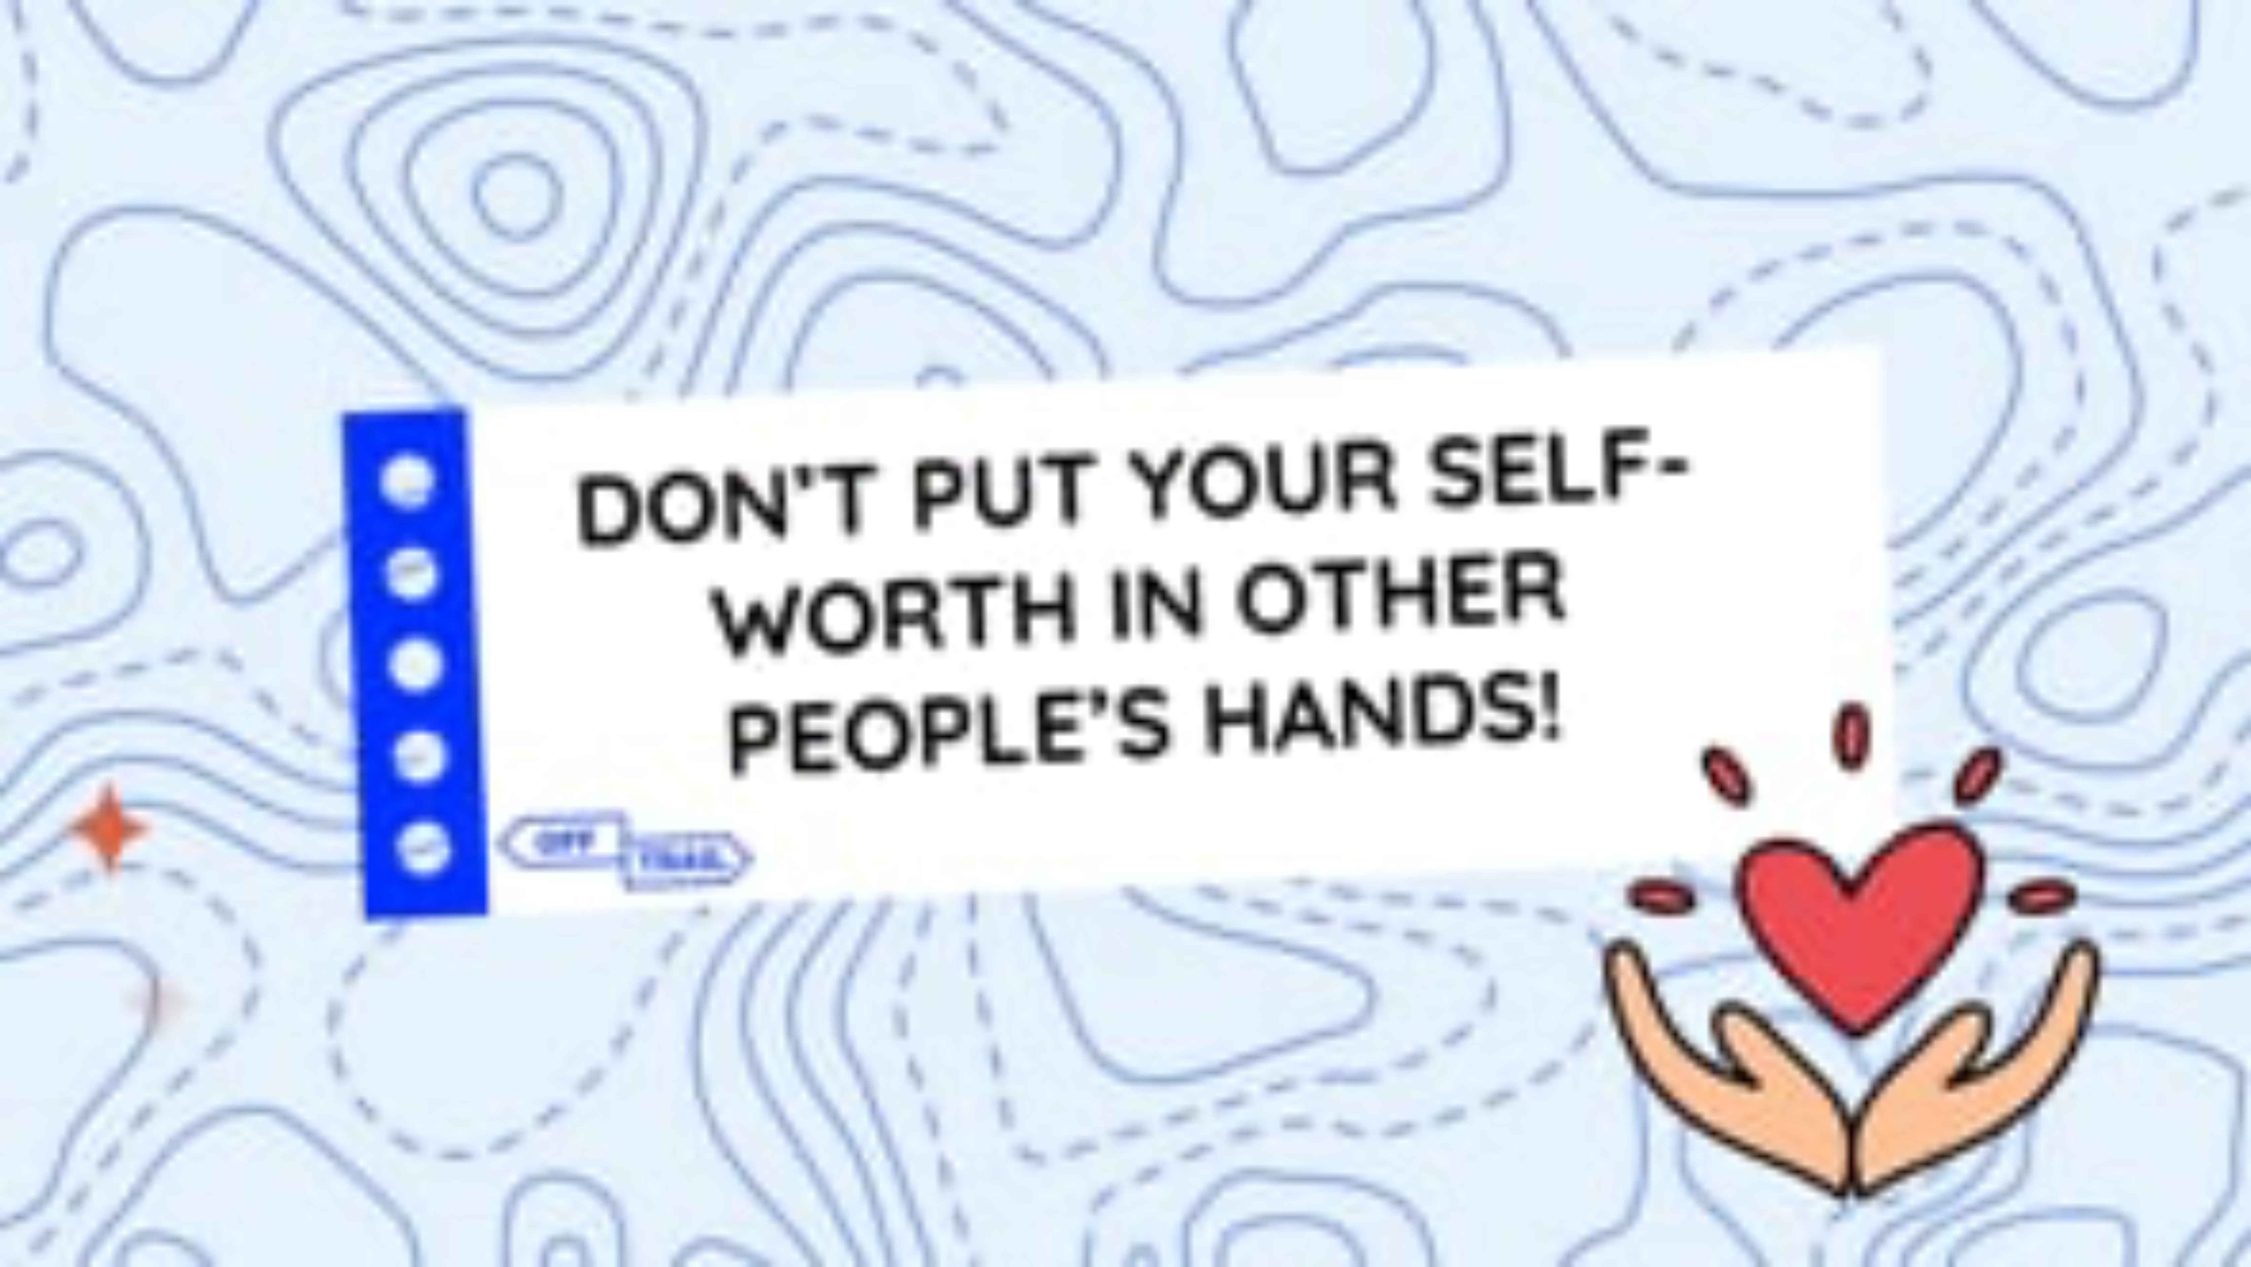
23
Educational clip – Part 2
Video clip
Notes:
NOTE!
Have your students listen to the educational clip Don't pur your self-worth in other people's hands – Part 2.
Make sure you use the same format as before.

Slide 24
24
OFF-TRAIL challenge
This week...
02
03
01
Thinking back to a situation where you caught yourself comparing yourself to others, ask yourself these questions:
Why did I feel the need to compare myself?
What did this create in me?
Did it have a helpful or harmful effect on me and on my confidence?
Pay attention to your tendency to compare yourself to others: Do you do it often? Rarely?
Use a strategy to better understand yourself and deal with social comparison.

