Slide 1





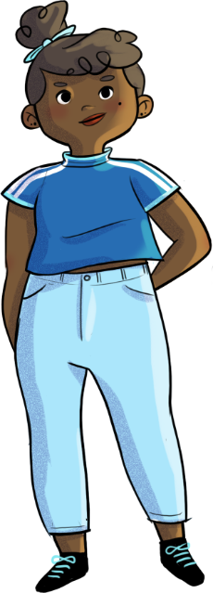


Emotions...
They’re only human!​
Text is under a CC BY-NC 4.0 licence. Graphics designed with Canva are under Canva's content licence.
© OFF-TRAIL program by Centre RBC d'expertise universitaire en santé mentale (2025), Université de Sherbrooke.

Slide 2
By the end of the workshop,
you will be able...
2
To better recognize your various emotions and understand their purpose;
To use new strategies to experience and manage your emotions
in a healthy way;
To ask for help if you need it. ​

Slide 3
3
Your emotions...
your inner weather
Emotions are spontaneous internal reactions:
joy, fear, anger, sadness, disgust, surprise, etc.
Our emotions can be said to be like our internal weather!
What is the purpose of all these emotions?​

Slide 4
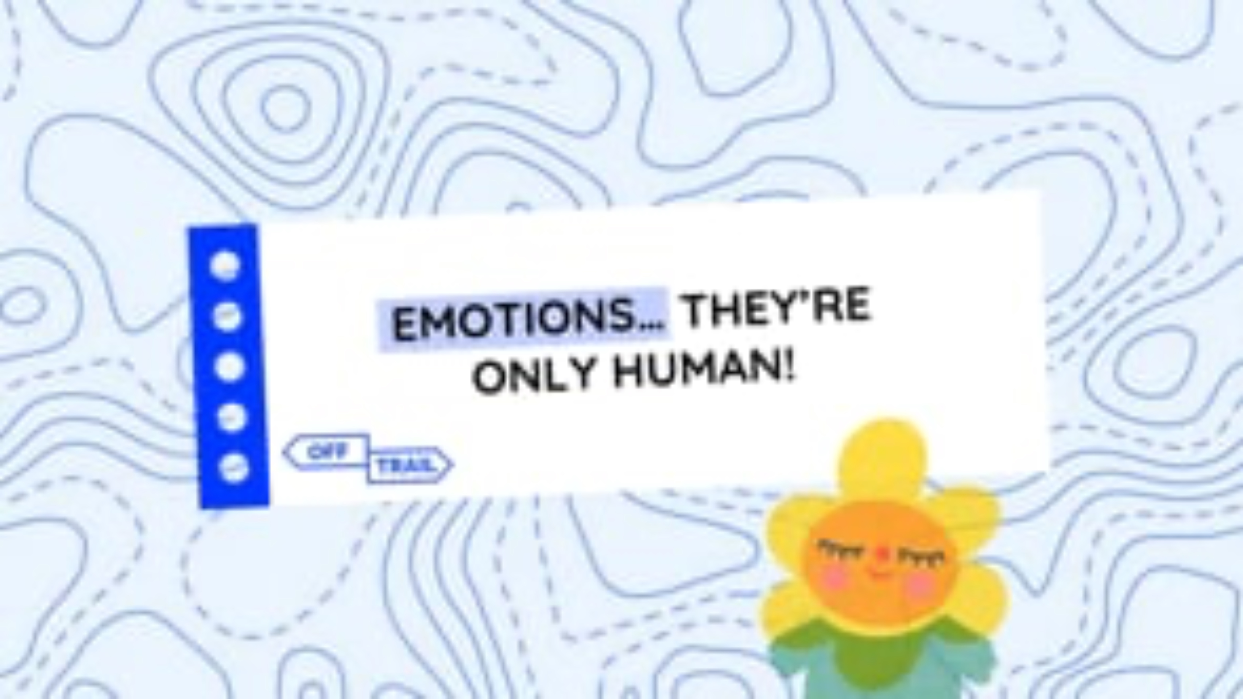
4
Educational clip – Part 1
Video clip

Slide 5
5
Explore your inner weather!​
Our emotions speak to us! ​
Much like the weather, they inform us about what is going on inside us…
Becoming aware of our emotional world (our internal weather!) helps us to better understand ourselves and regulate our emotions.​

Slide 6
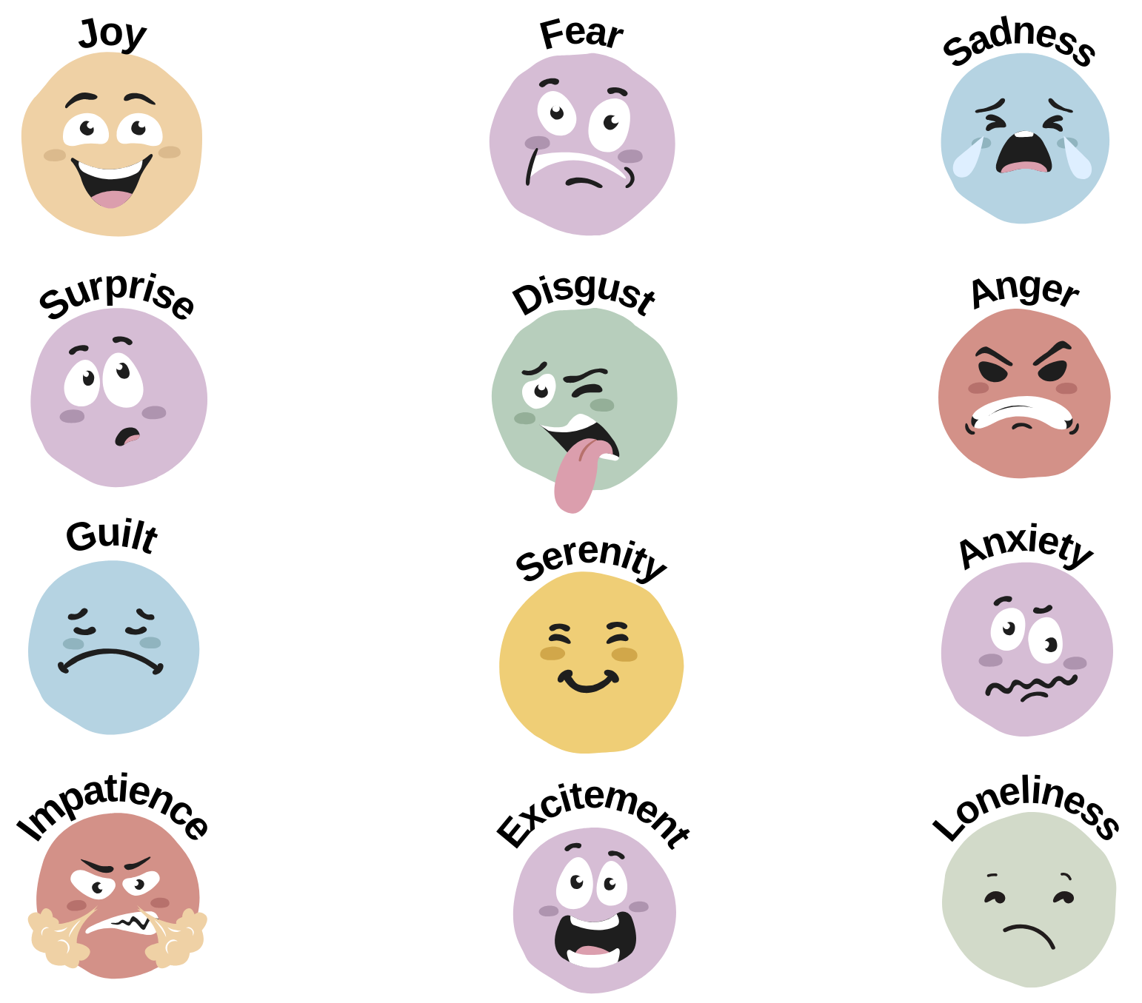
6
Explore your inner weather!​
Circle the emoji that best represents the emotion you feel.

Slide 7


Slide 8


Slide 9


Slide 10
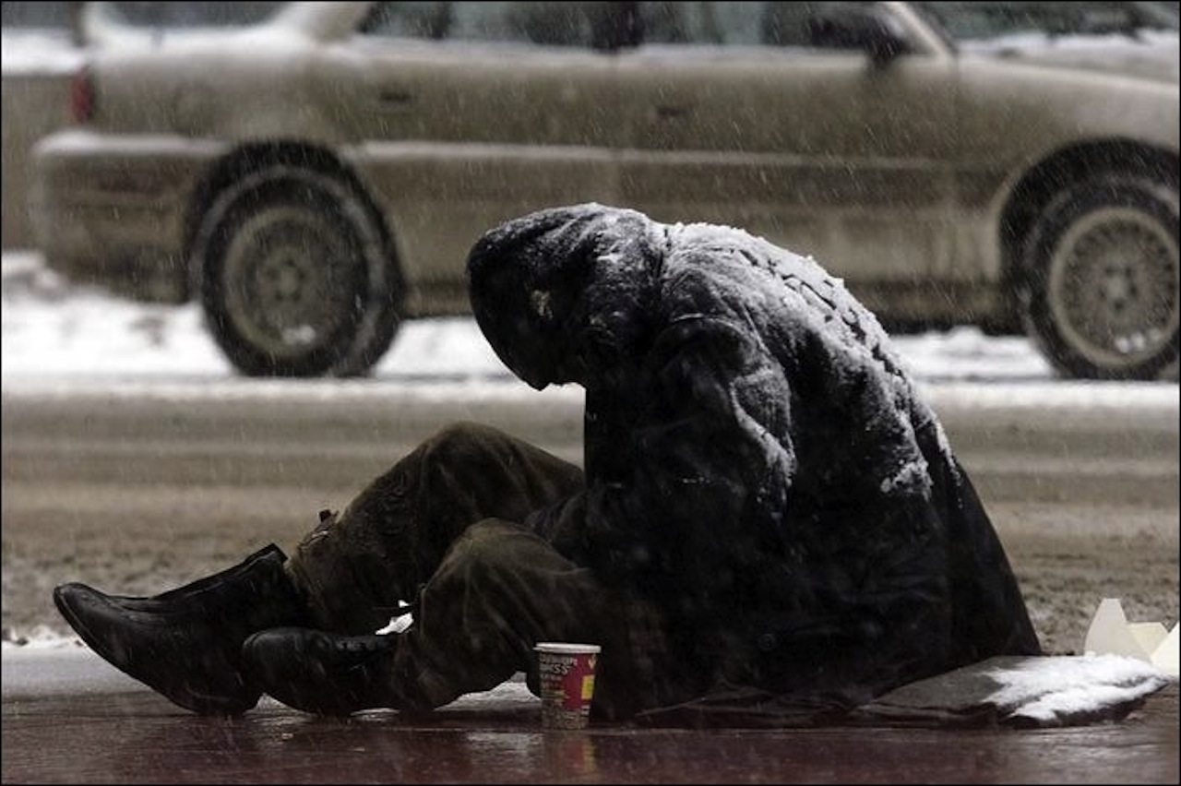

Slide 11


Slide 12


Slide 13


Slide 14


Slide 15

15
Explore your inner weather!​
Experiencing emotions is inevitable! ​
​
Even though we rarely have control over the emergence of our emotions, we do have power over how we regulate them. ​
​
Whether they’re pleasant or difficult, all our emotions have their place and their reason for being! ​
​
They all have the right to exist within us and
to be expressed... but not in just any way!

Slide 16

What stress level would you associate with each situation on your worksheet?
16
Your turn!
Express emotions in a healthy way?​
React in the heat of the moment?​
or
What is the difference between the two types of reactions?​
What are the pros
and cons of each?​
Do you have any examples?

Slide 17
An exam is a good example of a situation that should generate some stress to get you moving, without overwhelming or paralyzing you!
Your turn!
17
Strategies to regulate your internal weather​
You have power over how you experience your emotions, how you express them, and how you behave!​
Accept the situation as it is, without resisting it​
Reframe your harmful thoughts into more helpful ones​
Notice what is going on inside you​
Refocus your attention on what is important to you (needs, values and goals)​
Welcome your emotions without judging them or trying to block or deny them​
Express or release your emotions through art, sports, writing, etc.​
Look for solutions using your strengths ​
Be attentive to the needs that lie behind your emotions​
Ask for help​
Be compassionate and kind toward yourself ​

Slide 18

An exam is a good example of a situation that should generate some stress to get you moving, without overwhelming or paralyzing you!
18
Two heads are better than one!​
Why is it often said that talking about our emotions and asking for help is a taboo subject?​
How for help too soon or too often increase anxiety? ​

Slide 19

19
Two heads are better than one!​
Who to ask for help and how?​
In teams, answer one of the following 3 questions.
What is stopping you from asking for help (obstacles, fears)?​
What are the positive aspects of asking for help (pros)?​

Slide 20

20
Two heads are better than one!​
Ask a friend if they’d like to do an activity
or go for a walk together.
Text, call or directly talk to a friend, adult or parent you feel you can confide in.
Who to ask for help and how?​
Meet with a school counsellor.​
Seek advice, guidance or support
in a difficult situation.
Contact official resources: school counsellors, CLSCs, Tel-jeunes, Alloprof, youth centres, etc.​

Slide 21
21
Two heads are better than one!​
What is stopping you from asking for help (obstacles, fears)?​
Fear of being judged by others.​
Not wanting others to know that you have a problem.​
Fear of appearing vulnerable or weak.​
Difficulty trusting others.​
Feeling embarrassed or uncomfortable
asking for help.​
Being hard yourself for needing help, feeling ashamed.​
Believing that you are invincible, that you can do everything
on your own.
Not knowing where, when, how and whom
to ask for help.​
Believing that the problem will sort itself out (magical thinking!).
Fear of not being welcomed, of bothering others,
of being rejected.​

Slide 22
22
Two heads are better than one!​
What are the positive aspects of ​
asking for help (pros)?
Feeling supported, not being alone
when facing a challenge.
Finding new solutions to address the problem.​
Getting perspective, seeing the situation differently.​
Having someone you can rely on.​
Expanding your means and resources.​
Regaining self-confidence.​
Discovering new strengths.​
Feeling relief, calm.​
Creating a sense of mutual support and solidarity.​

Slide 23
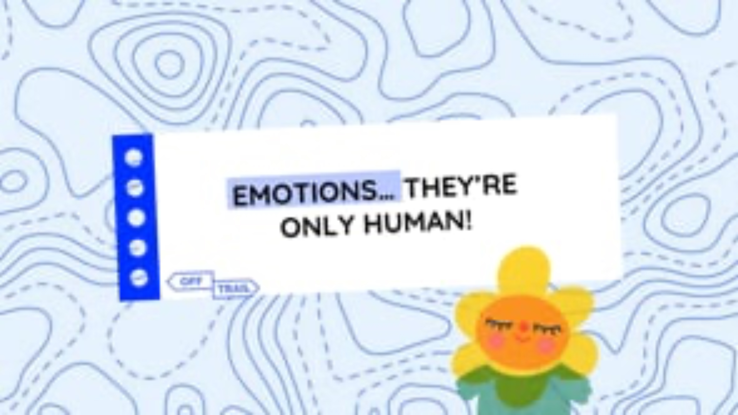
23
Educational clip – Part 2
Video clip
Notes:
NOTE!
You play the educational clip Emotions... they're only human! – Part 2 for your students.
Make sure you use the same format as before.

Slide 24
24
OFF-TRAIL challenge
This week, during a difficult situation...​
01
02
Use an emotion regulation strategy to better cope with the difficult situation.​
Identify the emotions you felt in response to this difficult situation.​

