Slide 1








The fear of being afraid...
When anxiety takes over!
Text is under a CC BY-NC 4.0 licence. Graphics designed with Canva are under Canva's content licence.
© OFF-TRAIL program by Centre RBC d'expertise universitaire en santé mentale (2025), Université de Sherbrooke.

Slide 2
By the end of the workshop,
you will be able to...
2
Distinguish between stress and anxiety;
Understand the concepts of comfort zone, avoidance and exposure;
Recognize situations that cause you more anxiety and recognize your signs of stress and anxiety;
Use strategies to calm yourself and expose yourself to anxiety-provoking situations.

Slide 3
3
Stress... anxiety...
What’s the difference?
Stress is always negative...
There’s no difference between stress and anxiety...
Anxiety is a fear of being afraid...
Anxiety is normal.
If you have anxiety now, you’ll have it for the rest of your life.

Slide 4
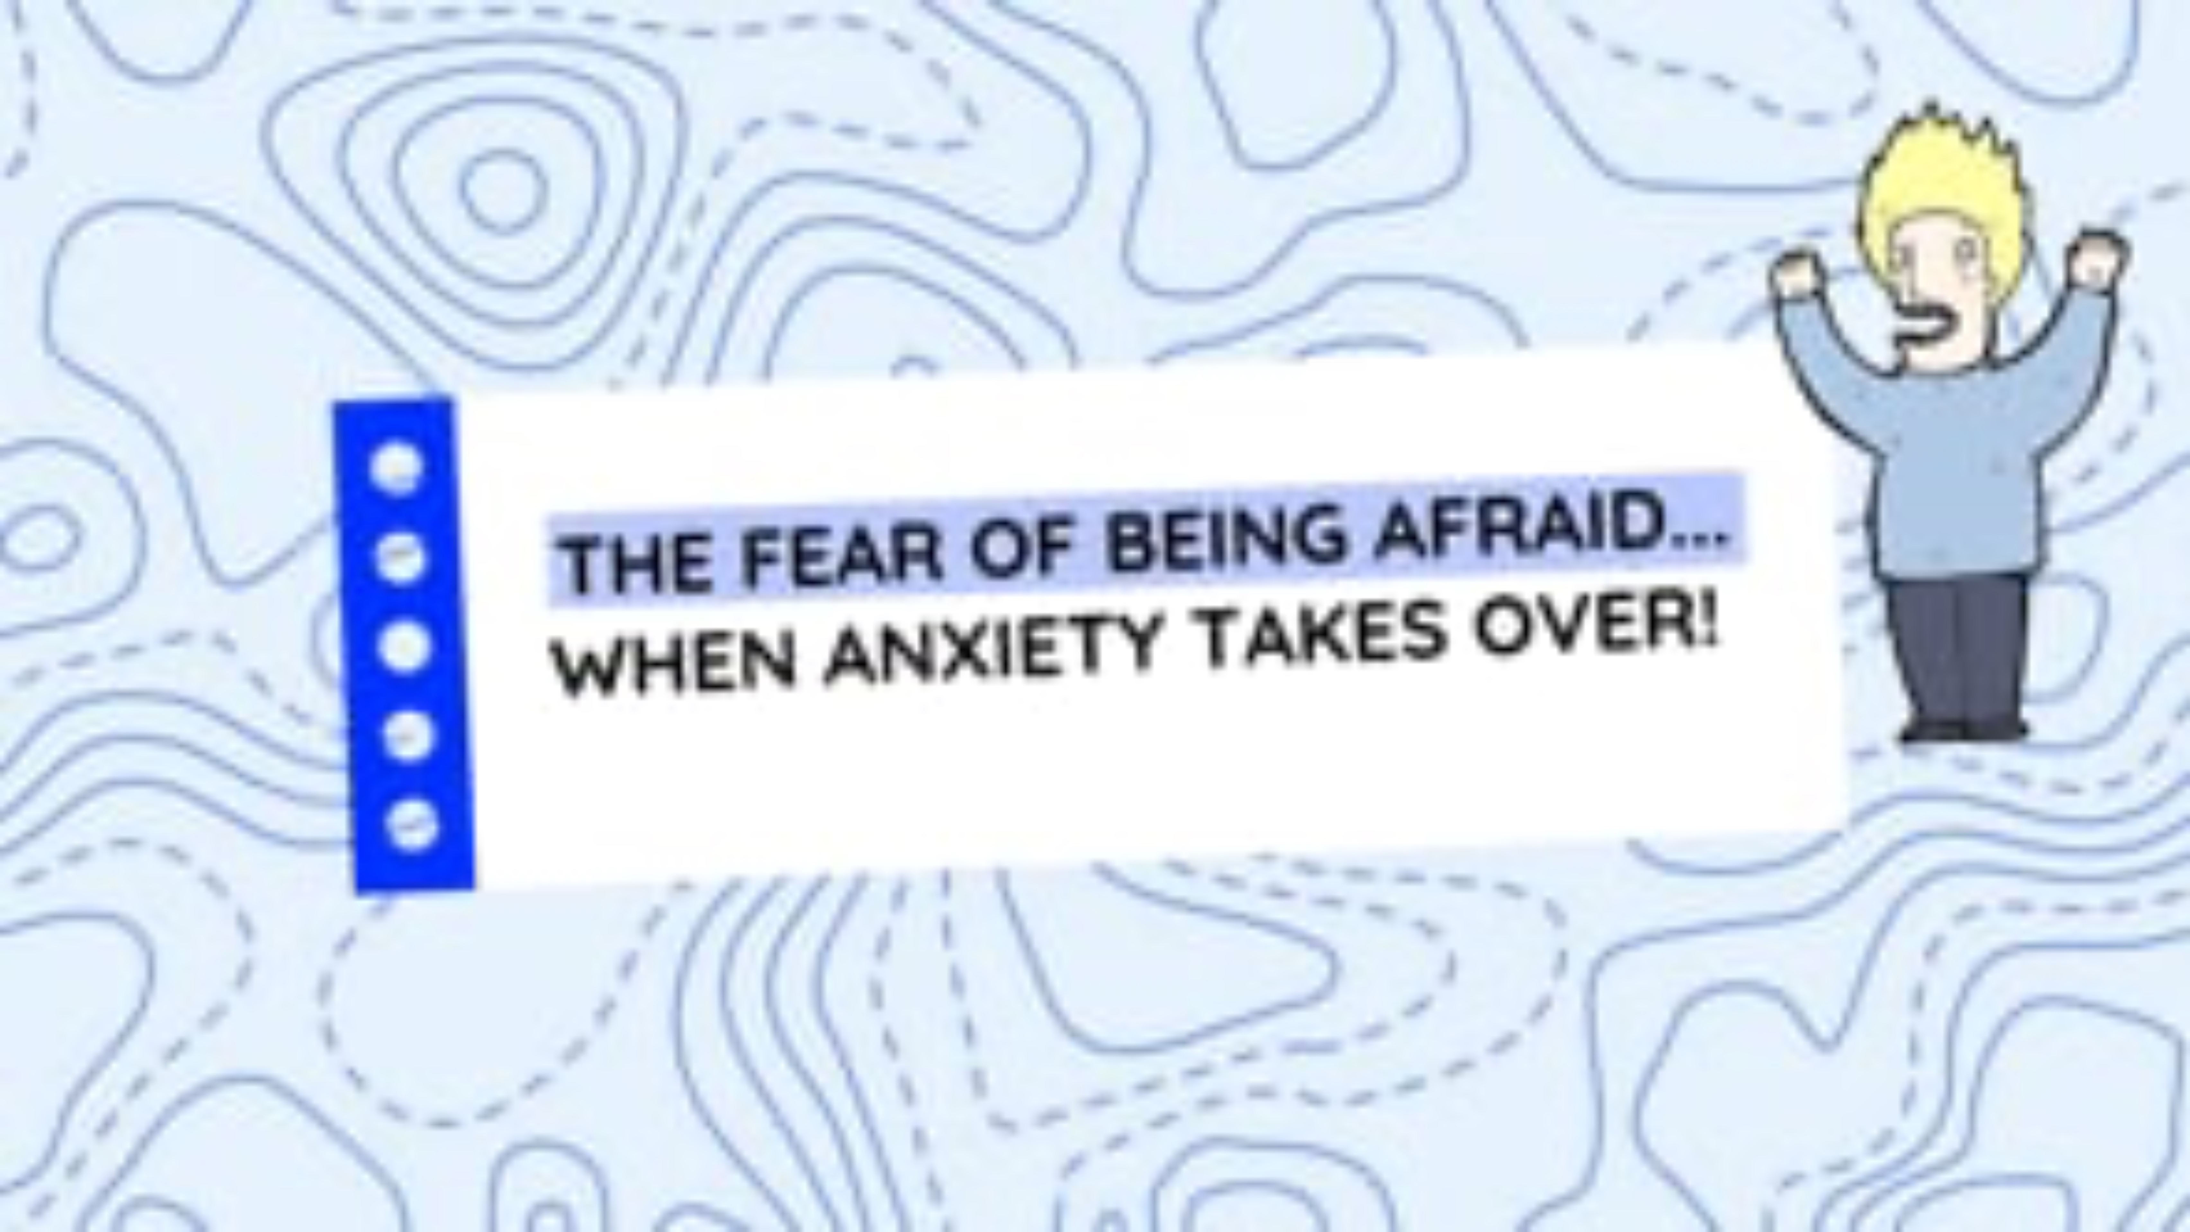

4
Educational clip – Part 1
Video clip
Notes:
NOTE!
You play the educational clip When anxiety takes over – Part 1 for your students.
To do so, choose the format that you consider most appropriate based on the needs and characteristics of your students, from the following two options.
Note that the two formats contain essentially the same information

Slide 5
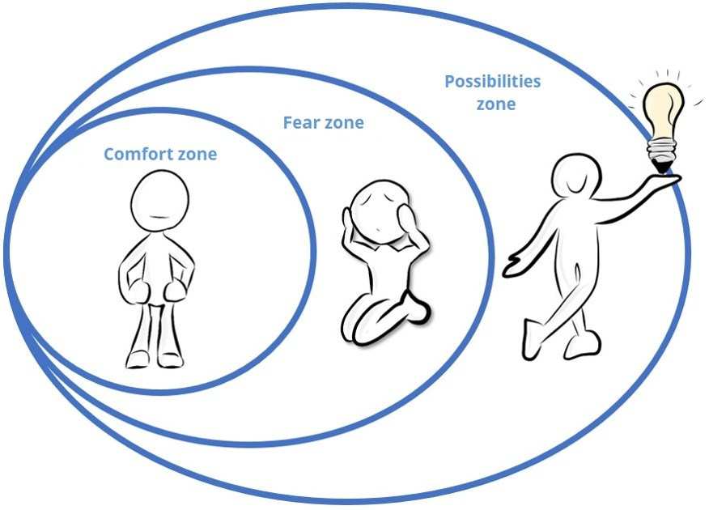
5
My comfort zone
Your comfort zone is where, in your life, you feel good or on familiar ground.
It’s the relationships, events and environments where you know how to react, where you don't ask too many questions.
It’s the zone where you feel COMFORTABLE.

Slide 6
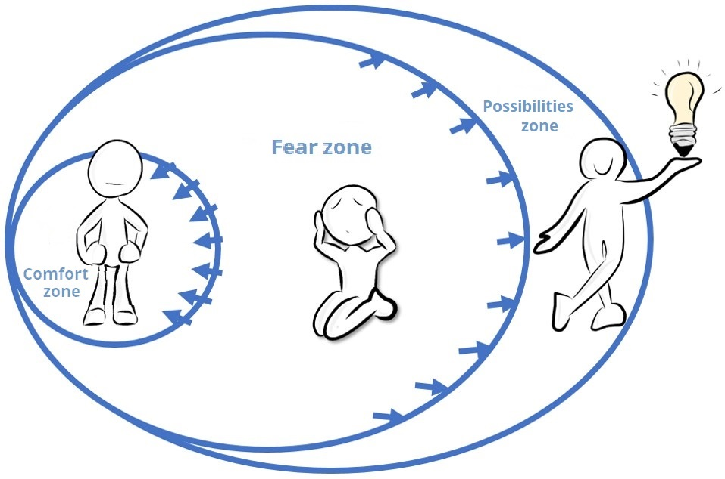
6
My comfort zone
Anxiety can occur when you step outside your comfort zone or even when you think about situations that take you outside your comfort zone.
So you want to avoid this situation and return to your comfort zone. This is called avoidance.
You then have to push through your fear zone... which is rather uncomfortable!

Slide 7
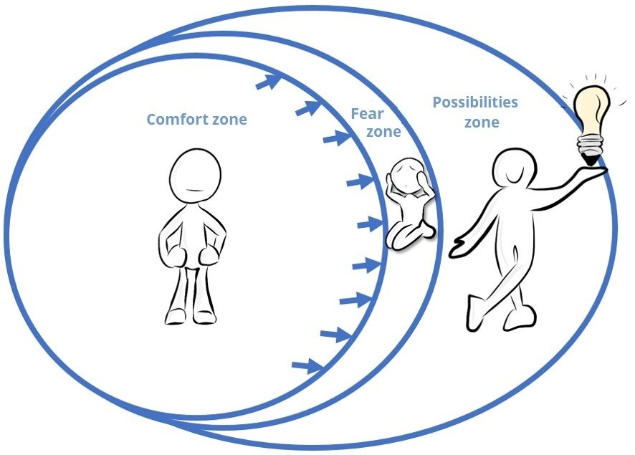
7
My comfort zone
Remember!
Anxiety is not dangerous.
It is temporary.
It always eventually goes away!
The more you face your fears, the more they will diminish and even disappear.
This is called exposure!

Slide 8


8
Intolerances that distort reality...
Each person has different tolerance levels for the situations they encounter... A bit like food intolerances!
When it comes to anxiety, these intolerances are like lenses that distort reality.
Why can the same situation be very anxiety-provoking
for one person and not at all for another?

Slide 9

Intolerances that distort reality...
9
Intolerance to uncertainty
Intolerance to potential danger, change and anything new.
“I struggle to function in new, ambiguous or unpredictable situations.”

Slide 10
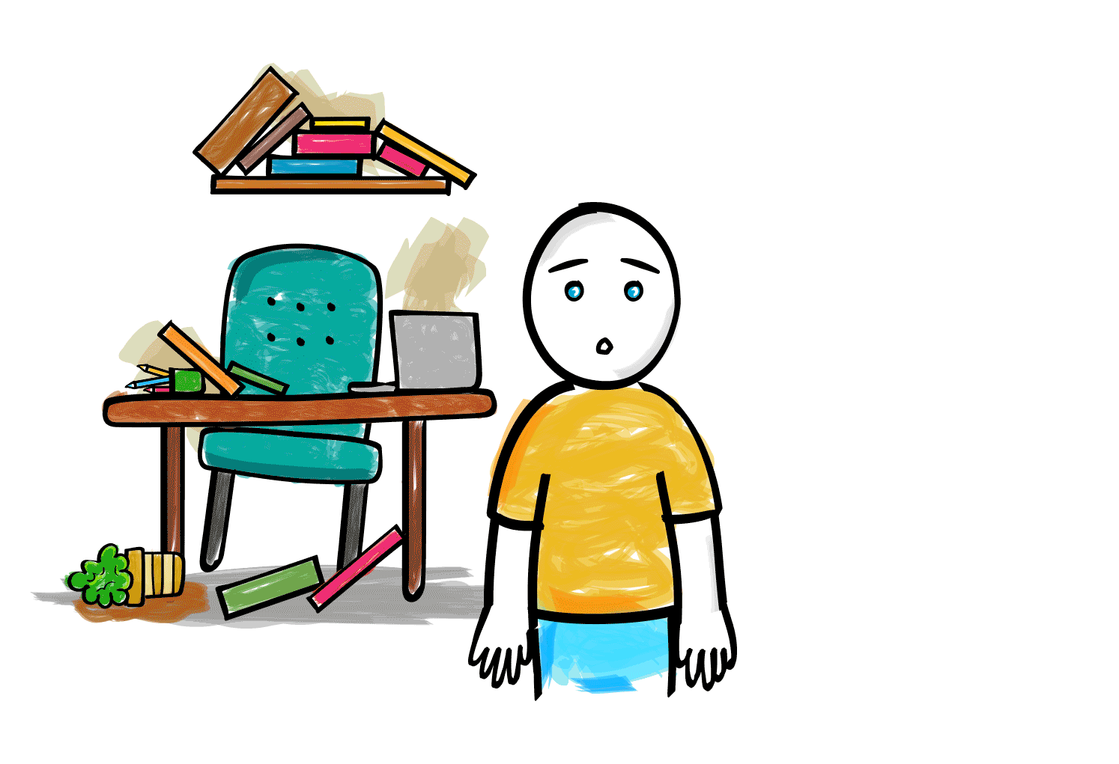
Intolerances that distort reality...
10
Perfectionism
Intolerance to the risk of making a mistake, to imperfection, and to guilt. Tendency to criticize one’s own achievements.
“I’m not satisfied unless it’s perfect.”

Slide 11

Intolerances that distort reality...
11
Excessive responsibility
Intolerance to consequences that might happen to or affect others;
you think it’s your fault because you didn’t do anything to prevent them.
“I feel guilty all the time.”

Slide 12

Intolerances that distort reality...
12
Fear of being judged by others
Intolerance to the possible judgment and criticism of others, mockery and
being laughed at.
“I often feel that
others are judging me.”

Slide 13

Intolerances that distort reality...
13
Intolerance to psychological and physical discomfort
The tendency to worry excessively about negative emotions, unpleasant physical sensations, and symptoms caused by anxiety.
“Something’s wrong with my body!”

Slide 14
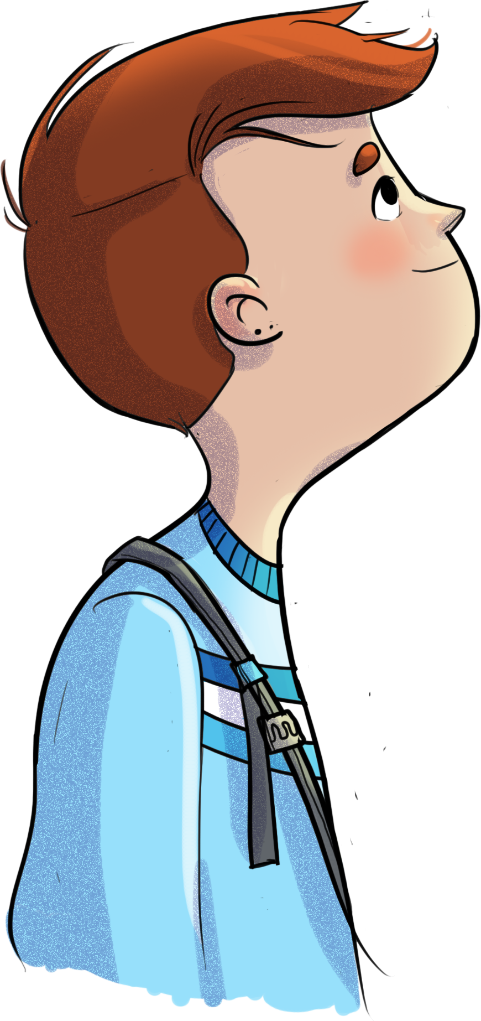
Intolerances that distort reality...
14
What intolerances does Sacha have?
What about you?

Slide 15
15
Your turn!
Strategies to help expose you to the situation
Accept that you can’t control everything.
See challenges and mistakes as opportunities to learn.
Maintain positive self-talk about your personal worth.
Put the actual risks of a situation into perspective.
What intolerances does Sacha have?
Question your thoughts and perceptions.
Express your boundaries to others, learn to say “no.”
Let go of what is not in your control.
Refocus on yourself and your needs.
Focus on the process, efforts and progress rather than on the results.
Remember that emotions and sensations in your body are normal and not dangerous.
Gradually expose yourself to anxiety-provoking situations.

Slide 16
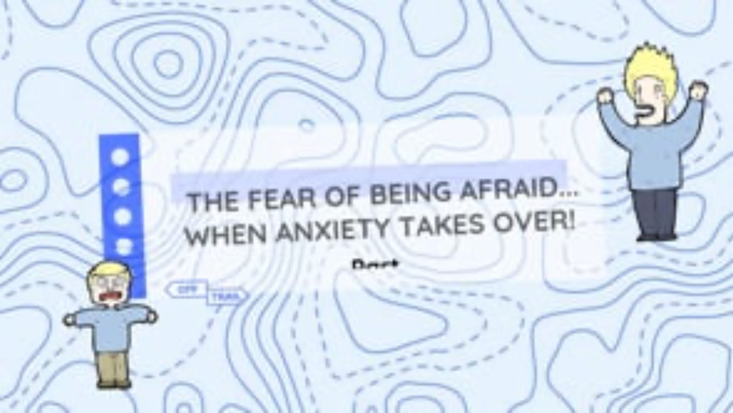

16
Educational clip – Part 2
Video clip
Notes:
NOTE!
You play the educational clip When anxiety takes over – part 2 for your students.
Make sure you use the same format as before.

Slide 17
17
OFF-TRAIL challenge
This week, when faced with an anxiety-provoking situation...
02
01
Try applying at least two strategies to calm yourself and to expose yourself to the situation, at your own pace.
Notice your reactions to certain situations that cause you to react strongly (intolerances).

