Slide 1





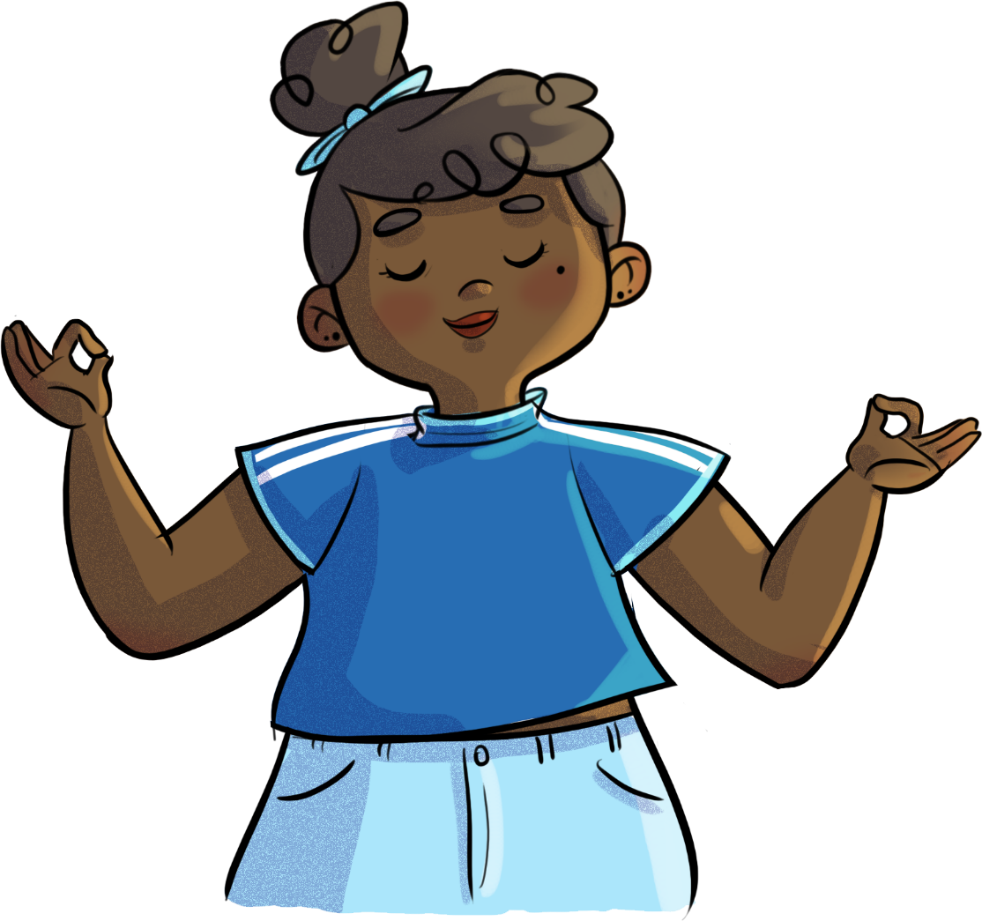


TOO MUCH IS JUST
AS BAD AS NOT ENOUGH!
WHEN STRESS PLAYS TRICKS ON ME...
Text is under a CC BY-NC 4.0 licence. Graphics designed with Canva are under Canva's content licence.
© OFF-TRAIL program by Centre RBC d'expertise universitaire en santé mentale (2025), Université de Sherbrooke.

Slide 2
2
By the end of the workshop,
you will be able to...
Recognize your signs of stress;
Understand what stress is and its purpose;
Better understand your own reactions to stress;
Use new strategies to manage your stress.

Slide 3
3
Ready, set... improv!
A quick improv exercise to get started!
Close your eyes if you want to...
What physical sensations do you feel?
What emotions are you experiencing?
What are you thinking about?
And now, time
to pick a name!

Slide 4
4
Ready, set... improv!
A quick improv exercise to get started!
Why is it important to recognize
your signs of stress?
How can this help you in life?
The more aware we are of our signs of stress, the more easily we can identify situations that cause us stress and find strategies to accept and manage it.

Slide 5
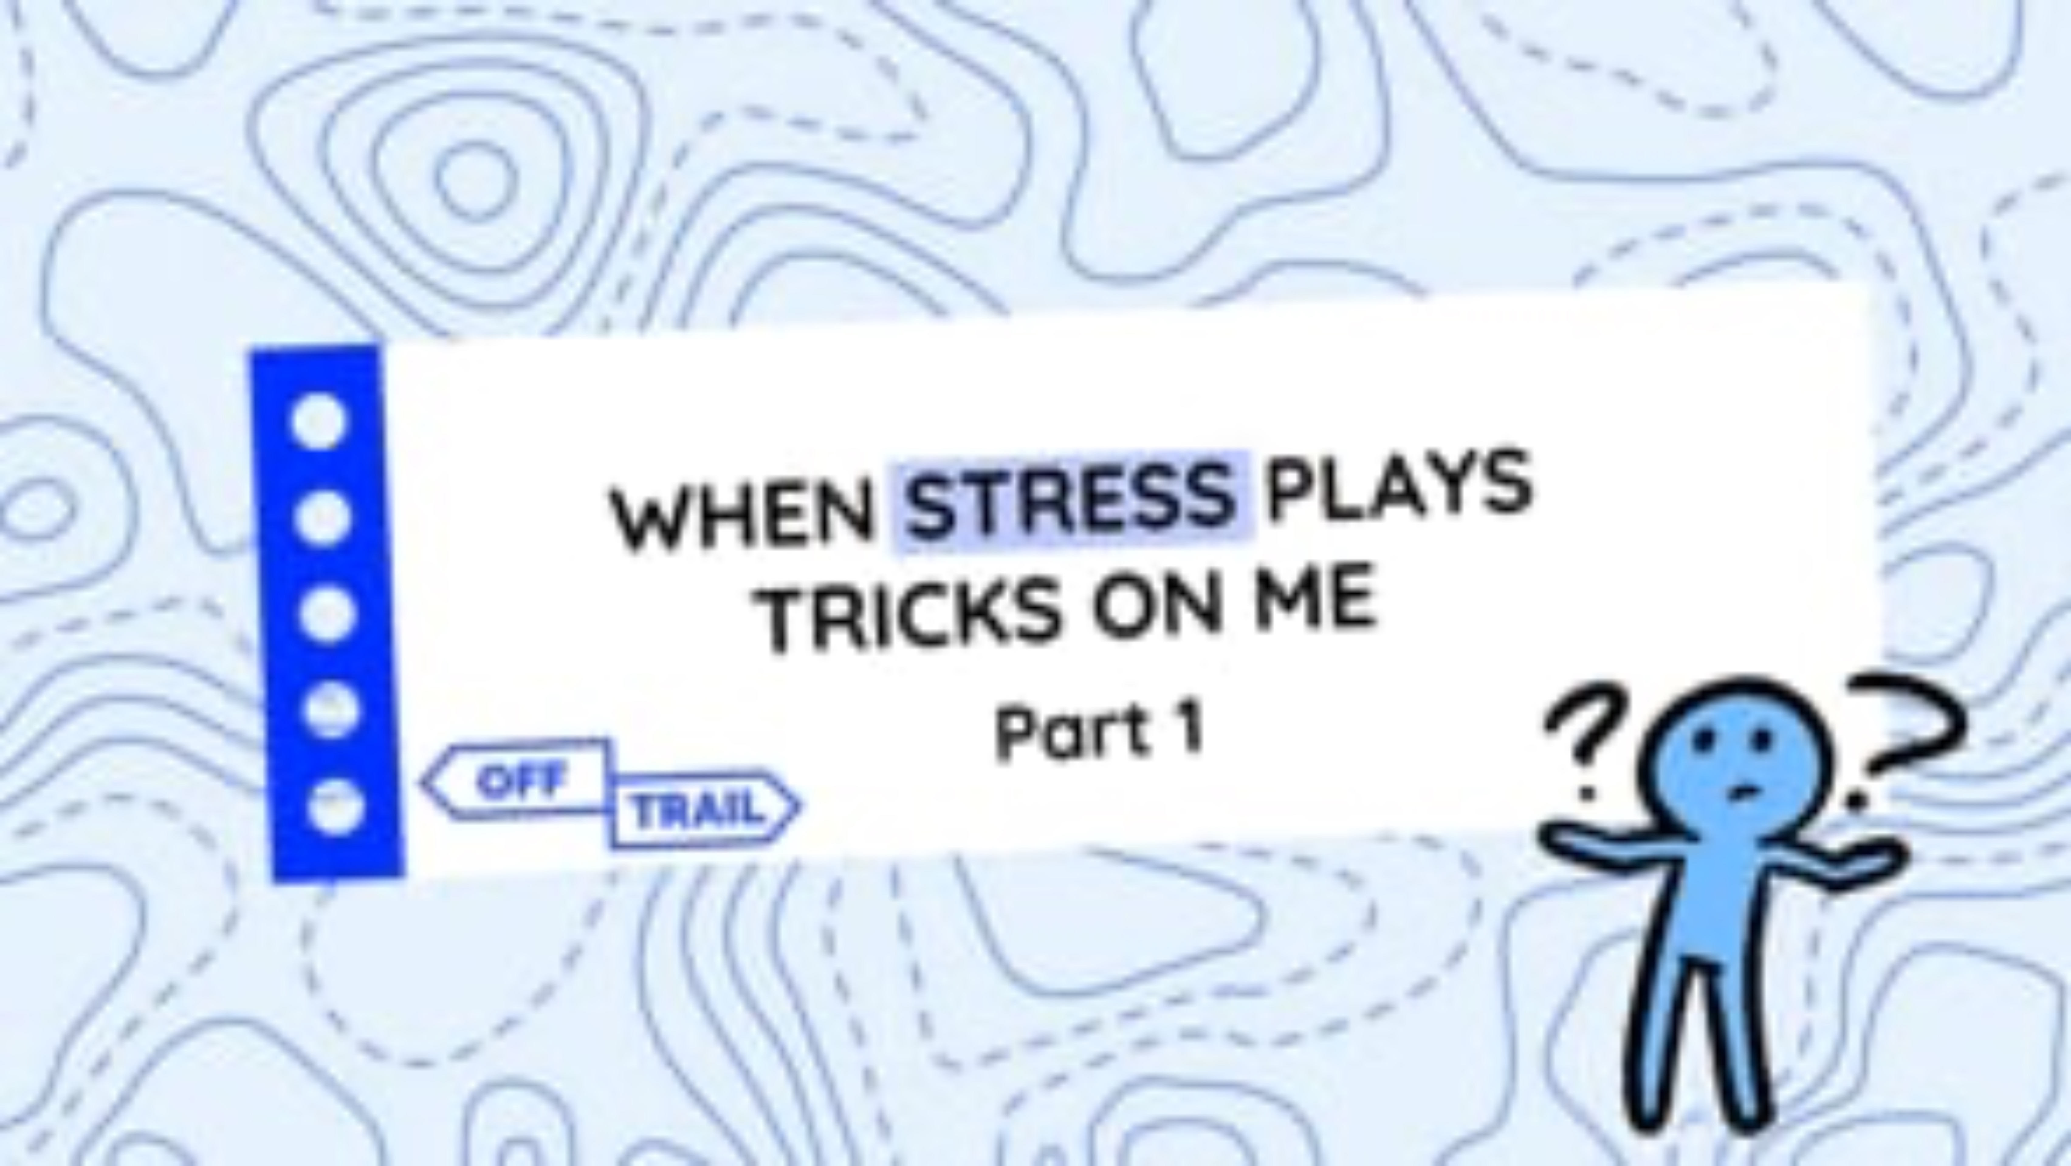
5
Educational clip – Part 1
Video clip

Slide 6
6
Stress… Good or bad?
Stress is a NORMAL alarm reaction
to a real, concrete situation.
This reaction helps ensure the survival of the species, and therefore allows you to respond appropriately
when faced with a danger.

Slide 7
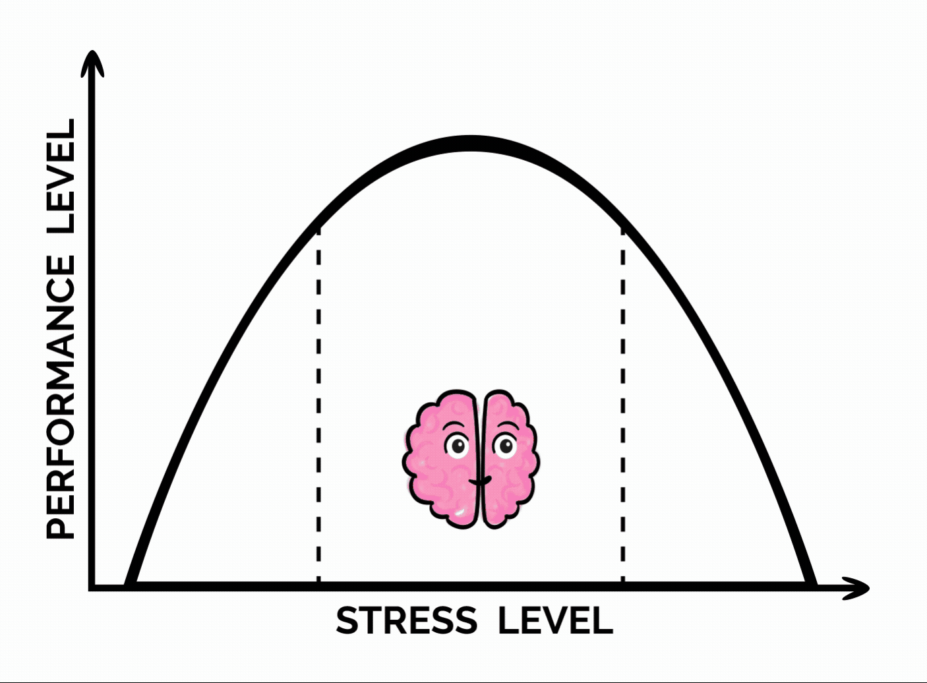
7
Stress…
Good or bad?
No stress or too little stress can cause you to fail to perceive the presence of danger in a situation, to let down your guard, and to under-react.
Too much stress (built-up, prolonged or excessive stress) can harm your balance, health and well-being.
A healthy level of stress (well balanced and in reasonable quantities) can be useful, motivate you, and even improve your performance.

Slide 8

8
Stress… Good or bad?
Can you think of examples of situations where an absence of stress led to negative consequences?
Can you think of examples of situations where you experienced too much stress?
Can you think of examples of situations where stress was useful?

Slide 9

9
Active break
Perform the movements in time with your in-breaths and out-breaths.
Move and stretch while focusing on your breathing.

Slide 10
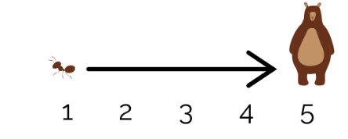
Which stress level does each situation on your worksheet correspond to?
Our brain plays tricks on us!
10
Sometimes our brain reacts to certain stressful situations as though we were face to face with a bear... instead of the tiny ant that’s actually
in front of us!
What stress level would you associate with each situation on your worksheet?
Low or no stress
Very stressful

Slide 11
Our brain plays tricks on us!
11
  What do you notice on your worksheet?
  Which did you circle most often:
  bear, ant or somewhere in between?
  Was it mostly even,
  depending on the situation?
  What does this tell you about yourself?

Slide 12
An exam is a good example of a situation that should generate some stress to get you moving, without overwhelming or paralyzing you!
Our brain plays tricks on us!
12
If, most of the time, you react as if you were faced with a tiny ant, you risk losing interest and motivation in everyday life, or even putting yourself in danger.
If, most of the time, you react as if you were faced with a bear, you risk exhausting yourself in the long run.
An exam is a good example of a situation that should generate some stress to get you moving, without overwhelming or paralyzing you!

Slide 13
Our brain plays tricks on us!
13
Do you have an example of a situation where your reaction to stress was not appropriate to the circumstances (either too much or too little stress)?
Share your example
with others!

Slide 14

14
Your turn!
Write down a situation that you consider stressful.
100%
anonymous
What strategies could you put in place to manage your stress, without avoiding the situation?

Slide 15
Your turn!
15
Take a warm bath or a relaxing shower
Write in a diary or journal
Strategy to manage stress
See friends
Stop, take a break
Play soft, gentle music
Practise mindfulness
Exercise
Do some yoga
Get in touch with nature
Confide in someone, ask for help
Do an artistic or creative activity
Do a breathing exercise
Take a step back, put things in perspective
(see the situation differently)
Spend time with an animal that makes you feel good

Slide 16
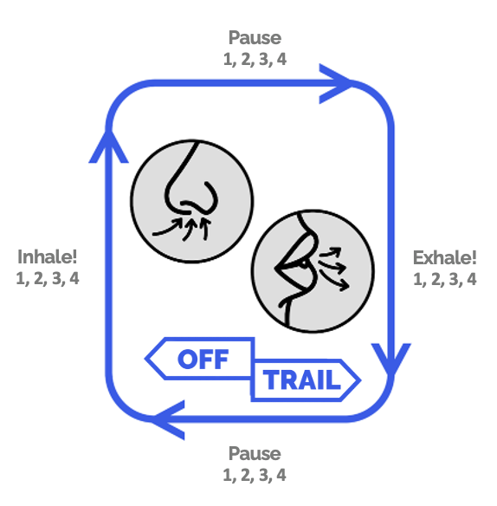
16
Your turn!
Box breathing

Slide 17
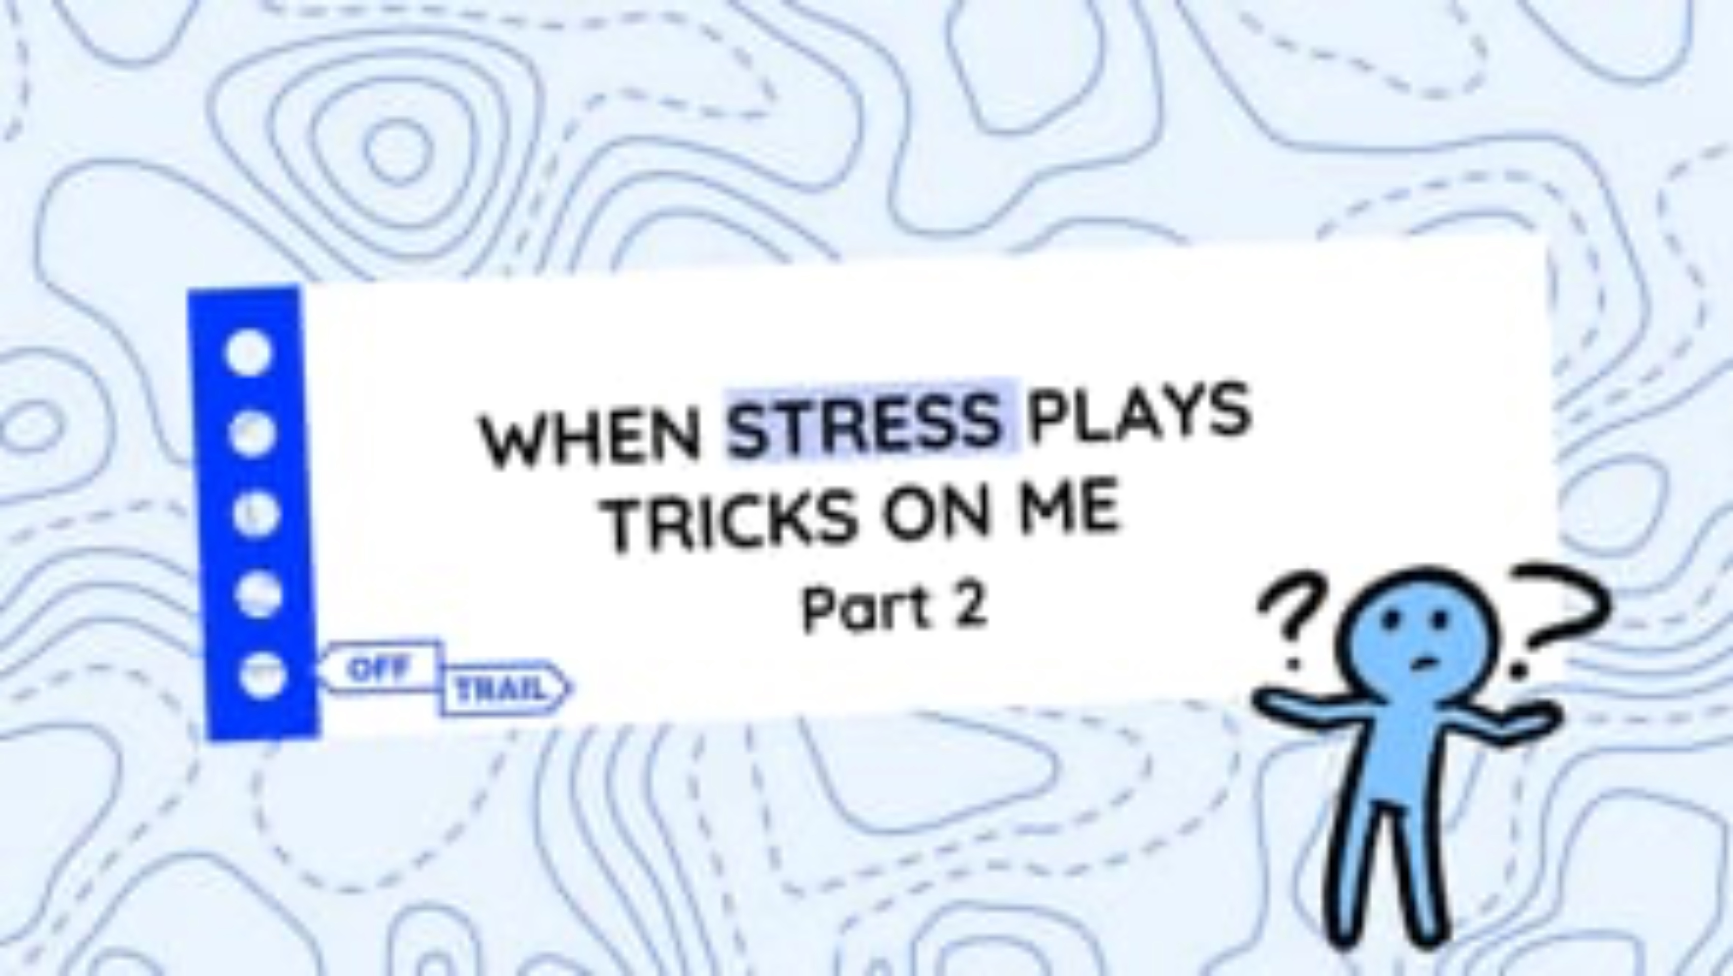
17
Educational clip – Part 2
Video clip

Slide 18
18
OFF-TRAIL challenge
This week, when faced with a stressful situation...
01
03
02
Try one or two strategies to manage your stress, without avoiding the situation!
Identify your stress level.
Pay attention
to your signs
of stress
(sensations, emotions
and thoughts).

