Slide 1
Expedition - Parent component

Slide 2

Workshop 1
My child’s anxiety... how can I help them step outside of their comfort zone?

Slide 3
Objectives
At the end of the workshop, you will:
Get to know the facilitator and the other group members;
Understand the program objectives and the concept of comfort zone;
Be able to identify your child’s avoidance behaviours;
Understand the link between thoughts, emotions, sensations, and behaviours;
Be able to ask your child questions to help them reflect on certain thought patterns.

Slide 4
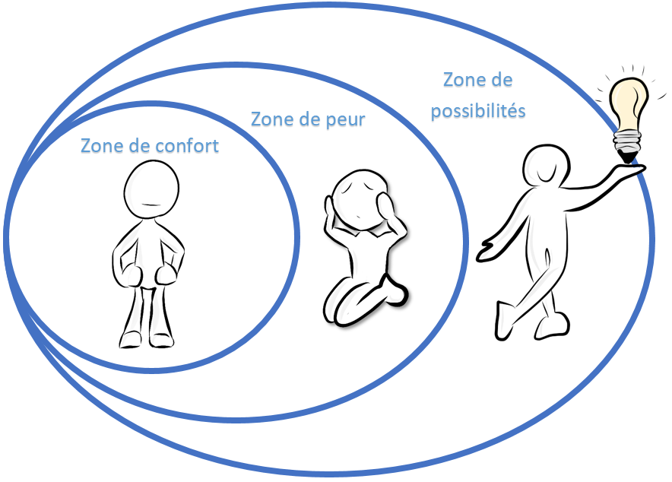
Comfort zone
Growth zone
Fear zone
Comfort zone

Slide 5
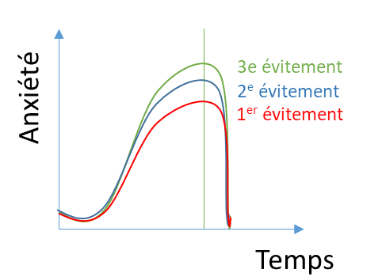
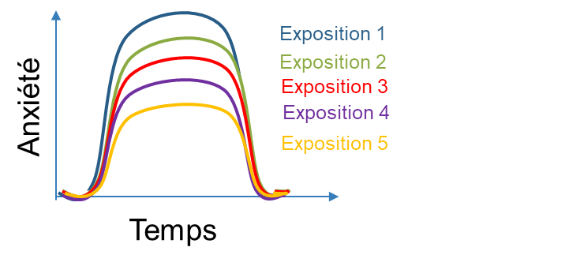
Avoidance and exposure strategies
3rd avoidance
2nd avoidance
1st avoidance
Exposure 1
Exposure 2
Exposure 3
Exposure 4
Exposure 5
Anxiety
Anxiety
Time
Time

Slide 6
To expand their comfort zone, your child will learn to:
My possibility zone
Fear zone
My comfort zone
Reformulate my thoughts
Manage my emotions
Reformulate their thoughts;
Manage their emotions;
Take action;
Adopt positive lifestyle habits;
Use stress management strategies
Nurture and properly use their social network.
Me
Use stress management strategies
Take action
Nurture and use my social network
Adopt positive lifestyle habits

Slide 7
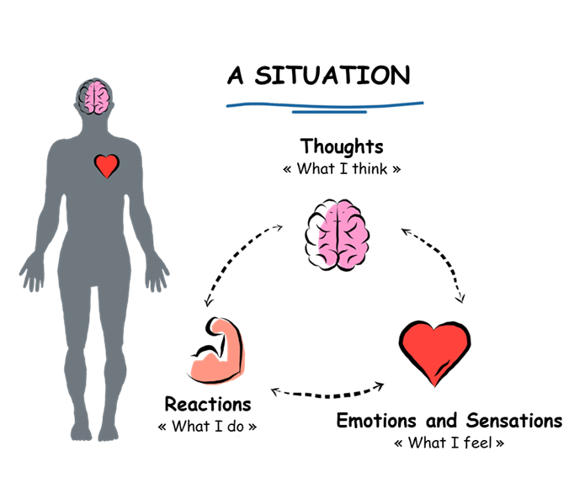
What's going on inside me?

Slide 8
Workshop 2
The accommodation trap

Slide 9
Objectives
At the end of the workshop, you will be able to:
Understand mindfulness and its benefits;
Identify your child’s type of intolerance;
Understand the concept of accommodation;
Target accommodating behaviours that you use;
Replace your accommodating behaviours with new solutions;
Discuss the necessary changes with your child.

Slide 10

Introduction to mindfulness
https://www.youtube.com/watch?v=_NC86pJWA7k

Slide 11

Mindful breathing
https://sante-mentale-jeunesse.usherbrooke.ca/wp-content/uploads/2022/08/Medit_Mindful-Breathing.mp3

Slide 12
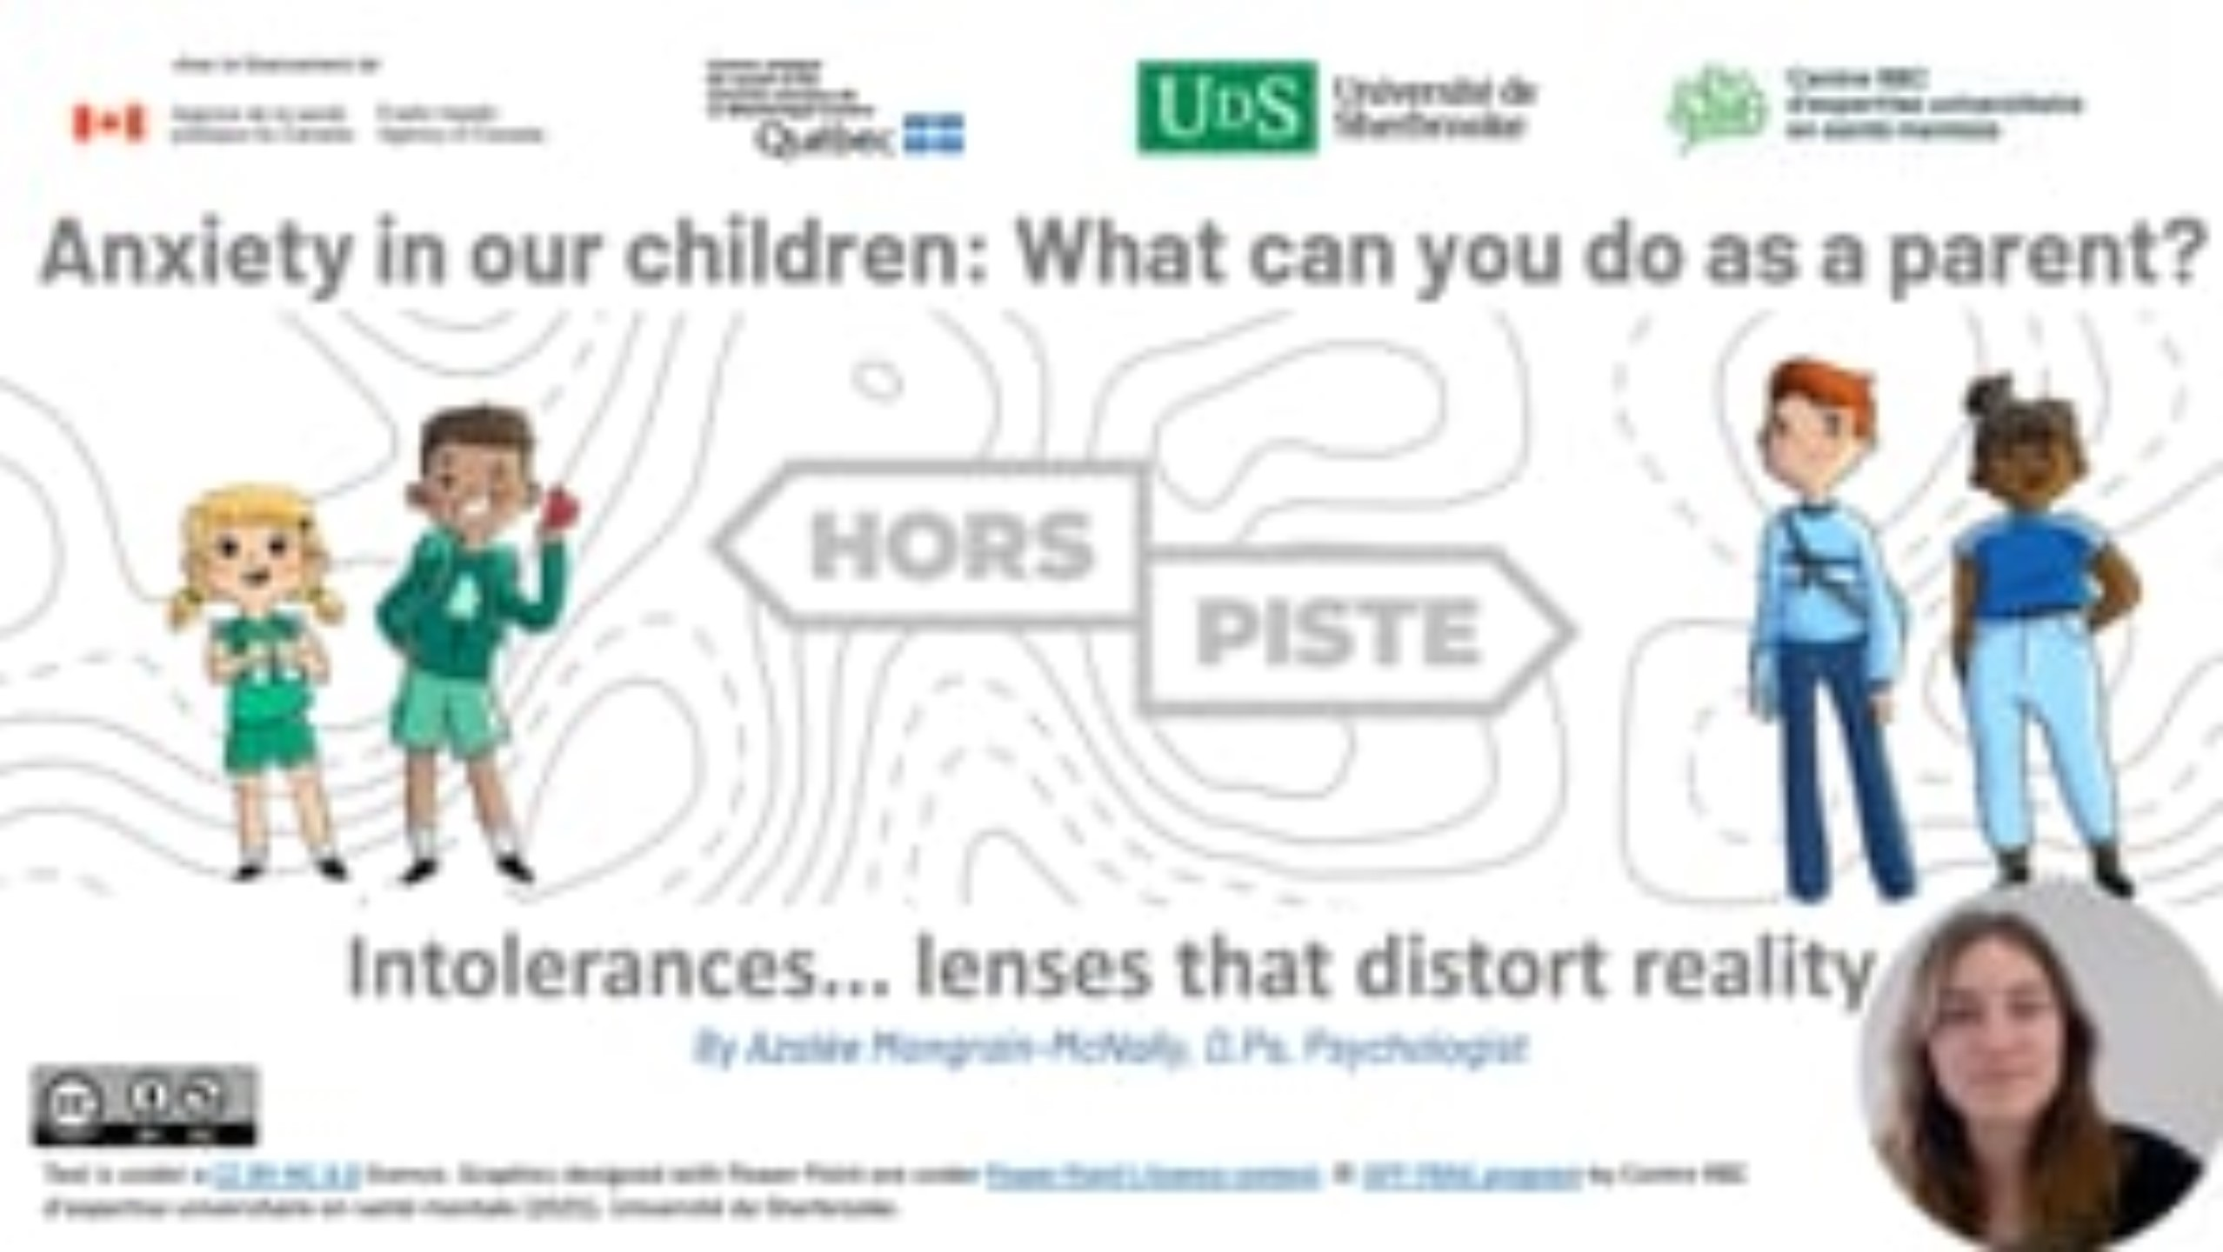
Intolerances… glasses that distort reality!
  https://vimeo.com/1113621854

Slide 13
Workshop 3
Preventing anxiety on a daily basis

Slide 14
Objectives
At the end of the workshop, you will be able to:
Identify positive and negative lifestyle habits;
Identify stress management strategies;
Take steps to help your child apply their helpful lifestyle habits and stress management strategies;
Review your progress and accomplishments;
Implement strategies to prevent your child from relapsing.

Slide 15
And after…?
Resources are available in your region:
CLSC
Community organizations
Your child’s school
Parent help line: https://www.teljeunes.com/en/parents

