Slide 1
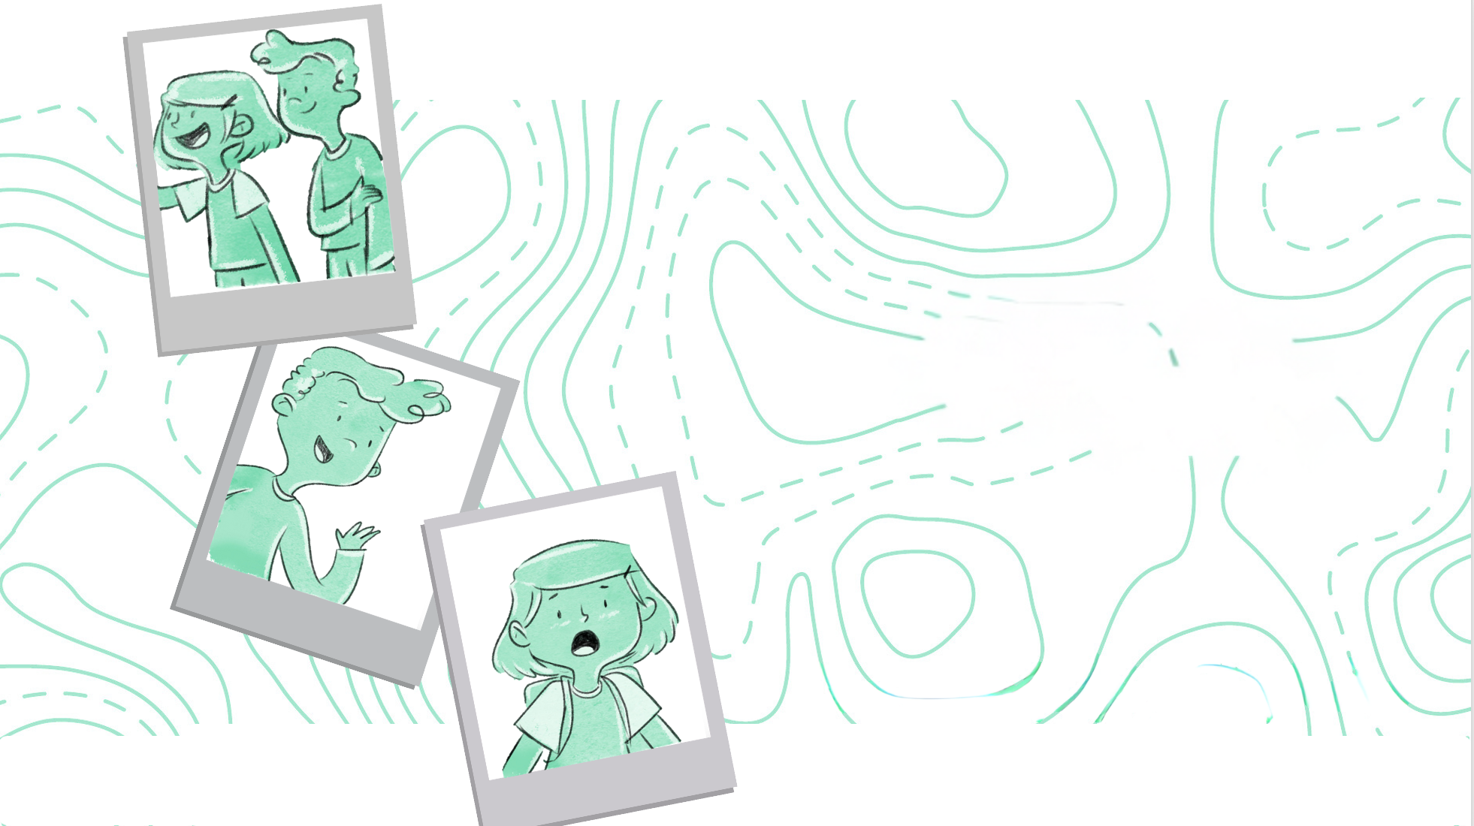
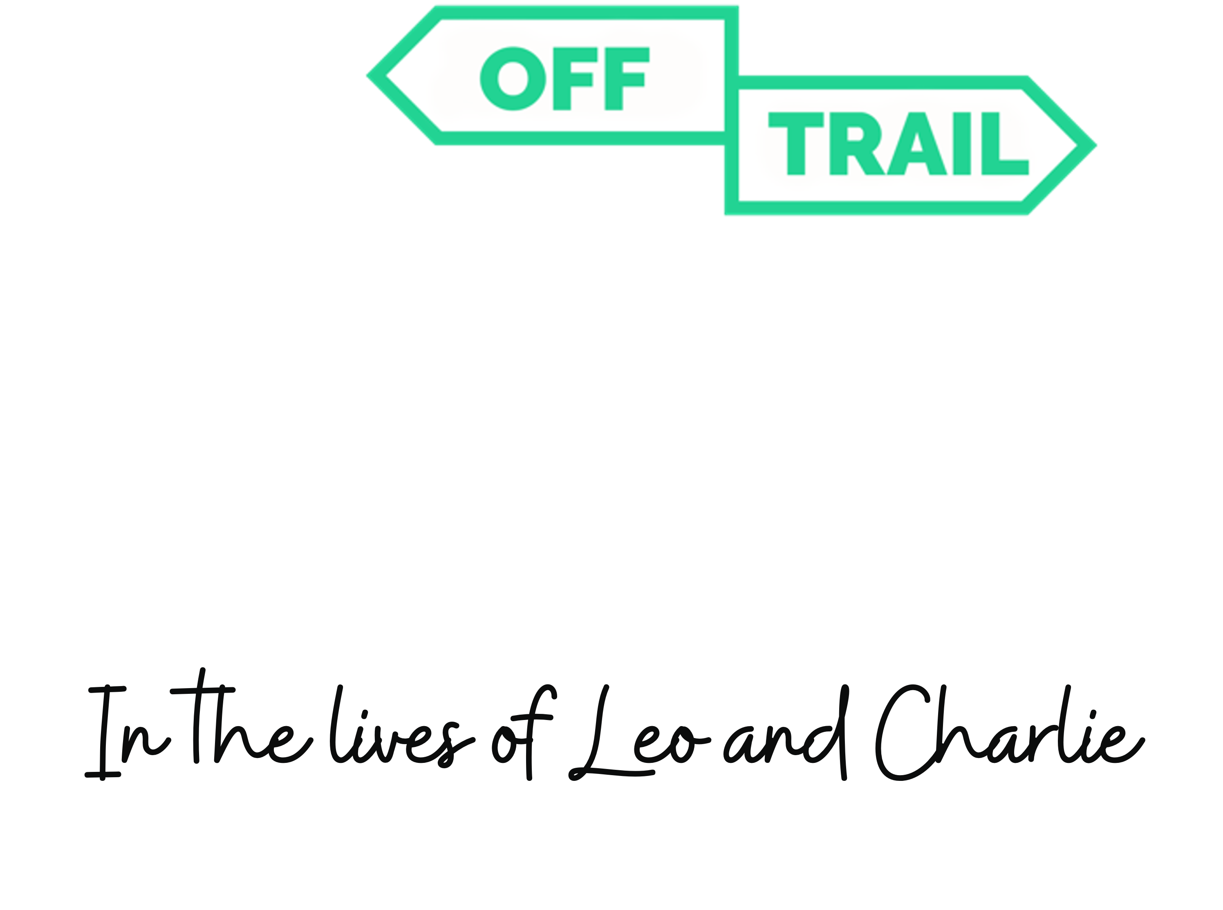
Grade 6
Workshop 6.3
Notes:
1

Slide 2

Review of the previous workshop
      Remember, in the last workshop, we talked about stress and anxiety…
      Do you remember the challenge I gave you? Tell me how you did it.

Slide 3
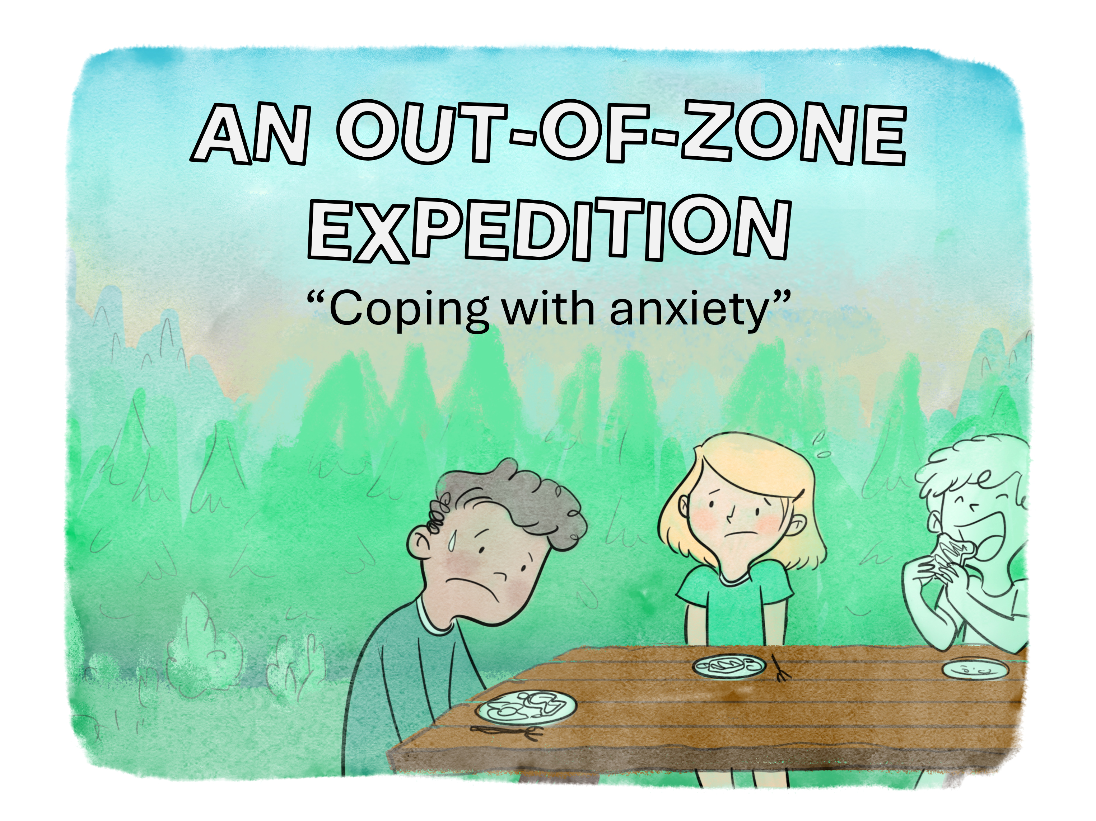

Slide 4
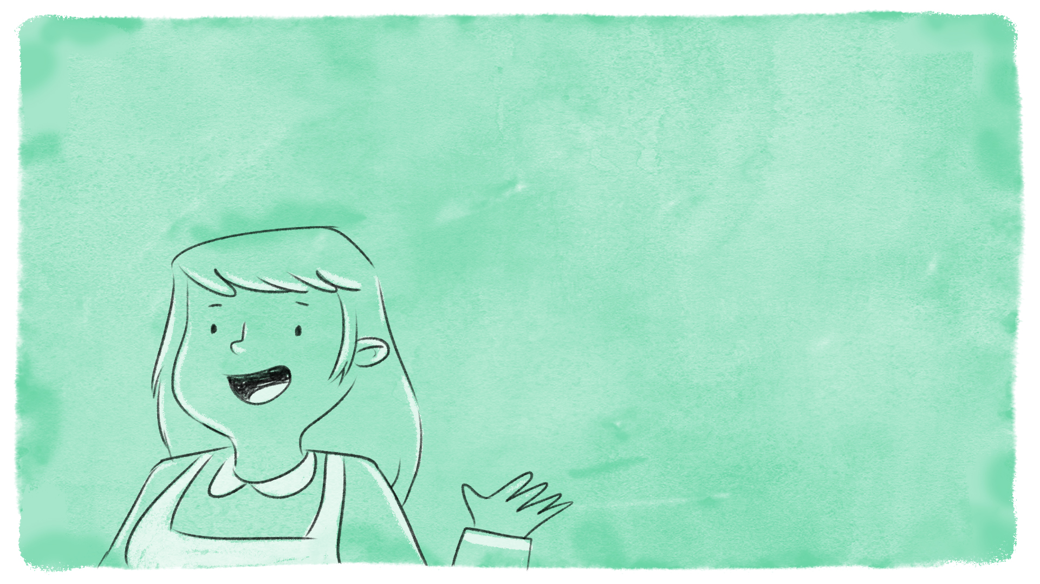

This morning at Camp OFF-TRAIL, it's the final blitz in preparation for the expedition to Mount Jacques-Cartier.
Miss Nathalie, the cook, explains:
I'll make you an ultra-nutritious breakfast! You'll need energy all day long.

Slide 5
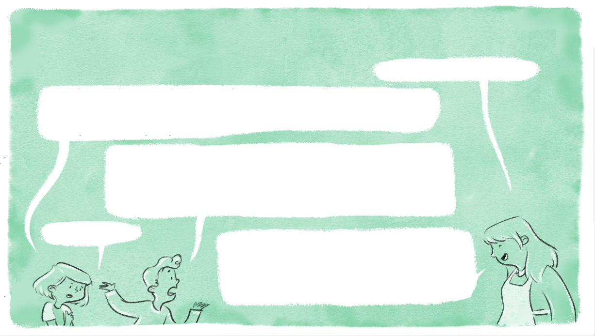

As she serves Leo and Charlie, she senses that the two novices are in a strange state this morning. Concerned they’re looking pretty tired, she takes a moment to question them:
What's wrong with you two?
We didn't sleep all night... Leo and I feel like we're about to climb Mount Everest! We haven't stopped thinking about it since yesterday… we're afraid we won't make it.
Yes, it’s true! We're totally unprepared for this! If we were to run out of supplies, have a big storm, get hurt, or even worse, get lost… I'm not sure I want to go anymore!
Me neither.
I understand your concerns, but we've planned the expedition well so there's nothing to worry about. Go eat and then we'll talk.

Slide 6
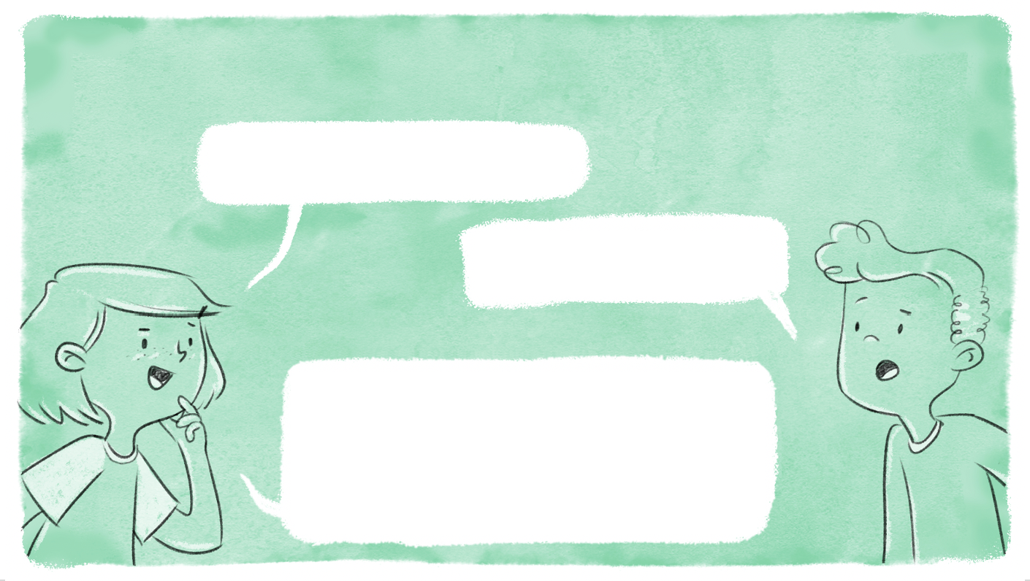
Charlie and Leo sit down to eat, but don't feel any more confident.
We have to avoid this hike at all costs!
Yes. We have to sneak out. But how?
Charlie lists a few ideas:
We say we have to visit our grandparents in the hospital. Or better still, we make them believe we've broken our ankle. Oh no, I've got a better idea. We pretend to have terrible indigestion!

Slide 7



Notes:
7

Slide 8



An Out-of-Zone Expedition
      Leo and Charlie seem to be feeling anxious about the hike up Mount Jacques-Cartier…
      This expedition takes them out of their comfort zone.
      What do you think a comfort zone is?

Slide 9
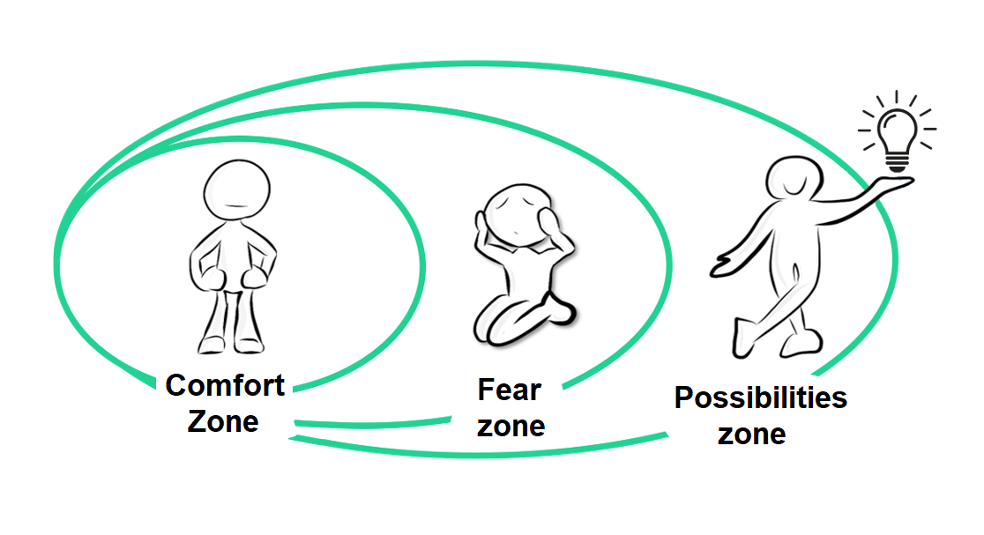

An Out-of-Zone Expedition
      The comfort zone is where you feel good or on familiar ground. It's when you feel comfortable.

Slide 10
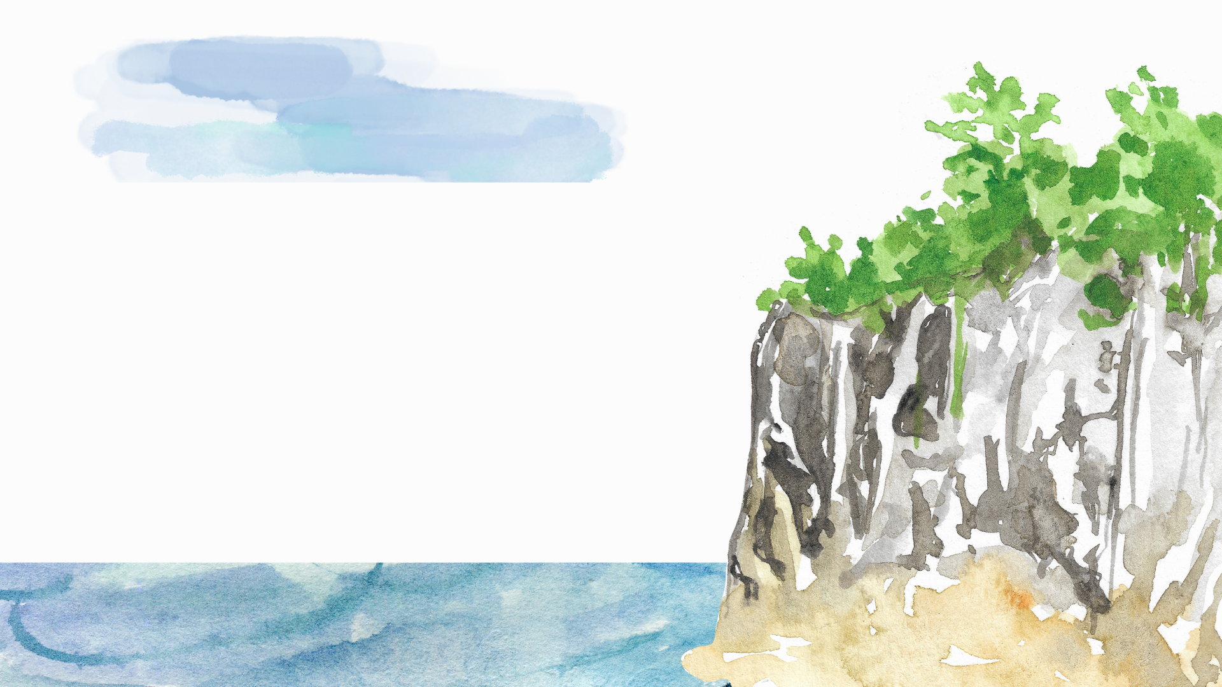
https://sante-mentale-jeunesse.usherbrooke.ca/wp-content/uploads/2025/02/HPp1_6.3_visualizing-ix.mp3

Slide 11
An Out-of-Zone Expedition
      Sitting on the big blanket
      Jumping off the top of the cliff
Overcoming the fear zone and trying out this new situation allows you to enter the possibilities zone.

Slide 12


An Out-of-Zone Expedition
      True or False?
      Raise an open hand to answer TRUE or a closed fist to answer FALSE.
      It’s not normal to feel anxiety.
      Escaping or avoiding an uncomfortable situation is an excellent way to reduce anxiety.
      It's by facing up to our fears that they can be reduced or even eliminated.
FALSE
FALSE
TRUE

Slide 13

An Out-of-Zone Expedition
      Can you tell me about a time when you had to step out of your comfort zone? Did you feel like running away?
What can you do to help yourself cope with anxiety-provoking situations?

Slide 14
Challenge
Between now and the next OFF-TRAIL workshop, when you realize that you feel like running away from an uncomfortable situation, try to use at least one way to reduce or cope with your anxiety.

Slide 15
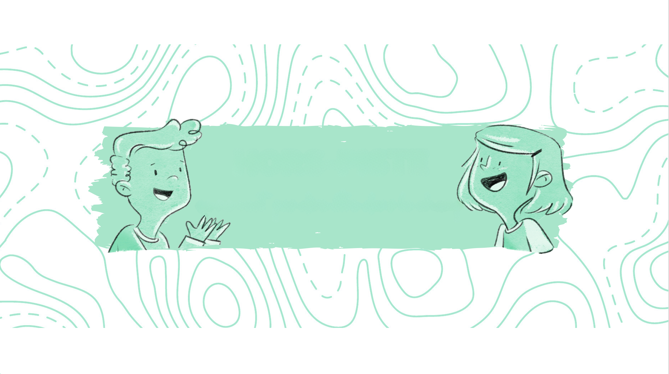
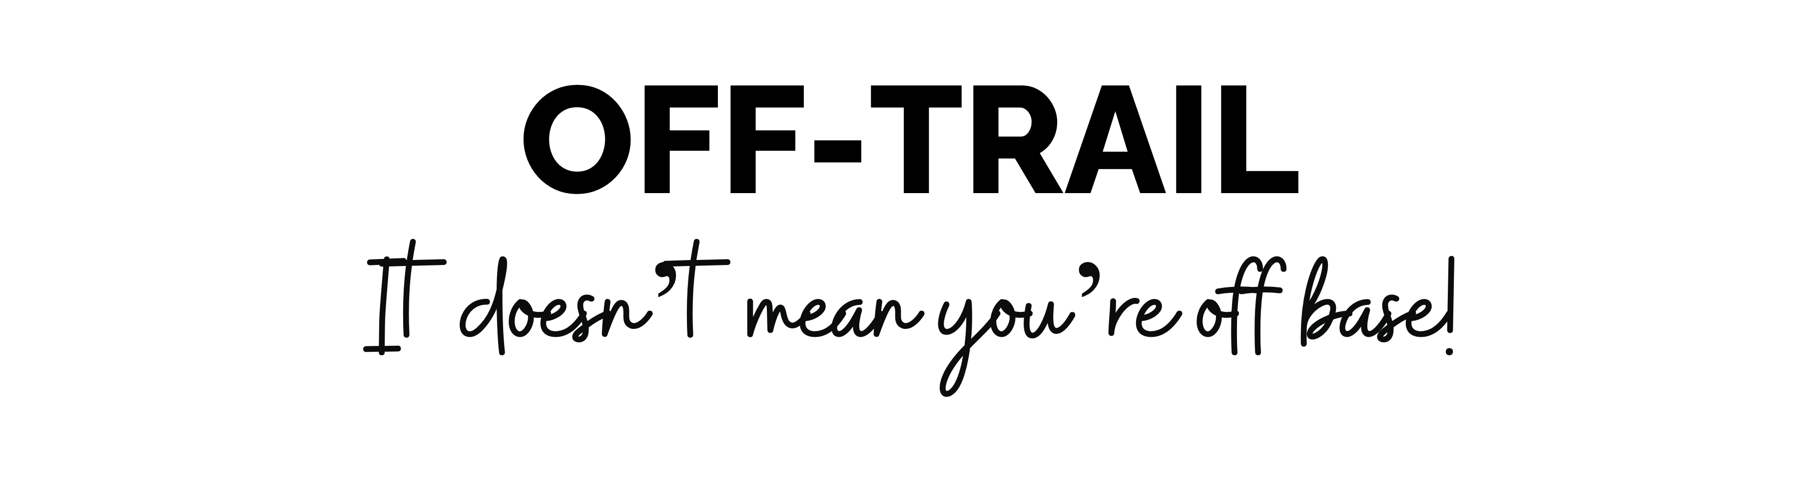
14

