Slide 1
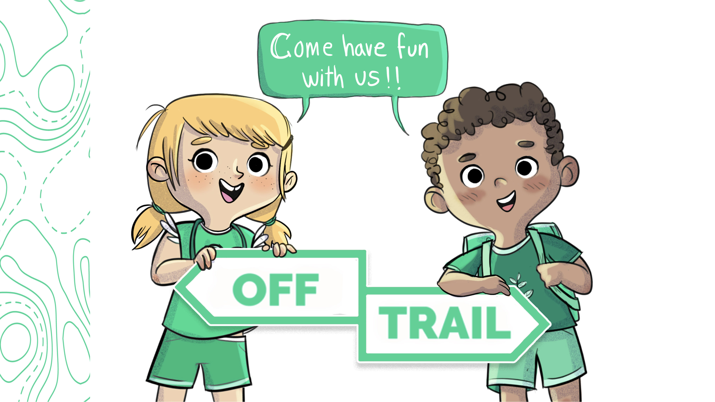
Grade 2
Workshop 2.5

Slide 2


REVIEW OF THE PREVIOUS WORKSHOP
      In the last workshop, we talked about good and not-so-good lifestyle habits…
      Do you remember the challenge I gave you? Tell me how you did it.

Slide 3
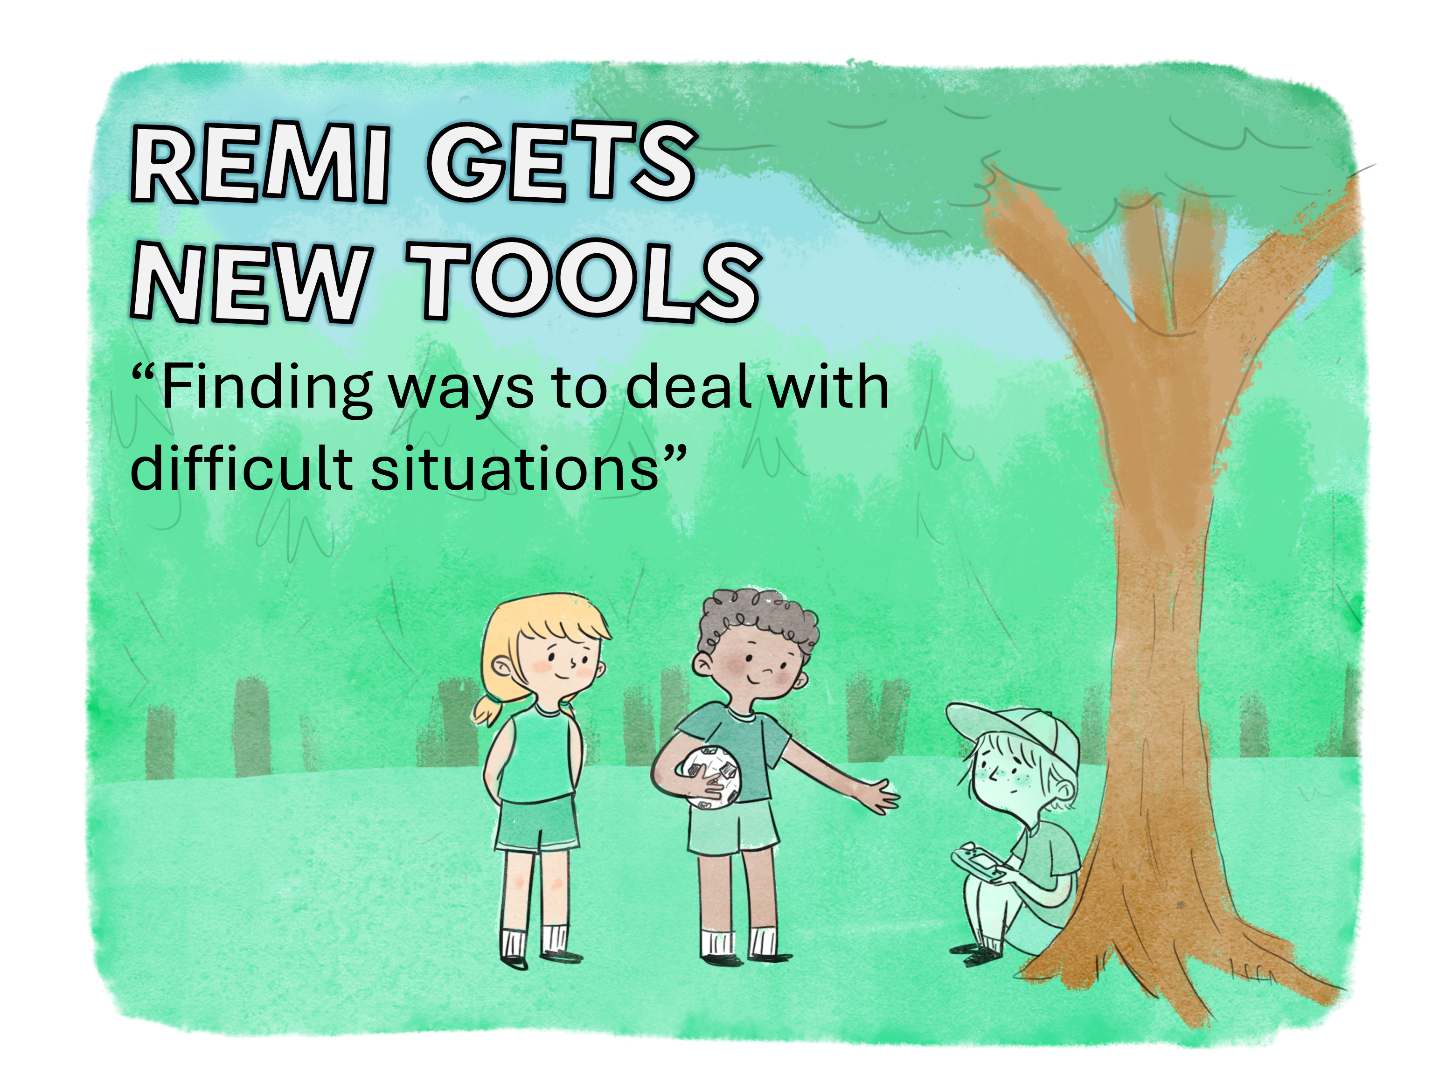
The Adventures of Leo and Charlie
Notes:
2.5

Slide 4
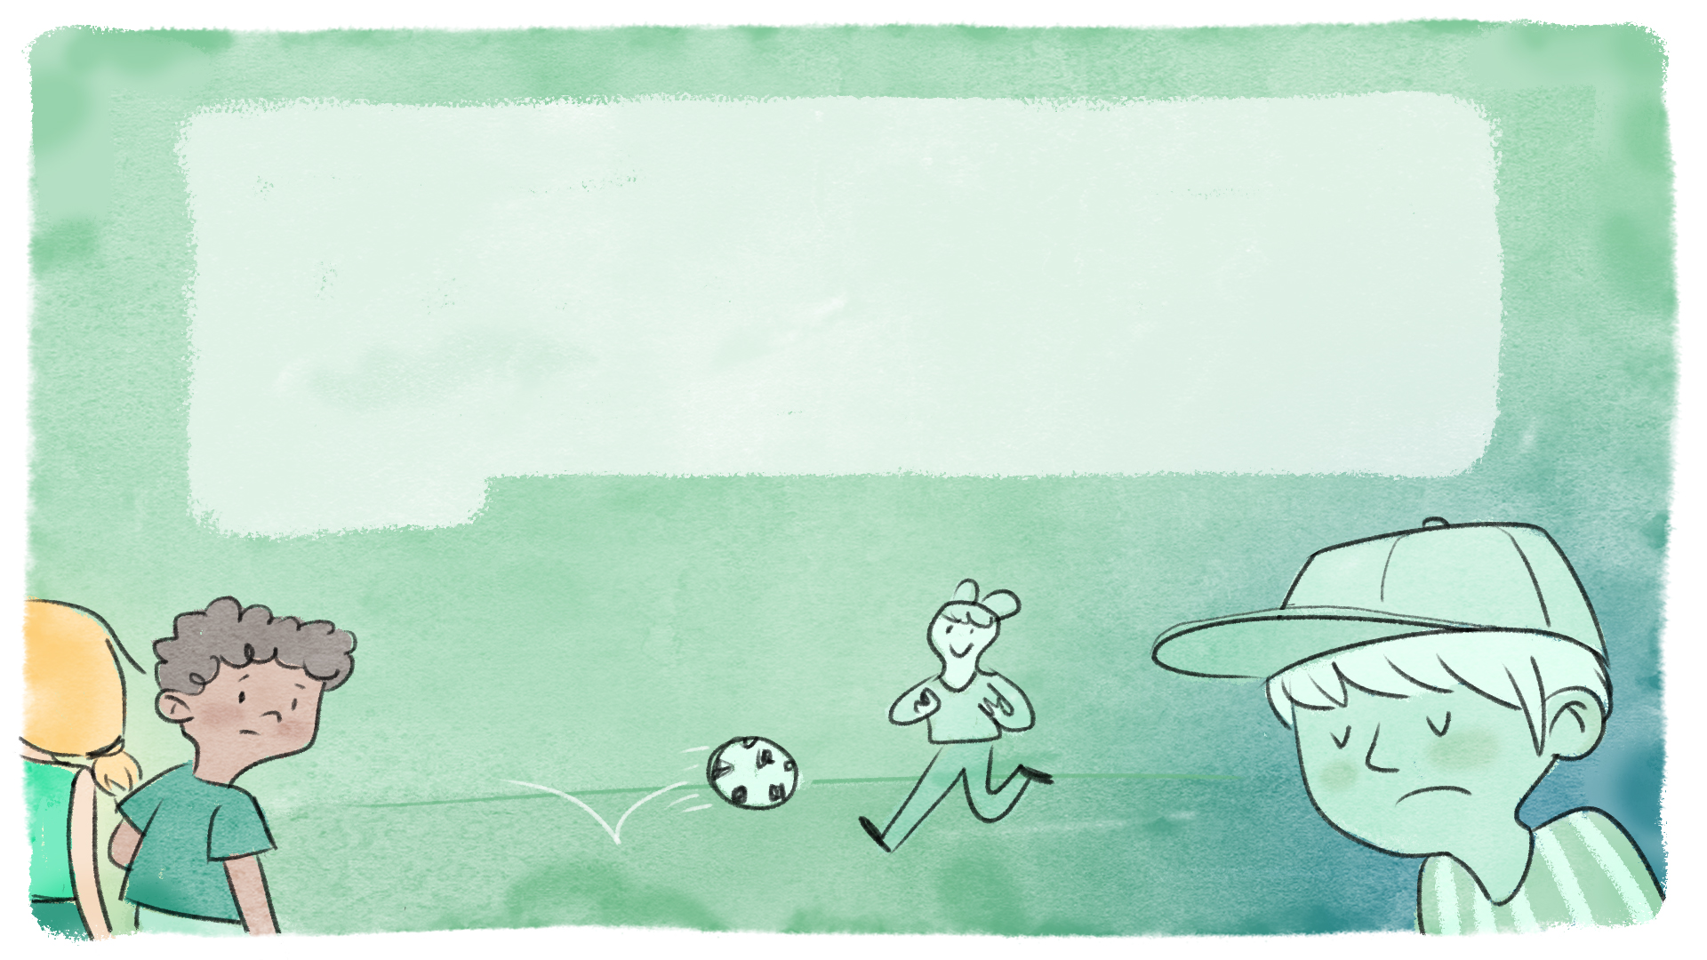
Back on dry land at last! Charlie and Leo head off to join a group of friends who are playing soccer while waiting
for supper. The teams are already formed, so Leo goes
to one side and Charlie to the other. Even after
paddling most of the day, all the campers still have
plenty of energy for a game of soccer, except
Remi…

Slide 5
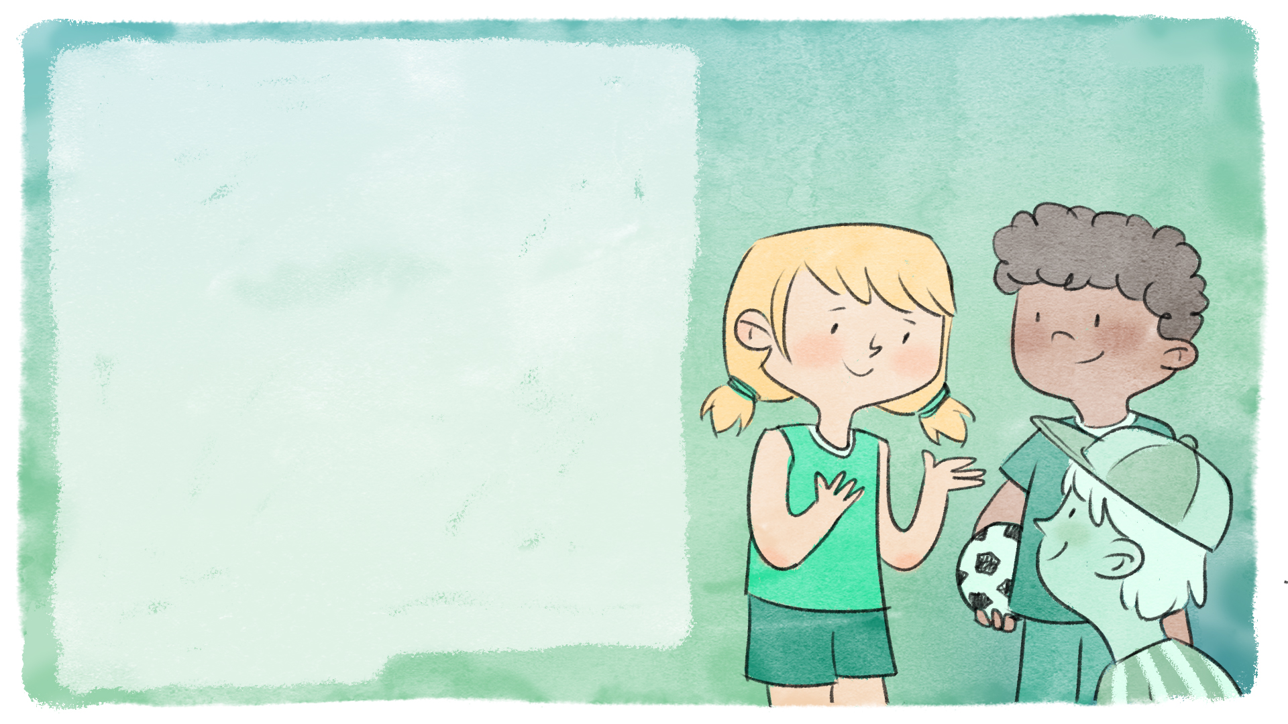
Leo notices Remi sitting alone at the foot of a tree, away from the game. Leo goes to see him and asks him to come join in. Remi refuses, saying that the Taylor twins told him to sit there because he's no good at soccer. Remi is feeling hurt and finds this rejection difficult. Leo tells him that it's important for him to tell someone in charge of the camp in order to fix the situation. Remi is hesitant; he finds it difficult to ask adults for help. Just then Charlie arrives and quickly understands what's going on. She suggests that she go with Remi to see one of the camp counsellors who can help him. Remi accepts Charlie's suggestion.

Slide 6
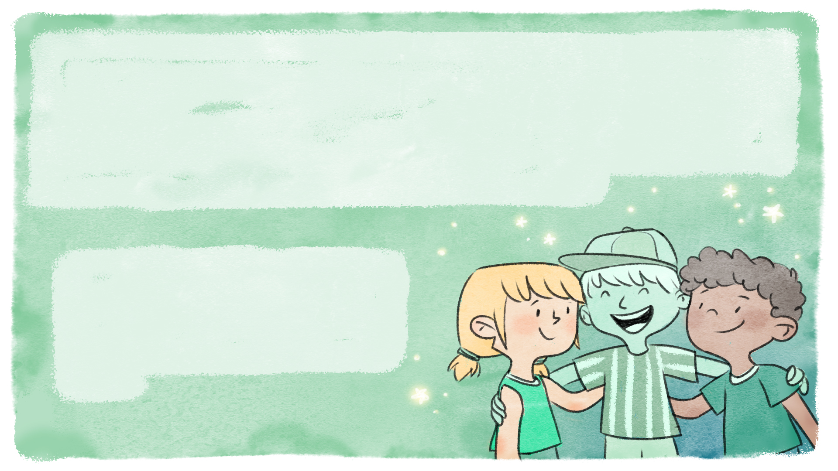
When they find a counsellor, Remi tells her what happened. She congratulates him on coming to see her, telling him that it's important to take the necessary steps to help yourself when you're going through a difficult situation. She suggests that she and Remi go and talk to the Taylor
twins to resolve the situation. A few minutes later, Remi, who’s now on Leo’s team, tries to trick Charlie with a clever fake-out!
Accepting help from Leo
and Charlie and going to see a counsellor was an excellent way for Remi to overcome this difficult situation.

Slide 7
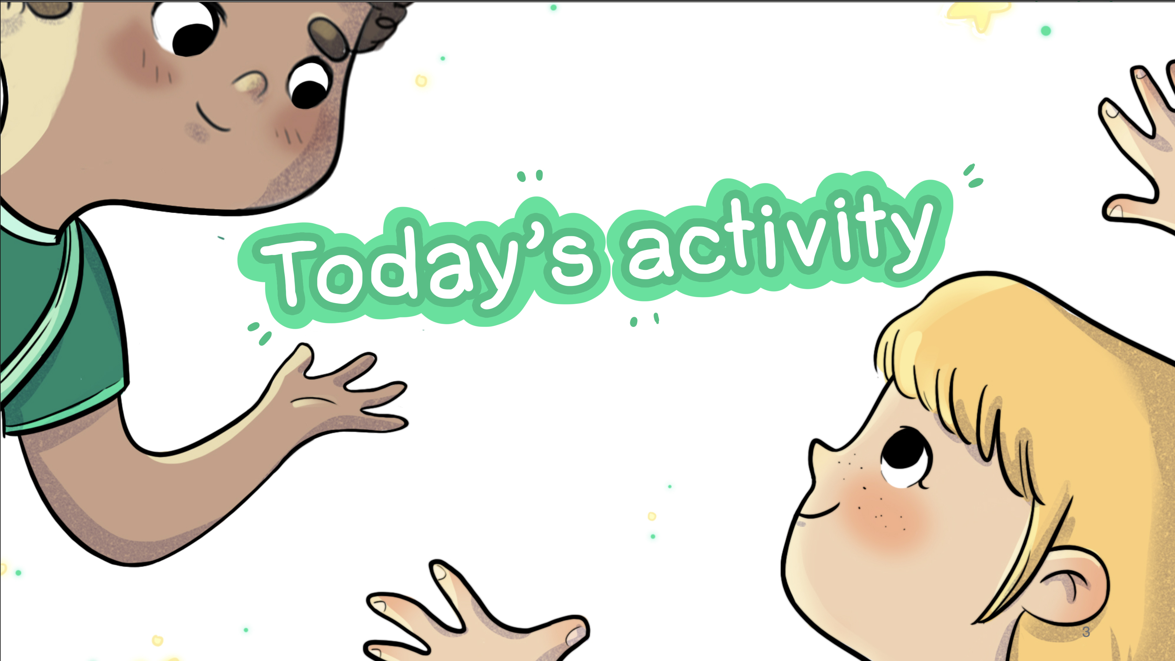

Slide 8


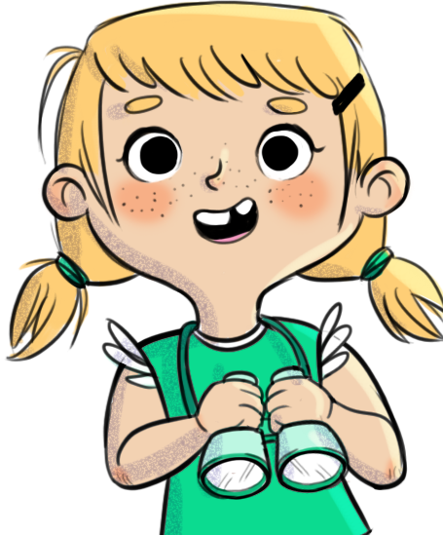

Remi gets new tools
          Form up into teams.
          With your teammates, build the tallest tower possible.
          You have 20 minutes to complete your tower.
          It must stand at least ten seconds without anyone touching it.
You'll receive some more tools to help you build your tower during the activity.

Slide 9
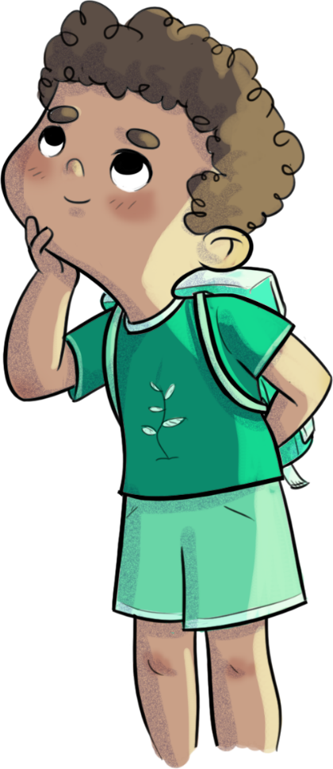
Rémi gets new tools
      First resource:
      Use a tool to help yourself

Slide 10
Remi gets new tools
      Second resource:
      Get more materials

Slide 11
Remi gets new tools
      Third resource:
      Ask an adult for help

Slide 12
Remi gets new tools
      Was the activity more difficult at first? Easier toward the end? Why?
      What made the difficult situation easier?
      Were the additional tools helpful or not?
      What happens when we don't use our tools to deal with a difficult situation?

Slide 13
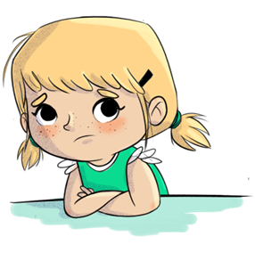
Remi gets new tools
      Tell me about a situation you found difficult…
      What resources do you have in your tool box that you could use to deal with this difficult situation?
      What happens if you don't use any tools?

Slide 14
