Slide 1
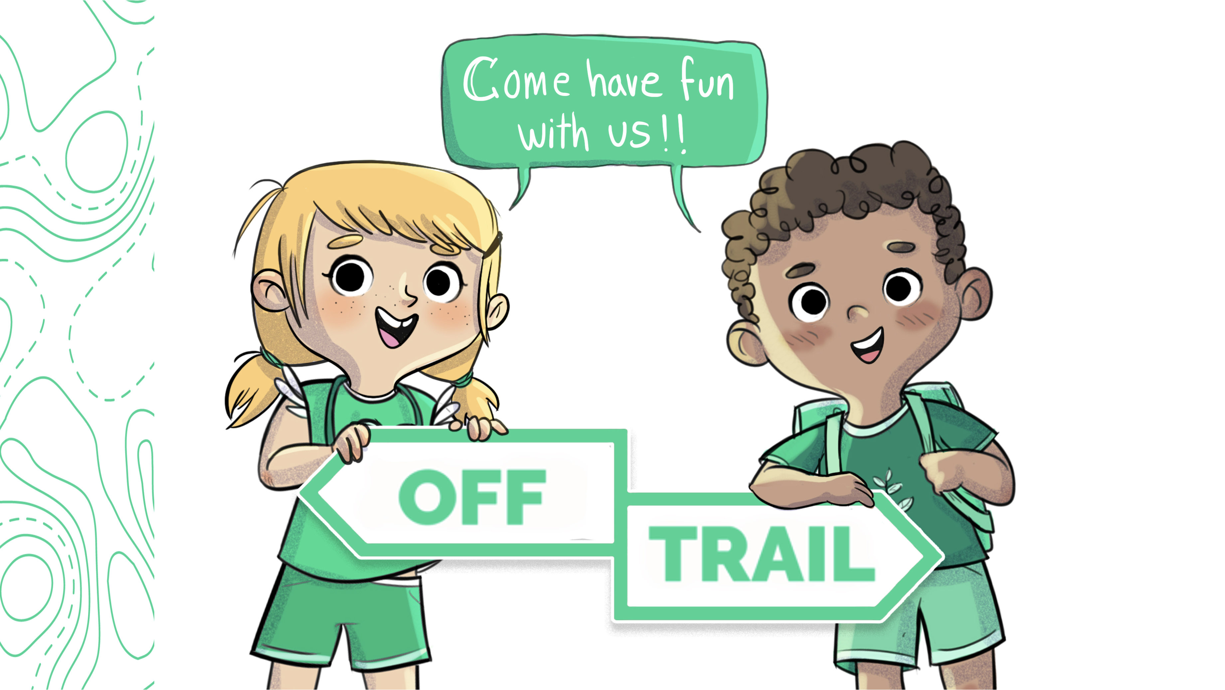
Grade 2
Workshop 2.3

Slide 2

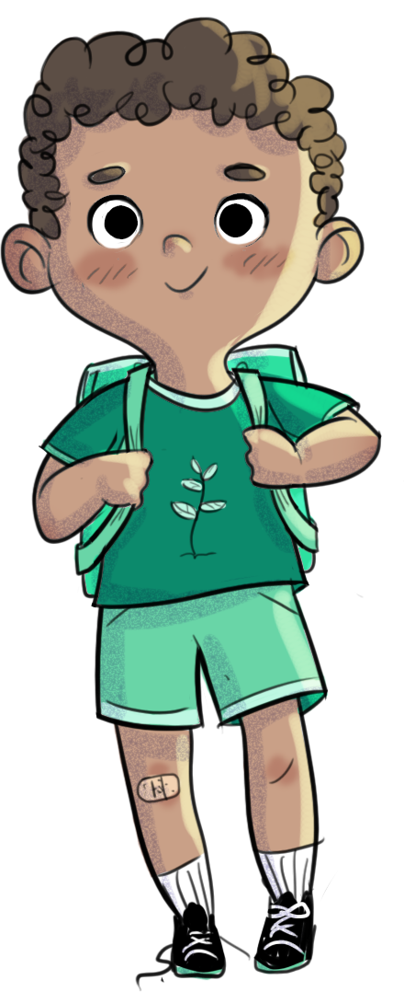
REVIEW OF THE PREVIOUS WORKSHOP
      Remember, in the last workshop, we talked about ways to express yourself…
      Do you remember the challenge I gave you? Tell me how you did it.

Slide 3
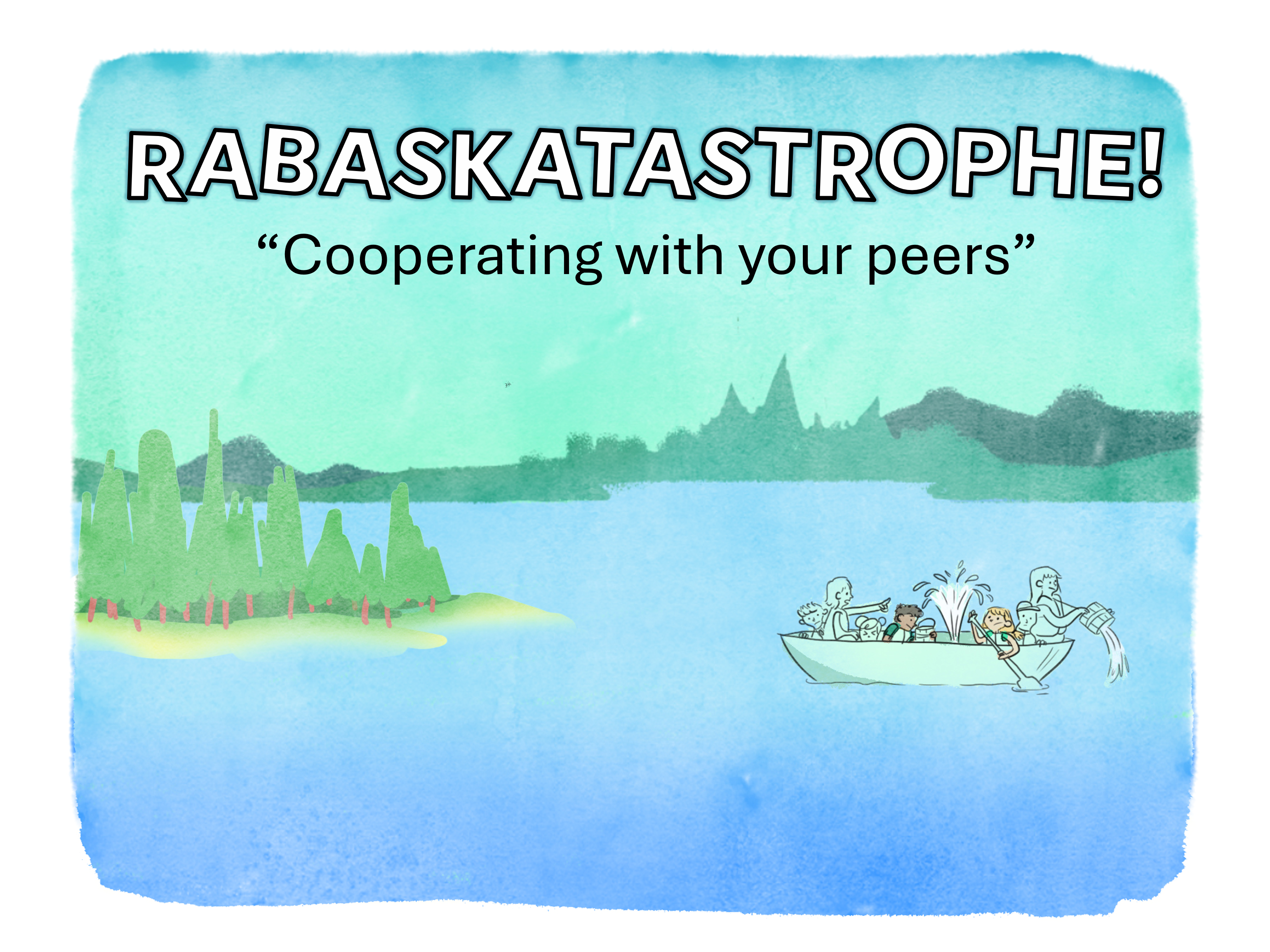
The Adventures of Leo and Charlie
Notes:
2.3

Slide 4
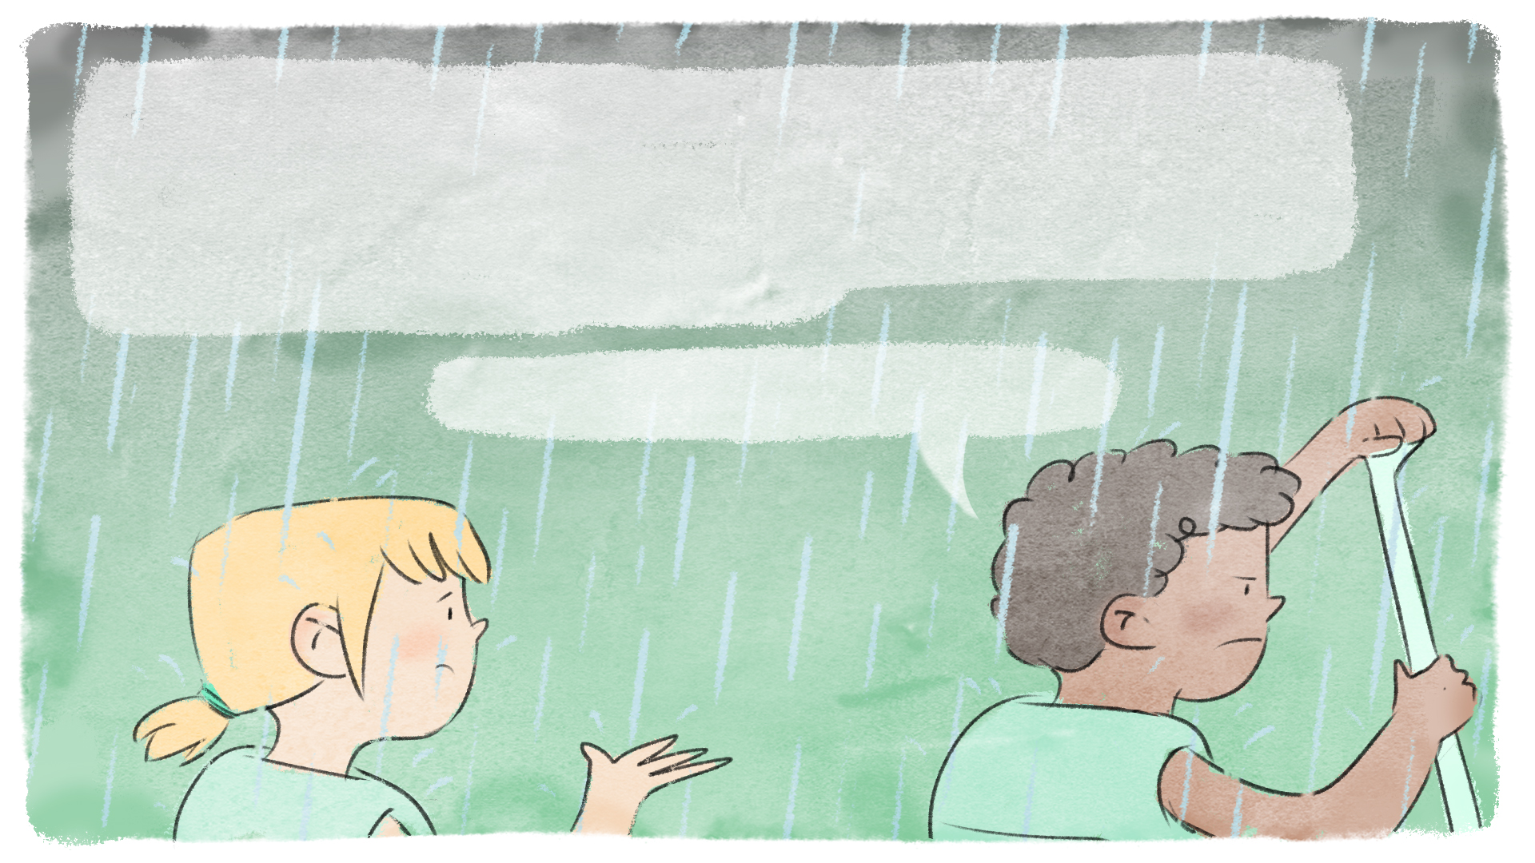
Rabaska canoeing is fun! Everyone paddles. Everyone sings.
However, Leo is not his usual enthusiastic self today…
It's raining, he feels soaking wet, and he would rather just sit inside with his favourite book. When Charlie asks him what's wrong,
Leo snaps back:
Nothing! Leave me alone and just row.

Slide 5
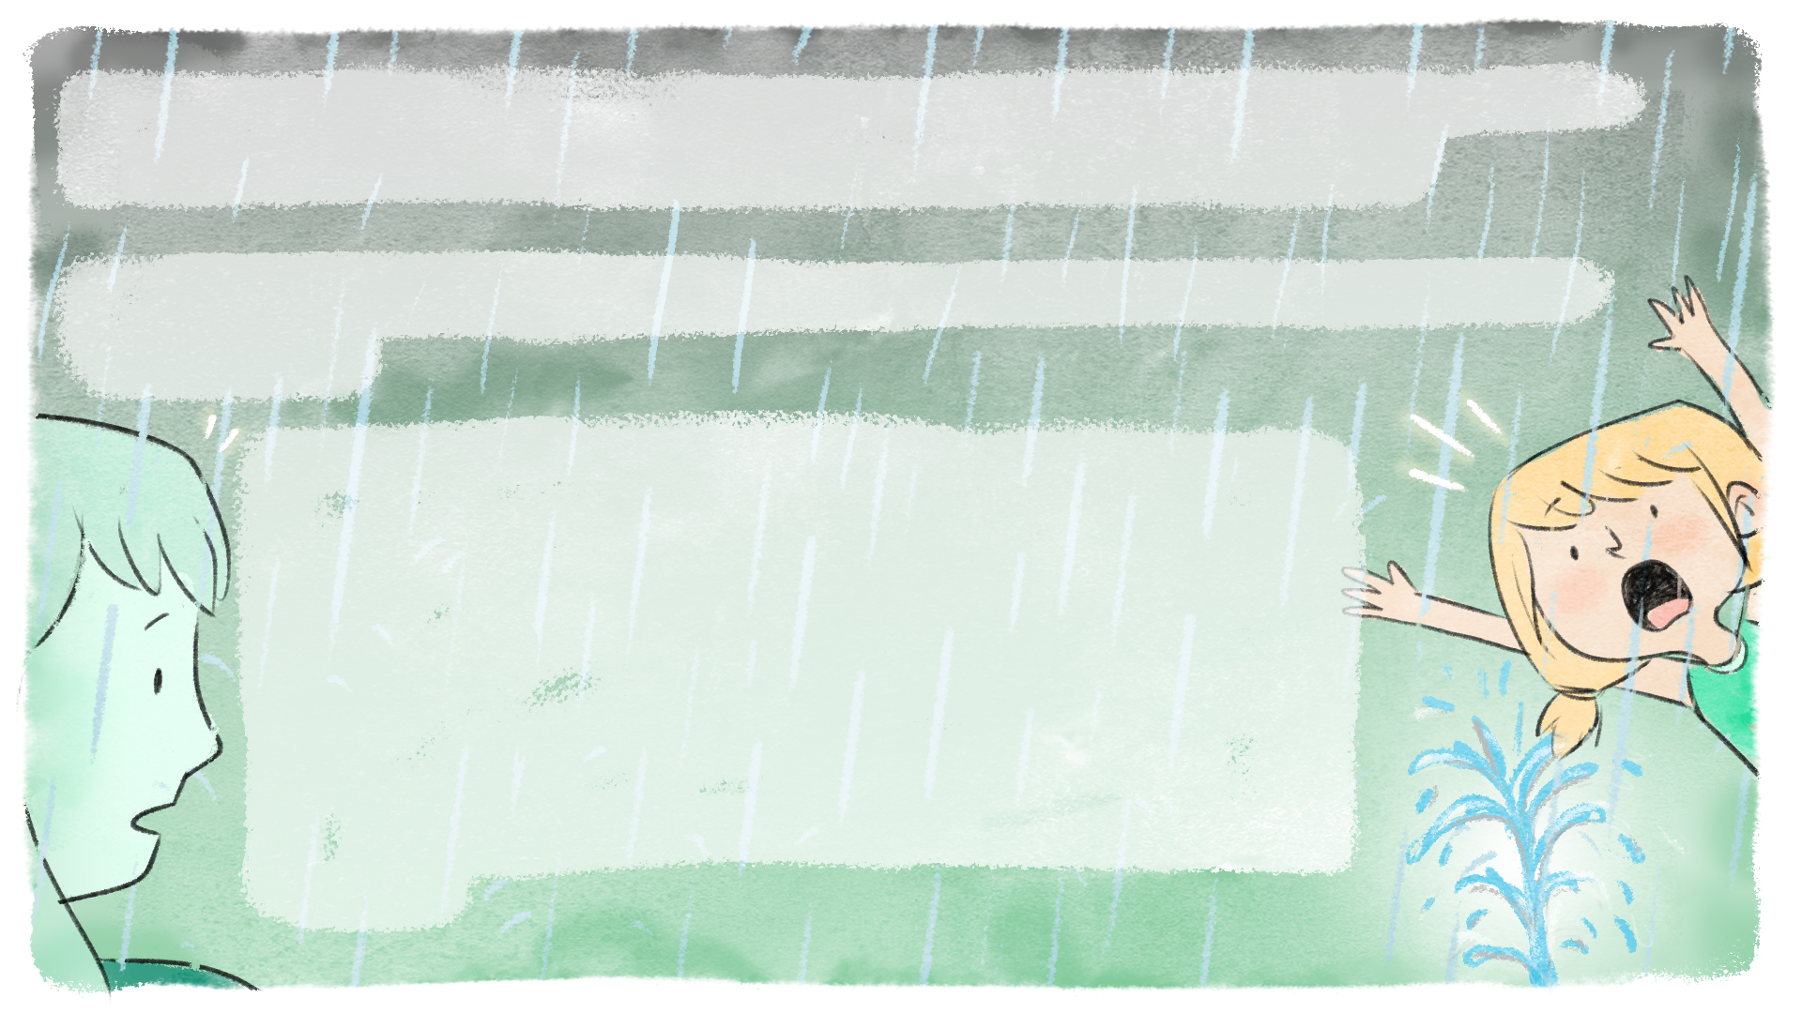
Feeling a little hurt, Charlie tries to keep on having fun, when suddenly
she notices that her feet are completely soaked…
- There's a hole in the rabaska! We're going to sink! Abandon ship!
Shouts Charlie.
Miss Catherine, a former firefighter accustomed to emergency situations and always calm as a cucumber, is accompanying the group on today's expedition. With one simple word, she manages to get the group's attention and restore order to the chaos. However, she tells them that everyone will have to work together to deal with the problem.

Slide 6
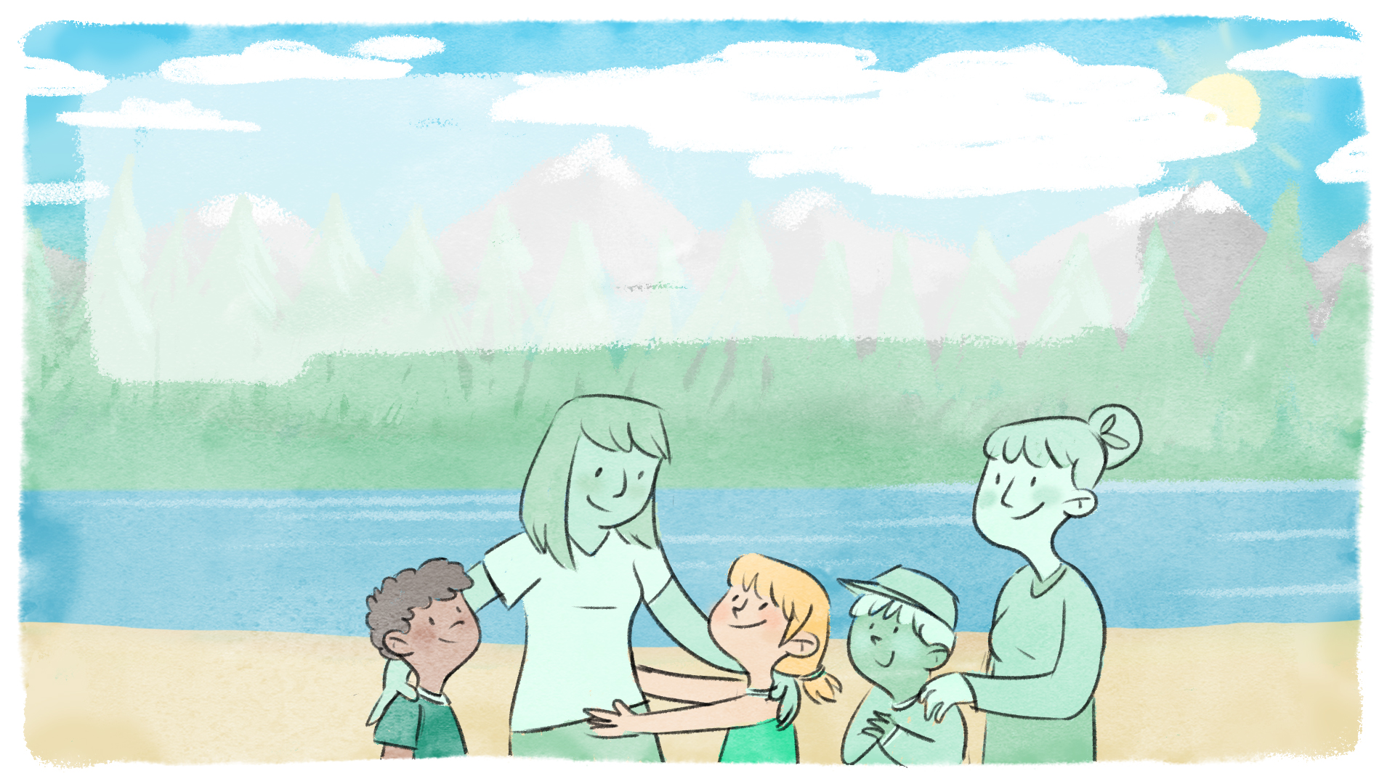
She gives everyone the role of making sure that the water doesn't fill up the rabaska. Thanks to everyone's efforts, the crew and canoe make it to an island. Fortunately,
Miss Catherine has all the materials she needs to repair the hole. She congratulates all the students on their fine teamwork.

Slide 7
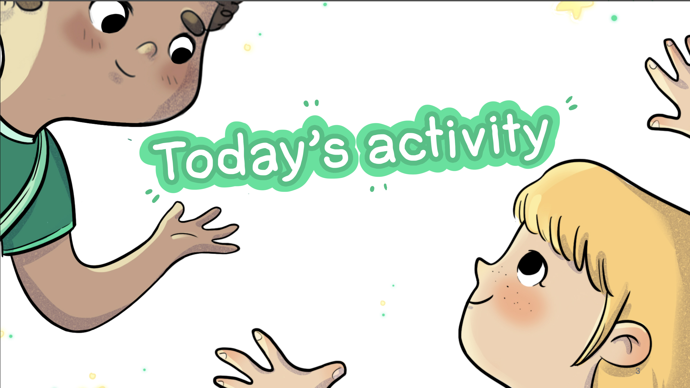

Slide 8
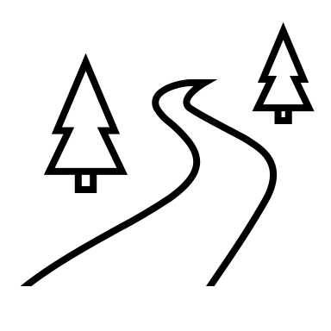
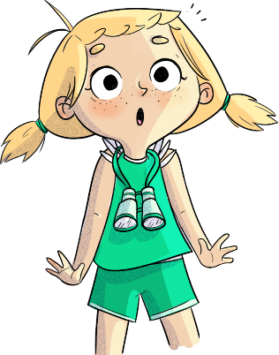

Rabaskatastrophe!
      We'll split the group in two.
      Everyone will have to pass between the two ropes, but... some of you will be blindfolded.
      You'll have to help the others through the ropes.

Slide 9
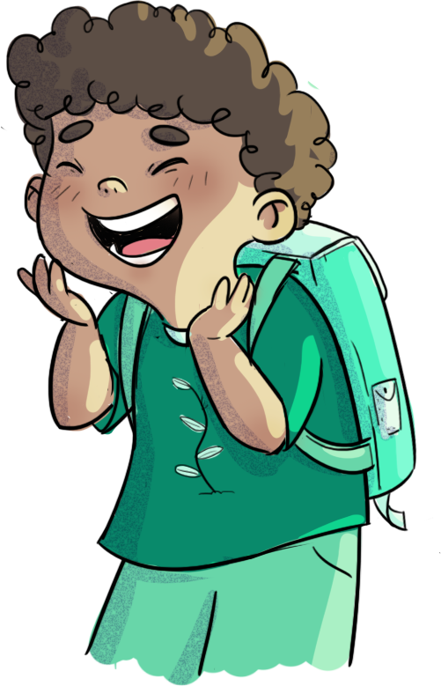
Rabaskatastrophe!
What did you find difficult?
How did the others help you cross the rope?
What did you do to help others?
Could you have done it without help?
Why do you think it's important to help each other in a team?

Slide 10
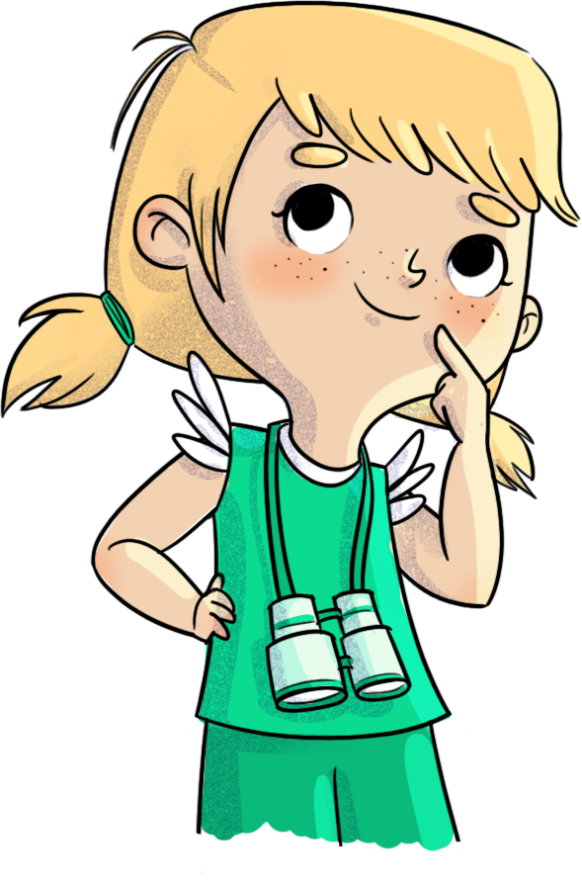
Challenge
Between now and the next OFF-TRAIL work-shop, help a friend in need.

Slide 11
