Slide 1
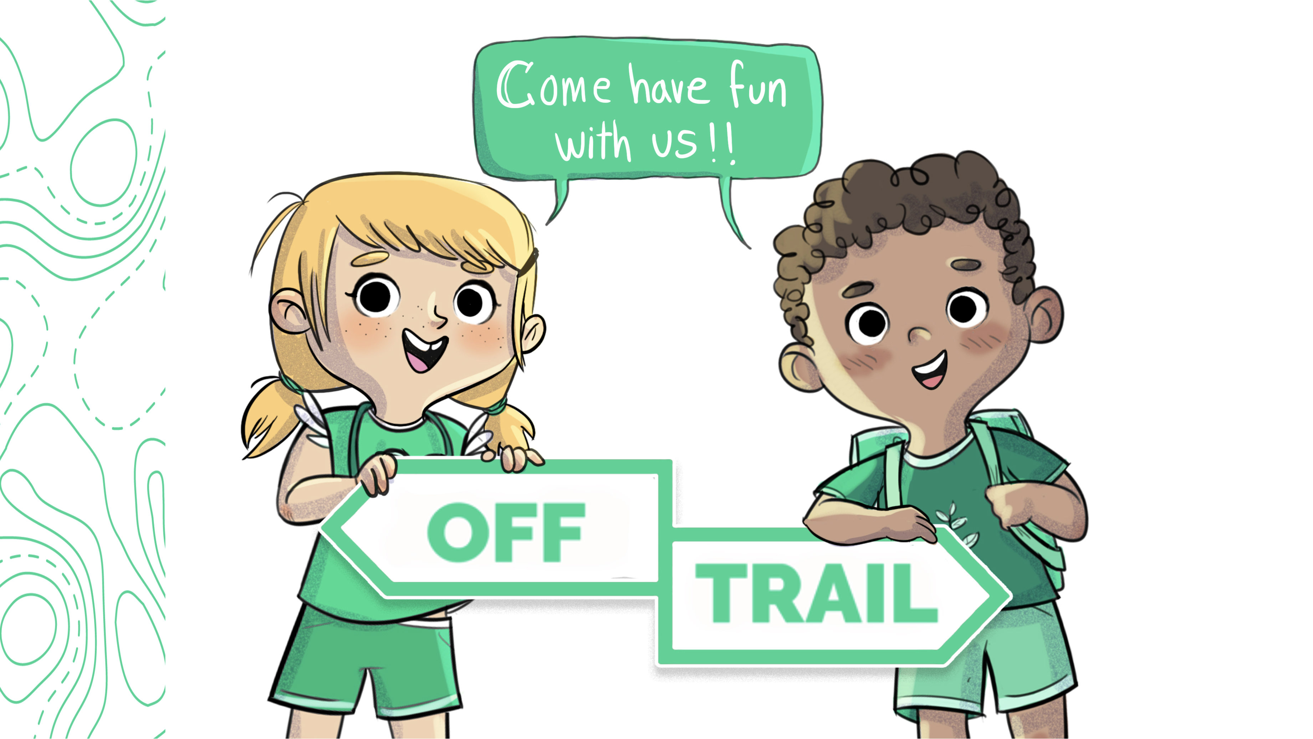
Grade 1
Workshop 1.1

Slide 2
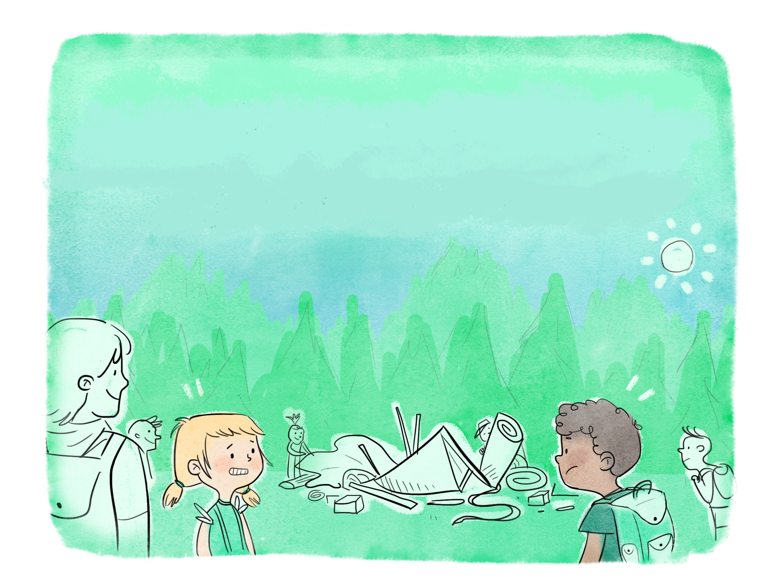
The Adventures of Leo and Charlie
OFF-TRAIL CAMPING
“Getting to know yourself”
Notes:
1.1

Slide 3
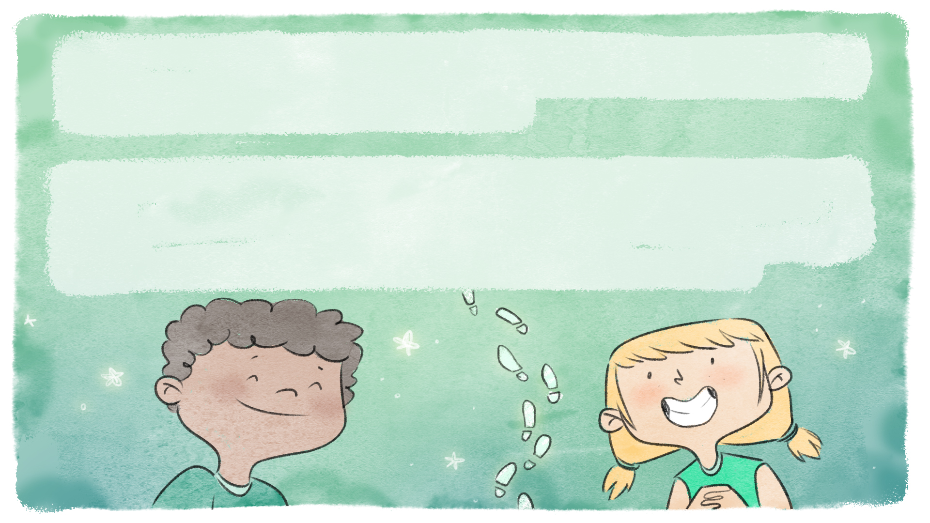
This year's OFF-TRAIL camp promises to be full of great adventures! While riding the bus to the camp, Leo and Charlie are already trying to guess what activity they’ll be doing.
Last year, they loved their hike. Leo discovered that he was curious and persevering, and Charlie learned that she was very resourceful and energetic. All year long, they put these qualities to good use and really enjoyed their outdoor activities.

Slide 4
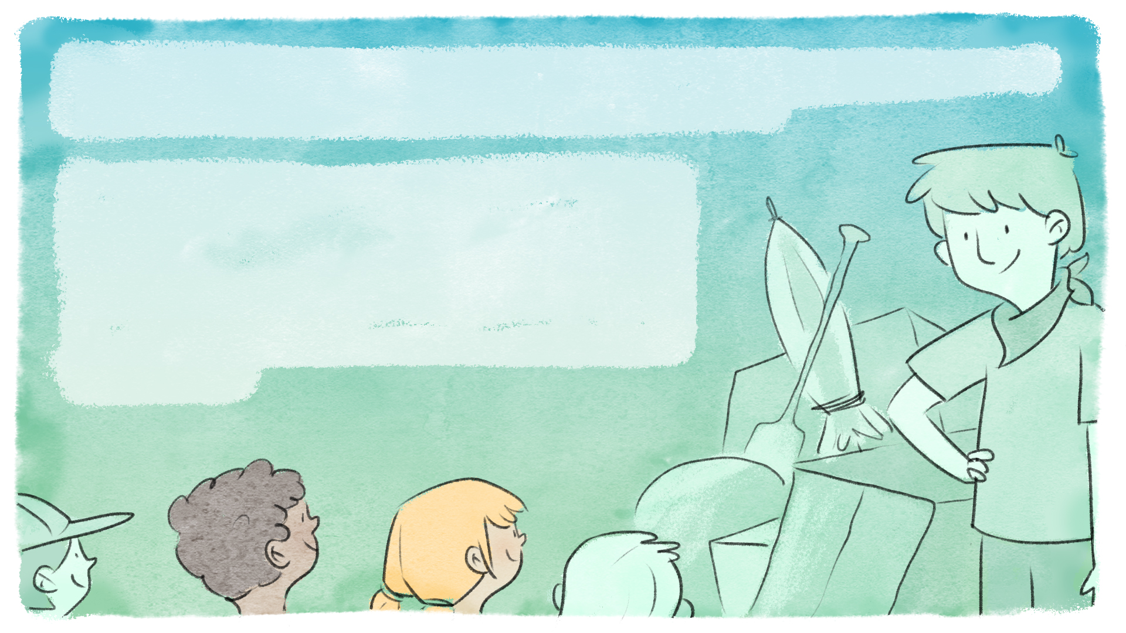
By the time the bus arrives at the camp, it's almost the end of the day, and the sun is getting low in the sky.
The group is greeted by Mr. Julian, an adventurer and nature lover, who is waiting for them next to a large pile of all kinds of objects. Everyone knows that Mr. Julian is sociable, hard-working and has a contagious good mood.

Slide 5
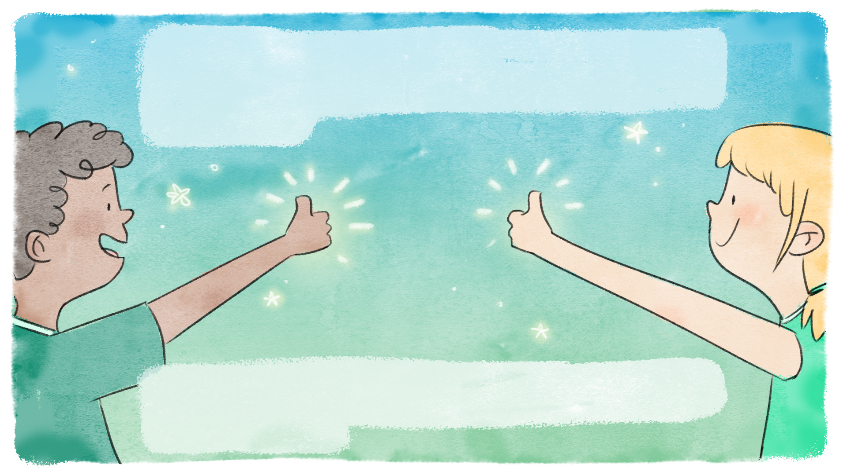
Once everyone has gathered around the pile of objects, he happily announces that they'll have to help each other set up the camp, as they'll be staying for their first
night of camping.
Night is coming, so they'll have to move fast. Everyone must use their qualities and strengths to get it done, and they must work as a team.

Slide 6
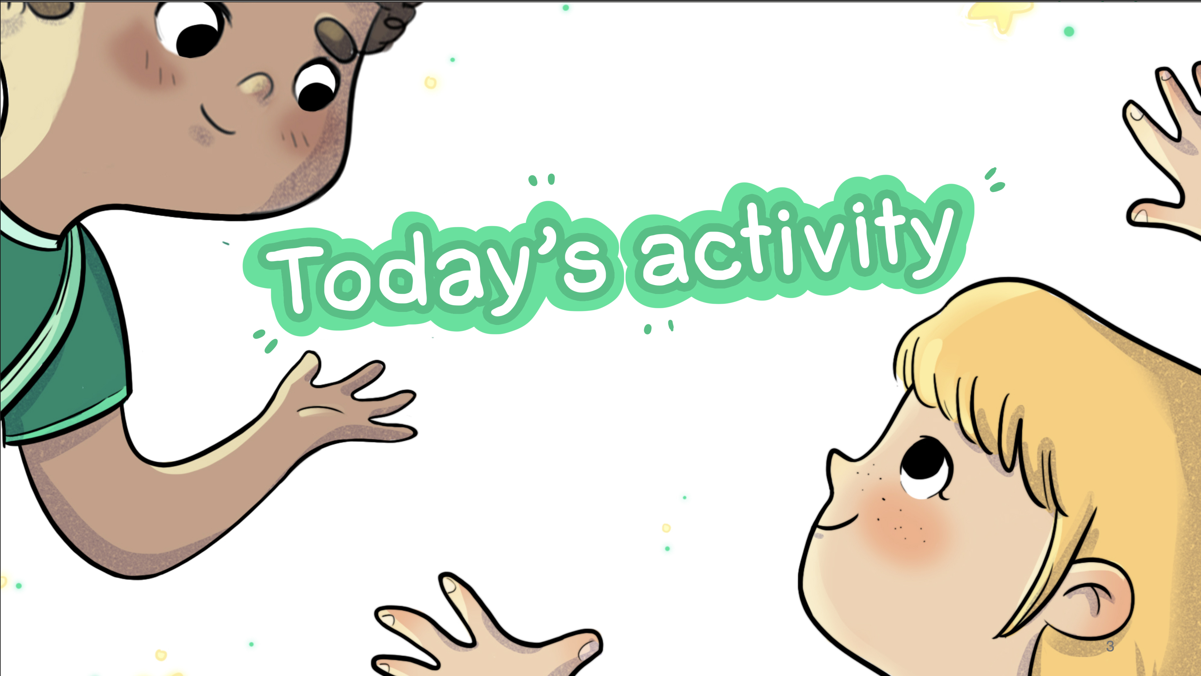

Slide 7


OFF-TRAIL Camping
  Do you know what a quality is?
  It's what describes a person,
  what we find special about them,
  what we love about them.

Slide 8
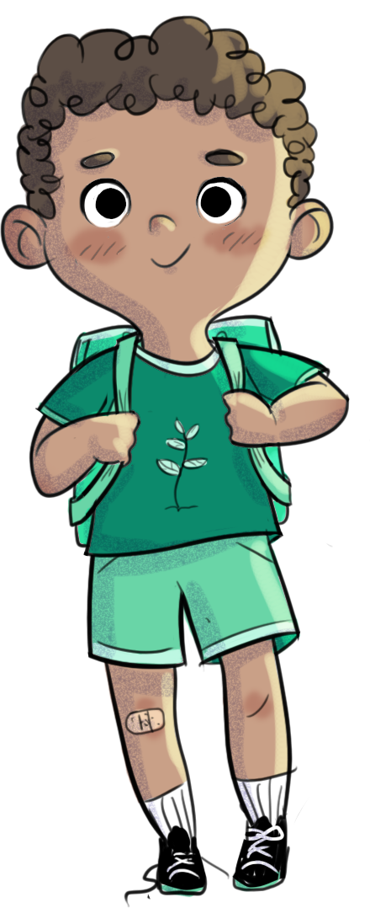
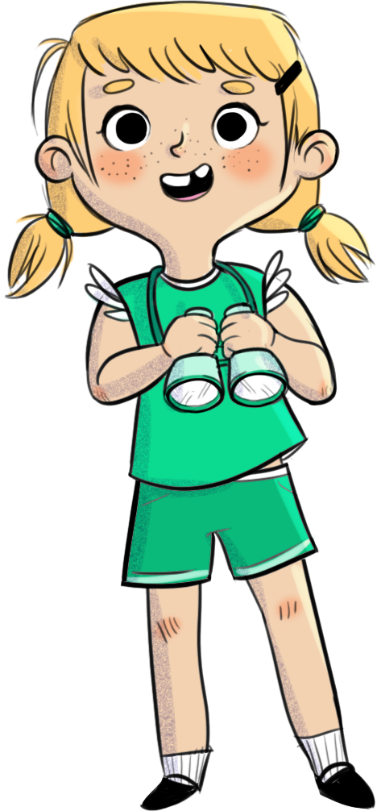
OFF-TRAIL Camping
  What are the qualities of Leo and Charlie in the story I read earlier?

Slide 9

OFF-TRAIL Camping
  With your team, build a cabin with the materials
  I've given you.

Slide 10
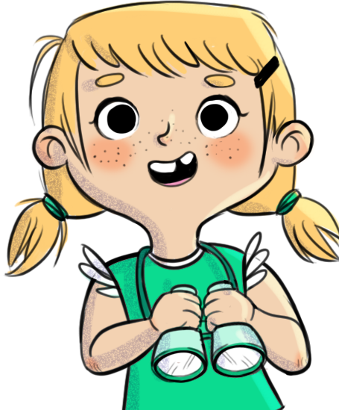
OFF-TRAIL Camping
  Now that the cabin is finished... Let's talk about your qualities.
  Name one quality you have, that you used to build the cabin.
  Name one quality you saw in your teammates.

Slide 11
















List of qualities
Creative
Smiling
Intelligent
Courageous
Friendly
Calm
Patient
Resourceful
Humorous
Energetic
Persevering
Kind
Manual
Imaginative
Encouraging
Curious

Slide 12
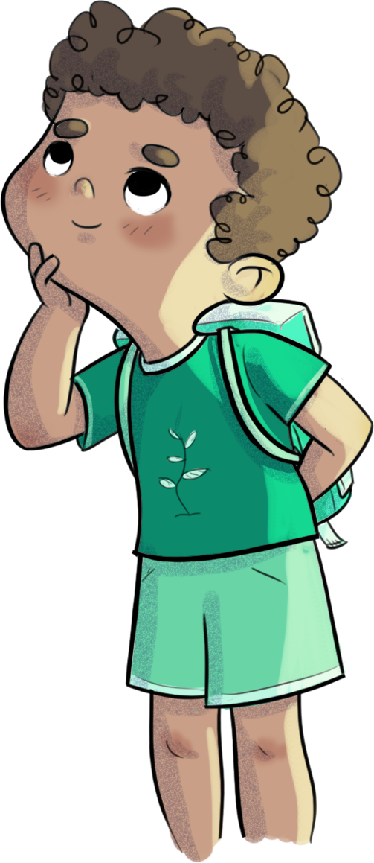
OFF-TRAIL Camping
Does everyone have qualities? Are they the same for everyone?
Why should we know our qualities? Why are they important?

Slide 13

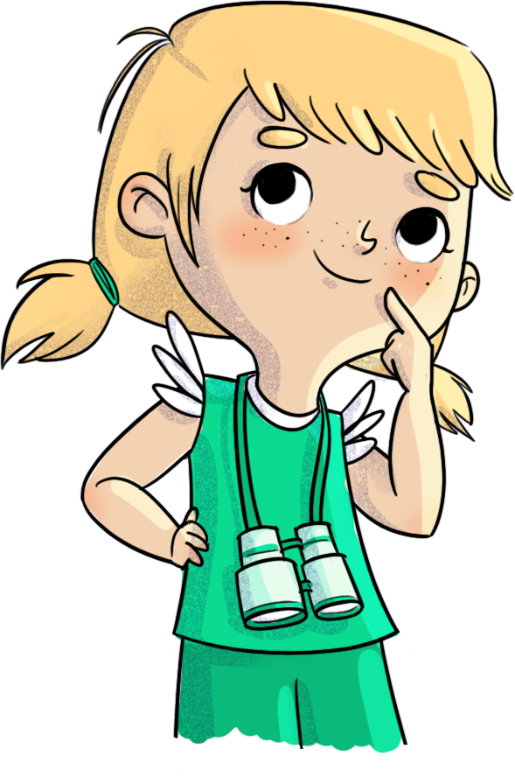
Challenge
Between now and the next OFF-TRAIL workshop, name a quality you notice in a friend.

Slide 14
