Slide 1






Introduction to the Program
Text is under a CC BY-NC 4.0 licence. Graphics designed under PowerPoint content licence. © OFF-TRAIL program by Centre RBC d'expertise universitaire en santé mentale (2025), Université de Sherbrooke.
August 2023

Slide 2

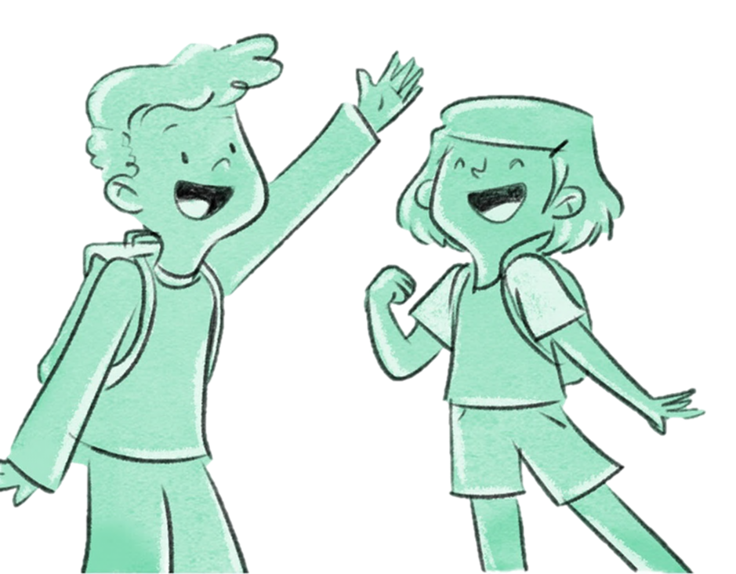

Hi, I'm Leo…
And I’m Charlie! We’re the two main characters in the OFF-TRAIL program stories. Our adventures will set the stage for the topics covered in the workshops.
2

Slide 3

Going off the beaten track… yes, but how?
With the help of 5 workshops focused on your active participation, which aim to…
Help you cope better with your emotions and your stress
Get to know yourself better
Learn to assert yourself among others
Face the toughest times
Stay zen

Slide 4

Participation Contract
You agree to be respectful.
You agree to respect the confidentiality of all information shared. In other words, what's said in the workshops stays in the workshops.
You will speak in the first person (the “I” tense). “I” means you. It’s no one else. This means talking about what you experience, what you feel.
You will share with others only what suits you. In short, nobody's forcing you to talk. (But it feels good to do it, believe us).
You will listen to others, without judging.
Between meetings, you will put into practice the things you've learned. You will continue to reflect on the topics we've covered and you will try to complete your weekly challenge.
Remember that all around you, there are friends, parents, caregivers and teachers that you can confide in to help you.

Slide 5
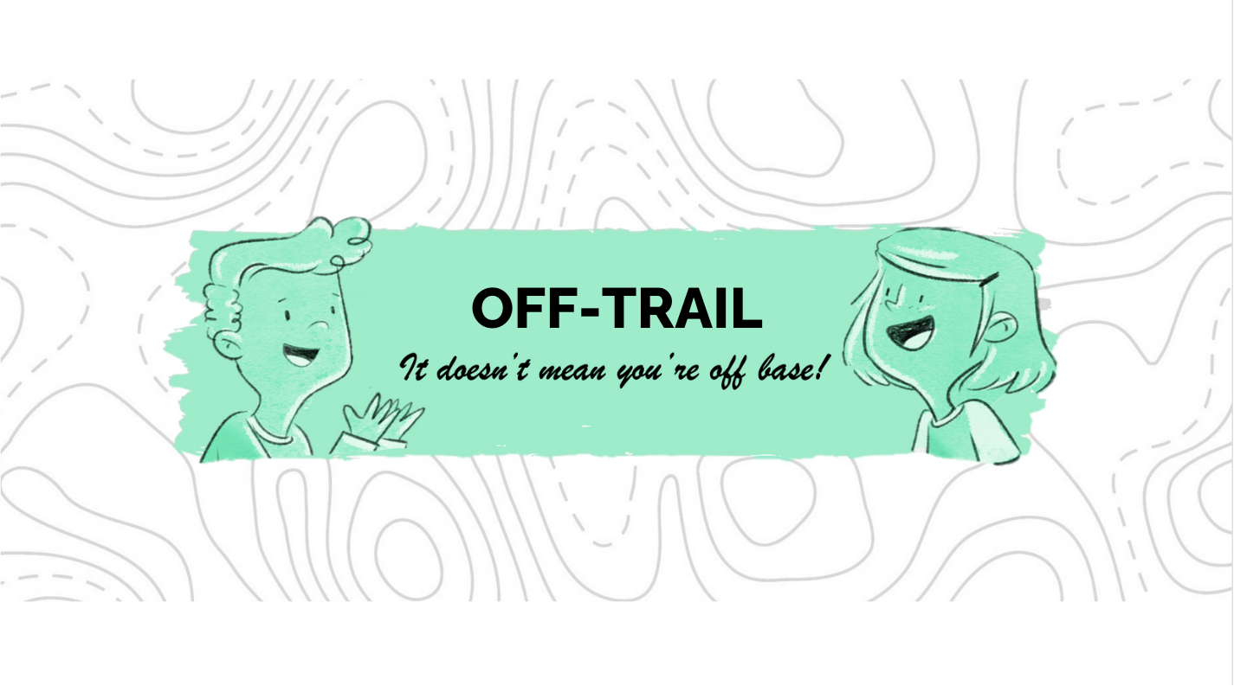
5

