Slide 1






Introducing Charlie and Leo
Text is under a CC BY-NC 4.0 licence. Graphics designed under PowerPoint content licence. © OFF-TRAIL program by Centre RBC d'expertise universitaire en santé mentale (2025), Université de Sherbrooke.
August 2023

Slide 2

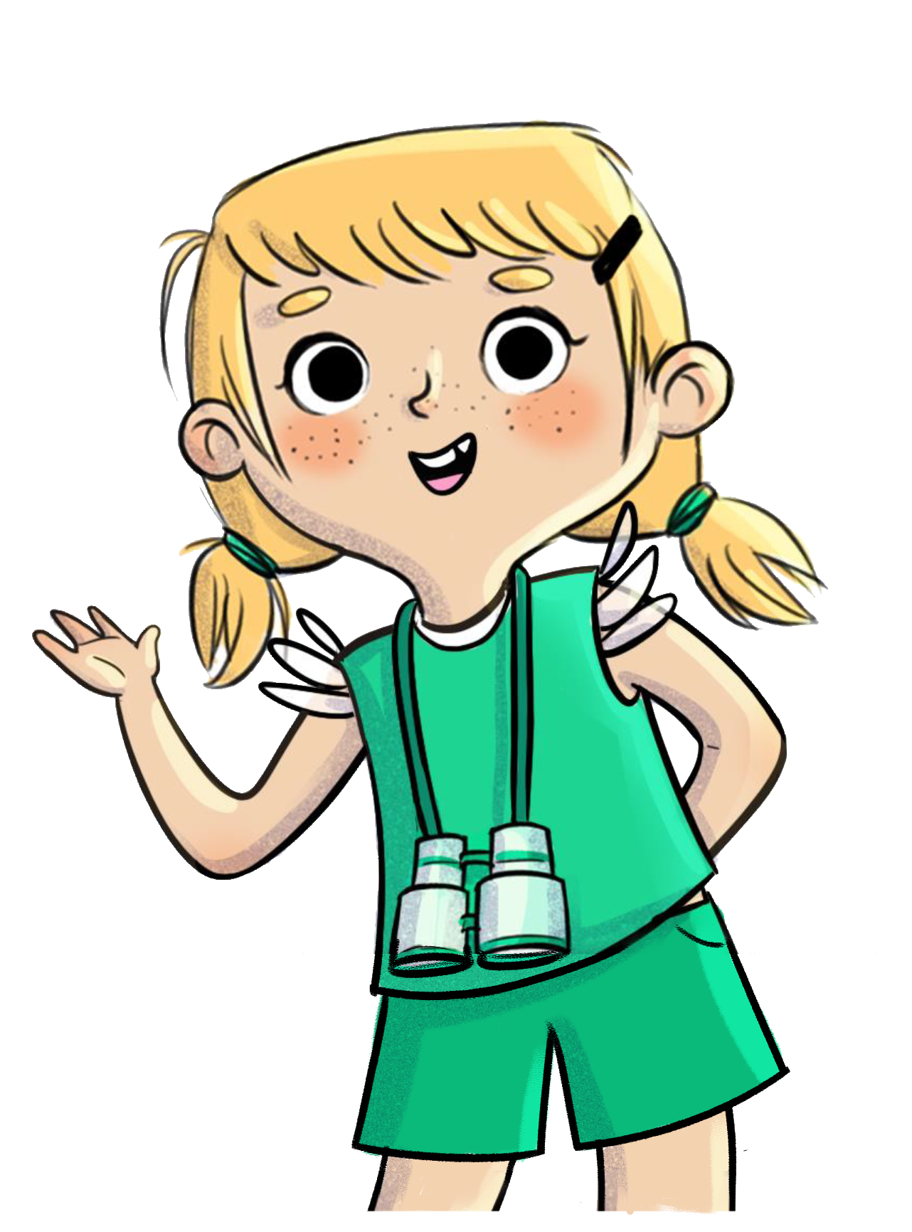
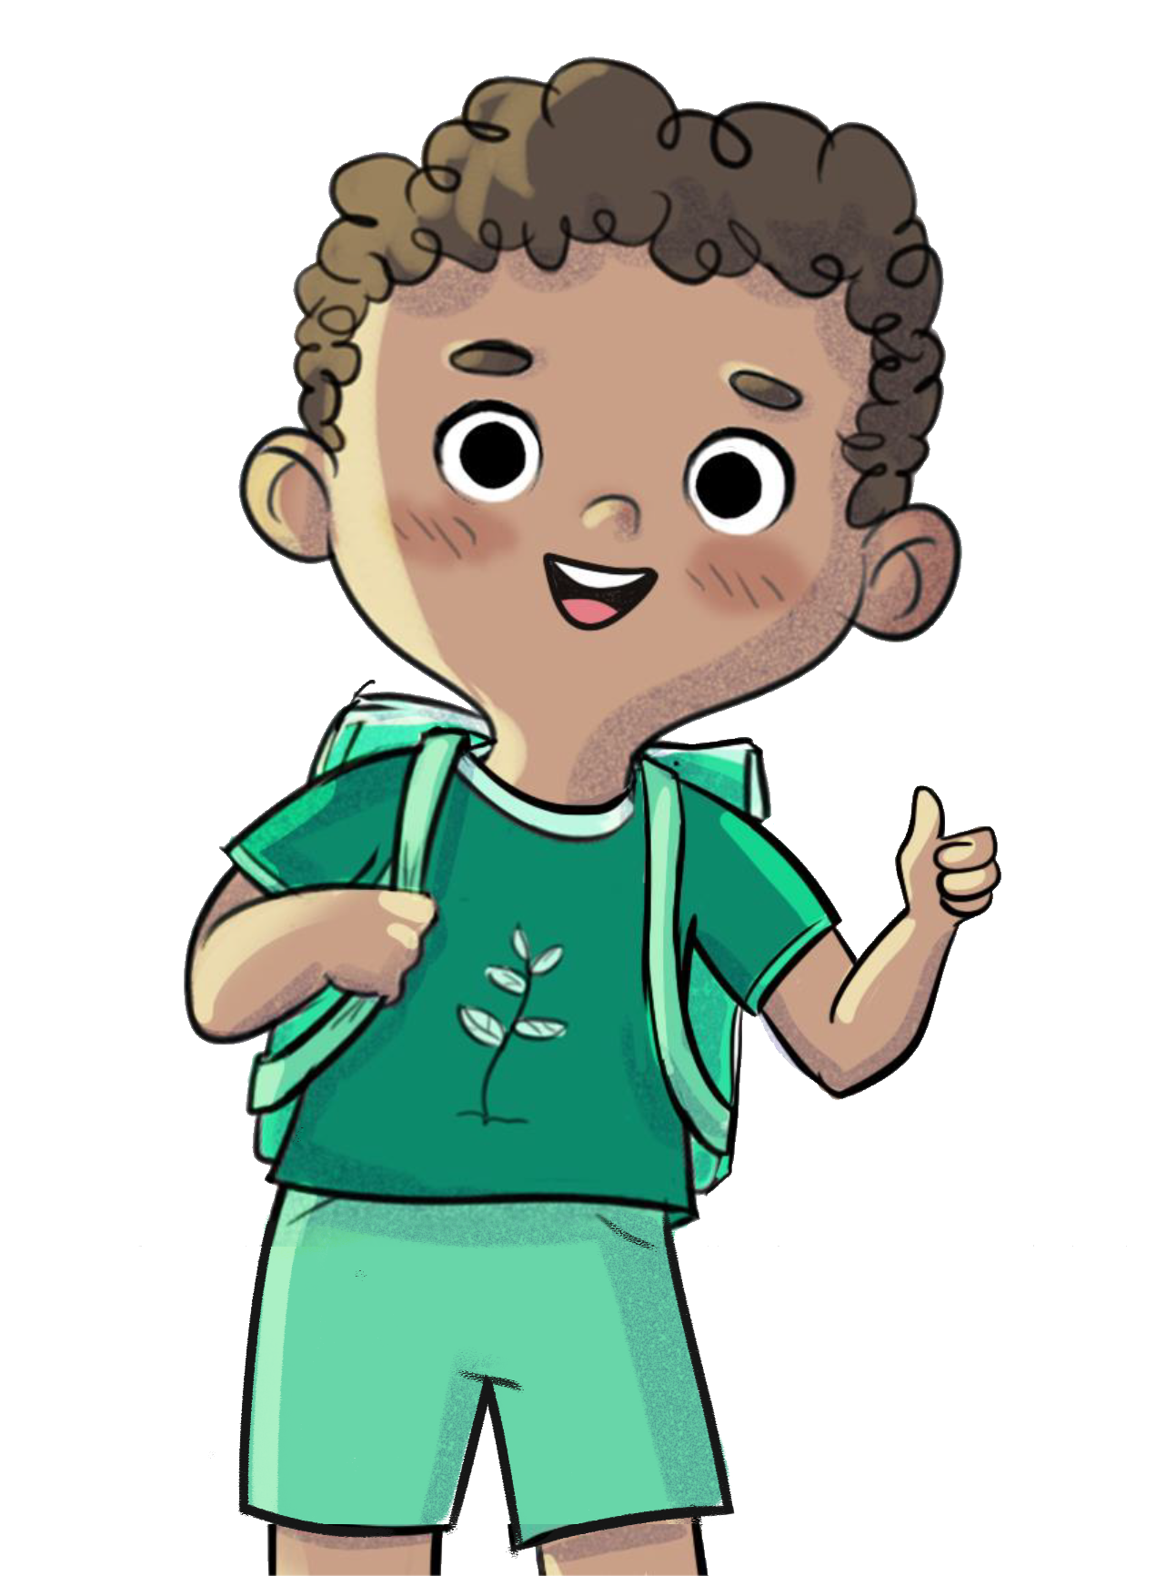

Hi, I'm Charlie!
And I'm Leo! Have you ever heard of Camp OFF-TRAIL?

Slide 3
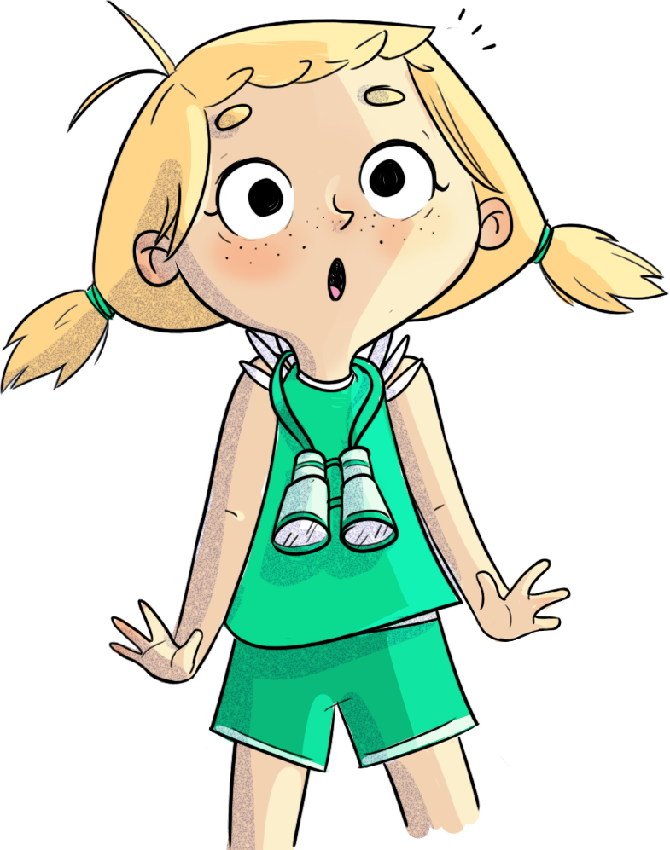
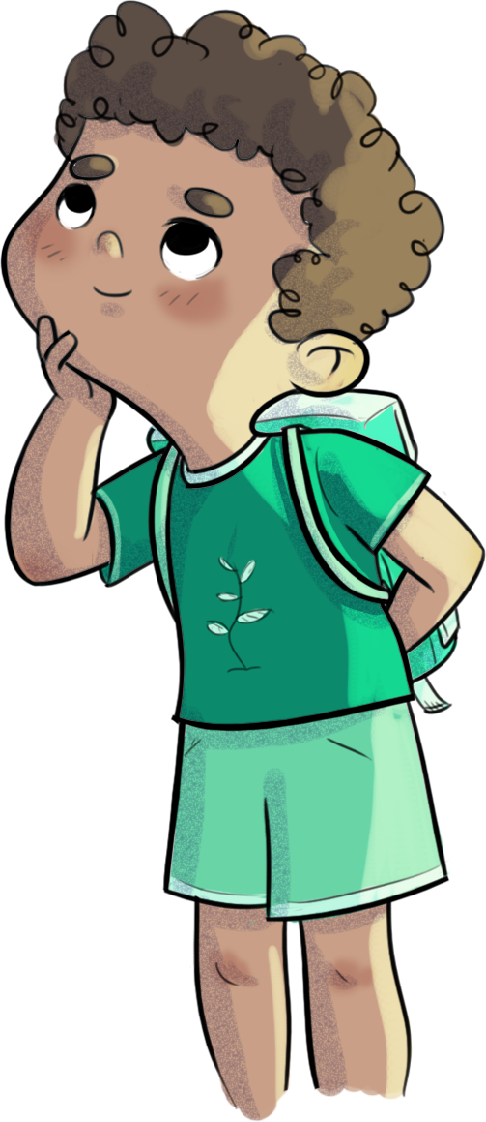
But Leo, what's a camp?
My cousin went to a camp...

Slide 4
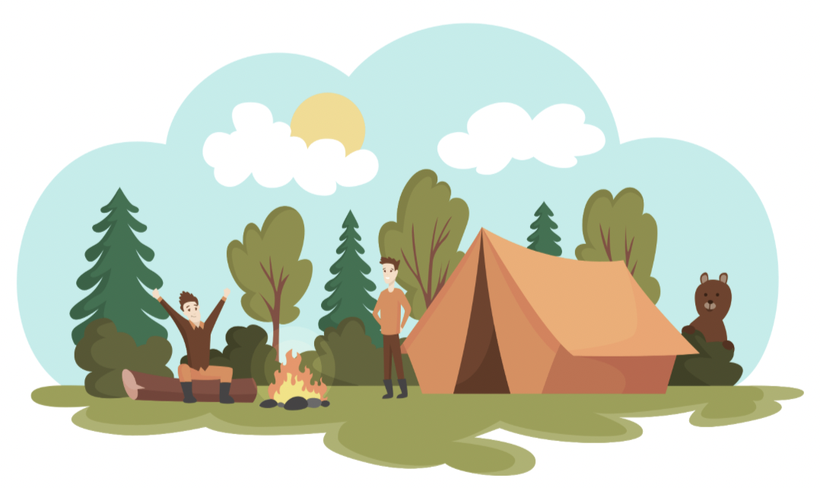

I think it's different place from school, where you can
stay a few days with other kids
and do outdoor activities.

Slide 5

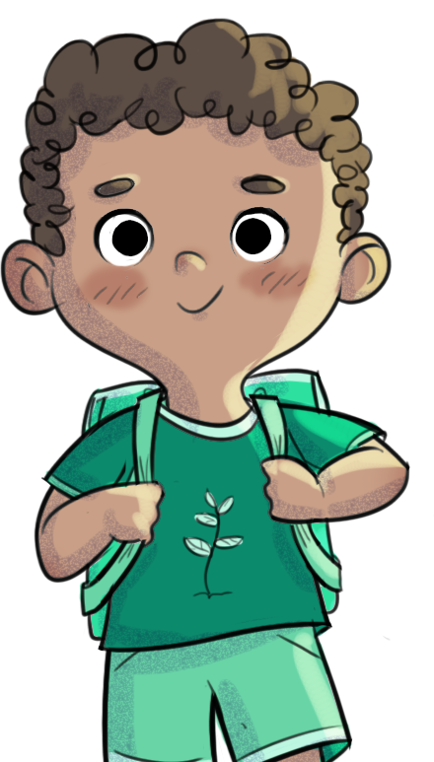

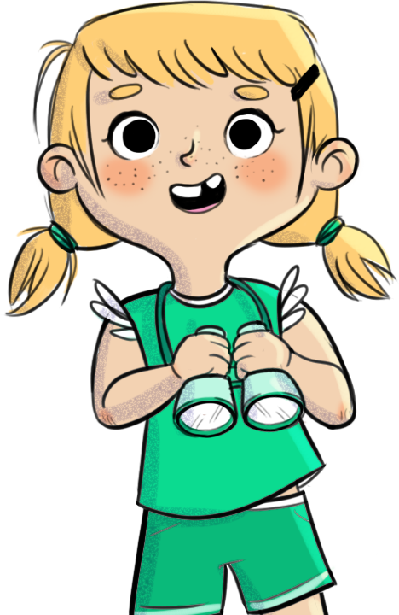
My cousin went there with his class,
on a school bus.

Slide 6


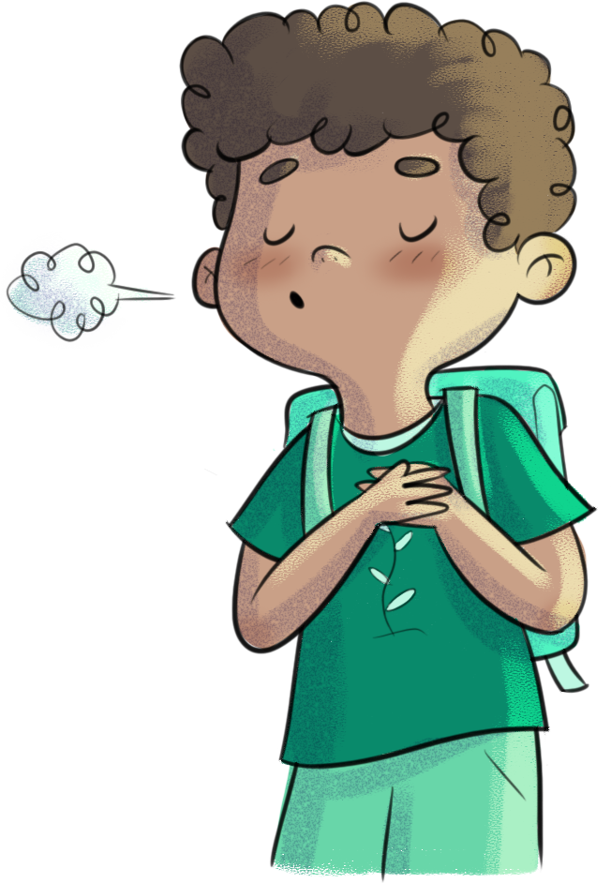




In the evening, they built a campfire and ate toasted marshmallows.

Slide 7

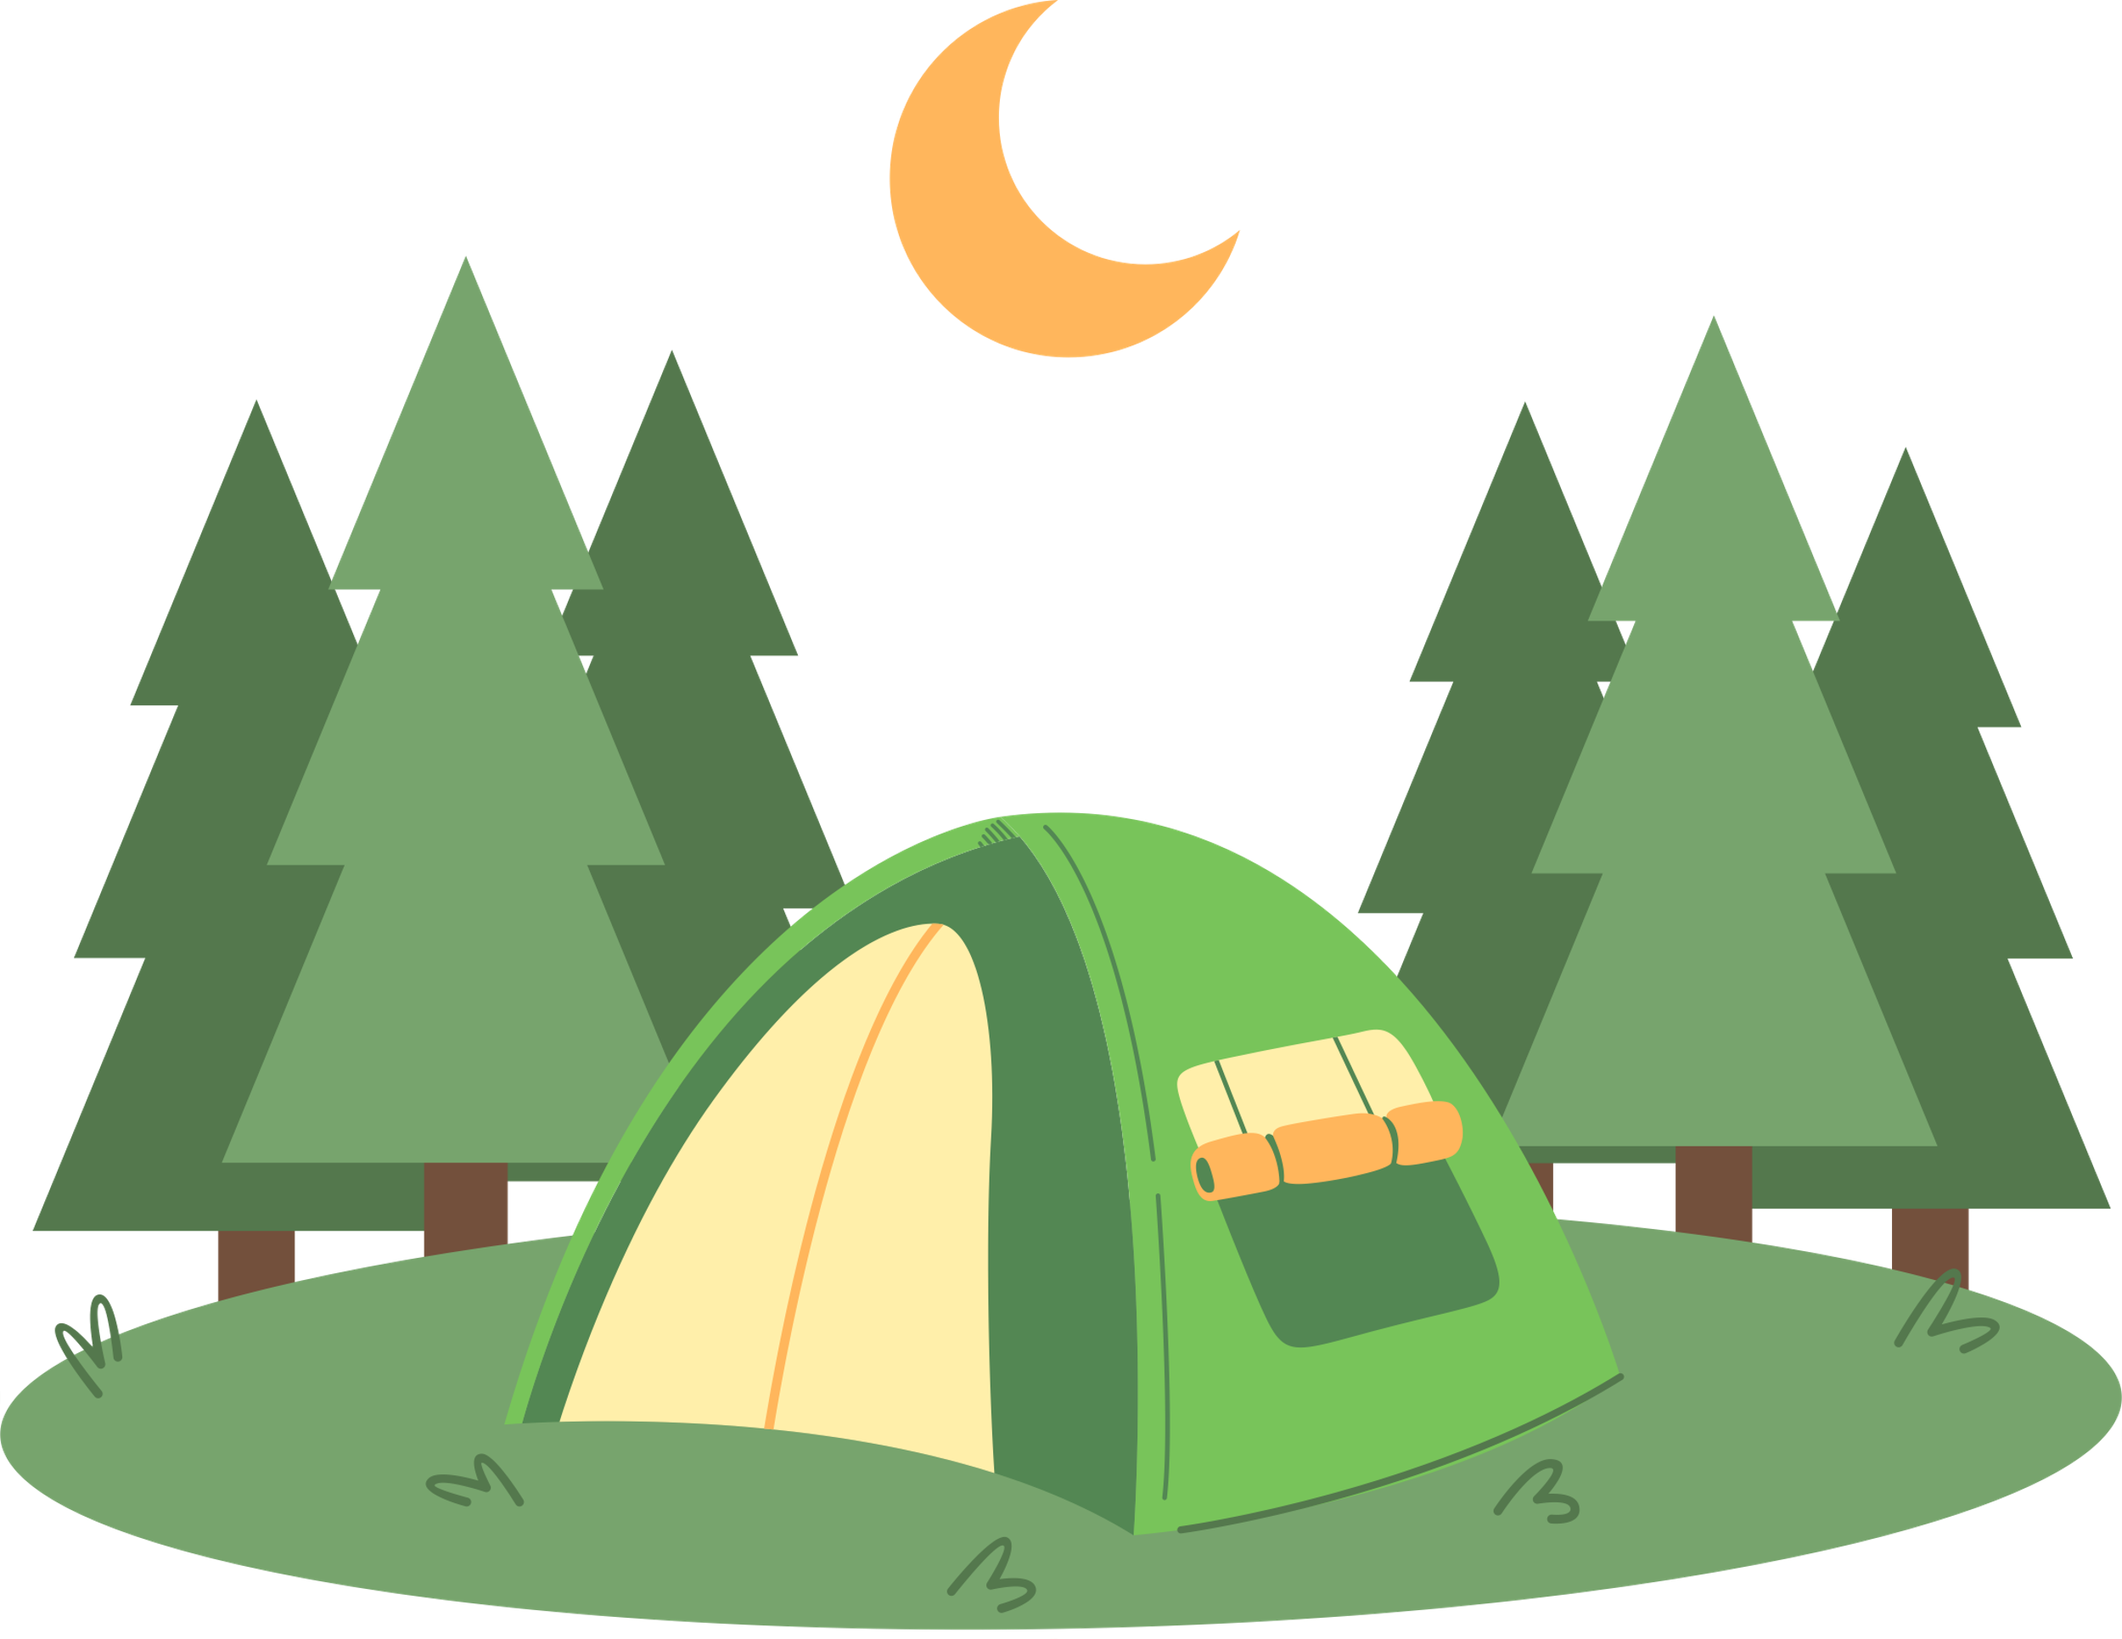
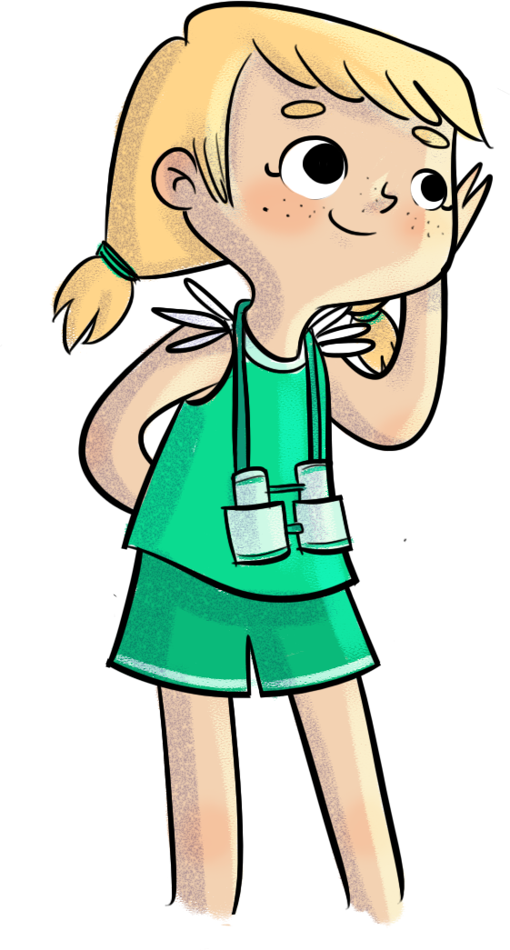





And they even slept in tents.

Slide 8



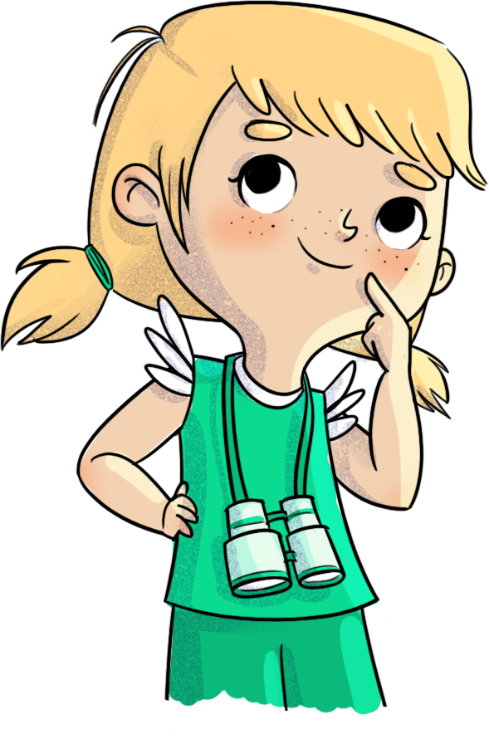
















I heard you can go hiking there! Did your cousin go hiking?

Slide 9

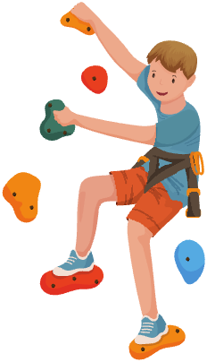
No, but he did climbing!!!

Slide 10
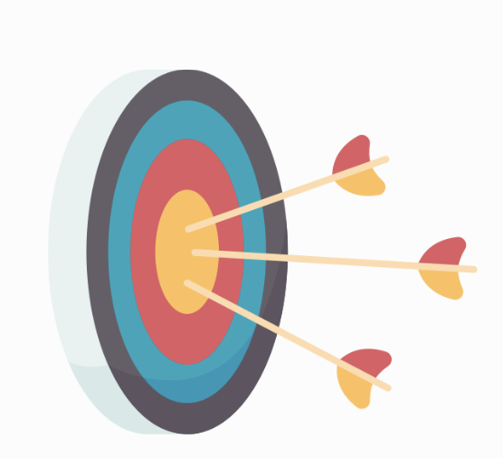

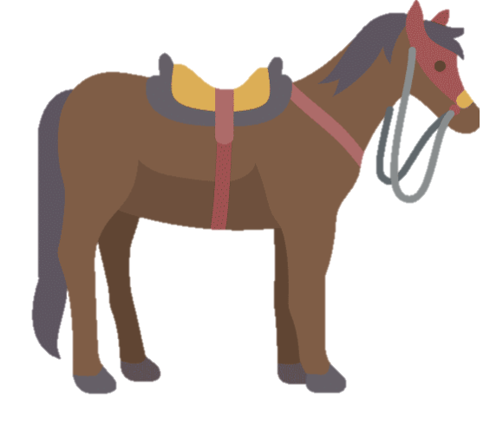
And lots of other outdoor activities like archery, fishing and horseback riding.

Slide 11
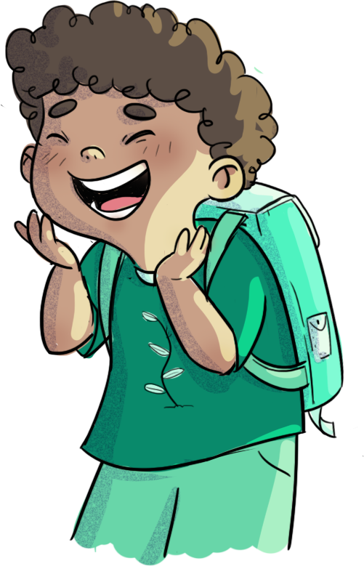
I can't wait to go! I wonder if there will be lots of birds? I love looking at them through my binoculars!
Oh yeah, we're going to have so much fun! And we're going to learn a lot of new things, too.

Slide 12
