Slide 1
The fear of fear itself . . .
When anxiety takes over!
Translate by Direction Santé Publique, CISSS Montérégie Centre
Traduit par Direction Santé Publique, CISSS Montérégie Centre
Translate by Direction Santé Publique, CISSS Montérégie Centre
Traduit par Direction Santé Publique, CISSS Montérégie Centre

Slide 2
At the end of the workshop, you’ll be be able to . . .
tell the difference between stress and anxiety, and recognize the signs of anxiety
understand the concepts of comfort zone, avoidance and exposure
identify situations that trigger an especially strong reaction
apply new strategies to prevent or lessen anxiety

Slide 3
True or false
Stress is always negative . . .
There’s no difference between stress and anxiety . . .
Anxiety is the fear of fear itself . . .
It’s normal to feel anxiety . . .
If you have anxiety now, you’ll have it forever . . .
(Lupien, 2019; Marchand, Letarte and Seidah, 2018; Shih and Lin, 2017; Strack et al., 2017; Yerked and Dodson, 1908)

Slide 4
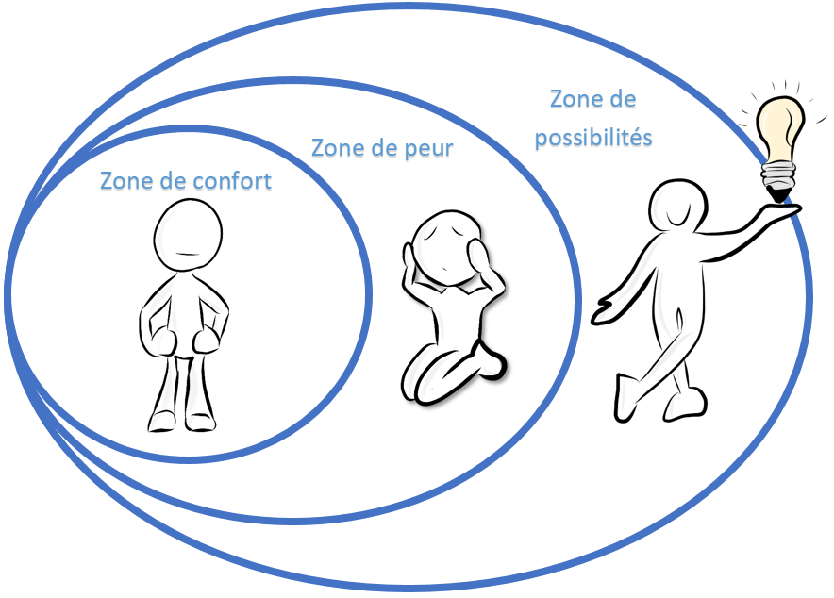
The comfort zone . . .
The comfort zone is that place in life where you feel good or in familiar territory.
It’s the relationships, events and places where you know how to react, where you don’t have to think about anything too much.
It’s the zone where you feel most COMFORTABLE.
(White, 2009)

Slide 5
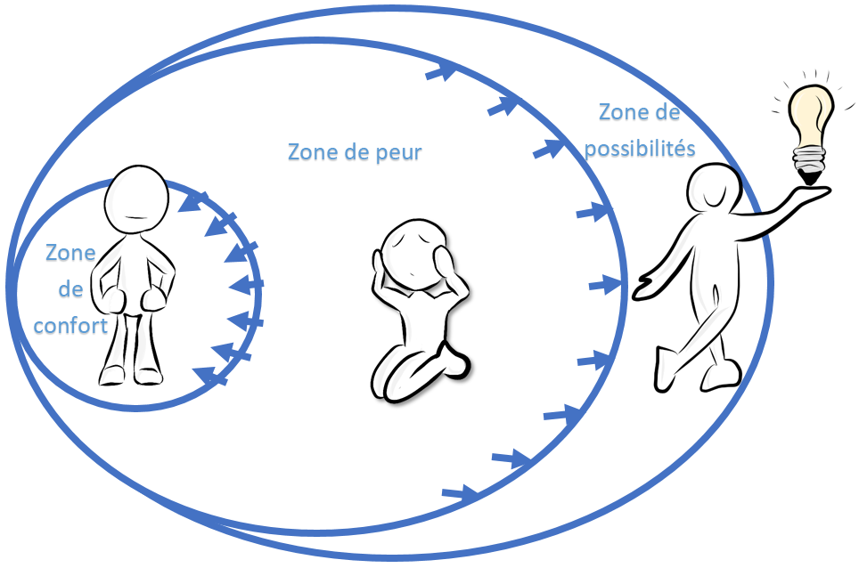
The comfort zone . . .
Anxiety can happen when you step out of your comfort zone, or even when you think about situations that take you out of your comfort zone.
You would have to go through your fear zone . . . which is pretty uncomfortable!
So, instead, you avoid the situation by retreating to your comfort zone. This is called avoidance.

Slide 6
The avoidance curve
Anxiety
3rd avoidance
Avoidance
is anxiety’s best friend!
2nd avoidance
1st avoidance
Time

Slide 7
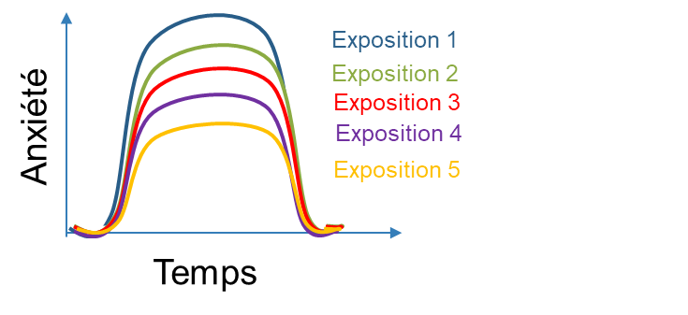
The comfort zone . . .
The more you expose yourself to uncomfortable situations, the more you expand your comfort zone!
The more you face your fears, the less intense they become; they might even disappear. This is called exposure!
(Forsyth and Eifert, 2007; Gosselin et al., 2019; Harvey and Ikic, 2014).

Slide 8
The comfort zone . . .
The more you expose yourself to uncomfortable situations, the more you expand your comfort zone!
Remember!
Anxiety is not dangerous . . .
It’s temporary.
It always disappears eventually.

Slide 9
Intolerances that distort reality...
Why can the same situation cause so much anxiety
for one person, but none at all for someone else?
We all have different tolerance levels for the situations we encounter.
Being intolerant is a little like being allergic to certain situations!
Intolerances are like glasses that distort reality.

Slide 10
Intolerances that distort reality . . .
Intolerance to uncertainty:
I worry about everything!
This is an intolerance to anything that is potentially dangerous, different, or new.

Slide 11
Intolerances that distort reality . . .
Perfectionism:
I don’t feel right unless it’s perfect!
This is an intolerance to the risk of making a mistake, a tendency to criticize your own achievements, an intolerance for anything less than perfect.

Slide 12
Intolerances that distort reality . . .
Excessive responsibility:
I always feel guilty!
This is an intolerance to the fact other people might be affected or suffer consequences because of you, and that you did nothing to prevent it.

Slide 13
Intolerances that distort reality . . .
The fear of being judged by others:
I know they’re judging me!
This is an intolerance to being judged and possibly criticized by others, of being mocked and laughed at.

Slide 14
Intolerances that distort reality . . .
An intolerance to negative emotions and unpleasant physical sensations:
There’s something wrong with my body!
This is the tendency to worry excessively about the physical sensations and symptoms caused by anxiety.

Slide 15
Strategies for coping with anxiety
Adopt healthy lifestyle habits
Recognize your physical sensations and warning signs of anxiety
Transform your unhelpful thoughts into helpful ones
Learn to see things differently
Use strategies to deal with your emotions
Confront anxiety-provoking situations instead of avoiding them
Step out of your comfort zone
Use concrete techniques to calm down when faced with a stressful situation:
Do a physical activity
Talk to someone about your stress
Have fun with your friends
Draw, paint, sculpt, create
Do a mindfulness exercise
Maintain quality social relationships
(Centre RBC d’expertise universitaire en santé mentale and its partners (2019)

Slide 16
HORS-PISTE challenge
Observe your reactions to situations that cause you anxiety.
Try to apply at least two strategies to cope with anxiety-provoking situations.

Slide 17
For more content . . .
Visit
Follow us on Instagram
@horspiste_explo

