Slide 1
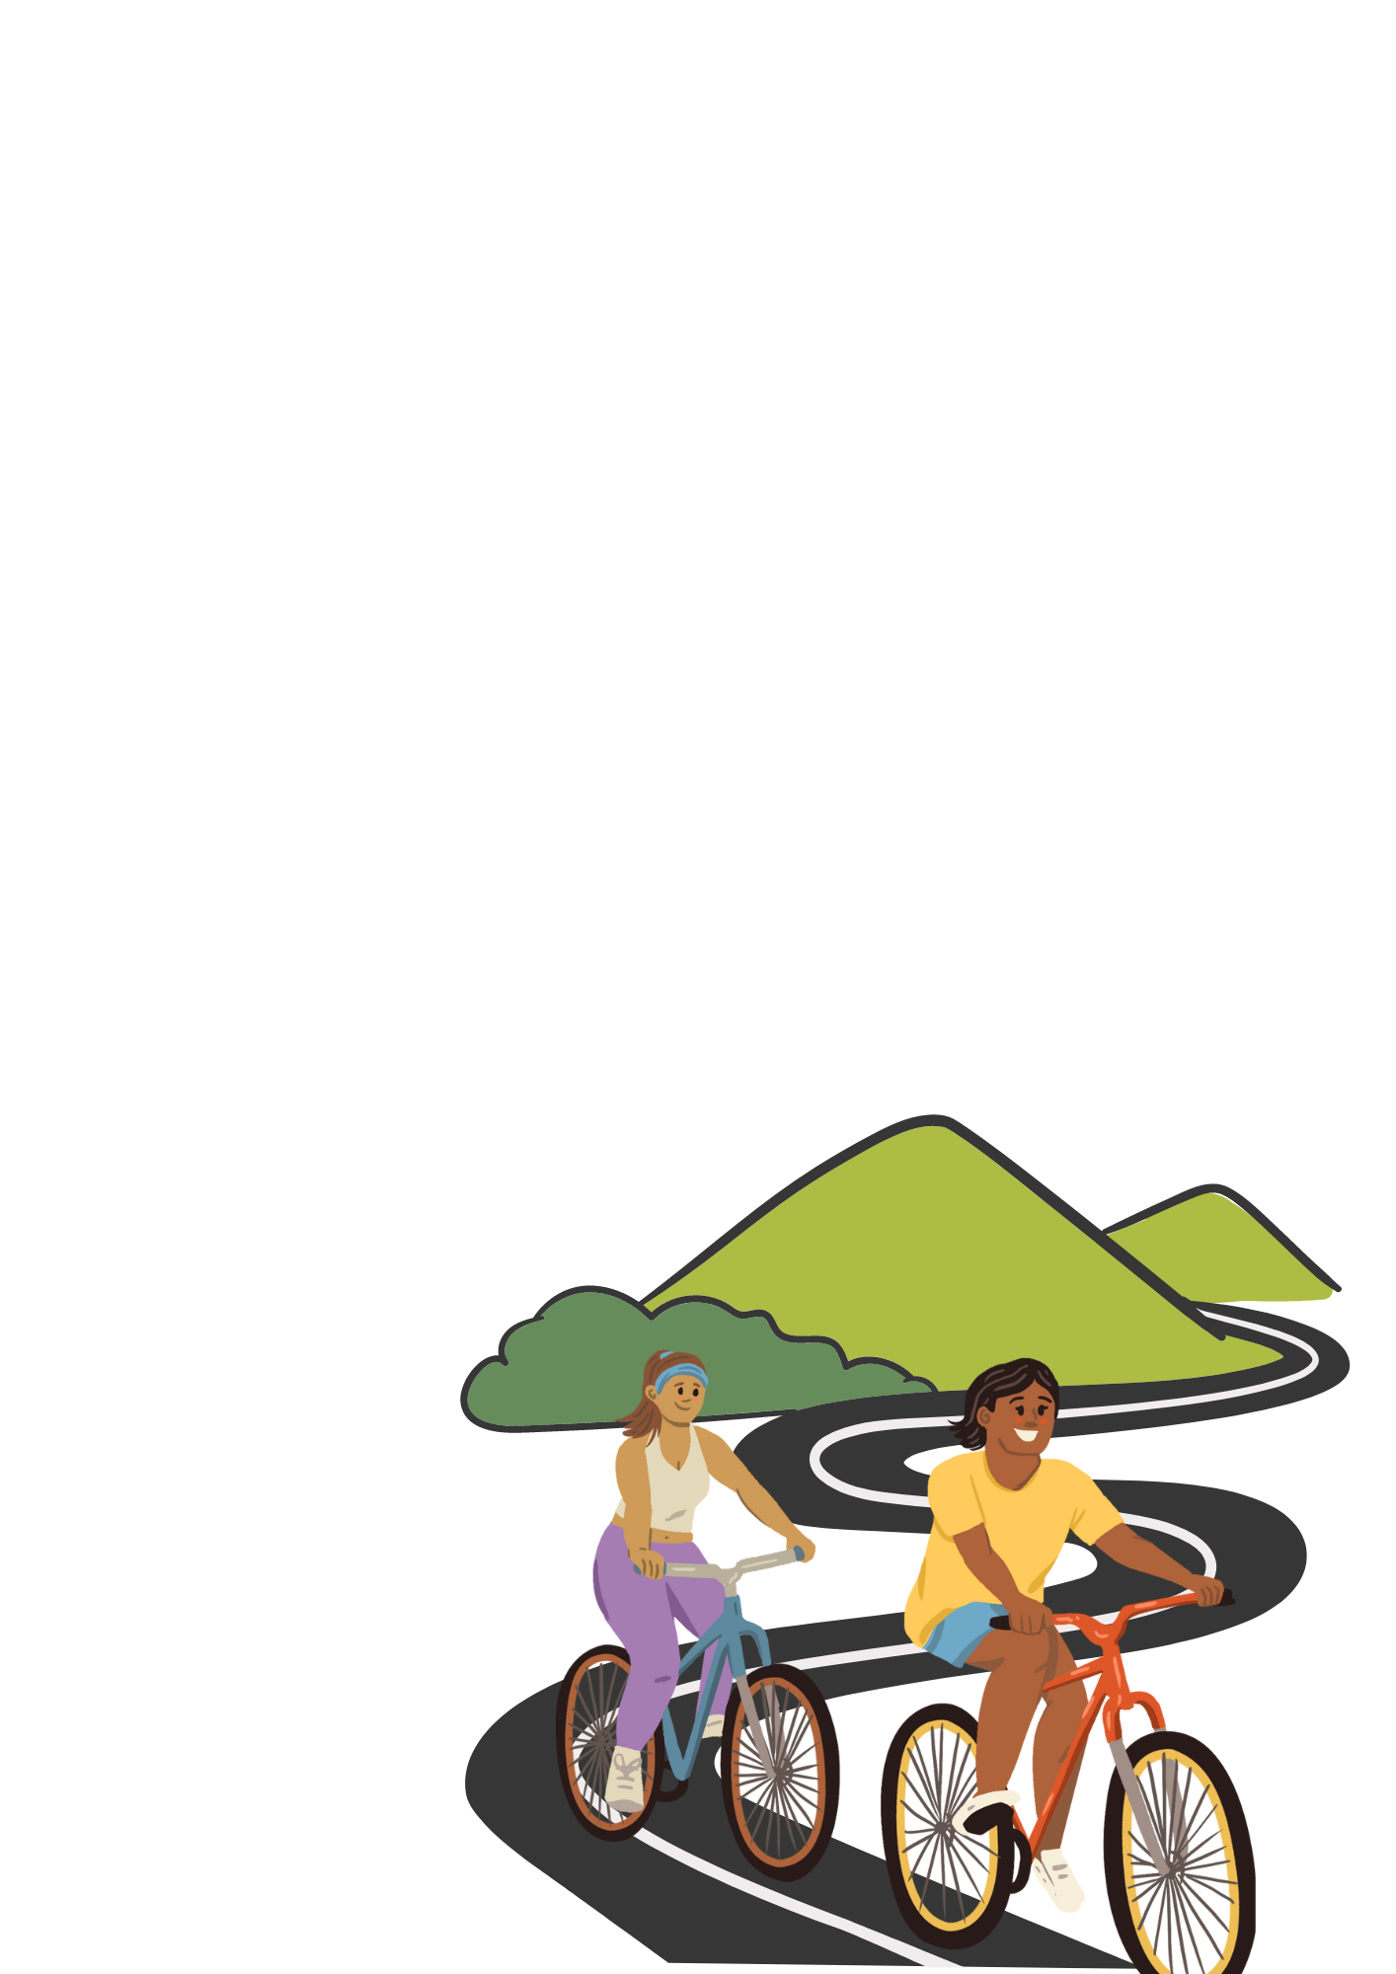
Exploration component
PHYSICAL
ACTIVITY
A HEALTHY LIFESTYLE
HABIT TO ADOPT
150 MINUTES
That’s how much moderate exercise per week the World Health Organization recommends you get!
Adding physical activity to your routine increases your heart rate.
The goal is to break the cycle of a sedentary lifestyle and get moving, even if the activity is low intensity (e.g., walking).
Translate by Direction Santé Publique, CISSS Montérégie Centre
Traduit par Direction Santé Publique, CISSS Montérégie Centre
Notes:
References:
Bel, S., De Ridder, K., Lebacq, T., Ost, C. and Teppers, E. (2014). Activité physique et sédentarité : résultats de l’enquête de consommation alimentaire (publication no. 2015). https://fcs.wiv-isp.be/nl/Gedeelde%20%20documenten/FRANS/PA_FR .pdf
WHO (2010). Global recommendations on physical activity for health. Geneva: WHO Publishing.

Slide 2
Exploration component
SCREEN TIME AND DIGITAL WELL-BEING
A HABIT TO WATCH OUT FOR!
Screen time for entertainment should be limited to 2 hours per day for children and teens.
For adults, 3 hours per day is enough.
IMPORTANT!
What you see on your screens can affect your well-being.
Screen time also increases sedentary behaviours, something you want to avoid when adopting a healthy lifestyle!
Translate by Direction Santé Publique, CISSS Montérégie Centre
Traduit par Direction Santé Publique, CISSS Montérégie Centre
Notes:
References:
Gouvernement du Québec (2021). Healthy lifestyle habits. https://www.quebec.ca/en/health/advice-and-prevention/healthy-lifestyle-habits (consulted on February 9, 2023).
Gouvernement du Québec (2023). Balanced screen use for children and teens. https://www.quebec.ca/en/health/advice-and-prevention/healthy-lifestyle-habits/healthy-screen-habits-among-youth(consulted on February 9, 2023).
Wang, C., Colley, R., Roberts, K.. Chaput, J.-P. and Thompson, W. (2022). Sleep behaviours among Canadian adults: Findings from the 2020 Canadian Community Health Survey healthy living rapid response module. https://www150.statcan.gc.ca/n1/pub/82-003-x/2022003/article/00001-eng.htm (consulted on February 9, 2023).
Morin, M.-C., Chaput, M., Desjardins-Turcotte, F., Turcotte, S., Beaudoin, S. and Berrigan, F. (2021). Revue de littérature : effets de l’utilisation des écrans sur l’adoption ou non d’un mode de vie physiquement actif chez les enfants et les adolescents. [Literature review: Effects of screen time on whether or not children and teens adopt a physically active lifestyle.] Submitted to the Table sur un mode de vie physiquement actif (TMVPA), 50 pages.

Slide 3
Exploration component
SLEEP
AN IMPORTANT HABIT!
Good habits to adopt:
7-9 HOURS
QUALITY SLEEP
REGULAR SCHEDULE
LIMIT SCREENS IN THE BEDROOM
TURN OFF SCREENS 30 MINUTES BEFORE BEDTIME
Physical activity and less screen time are two factors that can influence the quality of your sleep!
Translate by Direction Santé Publique, CISSS Montérégie Centre
Traduit par Direction Santé Publique, CISSS Montérégie Centre
Notes:
Reference:
Wang, C., Colley, R., Roberts, K.. Chaput, J.-P. and Thompson, W. (2022). Sleep behaviours among Canadian adults: Findings from the 2020 Canadian Community Health Survey healthy living rapid response module. https://www150.statcan.gc.ca/n1/pub/82-003-x/2022003/article/00001-eng.htm (consulted on February 9, 2023).

Slide 4
Exploration component
DIET
FINDING THE RIGHT BALANCE
A balanced plate means:
PROTEIN
(e.g., meat, fish, tofu, eggs)
WHOLE GRAINS
(e.g., rice, quinoa, pasta, whole wheat couscous)
VEGETABLES
(e.g., broccoli, carrots, mushrooms, spinach)
We also recommend you limit your intake of
ULTRA-PROCESSED FOODS
because they often have a long list of ingredients.
A LITTLE REMINDER!
"Eating a balanced diet also means enjoying treats once in a while!"
Translate by Direction Santé Publique, CISSS Montérégie Centre
Traduit par Direction Santé Publique, CISSS Montérégie Centre
Notes:
References:
Gouvernement du Québec (2021). Healthy lifestyle habits. https://www.quebec.ca/en/health/advice-and-prevention/healthy-lifestyle-habits (consulted on February 9, 2023).
Lavallée, B. (2018). N'avalez pas tout ce qu'on vous dit: superaliments, détox, calories et autres pièges alimentaires. Editions LaPresse.

Slide 5
DRUGS AND ALCOHOL
What things DON’T mix with drugs and alcohol?
Driving
Operating machinery or using tools
Taking medications that interact with alcohol
Doing anything dangerous
Making important decisions
Physical or mental health problems
Addiction, current or planned pregnancy
Being responsible for other people’s safety
Translate by Direction Santé Publique, CISSS Montérégie Centre
Traduit par Direction Santé Publique, CISSS Montérégie Centre
Notes:
Reference:
Institut national de santé publique du Québec (2023). Les recommandations de consommation d’alcool à faible risque. https://www.inspq.qc.ca/substances-psychoactives/alcool/dossier/alcool-recommandations-consommation-faible-risque (consulted on February 9, 2023).

