Slide 1


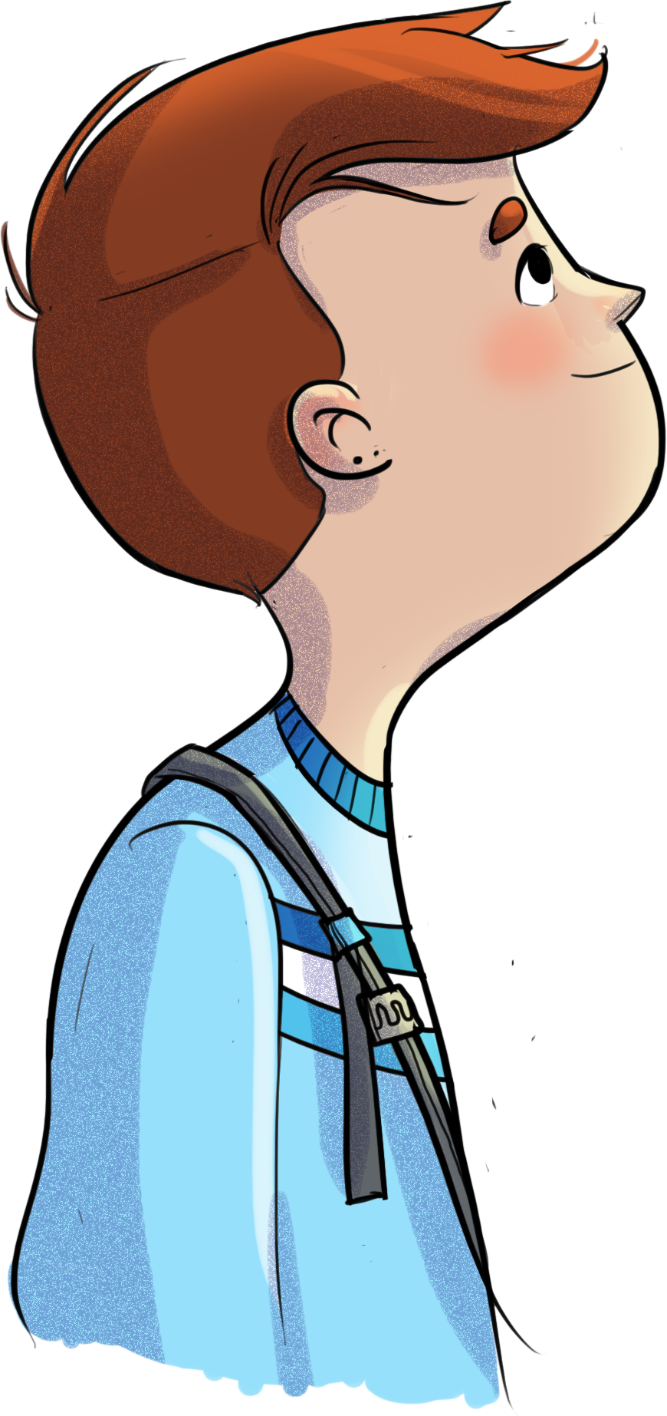
Expedition component
HORS-PISTE – Expedition is a program designed to help students develop the competencies they need to deal with the anxiety-provoking situations they face and to equip you, as parents, with strategies to help them develop these new competencies.
Like a road less travelled, the program encourages participants to push themselves, test out new solutions, and adopt new ways of thinking! HORS-PISTE helps the students to recognize their strengths and limitations and guides them toward new ways of approaching life with confidence, compassion, and perseverance.
8 group meetings for students
… that will help them to expand their comfort zone by learning to:
Recognize their sensations
Reformulate their thoughts into helpful ones
Manage their emotions to better cope with them
Adopt new behaviours
Adopt positive lifestyle habits
Use stress management strategies
Draw on their strengths to help other group members progress
3 group meetings for parents…
…that will give you the opportunity to:
Understand anxiety and recognize its effects on your child
Develop tools to help your child expand their comfort zone
Adopt new behaviours to reduce accommodation
Discuss your experiences and draw on your strengths to help other group members progress

Slide 2




Expedition component
How the program works
STUDENT group
PARENT group
8 weekly meetings
From ____ to ______ (add the dates)
On _________ (add day of the week) from _____ to _____ (add the times)
Facilitated by ____________ (add the facilitator’s name)
___________ (add the meeting location)
3 biweekly meetings
From ____ to ______ (add the dates)
On _________ (add day of the week) from _____ to _____ (add the times)
Facilitated by ____________ (add the facilitator’s name)
___________ (add the meeting location)
Other important information: (to be completed, as needed)
For questions, contact: (add the name and contact information of the contact person)
HORS-PISTE doesn’t mean being out in left field!

