Slide 1
Expedition - Student component

Slide 2
Workshop 1 Me, anxious…?

Slide 3
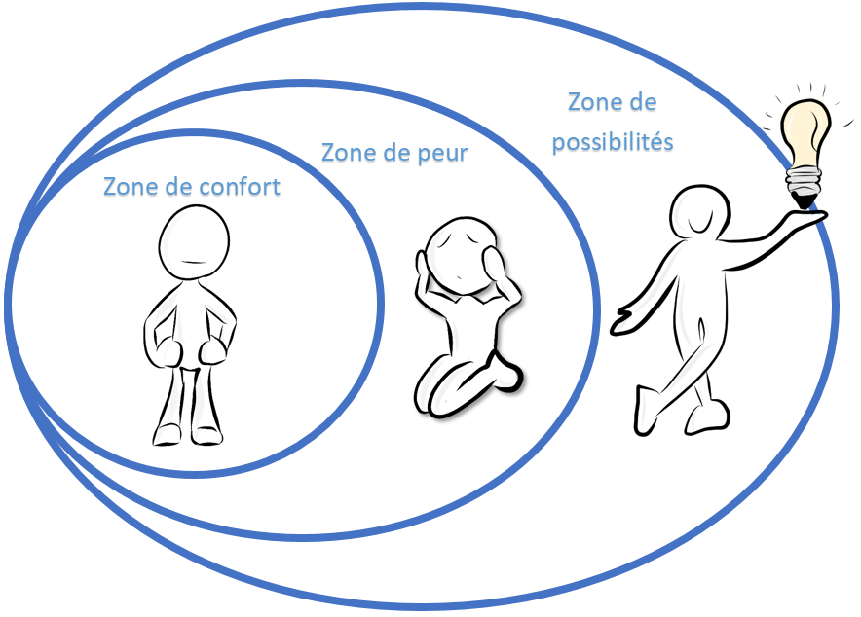
My comfort zone
Growth zone
Fear zone
Comfort zone

Slide 4
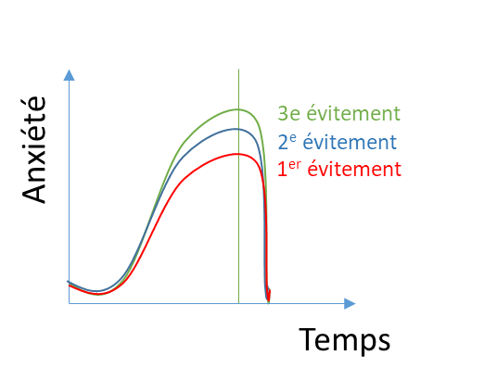
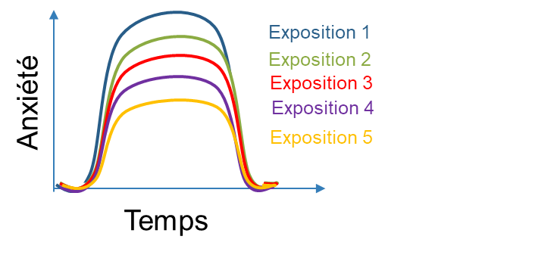
My avoidance and exposure strategies
Exposure 1
Exposure 2
Exposure 3
Exposure 4
Exposure 5
3rd avoidance
2nd avoidance
1st avoidance
Anxiety
Anxiety
Time
Time

Slide 5
To expand your comfort zone, you will learn to…
My possibility zone
Fear zone
My comfort zone
Reformulate my thoughts
Manage my emotions
Reformulate your thoughts;
Manage your emotions;
Take action;
Adopt positive lifestyle habits;
Use stress management strategies;
Nurture and properly use your social network.
Me
Use stress management strategies
Take action
Nurture and use my social network
Adopt positive lifestyle habits

Slide 6
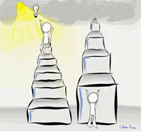
To succeed, you will have to take baby steps…
The importance of small steps
What is your objective with this program?
Identify 7 baby steps that will bring you closer to this objective.

Slide 7
Workshop 2 What if I thought about it differently…

Slide 8
Mindful listening
https://www.youtube.com/watch?v=toJf4_dvwSQ

Slide 9
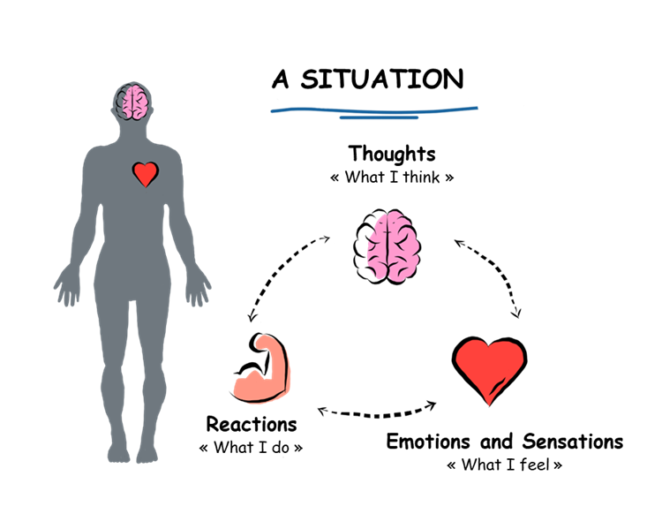
What’s going on inside me MY THOUGHTS

Slide 10
Are my thoughts helpful?
Description of the situation | Thoughts | Emotions and sensations | Reformulating thoughts into realistic, helpful, positive ones | Emotions and sensations
“Teamwork... I don’t know anyone” | “No one will want to be my partner” | “Fear, shame, pounding heart” | “Maybe there’s someone else who’s just as shy as me, and they’d be happy if I suggested we team up” | “Courage, stand up straight”

Slide 11
Workshop 3 What’s going on inside me?

Slide 12
Mindful drawing

Slide 13
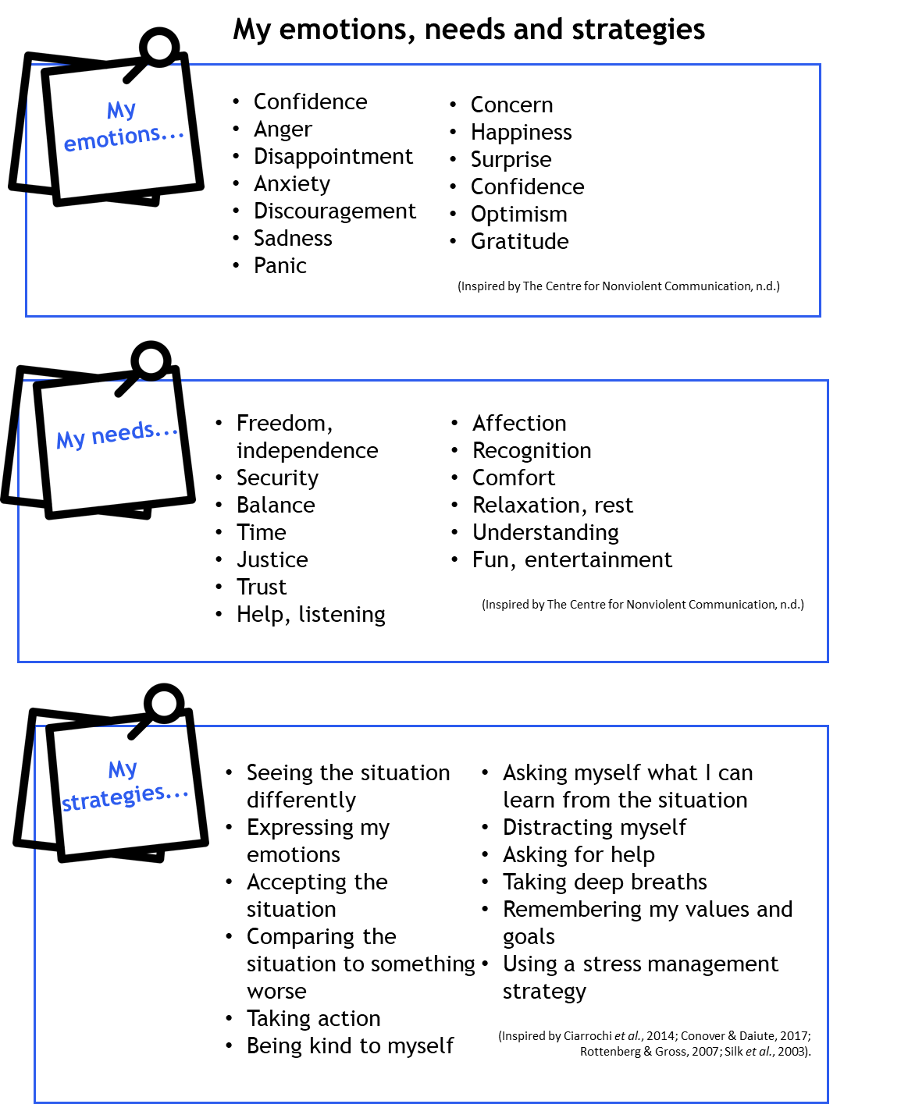
What’s going on inside me?
MY EMOTIONS

Slide 14
Workshop 4 HORS-PISTE activity

Slide 15
Mindful eating

Slide 16
Workshop 5 A helping hand?

Slide 17
The WOW effect!
https://www.youtube.com/watch?v=N6-2fVsFV8E&t=1s

Slide 18
Workshop 6 Glasses that distort reality

Slide 19
Mountain meditation
https://sante-mentale-jeunesse.usherbrooke.ca/wp-content/uploads/2022/11/Mountain-meditation-1.mp4

Slide 20
Workshop 7 HORS-PISTE activity

Slide 21
Mindful breathing

Slide 22
Workshop 8 WOW! Great progress!

Slide 23
Portrait of my comfort zone
My possibilities zone
3rd question to use
3rd emotion regulation strategy to try
My former comfort zone
Reformulate my thoughts
2 questions that help me reformulate
Regulate my emotions
2 emotion regulation strategies I use
Me
Use stress management strategies
2 stress management strategies I use
Take action
2 small steps I took
3rd stress management strategy to try
3rd small step I would like to take
Adopt positive lifestyle habits
2 habits I adopted
Grow and rely on my social network
2 people I can rely on
3rd person I’d like to get closer to
3rd lifestyle habit to adopt

Slide 24
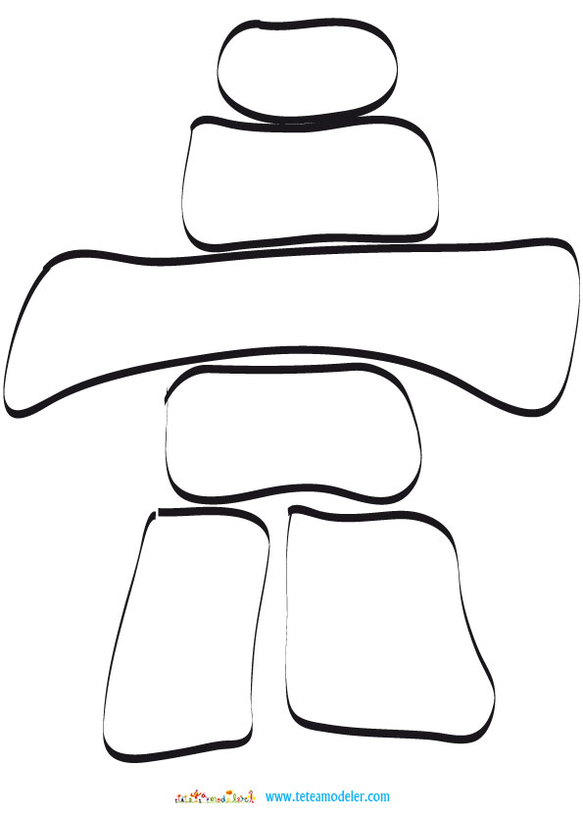
Place inukshuks on your path…
“Inukshuks are placed throughout the Arctic landscape and act as “helpers” for the Inuit. Among their many practical functions, they are used as navigation and hunting aids, as coordination points, as indicators of all kinds and as message centres.”
Hallendy, 2015

