Slide 1
Expedition+ - Student component

Slide 2
Workshop 1 Me, anxious…?

Slide 3
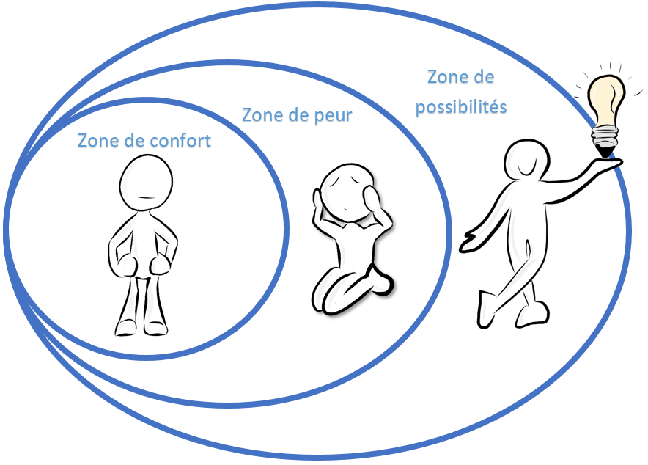
My comfort zone
Growth zone
Fear zone
Comfort zone

Slide 4
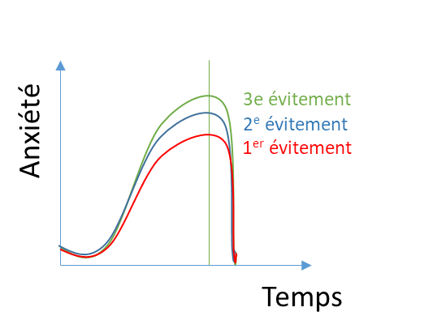
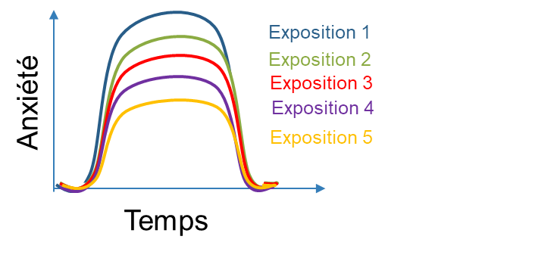
My avoidance and exposure strategies
Exposure 1
Exposure 2
Exposure 3
Exposure 4
Exposure 5
3rd avoidance
2nd avoidance
1st avoidance
Anxiety
Anxiety
Time
Time

Slide 5
To expand your comfort zone, you will learn to…
My possibility zone
Fear zone
My comfort zone
Reformulate my thoughts
Manage my emotions
Reformulate your thoughts;
Manage your emotions;
Take action;
Adopt positive lifestyle habits;
Use stress management strategies;
Nurture and properly use your social network.
Me
Use stress management strategies
Take action
Nurture and use my social network
Adopt positive lifestyle habits

Slide 6
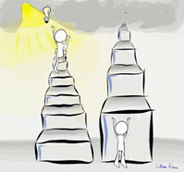
To succeed, you will have to take baby steps…
What is your objective with this program?
Identify 7 baby steps that will bring you closer to this objective.

Slide 7
Workshop 2 What if I thought about it differently…

Slide 8
Mindful listening
https://www.youtube.com/watch?v=toJf4_dvwSQ

Slide 9
Mindfulness, an essential tool
Digging deeper…
The Guide de présence à soi (GPS) is a collection of activities you can do at home.
https://sante-mentale-jeunesse.usherbrooke.ca/wp-content/uploads/2018/12/Final-GPS.pdf
Notes:
As part of the student workshops, you could be introduced to mindfulness activities.
You may be asked to think about different themes related to mindfulness, such as the attitudes to adopt, how to incorporate mindfulness at school, etc.
You can also observe the effects of mindfulness on the students in your groups.
If you’re interested in mindfulness and want to explore it a little further, we’ve also developed tools to help guide you, such as the Guide de présence à soi (GPS), which is a collection of activities to do with students, guided meditations, and mindfulness activity sheets for teachers and counsellors.
https://sante-mentale-jeunesse.usherbrooke.ca/wp-content/uploads/2018/12/Final-GPS.pdf

Slide 10
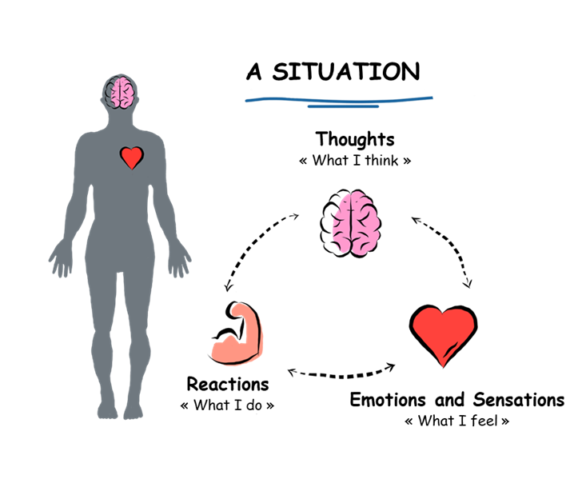
What’s going on inside me MY THOUGHTS

Slide 11
Are my thoughts helpful?
Description of the situation | Thoughts | Emotions and sensations | Reformulating thoughts into realistic, helpful, positive ones | Emotions and sensations
“Teamwork... I don’t know anyone” | “No one will want to be my partner” | “Fear, shame, pounding heart” | “Maybe there’s someone else who’s just as shy as me, and they’d be happy if I suggested we team up” | “Courage, stand up straight”

Slide 12
Workshop 3 HORS-PISTE activity

Slide 13
Mindful eating

Slide 14
Workshop 4 What’s going on inside me?

Slide 15
Mindful drawing

Slide 16
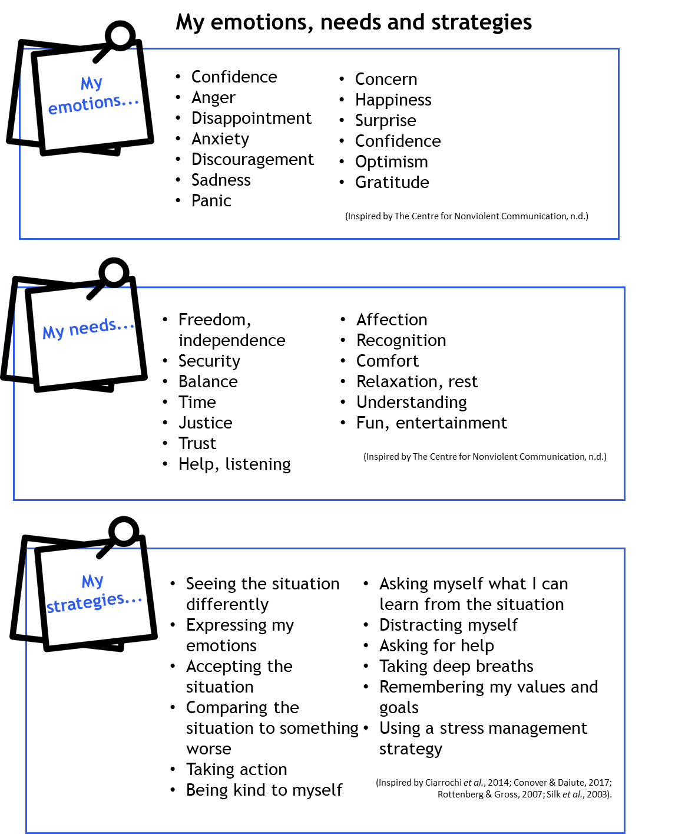
What’s going on inside me?
MY EMOTIONS

Slide 17
Because experiencing emotions… is NORMAL!
https://www.dailymotion.com/video/x37r89b

Slide 18
Workshop 5 A helping hand?

Slide 19
The WOW effect!
https://www.youtube.com/watch?v=N6-2fVsFV8E&t=1s

Slide 20
Workshop 6 HORS-PISTE activity

Slide 21
Mindful breathing
https://sante-mentale-jeunesse.usherbrooke.ca/wp-content/uploads/2022/08/Medit_Mindful-Breathing.mp3

Slide 22
Workshop 7 How to take care of my social network?

Slide 23
The importance of my social support network

Slide 24
Workshop 8 Integrative activity

Slide 25
Mountain meditation
https://sante-mentale-jeunesse.usherbrooke.ca/wp-content/uploads/2022/11/Mountain-meditation-1.mp4

Slide 26
Workshop 9 HORS-PISTE activity

Slide 27
Body scanning

Slide 28
Workshop 10 WOW! Great progress!

Slide 29
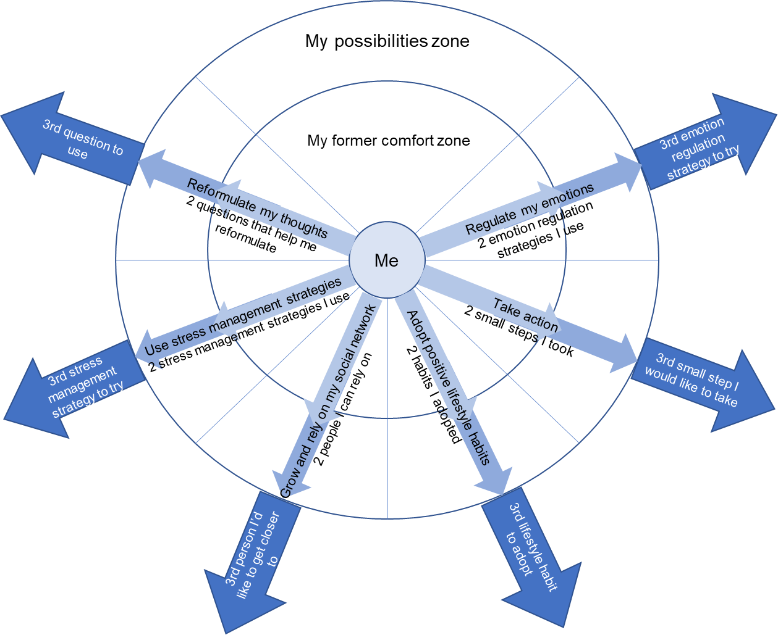
Portrait of my comfort zone

Slide 30
Place inukshuks on your path…
“Inukshuks are placed throughout the Arctic landscape and act as “helpers” for the Inuit. Among their many practical functions, they are used as navigation and hunting aids, as coordination points, as indicators of all kinds and as message centres.”
Hallendy, 2015

