Slide 1
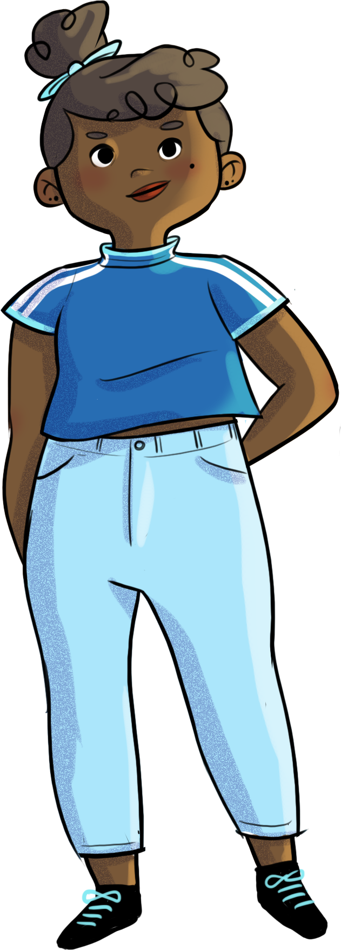

Slide 2
BEING OPEN-MINDED DOESN’T MEAN YOU HAVE A HOLE IN YOUR HEAD!

Slide 3
At the end of the workshop, you will be able to…
realize the impact of passing judgment on yourself and others
adopt an attitude of openness and compassion toward others
experiment with various strategies for self-compassion, inclusion, and amicable relationships
Notes:
realize the impact of passing judgment on yourself and others
adopt an attitude of openness and compassion toward others
experiment with various strategies for self-compassion, inclusion, and amicable relationships

Slide 4
Get labelling!
Lou often looks unhappy. At school, he doesn’t talk to anyone and keeps to himself. You’d almost think Lou doesn’t like people all that much.
Why do you think Lou acts this way?

Slide 5
Get labelling!
Why do you think we judge people?
Do you think it’s helpful?
What harm do you think judging others can do?
Judgments are often based on incomplete information. If we rely only on labels, we never really get to know the other person.
“While judging is sometimes a pleasure,
understanding always is.”
- HENRI DE RÉGNIER

Slide 6
Nadège and judgment
https://youtu.be/0WC7gKhYhgI

Slide 7
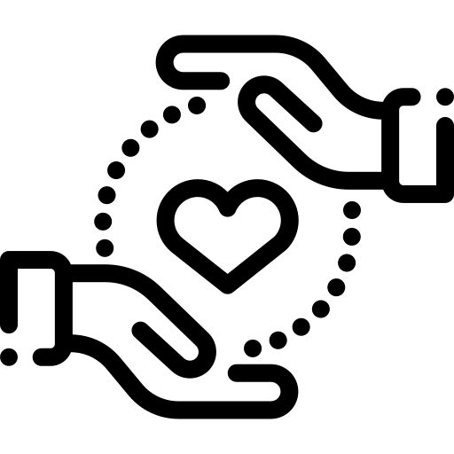
Being kind to yourself
What do you think empathy is?
Empathy is …
the ability to put yourself in the other person’s shoes, to acknowledge their feelings and imagine how they feel.

Slide 8
Being kind to yourself
What do you think compassion is?
Compassion is…
wanting what’s best for others;
being able to see the good in people;
accepting people the way they are;
being willing to act for the common good!
Having compassion for yourself is also very important. This is called self-compassion!

Slide 9
Labels that leave their mark…
Now that you know what Lou’s going through, what would you like to say to him?
What could you do to lessen the burden of people’s judgements for Lou?
Our prejudices about people, and the labels we place on them—often too quickly and without really knowing them—can leave their mark. We’re better off taking the time to get to know them, to spend time with them, to develop a real interest in them…
And to listen to them with kindness!

Slide 10
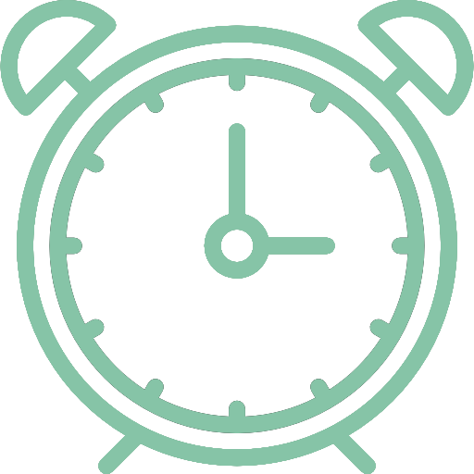
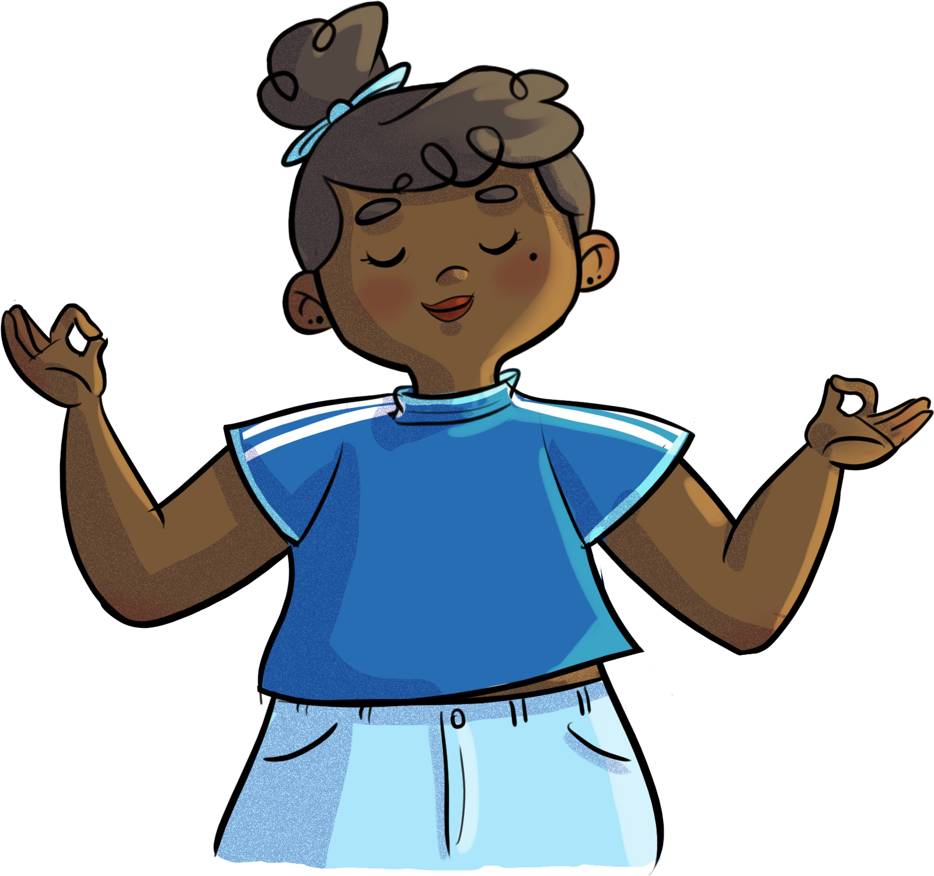
Compassion meditation
Audio file:
Close your eyes and centre yourself.

Slide 11
Because we’re a lot alike...
Your turn!
For this exercise, I need you all to be… honest, respectful, and mature.

Slide 12
Because we’re a lot alike...
1) Sit comfortably, with your eyes closed.
2) For each scenario that applies to you, raise your hand.
3) At the facilitator’s signal, open your eyes and look around you.
4) If the scenario does not apply to you, keep your eyes closed.

Slide 13
Because we’re a lot alike...
Did you find this exercise easy? Hard? Why?
How did you feel when you saw other students in the same boat as you?
What things did you find out about the others?
And about yourself?

Slide 14
Hands on!
Do you have any tips for how to be compassionate?
Strategies for being compassionate
Be present and listen attentively.
Try to understand emotions and needs.
Avoid making assumptions and judgments.
Describe a behaviour instead of judging it.
Be open-minded and kind to others, see their good side.
Practise gratitude (thank others for what they bring you).
Do good deeds, help someone in need.

Slide 15
Hands on!
Do you have any tips for how to be self-compassionate?
Strategies for being self-compassionate
Talk to yourself like you would talk to your best friend.
When you’re overwhelmed by negative thoughts, take a deep breath and focus on what you’re feeling.
Write down what you’re feeling.
Identify your needs and goals.
Practise self-care by doing things you enjoy and that make you feel good.

Slide 16
Nadège and judgment
https://youtu.be/vn_OkULmh5k

Slide 17
HORS-PISTE challenge
Transform your thoughts into self-compassionate ones.
Think about a person (or a group of people) you tend to judge without really knowing them.
Over the next week, try to think of at least one good quality about that person (or group of people) and two things you have in common.
Think about how this affects the way you act with that person (or group of people). to

