Slide 1
SECONDARY program

Slide 2
Introduction workshop
School staff

Slide 3
At the end of the introduction workshop, you will be able to…
Understand the importance of the
HORS-PISTE program
Understand the philosophy
of the program
Better understand what
mindfulness is
Notes:
Start sentences with lower case

Slide 4
TRUE OR FALSE?
1
Anxiety is decreasing among high school students
FALSE! The number of students with an anxiety disorder, depression, eating disorder or ADHD is up compared to 2010-2011; the number of students with significant psychological distress has also risen from 21% to 29% in the same time. This increase is seen across the board at the high school level (Québec Health Survey of High School Students, 2016-2017).
2
Students with anxiety are easy to spot
FALSE! Students with anxiety are rarely noticed. Most suffer in silence (Dumas, 2013), isolate themselves and become socially invisible (Lambert-Samson, 2016). Which means you have more anxious students in your classes than you think. Moreover, 70% of children and adolescents with an anxiety disorder have never received professional help (Bosquet and Egeland, 2006).
3
Approximately 10% of high school students report having been diagnosed with an anxiety disorder by a doctor or a health professional
FALSE! Approximately 17% of high school students report having been diagnosed with an anxiety disorder by a doctor or a health professional (Québec Health Survey of High School Students, 2016-2017).

Slide 5
TRUE OR FALSE?
4
Anxiety disorders are among the most common childhood and adolescent psychopathologies.
TRUE! As mentioned above, 17% of high school students report having been diagnosed with an anxiety disorder by a doctor or a health professional, compared to 6% for depression and 2.2% for an eating disorder.
5
Twice as many adolescents as adults have anxiety disorders.
FALSE! Approximately 15% of adults aged 18-65 will develop an anxiety disorder this year. Approximately 21% of adults will develop an anxiety disorder during their lifetime. Hence the importance of intervening in high school!
6
An anxiety disorder in adolescence has relatively minor consequences in adulthood.
FALSE! Anxiety disorders can precede—sometimes by several years—the onset of a panic disorder, depressive disorder, alcohol, drug, or tobacco abuse, and a higher risk of contemplating suicide and committing suicide (Dumas, 2013).

Slide 6
What is the basis for the HORS-PISTE program?
This is version 5 of the anxiety disorder prevention program developed by the Centre RBC d’expertise universitaire en santé mentale, previously known as HARDIS.
It’s the result of a concerted effort between partners from various expert committees at different Québec secondary schools.
It’s also the outcome of many adjustments made following consultations with students, teachers, parents, and members of the HORS-PISTE committees at the schools involved in the initial trials in 2017-2018, 2018-2019, 2019-2020, and 2020-2021.

Slide 7
It’s a program based on…
a comprehensive data collection on the academic, family, social and personal characteristics of students, which was then used to draw up a portrait of the students at the different high school levels, as well as identify their main needs;
a literature review of the risk factors associated with anxiety disorders that led to the development of a conceptual map of anxiety disorders;
literature reviews of successful and promising programs in the field of anxiety disorder prevention;
the professional knowledge and experience of the HORS-PISTE committee members.
Notes:
For version 3, a design team was formed to follow up on the observations from version 2 (made by teachers, students, parents, expert committees, facilitators). As such, version 3 is an amalgamation of these elements and the Ekip/WHO proposals in terms of the important role that developing psychosocial competencies plays in prevention and the promotion of health and healthy lifestyle habits.
When it comes to preventing anxiety, it’s important to think more broadly than just the anxiety symptoms themselves. Hence why developing psychosocial competencies is the main focus of the intervention: to equip students for life!

Slide 8
A program that makes a difference!
Here are some promising preliminary results from the analysis of the evolving portraits of all students participating in the program before and after program implementation in fall 2019, at 15 schools in Québec:
Reduction in symptoms related to:
generalized anxiety disorder;
separation anxiety;
social phobia;
obsessive-compulsive disorder;
post-traumatic stress disorder.
1,948 participants
Ongoing research will focus on the program implementation to identify its “active ingredients,” among other things.

Slide 9
A program that makes a difference!
Decreased fear of being judged by others
Decreased impact of anxiety on school and social activities
Decreased cognitive avoidance
Decreased intolerance to uncertainty
Decreased perfectionism
Increased sense of self-efficacy

Slide 10
The HORS-PISTE program
What is it?
10 workshops
In the fall
During class time
Led by… maybe you!
Notes:
You could be asked to lead some of the workshops or to host a facilitator in one of your classes. In that case, the teacher is encouraged to stay in the classroom while the workshop is going on. To make a strong impression with their students, they should sit at the front of the class, near the facilitator. They can even participate, tell personal anecdotes, and ask the students questions about the workshop topic. Experience has shown that students participate more when their teacher shows an interest in the content, and the reason for that is your meaningful student-teacher relationship with them!

Slide 11
The HORS-PISTE program
What’s it about?
Workshops 1-5
Workshops 6-10
Stress
Anxiety
Emotions
Social comparison
Social pressure
Self-esteem
Judgment and compassion
Conflict and communication
Friendship
Social media and critical thinking

Slide 12
Why this name?
Taking risks
The road less taken
More difficult
Learning
Discoveries
Challenges
Notes:
HORS-PISTE represents the road less taken—the trail that few people dare to follow. In skiing, snowboarding, and hiking, it implies taking risks: going down an unfamiliar path, with a high difficulty level. It’s risky, but it’s also an opportunity for the students to discover something new, to challenge themselves, and to figure out their strengths and weaknesses.
The HORS-PISTE program draws its inspiration from this concept. During the workshops, the HORS-PISTE program will encourage students take risks, confront their issues, venture down new paths, and try new solutions and new ways of handling stressful situations. Through it all, the HORS-PISTE program will help them get to know themselves better and to figure out their strengths and weaknesses. Above all, it will help them explore new ways to approach life with confidence, compassion, and perseverance.

Slide 13
Data collection
Students will be asked to fill out a questionnaire about their personality, their family, and their school and social life, once before the HORS-PISTE workshops start and again after they’re over
These questionnaires will allow a team of researchers to evaluate the effects of the program to determine if it’s effective and meets the needs of students.
The program may then be adjusted and improved based on this evaluation.
Notes:
Before the workshops start (give date, if possible), the students will be asked to fill out a questionnaire about their personality, their family, and their school and social life. If you are present at the time, make sure the students understand that this is not a test and that there are no right or wrong answers! The students will be asked to fill out the questionnaire again at the end of the workshops. It takes between 45 and 60 minutes to fill out. A team of researchers will evaluate the effects of the program to determine if it’s effective and meets the needs of students. The program may then be adjusted and improved based on this evaluation.

Slide 14
Workshops focused on the students’ active participation
The HORS-PISTE workshops are designed to:
Activate the students’ knowledge;
Develop their competencies.
feel
discover
share
activate
experiment
live
Yes, but how?

Slide 15
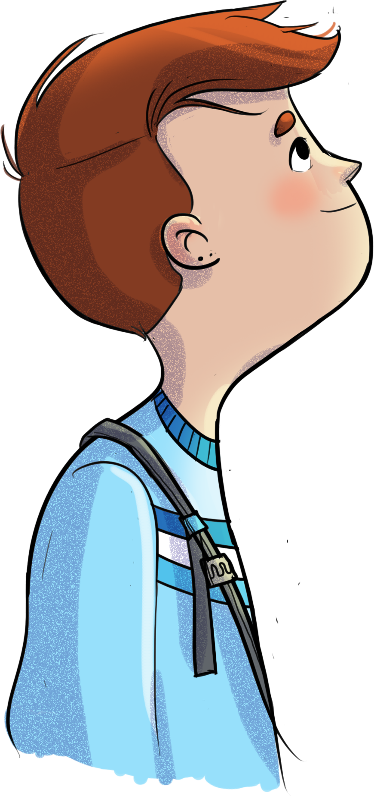
Approaches used
Theoretical knowledge transfer
Scenarios and role play
Discussions
Interactive theatre
Debates
Quizzes
Videos
Individual and group reflection
Impact techniques
HORS-PISTE challenges
Mindfulness

Slide 16
Mindfulness: an essential tool
Mindfulness is…
paying attention to what’s happening in the present moment;
embracing what’s happening right now;
to better enjoy today.
Let’s experiment together!
Notes:
The workshop leader explains that, when it comes to preventing anxiety, the HORS-PISTE program encourages mindfulness as a way of life or way of thinking. Through the language used, the activities, and the philosophy they are introduced to, the students will experiment with mindfulness, practising it at their own pace and in their own way.
Understanding what mindfulness is:
A simple definition of mindfulness is: paying attention to what’s happening in the present moment, embracing what’s happening right now. In the hectic pace of everyday life, we tend to overlook a lot of things. Here’s a little experiment to help you truly understand the implications of this:
Applause:
On my signal, please give a big round of applause for the start of the new school year (start the clapping and let it go on for about 30 seconds).
Now put your arms down on either side of your body, close your eyes, and focus your attention on your hands.
Take a minute to notice the sensations. Some of you may feel a tingling sensation, while others may feel like your hands are heavy or very light. All feelings are welcome. Maybe some of you don't feel anything specific, and that's perfectly fine, too.
Now, open your eyes.

Slide 17
Mindfulness: an essential tool
Outcomes
The things that we overlook are sometimes the most significant or can lead us down a different path.
Mindfulness
Positive outcomes, including better stress management
Notes:
This short activity is designed to show you how mindfulness can help you focus on certain things or details that happen so fast in our daily lives that we sometimes forget to notice them.
Have you ever felt a tingling sensation in your hands after clapping vigorously?
It may seem hard to ignore when you’re told to specifically notice it. But the things we tend to overlook can be quite another matter. In the hustle and bustle of daily life, we might forget to check in with ourselves after a heated meeting with colleagues or a chaotic morning at home. We might end up taking our frustrations out on the students, without necessarily understanding why. And that’s just one example. You and your students experience this type of thing every day. But, as several studies show, practising mindfulness often has positive spinoffs, such as improved communication, increased openness to learning, improved quality of relationships, and better management of stress and emotions, among other things.
Being in the present moment helps to curb anxious thoughts, prevent anxiety-provoking situations and better manage them when they arise.
Keng, S. L., Smoski, M. J., & Robins, C. J. (2011). Effects of mindfulness on psychological health: A review of empirical studies. Clinical Psychology Review, 31(6), 1041-1056.

Slide 18
Mindfulness: an essential tool
A way of life
Practising mindfulness on a daily basis will allow you to:
gain a fresh perspective on the present moment and everyday life;
cultivate positive attitudes;
stop anticipating.
STOP THINKING
Mindfulness doesn’t mean thinking about nothing
Notes:
More than just savouring the moment, mindfulness is a way of life that can help students to view the various situations they experience differently, by allowing them to stop, breathe, observe, and feel more deeply.
This is why mindfulness is so important to stress management, because it helps us become aware of what’s happening inside us and around us, thereby equipping us to better cope with—and carefully and thoughtfully navigate—stressful situations instead of avoiding them and creating an accumulation of stress.
Mindfulness also gives us a fresh perspective on the present moment and on daily life, by cultivating positive attitudes, shutting down anticipation, and embracing the idea of slowing down and making informed decisions, with full awareness of what this brings up, both within and outside ourselves.
Many people think that mindfulness means thinking about nothing. Let’s put this misconception to rest right now. There’s no “stop thinking” button. Even when we’re practising mindfulness, we never stop thinking—and that’s perfectly normal. With practice, we become more aware of our thoughts, learn to let them settle, and learn to live with them. Imagine, for example, a snow globe (you can make a simple one and keep it on hand to explain the concept to students). The snow that you see swirling around when you shake it represents your thoughts (tasks, concerns, emotions, etc.).
When you hold the snow globe still, the thoughts settle at the bottom, and you can take the time to examine them. So, it’s important to stop sometimes and let our thoughts settle. This helps us to better understand and accept them, which lessens the anxiety associated with them.

Slide 19
Mindfulness: an essential tool
Digging deeper…
The Guide de présence à soi (GPS) is a collection of activities to do with students, guided meditations, and mindfulness activity sheets for teachers and counsellors.
https://sante-mentale-jeunesse.usherbrooke.ca/wp-content/uploads/2018/12/Final-GPS.pdf
Notes:
As part of the student workshops, you could be introduced to mindfulness activities.
You may be asked to think about different topics related to mindfulness, such as which attitudes to adopt, how to incorporate mindfulness at school, etc.
You can also observe the effects of mindfulness on the students in your groups.
If you’re interested in mindfulness and want to explore it a little further, we’ve also developed tools to help guide you, such as the Guide de présence à soi (GPS), which is a collection of activities to do with students, guided meditations, and mindfulness activity sheets for teachers and counsellors.
https://sante-mentale-jeunesse.usherbrooke.ca/wp-content/uploads/2018/12/Final-GPS.pdf

Slide 20
Questions? Comments?
THANK YOU!

