Slide 1
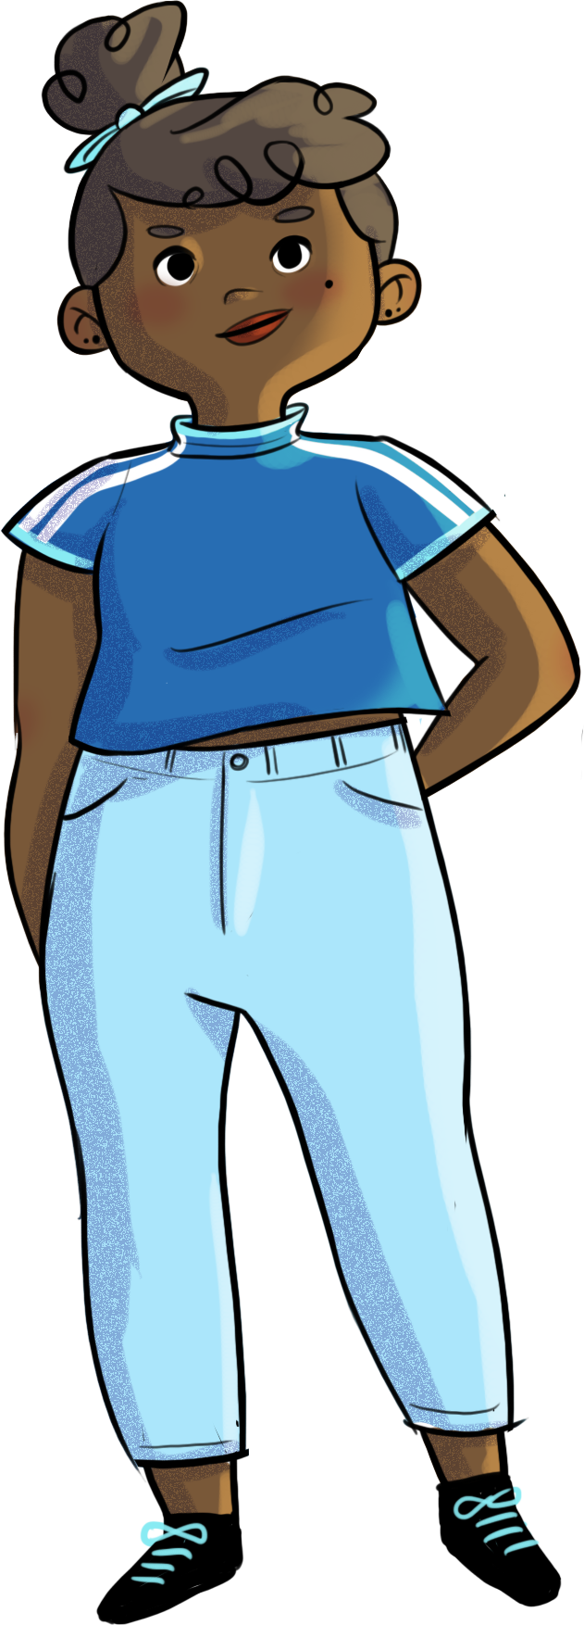
SECONDARY program

Slide 2
Introduction workshop for students
Notes:
The introduction workshop is used to introduce the HORS-PISTE program to students, so that they understand the importance of this prevention program. It is intended to describe the program philosophy, an outline of its content, and its approach, i.e., workshops requiring the students’ active participation, during which they will experiment with mindfulness exercises.

Slide 3
By the end of the introduction workshop, you will…
understand the point of the
HORS-PISTE program
understand the philosophy
of the program

Slide 4
ADOLESCENCE IS A PERIOD OF:
major physical and psychological changes;
wonderful discoveries;
major personal challenges.
It’s a bit like
climbing a mountain…
1
Why do you think that is?
What are the challenges you will face along the way?
Do you ever feel stressed or worried about the
path that you’re on?
2
3
Notes:
Getting through high school is like climbing a mountain… We all start at the bottom and follow the path ahead of us. On the way up, we have good times with our friends, we make exciting discoveries, we have successes, but we also face many obstacles: steeper climbs, raging rivers, fatigue, hunger, mosquitoes. Sometimes we need to take breaks and reach into our backpack for supplies: materials to repair our gear, food to eat, warm clothes, water, mosquito repellent, a map and a compass to find our way, etc.
During high school—and in life—it’s perfectly normal to encounter more stressful situations, such as dealing with pressure from our parents, teachers and friends, carving out our place in our group of friends, resolving conflicts, dealing with comparisons, worrying about being excluded or judged, and fearing failure.
The HORS-PISTE program is designed to help you use the tools you already have in your backpack and develop new ones that will serve you well throughout high school and for the rest of your life. Even if everything’s fine right now and you’re not feeling stressed, the workshops will still give you plenty of tips, ideas and scenarios that will come in handy one day.

Slide 5
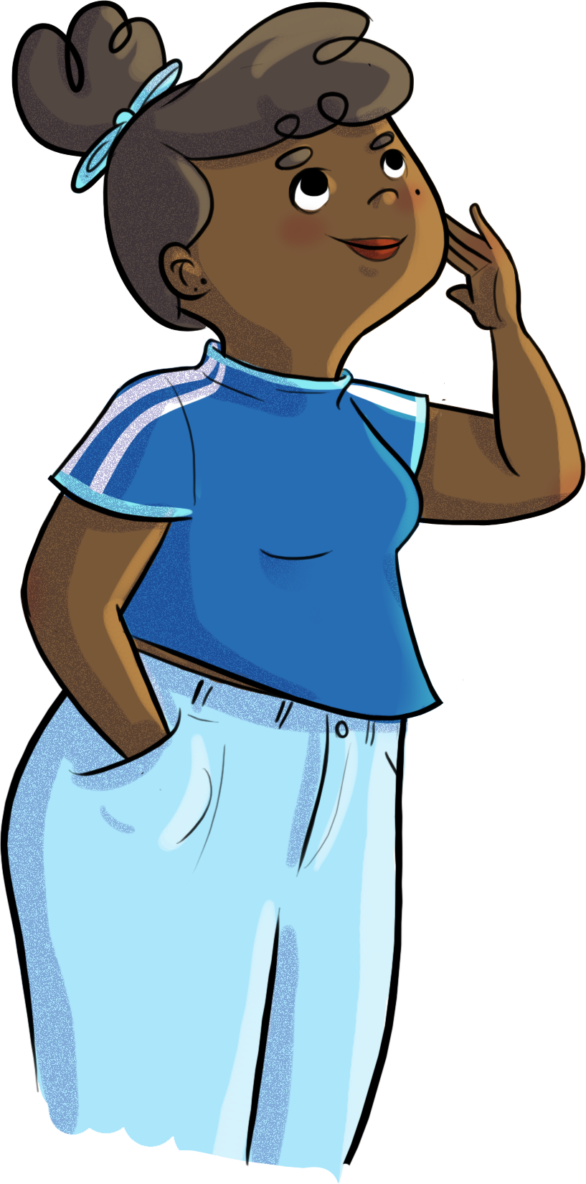
The HORS-PISTE program
What is it?
10 workshops (5 per year)
In the fall
During class time
Led by school staff members
Notes:
The HORS-PISTE program is a series of 10 workshops (five in secondary 1 and five in secondary 2).
The workshops will be held during class (or study periods), from September to December.
School staff members (facilitators’ names) will lead the workshops.

Slide 6
Introductory video

Slide 7
Think outside the box… yes, but how?
Through workshops that focus on your active participation
The HORS-PISTE program workshops are designed to…
awaken your knowledge;
develop your competencies.
feel
discover
share
activate
experiment
live
There’s no slacking off during the HORS-PISTE workshops!
Notes:
The goal isn’t to give you material, but to let you have experiences, share your knowledge and experiment with new strategies. You’ll have an opportunity to share your questions, stories and tips.
It’s been proven that we learn better and retain more information when we have the chance to experiment. So, if you want to fill your backpack with handy tools, you’ll have to step up and participate actively in all the activities. And if you want the tools to really work for you, you’ll need to apply them in your everyday life.

Slide 8
The workshops are designed to help you:
express yourself;
get to know yourself;
share your opinions;
assert yourself;
learn to love yourself;
carve out a place for yourself;
connect with others;
settle down and refocus;
formulate your thoughts;
reflect;
develop your opinions;
etc.

Slide 9
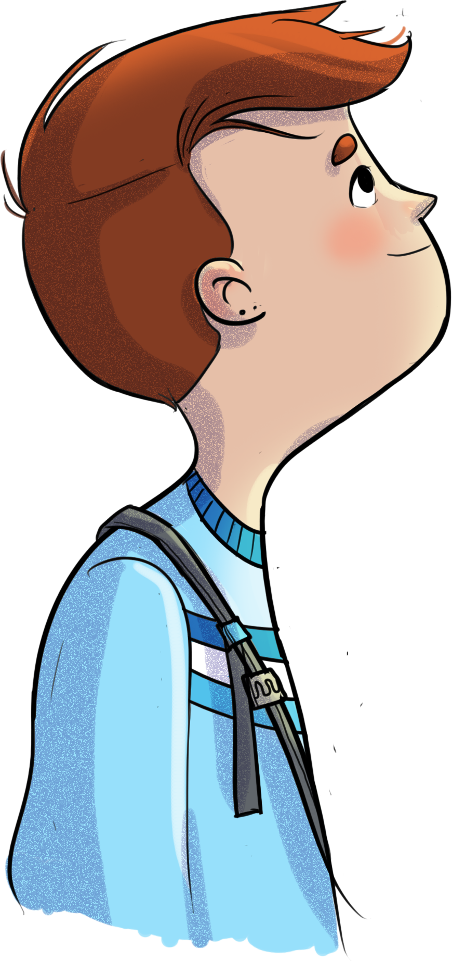
Approaches used
Theoretical knowledge transfer
Scenarios and role play
Discussions
Interactive theatre
Debates
Quizzes
Videos
Individual and group reflection
Impact techniques
HORS-PISTE challenges
Mindfulness

Slide 10
My contract
1
I will respect others. Period. That’s non-negotiable.
I will keep everything I hear confidential. In other words, what’s said in the workshops stays in the workshops.
I will use “I” statements. (“I” is referring to you. Not the others. Talk about your experiences, your feelings.)
I will only talk about the things I feel comfortable sharing. (Basically, no one is forcing you to say anything. But, trust us, it feels good to talk.)
I will listen to others, without judging. That’s expert-level respect.
I will wait my turn before speaking. Once again, that’s just a given.
I will help others express and share their opinions.
I will participate in the workshops. Otherwise, what’s the point? No, but really?
Between meetings, I will practise the tips I’ve learned. I will continue to think about the topics discussed and try to do my weekly challenge.
I will remember that I am surrounded by friends, family, counsellors, and teachers I can confide in and ask for help.
I I commit to following—to the best of my ability—these 10 basic rules.
2
3
4
5
6
7
8
9
10
10

Slide 11
Data collection
As with everything, practice makes perfect, and it’s important to check in with how you’re doing and adjust, if needed.
The HORS-PISTE program team needs you to help it adjust.
How? It’s easy!
By filling out a questionnaire about your personality, your family, and your school and social life, once before the HORS-PISTE workshops start and again after they’re over.
Your answers will remain CONFIDENTIAL.
11
Notes:
Before the workshops start (give date, if possible), you’ll be asked to fill out a questionnaire about your personality, your family, and your school and social life.
Your answers will be used to better understand your reality and to adjust the program accordingly. This isn’t a test! There are no right or wrong answers! What matters is that you give your perspective and answer honestly. Your answers will remain confidential. You will be asked to fill out the questionnaire again at the end of the workshops to track your progress.
A team of researchers will use the questionnaires to see if the program is actually helping students and will adjust it as needed.

Slide 12
Thank you for your attention!

