Slide 1
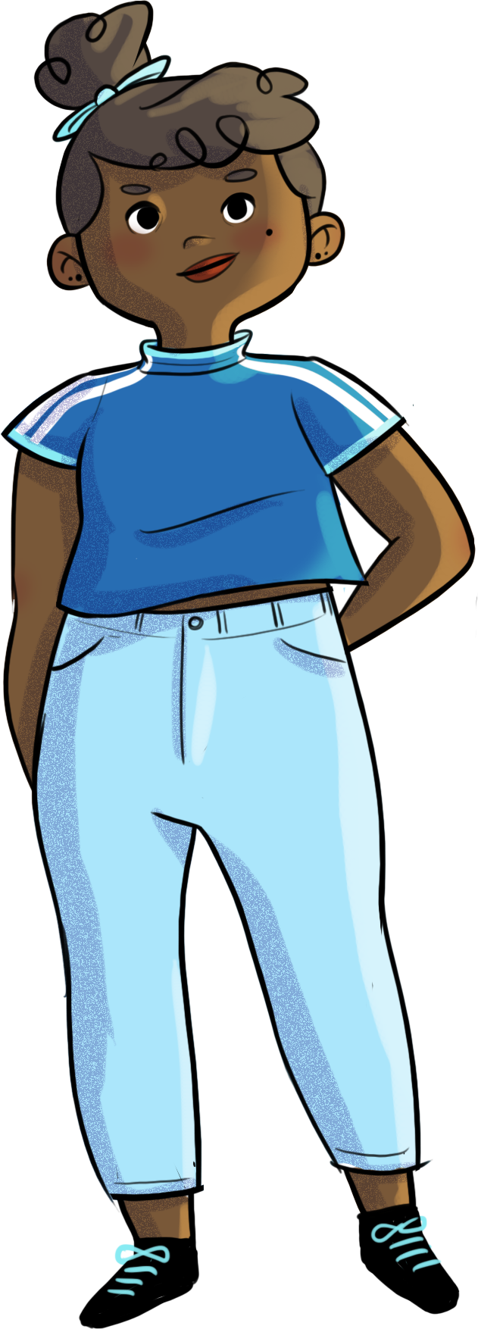

Slide 2
CARVING OUT YOUR PLACE!

Slide 3
At the end of the workshop, you will be able to…
recognize the importance of healthy friendships and choosing yourself first and foremost
apply strategies for getting out of uncomfortable interpersonal situations
adopt new prosocial behaviour to develop and maintain quality relationships

Slide 4
Twelve skilled hands…
As a group, appoint one person to be in charge of the material
Warning!
The people in charge have to come to the front of the class to get the material!

Slide 5
Twelve skilled hands…
You have 10 minutes to make
a group drawing on the theme of your choice.
Examples: Friendship, love, music, sports, the environment, etc.

Slide 6
Twelve skilled hands…
Warning!
Time’s up!
Tell the others about your experience as a group
How did your group decide on your theme?
Did your group decide on the specific roles for each member, or did everyone naturally take their place in the group?
Did you rely on the talents of certain group members to do the drawing?
Did all group members contribute equally to the drawing?
How did you personally react to the student who developed a negative attitude halfway through?
How did you resolve the situation as a group?
How did you feel about the others during the activity?
Does your personal contribution to the drawing reflect your usual role in group activities?
What parallels can you draw between your contribution to the group drawing and your role in your group of friends or with your classmates?

Slide 7
Twelve skilled hands...
Remember...
Everyone needs to find a comfortable place among their peers.
Each individual has a unique and important role to play in a group.

Slide 8
Nadège and friendship
https://youtu.be/8WUJ1a6SGPo

Slide 9
The umbrella effect
Friendships play an important role in your ability to adapt to the many challenges you’ll face during adolescence.
These ties are a valuable source of security, support, and well-being during the transition to adolescence.
Having friends makes you feel braver, more optimistic, and good about yourself.
Carving out a place for yourself in a group is a very important part of adolescence.

Slide 10
The umbrella effect
On the other hand…
When you feel left out or uncomfortable and “out of place” in your group, you may feel more stress and sadness.
You may also feel like you’re lacking the strength to get through life’s challenges.
Carving out a place for yourself in a group is a very important part of adolescence.

Slide 11
The umbrella effect
The umbrella metaphor
Imagine that you’re hiking in the forest when you’re suddenly caught in a torrential downpour. You have an umbrella in your backpack. You quickly take it out and open it up to protect yourself from the rain. Phew! Even though it’s pouring, now you won’t get wet (or at least not too wet). Even though the rain caught you off guard, forcing you to change your plans, you can still appreciate this force of nature and maybe even have a good laugh! But without an umbrella, you would have been soaked, possibly angry, and very uncomfortable…
Carving out a place for yourself in a group is a very important part of adolescence!

Slide 12
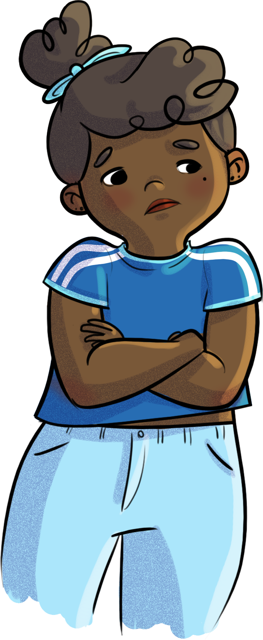
Navigating troubled waters…
Why do you think Nadège stays in her group, even though she’s increasingly uncomfortable with her friends’ behaviour?
Share your thoughts with the others.
What advice would you give Nadège?

Slide 13
Navigating troubled waters…
Remember...
While there are a lot of attitudes conducive to making and maintaining friendships, the challenge is to apply them while still staying true to yourself, your values, and your needs.

Slide 14
Some strategies!
Smile, be calm.
Use humour.
Appreciate the person, show interest in them.
Compliment their accomplishments and skills.
Make eye contact with the person you’re talking to or who is talking to you.
Practise active listening.
Take the first steps to talk to someone.
Attitudes and behaviours conducive to
making friends!

Slide 15
Some strategies!
Ask questions about the other person’s situation and experiences.
Take the time to listen before resuming the discussion.
Identify shared interests.
Wait your turn to talk.
Participate in the discussion.
Use a calm, steady tone of voice.
Attitudes and behaviours conducive to
making friends!

Slide 16
Some strategies!
Listen attentively.
Get involved, show interest in others.
Open up, learn to talk about yourself.
Express yourself clearly and honestly.
Take initiative, talk about your ideas and projects.
See and respect other people’s points of view.
Attitudes and behaviours conducive to
maintaining good relationships!

Slide 17
Some strategies!
Attitudes and behaviours conducive to
maintaining good relationships!
Criticize opinions and behaviours, not people.
Accept criticism from others and tolerate differences.
Encourage, help, and compliment others.
Have a sense of humour.

Slide 18
Some strategies!
Here are some strategies for getting out of uncomfortable situations with your friends:
Talk to them about what’s making you uncomfortable.
Identify and express your needs.
Find an ally.
Actively look for solutions.
Develop other relationships at the same time.
Gradually distance yourself from people who are bad for you.
Leave the group when you disapprove of their behaviour.
Choose activities where the situation is less obvious.

Slide 19
Nadège and friendship
https://youtu.be/qei6LB7Yv0w

Slide 20
HORS-PISTE challenge
Think about your friendships…
Where do you fit in with your group of friends?
How do you feel in this group? Comfortable? Happy?
Identify one or two strategies you could use to improve the quality of your friendships.

