Slide 1
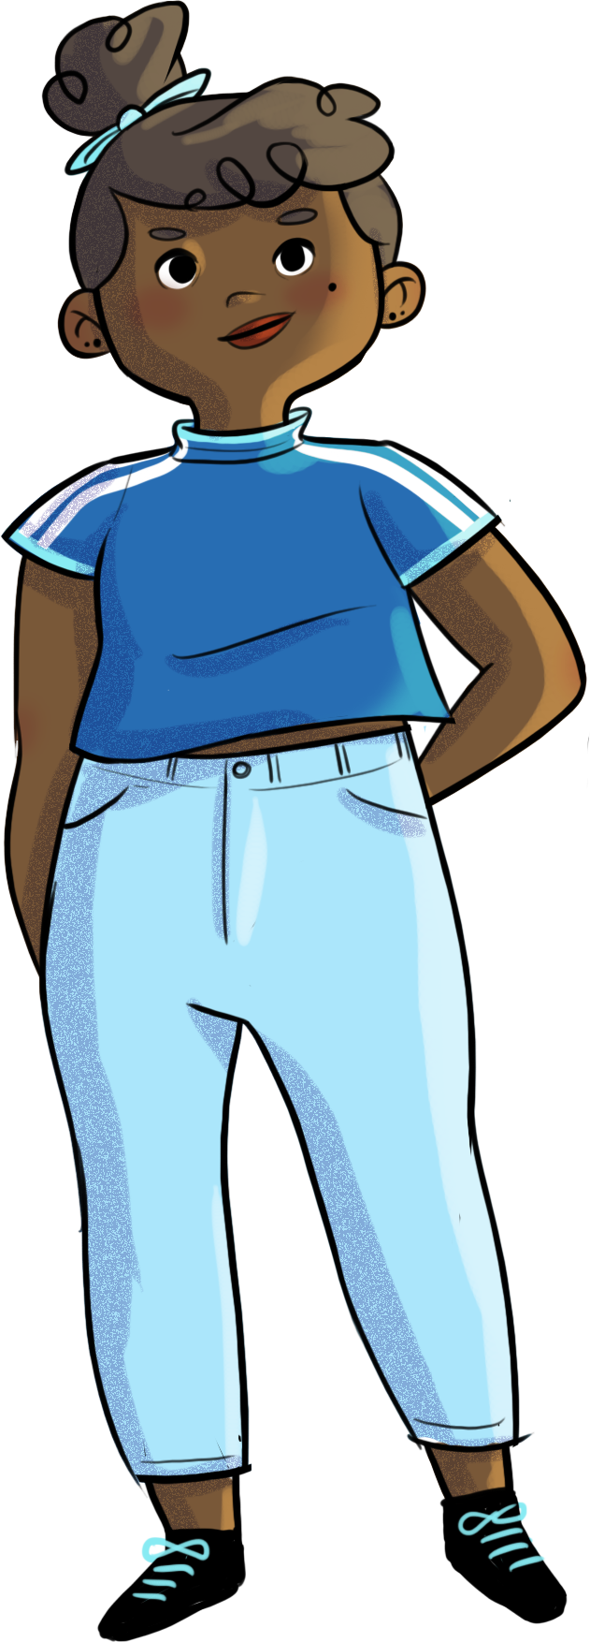

Slide 2
NOT RIGHT OR WRONG: It’s a matter of perception!

Slide 3
At the end of the workshop, you will be able to…
understand how conflicts develop
understand how your own attitudes and behaviours affect your conflict management style
use conflict management strategies, including communication and compassionate listening

Slide 4
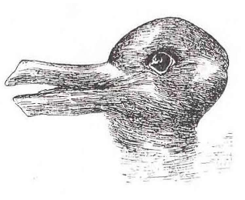
Perceptions
What do you see?

Slide 5
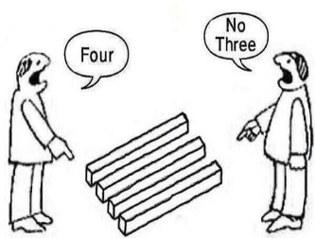
Perceptions
What do you see?

Slide 6
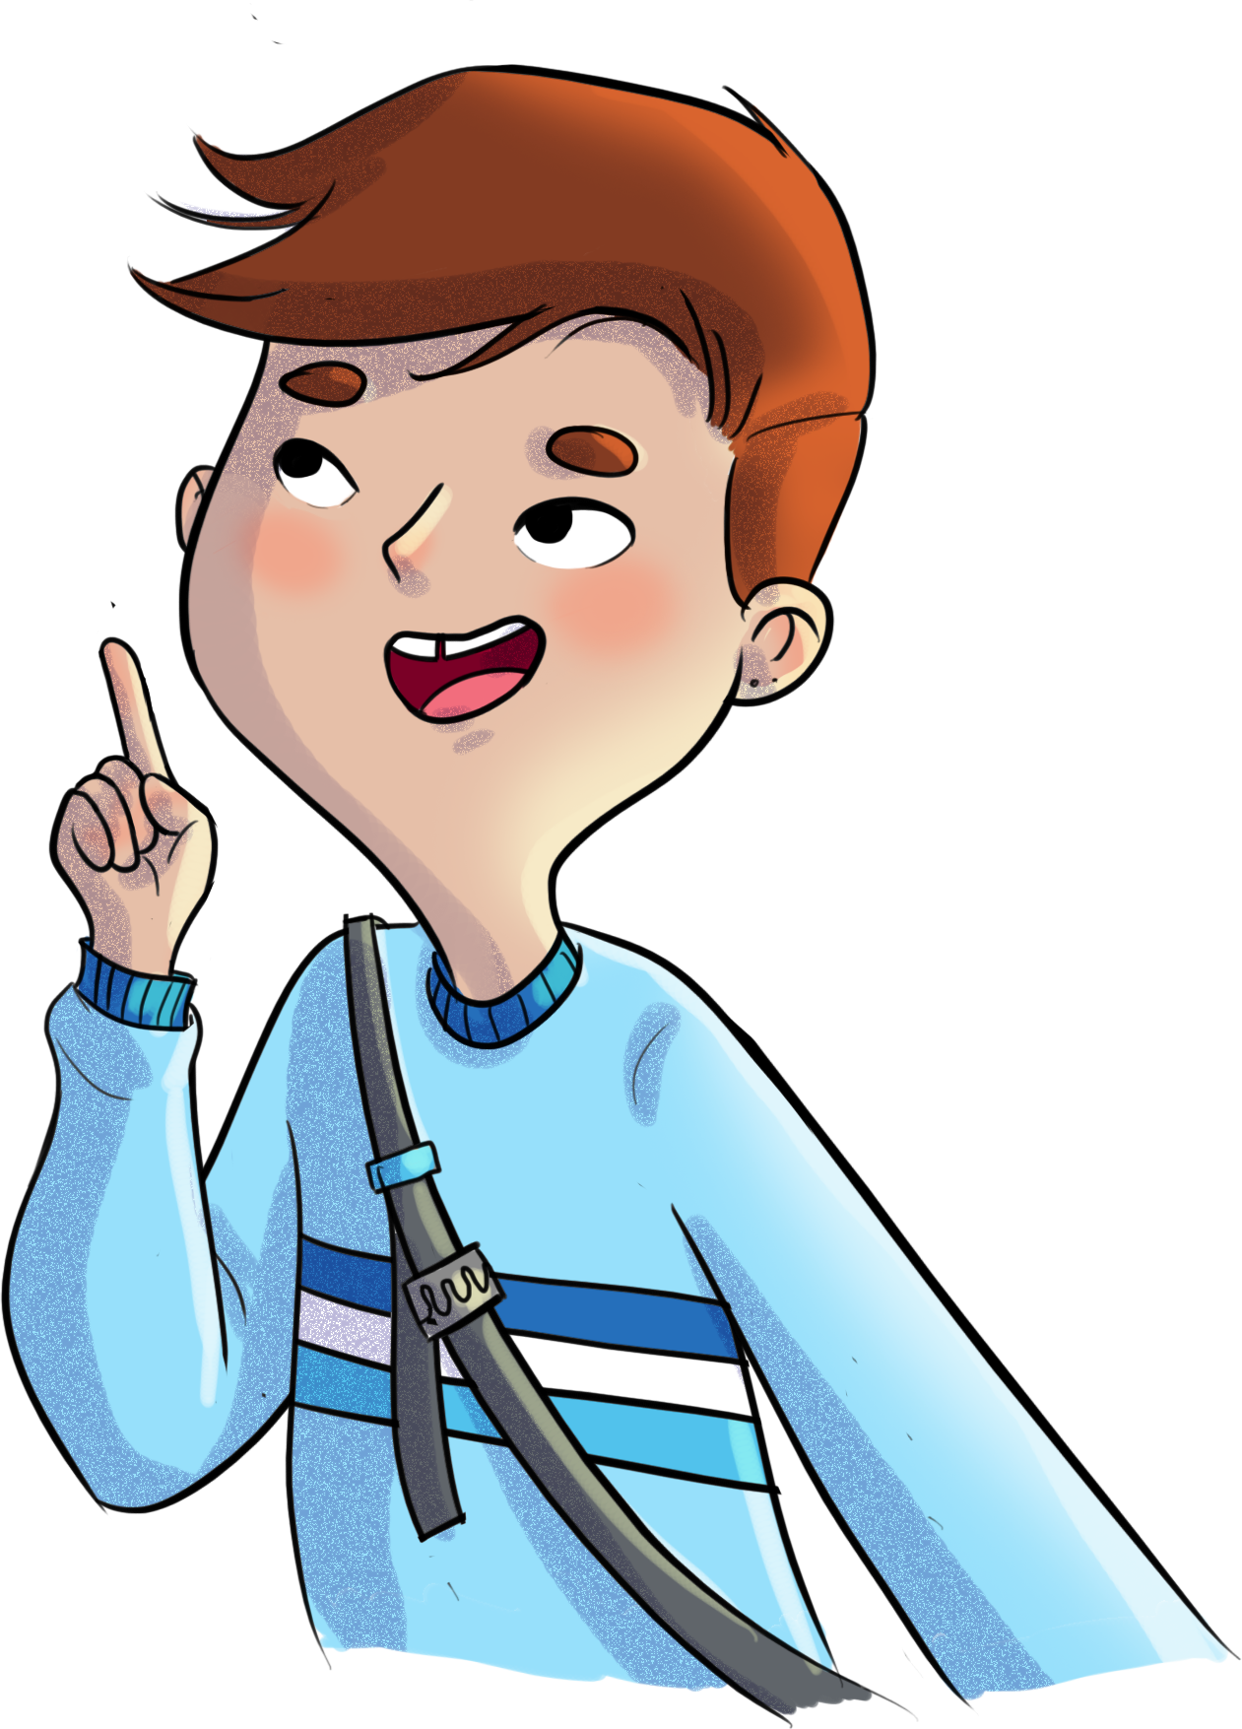
Perceptions
Why do you think you might see something different from your neighbour?
Can you think of situations in your life where people might perceive things differently?

Slide 7
Perceptions
Differences in perceptions can lead to misunderstandings and interpersonal conflicts.
Can you think of a conflict that was caused by two people having different perceptions of the same situation?
Because there can be two different perceptions of the same situation, it’s pointless to try to figure out who’s right and who’s wrong.

Slide 8
Sacha and conflicts
https://youtu.be/0krUrLbBZBI

Slide 9
The communication wire
Can conflicts be helpful?
When managed properly, a conflict between two people can help them get to know each other better, understand each other better, and even develop their creativity and find new solutions.

Slide 10
The communication wire
Your behaviour influences how the conflict will be resolved.
Do you react?
OR
Do you respond?

Slide 11
The communication wire
Sometimes, your feelings about a situation can push you to escalate the conflict.
Have you ever been in a situation where you felt like escalating the conflict instead of resolving it?
Why do you think that is?
What were the consequences?
What is the point of resolving your conflicts?
What things help you manage your conflicts?

Slide 12
A dramatic turn of events!
To learn more about conflict resolution strategies…
One scene
Two characters
Role play
One director
All audience members can call out “CUT!”

Slide 13
A dramatic turn of events!
Show openness and interest through body language: look, tone, attitude, smile, attention.
Try not to interrupt or interject; let the person finish their sentences.
Try to put yourself in the other person’s shoes when they’re describing how they feel.
Be respectful and empathetic toward the other person.
Refocus your attention on the other person; stay in the moment.
Compassionate listening strategies

Slide 14
A dramatic turn of events!
Take the time to listen to the other person’s opinion.
Say what you’re feeling, name your emotions.
Use “I” statements.
Express your needs in the situation.
Tell the other person what you expect from them.
Talk openly with the other person.
Stay calm.
Communication strategies

Slide 15
A dramatic turn of events!
Define the problem.
Evaluate the solutions (feasible? realistic?).
Be respectful (don’t judge or blame the other person)
Be willing to compromise.
Accept your share of the responsibility for the situation.
Evaluate all possible solutions.
Clarify your thoughts.
Seek social support from peers.
Other conflict resolution strategies

Slide 16
Sacha and conflicts
https://youtu.be/C25USHFCFRA

Slide 17
HORS-PISTE challenge
Thinking about how I react to and handle conflicts.
How do I react to a conflict?
I identify a spontaneous reaction that I often have without thinking… and that can escalate conflicts.
I identify a conflict resolution strategy I already use, that comes naturally.
I identify a new strategy that I will try out soon.

