Slide 1
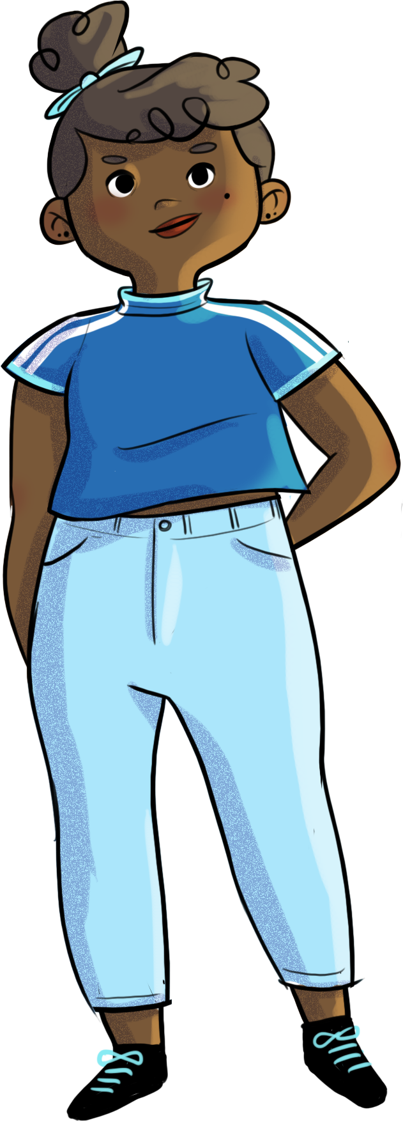

Slide 2
IMPERFECT? PERFECT!

Slide 3
At the end of the workshop, you will be able to…
understand self-esteem and its components
recognize and appreciate your strengths and good qualities
recognize and better accept your limits and imperfections
use your personality traits to your advantage

Slide 4
The eyes are the mirror of the soul
People react to being called beautiful
“I’m taking pictures of things I find beautiful.”
One situation…
Many different reactions!
URL link: https://www.youtube.com/watch?v=aW8BDgLpZkI

Slide 5
The eyes are the mirror of the soul
Share your first impressions…
How does this video make you feel?
What do you find beautiful?
Is it conceited to think of yourself as beautiful or handsome? Why?
Did the kids’ reactions speak to you?
How do you react when someone compliments you?
Why is it so hard to accept a compliment?
Did you notice that the kids became even more beautiful when they were complimented?
Can we say that EVERYONE is beautiful, or just a select group of people? Are some people just born lucky?

Slide 6
The eyes are the mirror of the soul
Remember!
It’s not conceited to love and think highly of yourself.
It’s IMPORTANT!

Slide 7
Sacha and self-esteem
https://youtu.be/LFDnMZ9Prn8

Slide 8
The real me vs. the ideal me
In your own words, can you tell me
what self-esteem is?

Slide 9
The real me vs. the ideal me
Self-esteem refers to the value that a person gives to themselves.
High self-esteem is developed by making positive self-assessments and favourable comparisons with others.
It’s a work in progress during adolescence!

Slide 10
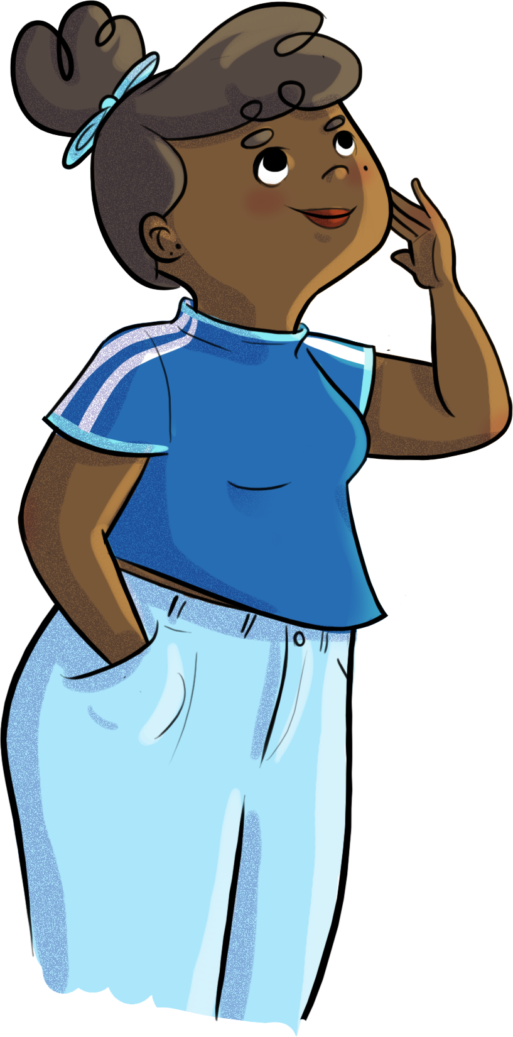
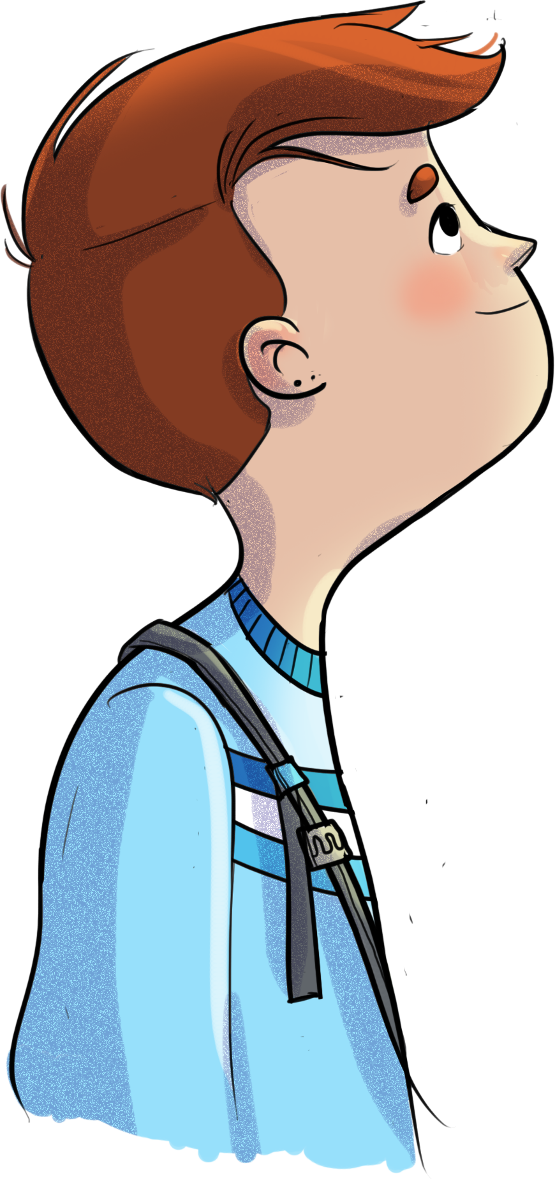
The real me vs. the ideal me
Describe your “real me” and your “ideal me” on the
Exploring and building my self-esteem worksheet
The bigger the gap between who you are and who you would like to be, the more your self-esteem will suffer
The real me
The ideal me
Your “real me” is the image you have of yourself, of your strengths and weaknesses; it’s your reflection in the mirror, whether positive or negative.
Your ideal me is how you view yourself at your very best. It’s the person you would ideally like to be.

Slide 11
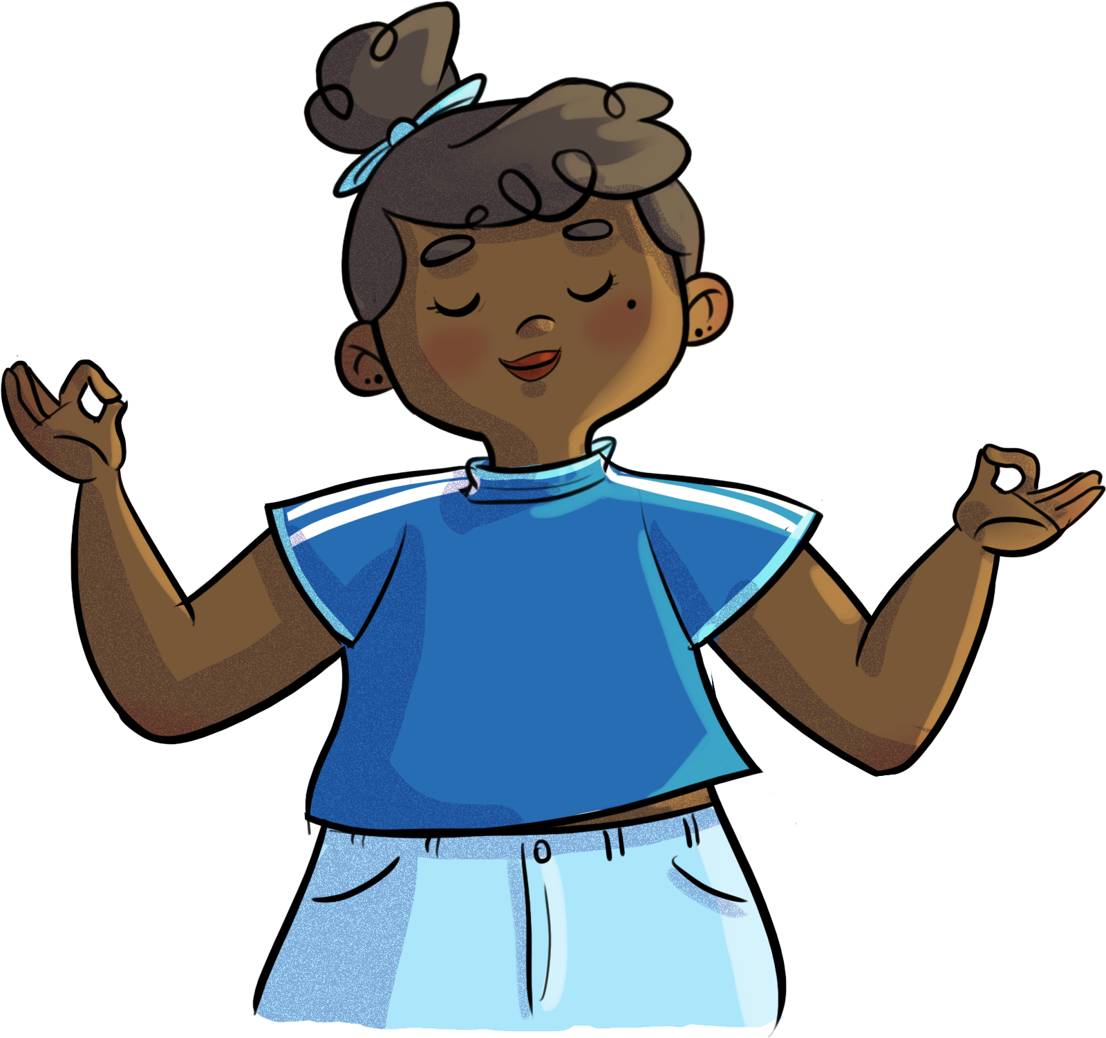
Meditation on your strengths
Close your eyes and centre yourself.

Slide 12
Bridging the gap between your two “me’s”
YOU
Academic sphere
Your perception of your ability to do well at school
REAL ME IDEAL ME
Social sphere
Your perception of your ability to make new friends and maintain relationships
REAL ME IDEAL ME
Emotional sphere
Your perception of
your ability to manage your emotions
REAL ME IDEAL ME
Physical sphere
Your perception of your physical appearance and abilities
REAL ME IDEAL ME

Slide 13
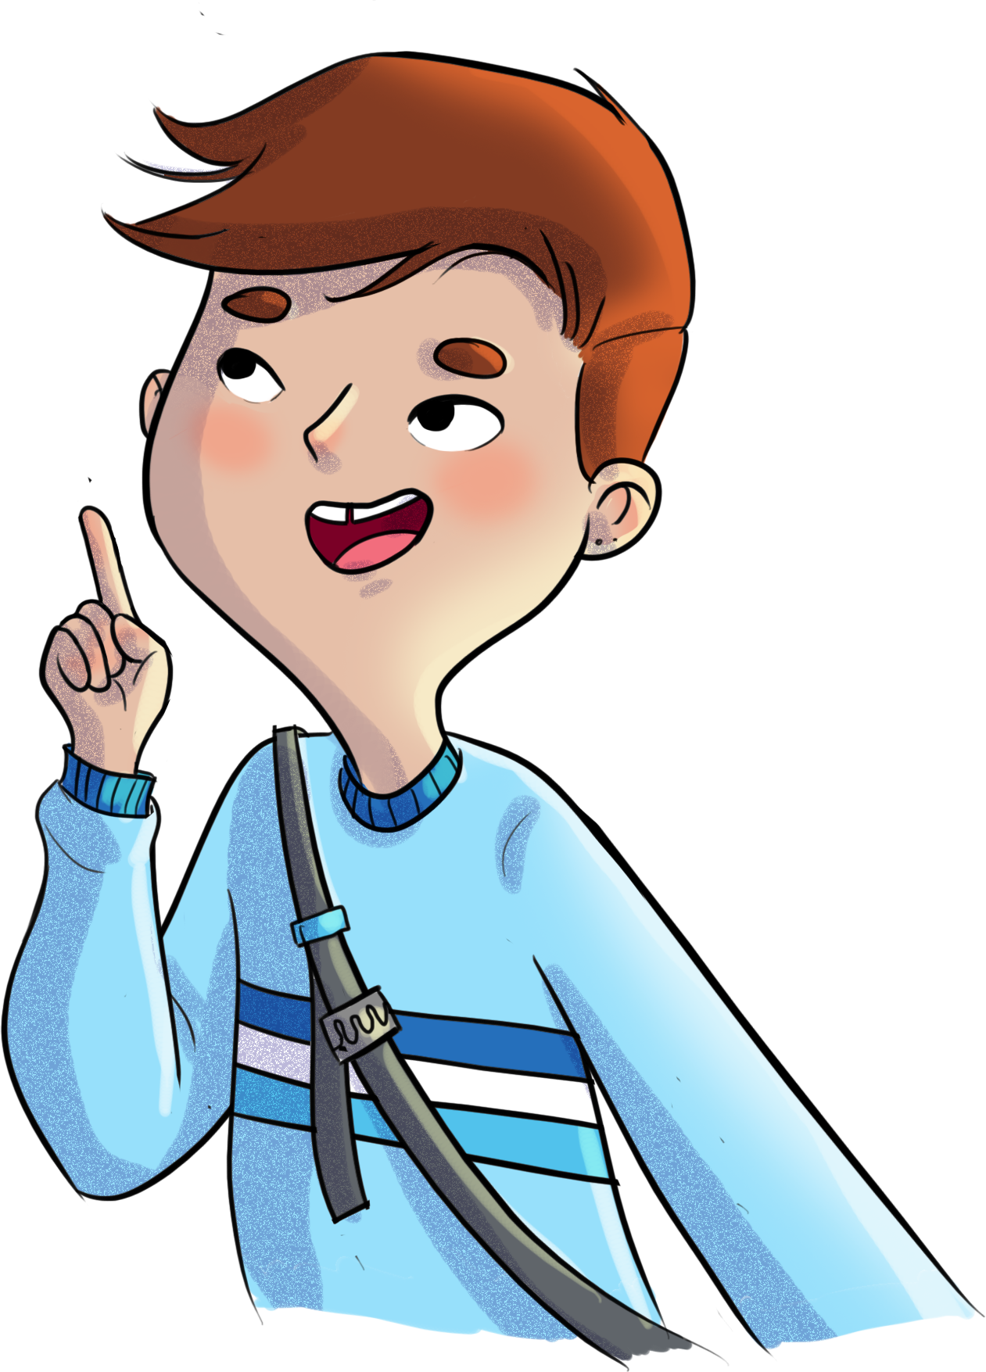
Bridging the gap between your two “me’s”
To build your self-esteem, recognize
your strengths and accept your imperfections.
Copy your descriptions of your “real me” and your “ideal me” into the four spheres table
Complete all four spheres, as needed

Slide 14
Bridging the gap between your two “me’s”
For example:
“I’m afraid others will laugh at me AND I’ll get up on stage NO MATTER WHAT to sing at the annual talent show because I know I can do it.”
Choose the sphere in which you feel your self-esteem suffers the most.
Write a sentence using “AND... NO MATTER WHAT” that bridges the gap between your two “me’s.”

Slide 15
Bridging the gap between your two “me’s”
Being kinder to ourselves, despite our imperfections, helps to build our self-esteem. No one is perfect, but you don’t have to be perfect to love yourself and be loved by others. See the things you like less about yourself as opportunities to take action!
“So, do we need to accept ourselves the way we are, or try to change?”
A little bit of both…

Slide 16
Bridging the gap between your two “me’s”
Start by accepting yourself the way you are today, knowing you’d like to make changes eventually.
Accepting yourself the way you are and making improvements is not a contradiction.
Try using the “and... no matter what” strategy!
Have you ever taken action despite not liking certain things about yourself?

Slide 17
Sacha and self-esteem
https://youtu.be/6Pv8ym-sexk

Slide 18
HORS-PISTE challenge
Listen to your inner voice
Turn self-criticism
into kind and compassionate
statements about yourself.
This week, notice and pay attention to the messages you send yourself... the positive statements, the self-criticism, etc.
What effect do they have on you?
Take time to meditate.

