Slide 1
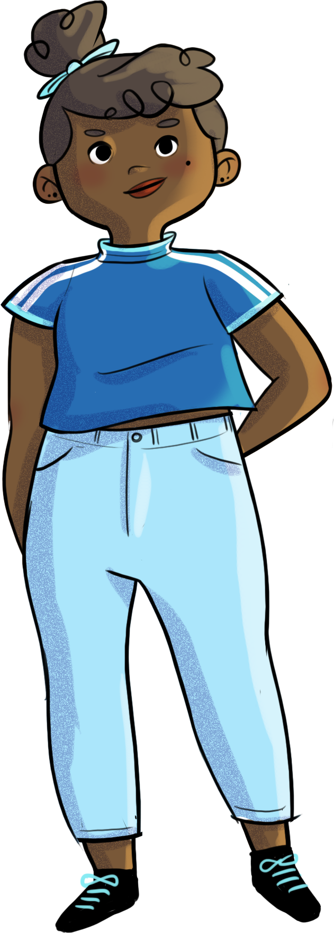

Slide 2
Don’t let others decide your worth!

Slide 3
At the end of the workshop, you will be able to…
recognize some of your own
values and qualities
understand the impact of social comparison on your self-confidence
use new strategies to get to know yourself better

Slide 4
Three wishes!
You have the power to make three of your deepest wishes come true.
What do you wish for?
Write your three wishes on the worksheet you were given.

Slide 5
Three wishes!
List of values
Match the values with the wishes written on the board.
Work
Education
Courage
Honesty
Honour
Inspired by Alloprof: http://www.alloprof.qc.ca/BV/pages/f1603.aspx
Beauty
Discipline
Friendship
Health
Patience
Justice
Money
Sharing
Helping
Hard work
Love
Freedom
Family
The environment
Power
Loyalty
Listening
Success
Respect
Fun
Security

Slide 6
Three wishes!
What is a value?
Values are “our heart's deepest desires for the way we want to interact with and relate to the world, other people, and ourselves. They are leading principles that can guide us and motivate us as we move through life.”

Slide 7
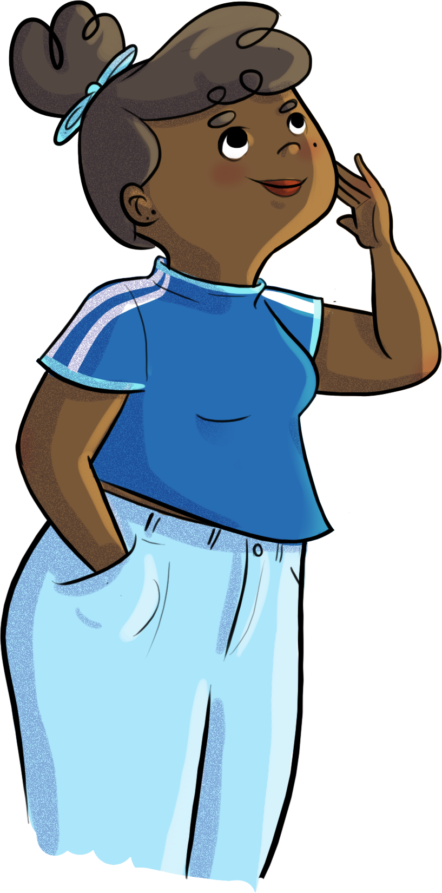
Three wishes!
Why is it important to know your values?
Should your values be the same as other people’s?
Choose a wish and write the corresponding value on your worksheet.

Slide 8
Sacha and social comparison
https://youtu.be/BNdVuXbBSoU

Slide 9
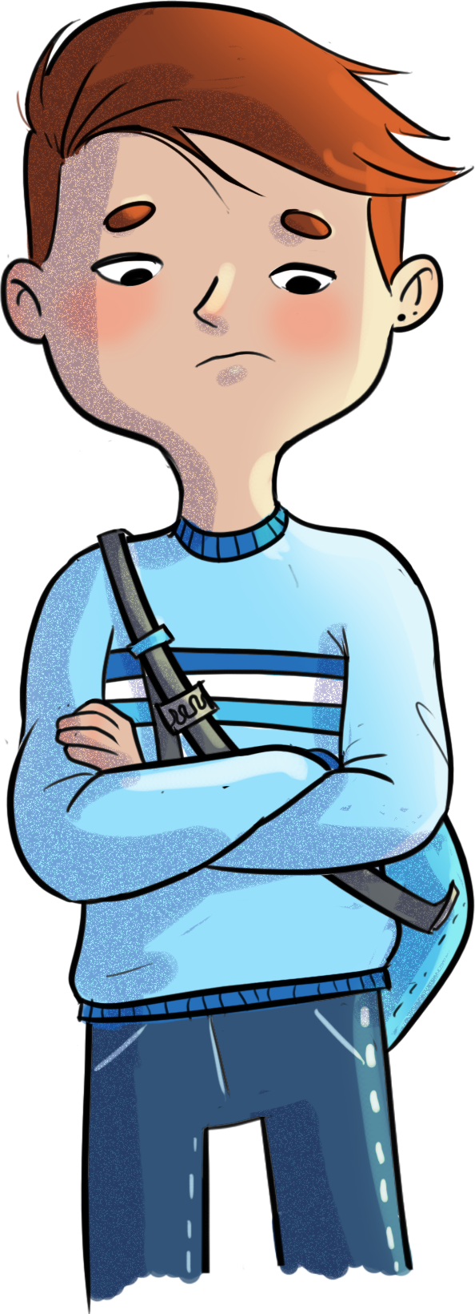
Same but different!
How might Sacha’s situation in the video have negative effects on his self-confidence?

Slide 10
Same but different!
Imagine that the balloon represents self-confidence.
If it’s inflated, what
does that mean?
If I deflate it, what does that mean?
Self-confidence varies depending on the situation and the people you’re with.
Icon made by Freepik on www.flaticon.com

Slide 11
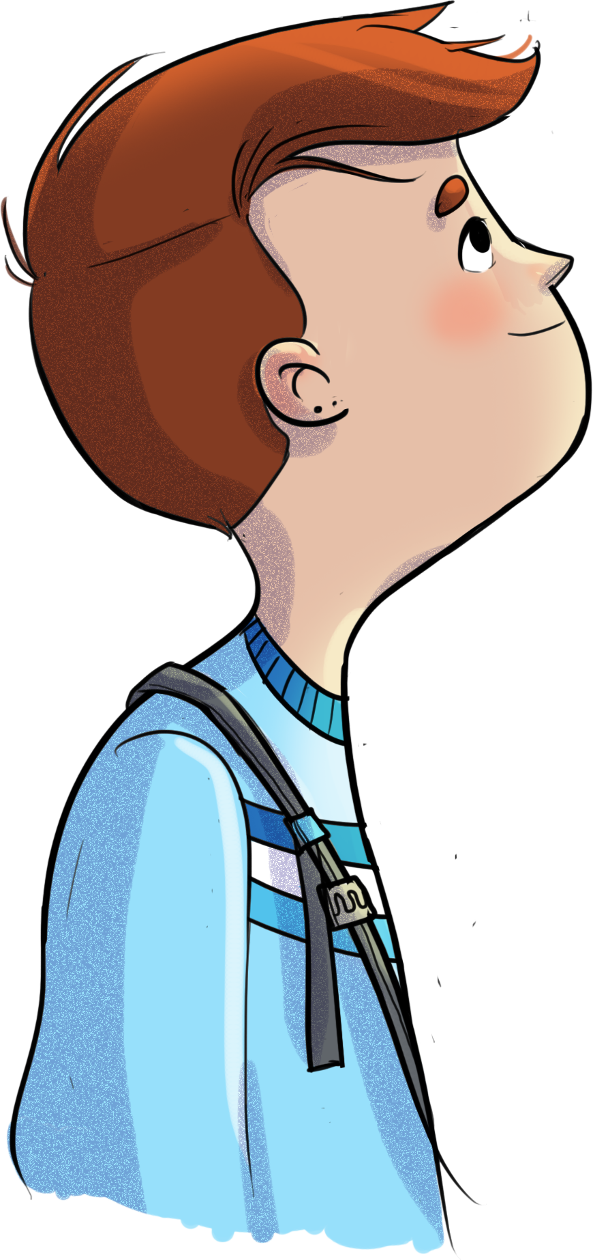
Same but different!
What do you think is a “normal” size for the balloon?
The balloon’s “normal” size depends on how you perceive your self-confidence. It can vary a lot from person to person.
Icon made by Freepik on www.flaticon.com

Slide 12
Same but different!
Inflate your balloon (mimicking it with your hands) until it represents your level of self-confidence.
Did you try to look at the other students’ balloons before blowing up your own?
As you listen to each scenario, adjust your balloon to reflect your feelings and self-confidence.

Slide 13
Same but different!
Scenario 1
KEEP YOUR EYES OPEN You had a very quiet weekend, relaxing at home. When you check your Instagram on Sunday, you see that your friends went into the city on Saturday night and posted pictures of them having a great time. You weren’t invited. How does that make you feel? What about your self-confidence? Adjust your balloon.

Slide 14
Same but different!
Scenario 2
CLOSE YOUR EYES AND FOCUS ON YOUR FEELINGS Your teacher announces that you will be working in teams of four students. Four of your friends form a group, and you’re left on your own. By the time you start looking around for other classmates to work with, everyone else is already in a group. How does that make you feel? What about your self-confidence? Adjust your balloon.

Slide 15
Same but different!
Scenario 3
CLOSE YOUR EYES AND FOCUS ON YOUR FEELINGS Your friends are talking about their love lives and sexual encounters. You’re not very experienced, and you’re actually embarrassed about the whole subject. They ask you how far you’ve gone. They’re all looking at you, waiting for your answer... How does that make you feel? What about your self-confidence? Adjust your balloon

Slide 16
Same but different!
Scenario 4
KEEP YOUR EYES OPEN In today’s class, you found out how you did on your math test. You studied really hard but only got 73%. The class average is 85%. How does that make you feel? What about your self-confidence? Adjust your balloon

Slide 17
Same but different!
Did being able to see each other influence what you did with your balloon? Why is that?
How did you feel when you noticed that your balloon didn’t look like the others?
How important are other people’s opinions to you? (a lot, a little…)
What do you get from comparing yourself to others? Why compare yourself to others?

Slide 18
Between me and myself!
Your four (4) good qualities
Your two (2) faults
What makes you unique or different
Something you do well or that makes you happy
Something you’d like to be able to do
Write your answers on the second worksheet you were given.

Slide 19
Between me and myself!
What is the point of getting to know yourself better? Do you have examples of situations where this has been good for you?
How does knowing yourself better affect your self-confidence?
How do you get to know yourself better?

Slide 20
Between me and myself!
To get to know yourself better, you need try new things. Go for it!
Allow yourself to make mistakes without judging yourself… Accept that you’re not perfect.
Also try to get in touch with your physical sensations, emotions, and thoughts, the things that make you happy or sad, and the things you like or find difficult.

Slide 21
Sacha and social comparison
https://youtu.be/ffaQWIg93l4

Slide 22
HORS-PISTE challenge
1
2
I notice my tendency to compare myself to others:
Do I do this often? Or only rarely?
I identify a situation where I compared myself to others.
3
I wonder...
Why did I feel the need to compare myself to others?
Did this have a more positive or negative effect on my self-confidence?
What did this create in me?

