Slide 1
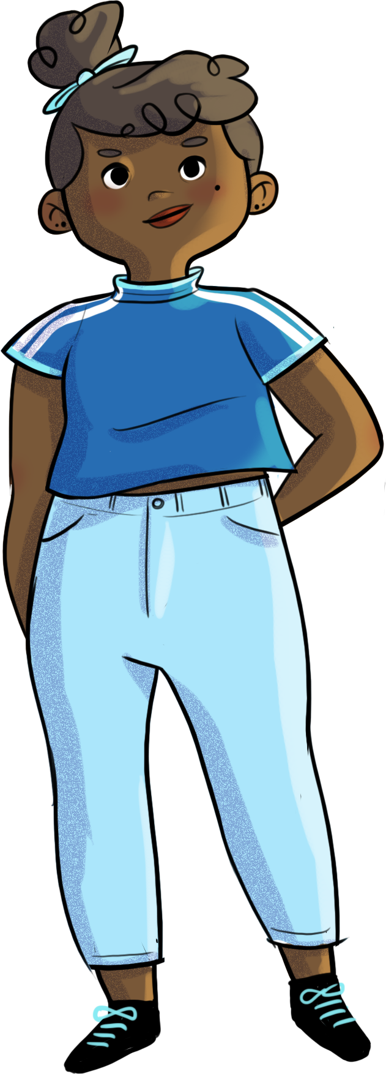

Slide 2
Journey to the centre of your universe…

Slide 3
At the end of the workshop, you will be able to…
identify some of your emotions, differentiate between them, and understand their importance
use new strategies to control and manage your emotions
recognize situations in which you need help and the factors that influence your decision to ask for help
understand the importance of asking for help when needed

Slide 4
Explore your inner forest!
We’re going to show you eight pictures,
one at a time...
After each picture, close your eyes, take a deep breath, and notice which emotion the photo made you feel.

Slide 5
Explore your inner forest!

Slide 9
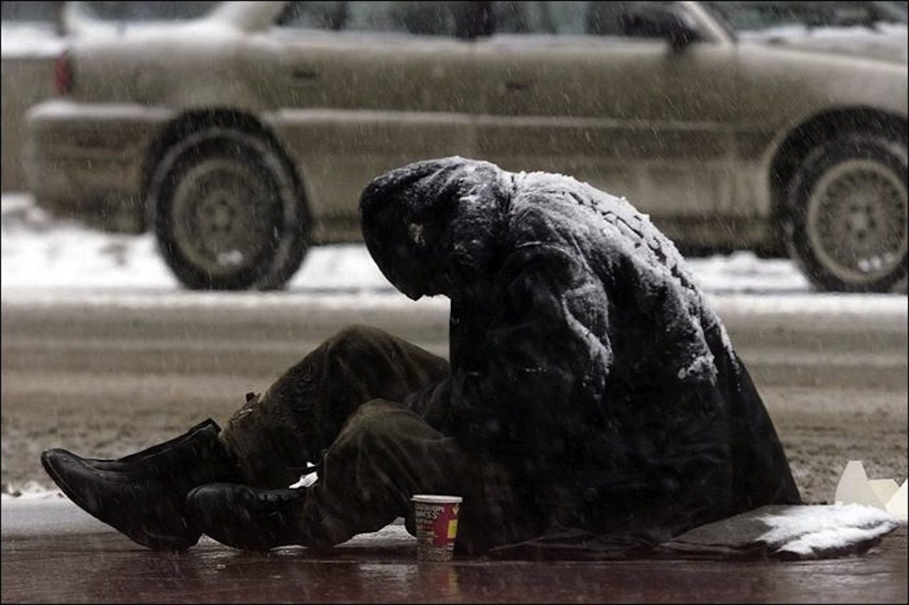

Slide 10
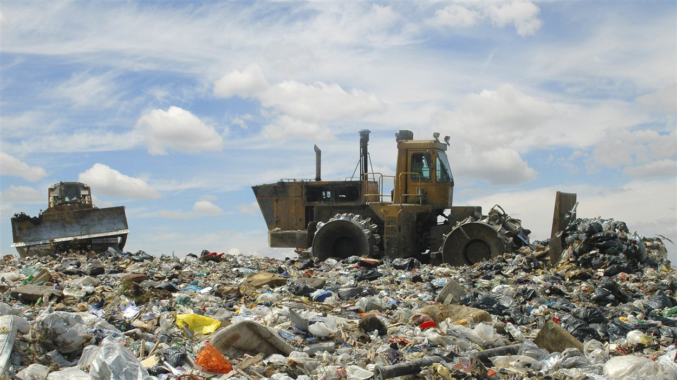

Slide 14
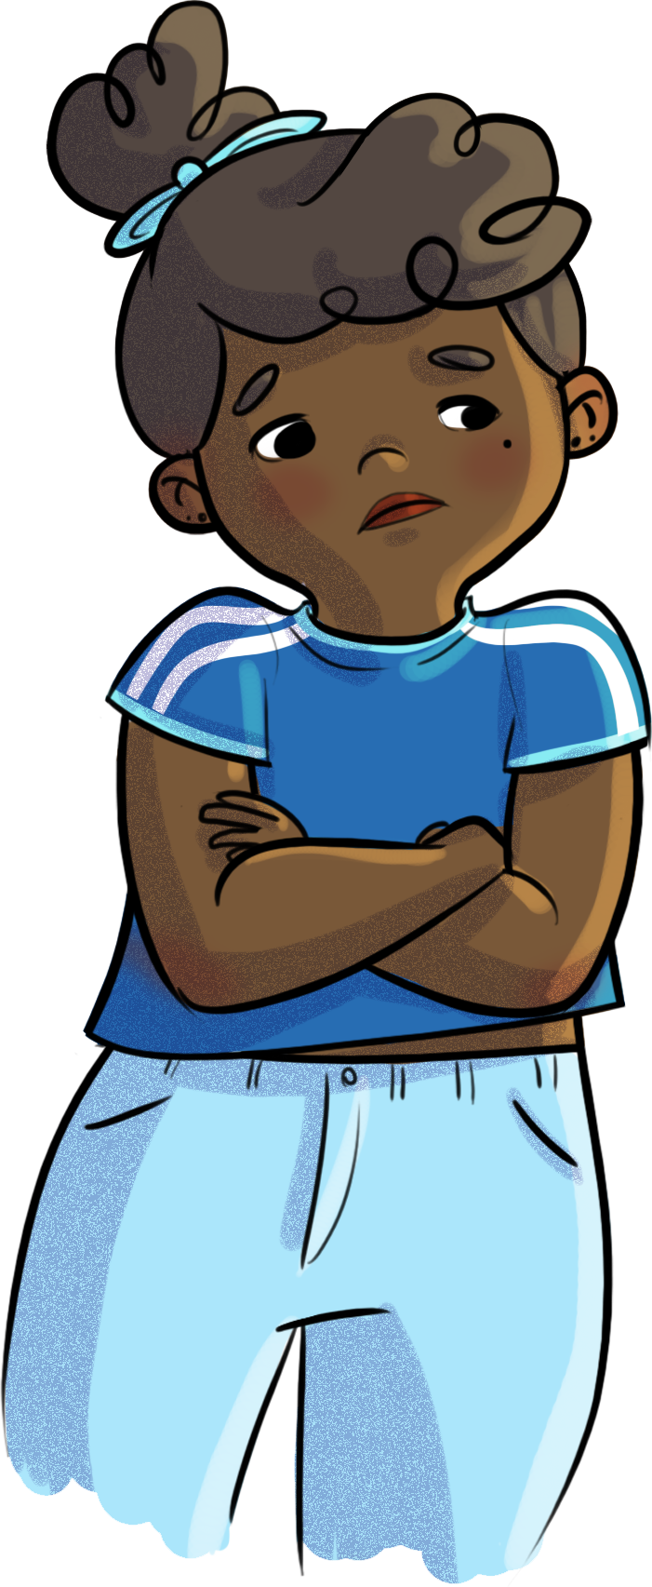
Explore your inner forest!
Why is it important for you to be able to identify your emotions?
The better you are at identifying your emotions, the better able you are to manage them.

Slide 15
Nadège and emotions
https://youtu.be/BSHZ2BRPfBg

Slide 16
Emotions… your inner weather systems!
Your emotions serve as a guide… They tell you what’s good for you and what’s not.
They’re kind of like the weather… sometimes unpredictable. You can’t always control when they appear.
But you can control how you REACT to your emotions.

Slide 17
Emotions… your inner weather systems!
When you find yourself in a pleasant or unpleasant situation, how does that make you feel?
What messages do your emotions
send you?
Are you able to name the emotions you felt?
After identifying what’s going on inside you, what do you do with those emotions?

Slide 18
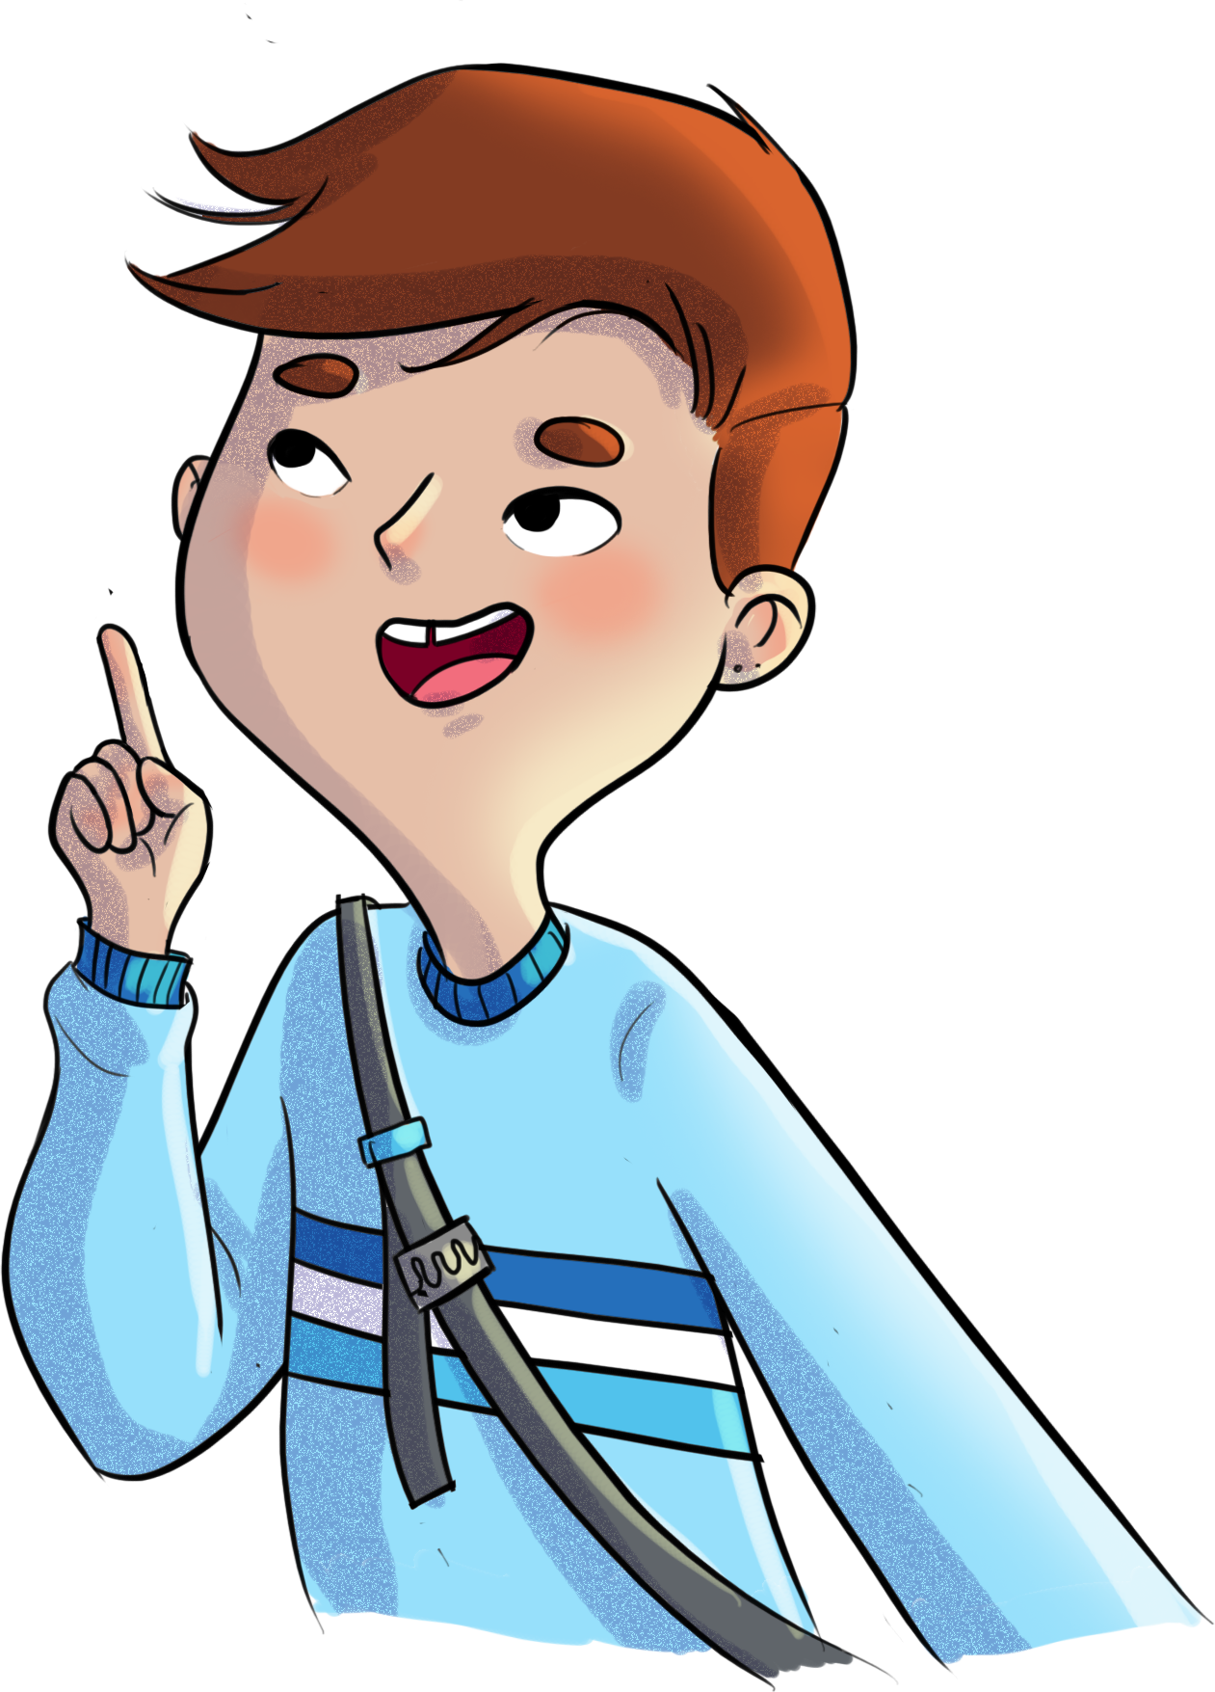
Emotions… your inner weather systems!
Emotion regulation strategies
Here are some strategies to help you deal with your emotions
Notice and reformulate your thoughts
Express your emotions
Accept the situation
Put situations into perspective
Look for solutions
Be kind to yourself (don’t judge yourself too harshly)

Slide 19
Emotions… your inner weather systems!
Emotion regulation strategies
Distract yourself
Focus on the positive
Ask for help
Take deep breaths
Focus your attention on what’s important to you (your values and goals)

Slide 20
Emotions… your inner weather systems!
No one strategy is better than the others.
The right strategies are the ones that help you regain your balance. Sometimes, you need to have the courage to ask for help, because… Two heads are better than one!

Slide 21
Two heads are better than one!
Why is asking for help taboo?
How can asking for help too soon or too often make you feel more anxious?

Slide 22
Two heads are better than one!
How can asking for help too soon or too often make you feel more anxious?
Thinking you can’t do it without help.
Loss of self-confidence.
Decreased control over your emotions.
Dependence on the opinions and solutions of others.
Exhaustion of your network and feeling of loneliness.

Slide 23
Two heads are better than one!
In small groups, answer the following questions, based on Nadège’s situation in the video:
Who could she ask for help?
How?
What’s stopping her from
asking for help?
How could she benefit from asking for help? (benefits)

Slide 24
Two heads are better than one!
Who can you ask for help? How?
Talk/vent to a trusted friend, adult, or relative
Ask for advice or guidance
Ask a friend to go for a walk or do something with you
Ask for help during a difficult situation
Meet with a school counsellor
Reach out to formal resources: school counsellors, CLSC, Tel-Jeunes, Alloprof, youth centre, etc.

Slide 25
Two heads are better than one!
What’s stopping you from asking for help?
Fear of being judged by others/looking weak/bothering other people; shame
Being hard on yourself for needing help
Thinking you need to do it on your own, without help
Not knowing who or how to ask for help
Difficulty trusting others
Fear of rejection
Thinking that the problem will sort itself out
Worrying that others will find out you have a problem
Feeling shy or embarrassed

Slide 26
Two heads are better than one!
How could you benefit from
asking for help?
Finding new solutions to the problem
Having someone you can rely on
Seeing the situation differently
Feeling relief
De-dramatizing the situation
Regaining self-confidence
Expanding your network
Discovering new strengths
Creating a sense of solidarity

Slide 27
Nadège and emotions
https://youtu.be/YJSFx46XsGo

Slide 28
HORS-PISTE challenge
This week, identify a difficult situation.
What emotions does this situation make you feel?
What strategies will you choose to deal with the situation?
Will you ask for help? How?

