Slide 1
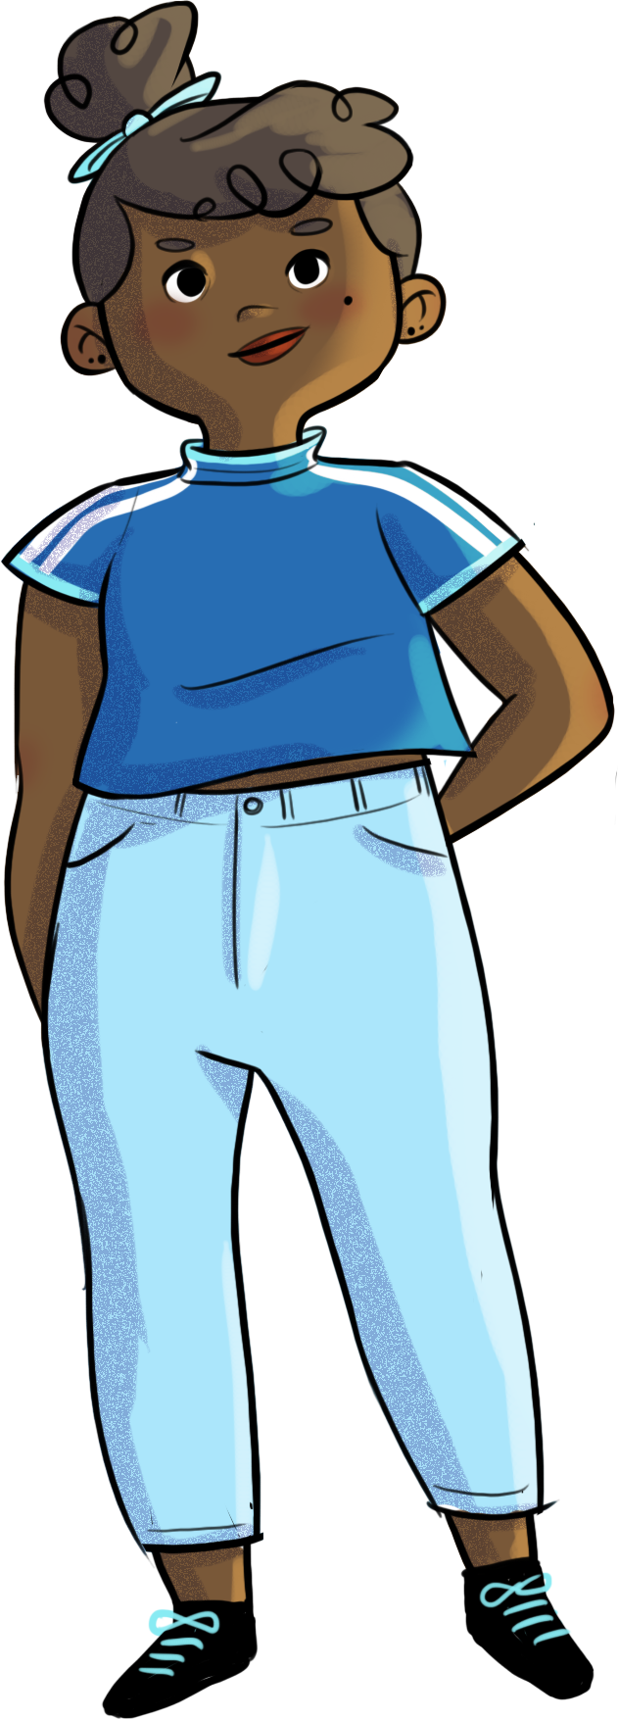

Slide 2
TOO MUCH IS JUST AS BAD AS NOT ENOUGH! WHEN STRESS PLAYS TRICKS ON ME...

Slide 3
At the end of the workshop, you will be able to…
identify the signs
of a stressful situation
understand how stress
affects you
apply new stress
management strategies

Slide 4
Ready, set... improv!
Let’s start with a short icebreaker!
Close your eyes and take some time to think about…
What physical sensations are you feeling? What emotions are you feeling?
Share some of your answers with the others.

Slide 5
Ready, set... improv!
So, why is it important to recognize your signs of stress?
How can this help you in your life?

Slide 6
Nadège and stress
https://youtu.be/PPXqIh9Uq_Q

Slide 7
Stress… Good or bad?
Stress is a NORMAL alarm reaction to a real, concrete situation. It triggers a stress response in your body: fight, flight, or freeze.
This response is what predisposes species to survive.

Slide 8
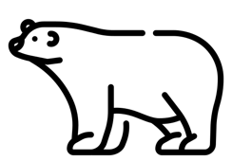
Stress… Good or bad?
In reasonable amounts, stress can boost your performance.
Can you think of examples where stress helped you?
No stress or too little stress can cause you to under-react, let down your guard, or not notice something dangerous about a specific situation.
On the other hand, too much stress can throw you off your game. Can you think of situations where you felt cumulative stress, prolonged stress, or too much stress?

Slide 9
Stress… Good or bad?
In the video, how stressed did Nadège feel about her math test?
NOT ENOUGH? TOO MUCH? JUST ENOUGH?

Slide 10
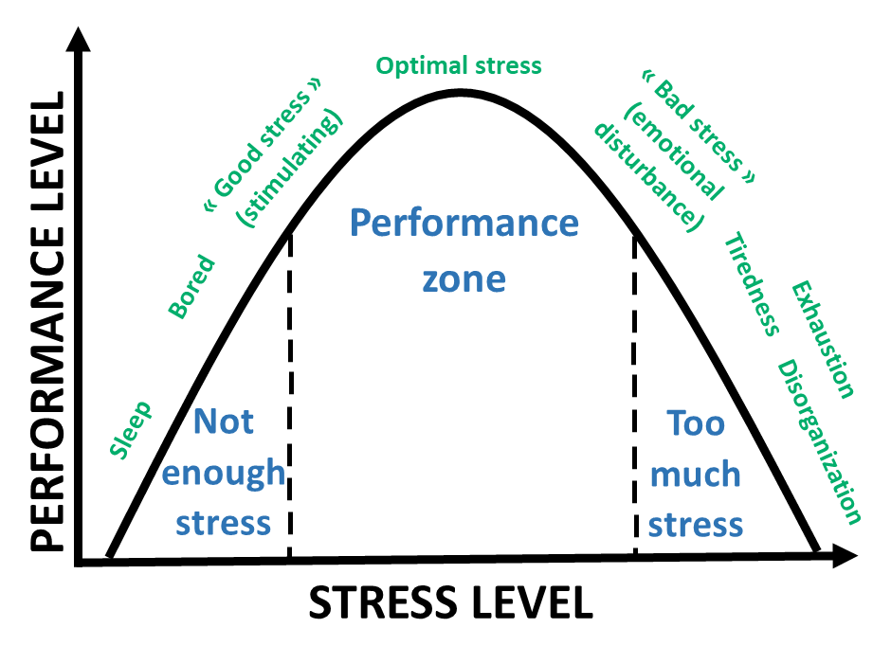
Stress… Good or bad?
Not enough?
Too much?
Just enough?

Slide 11
Body break
Get up and move around; focus on your breathing.
Do the movements in time with your inhales and exhales.
Icon fait par Freepik sur www.flaticon.com

Slide 12
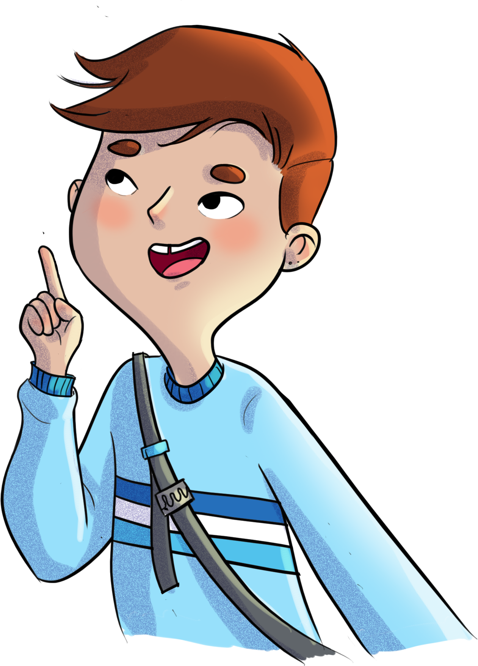
Our brain plays tricks on us!
Sometimes our brain reacts to stressful situations as though we were face to face with a bear instead of the tiny ant that’s actually in front of us!
Now… let’s do an exercise to make sure you understood everything.

Slide 13
Our brain plays tricks on us!
Is a final exam an ant or a bear?
Maybe neither!
Tests should make you feel somewhat stressed, to give you the boost you need, but too much stress can also cause you to freeze!
What if it were actually a mouse?

Slide 14
Our brain plays tricks on us!
Can you think of a situation where you had a “bear” reaction when the situation actually called for an “ant” reaction instead?
Share your example with the others.
Icon fait par Freepik sur www.flaticon.com

Slide 15
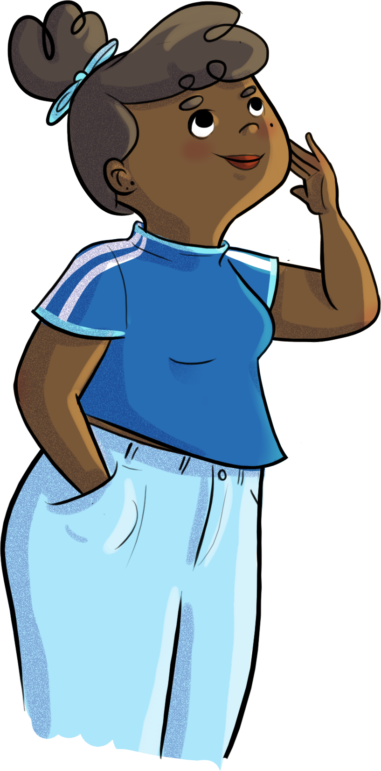
Your turn!
Write down a situation that you consider stressful.
What strategies can you use to deal with stressful situations?

Slide 16
Your turn!
Here are some strategies
Do something
Exercise
Listen to music that calms you down
Talk to someone about your stress, get help
Meditate or do relaxation exercises
Have fun with your friends
Watch a TV show you like
Draw, paint, sculpt, create something
Take a walk, get outside
Practise breathing techniques
Do a mindfulness
exercise
Take a step back, put things in perspective
Practise positive self-talk, be kind and compassionate with yourself

Slide 17
Nadège and stress
https://youtu.be/yiPTsOGuFBk

Slide 18
HORS-PISTE challenge
This week, pay attention to your signs of stress (physical sensations, emotions, thoughts).
When you find yourself in a stressful situation, pick one or two strategies for managing your stress.

